Slide 1
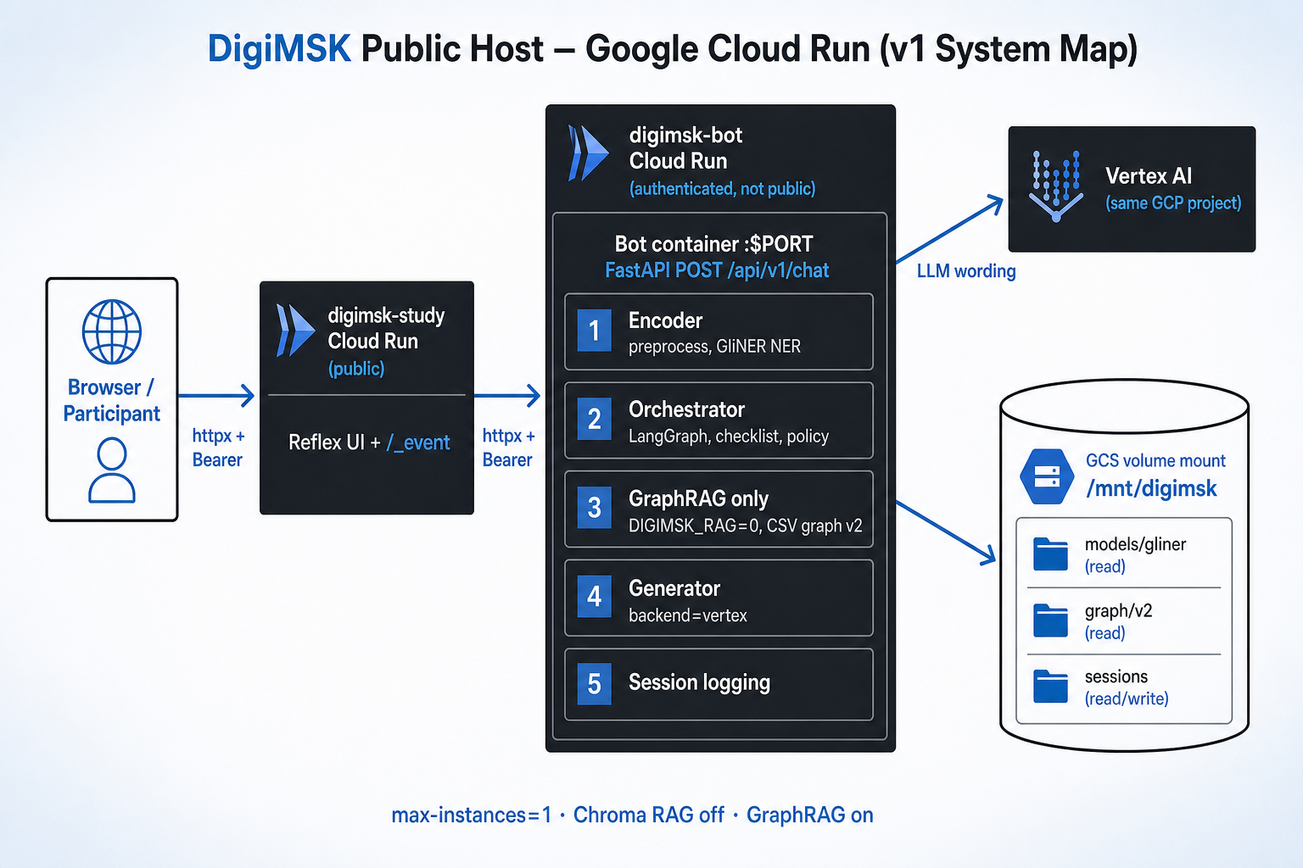
DigiMSK chatbot now deployed on Cloud Run (Cloud Build + Dockerfiles on Git push) in the funded GCP project.
Delivers a cloud-hosted stable HTTPS website for the study UI, which interacts with bot backend via API.
Models & RAG (knowledge graph) mounted to Google Cloud Storage (GCS)- session logs (.json) written to same.
Request-based billing- charged only when processing requests. Cloud CPU is limited outside of requests.
Two Services (VPS)
1. User-facing app- public Cloud Run service (browser-facing)
↓ checks unique API key and token rate
2. DigiMSK chatbot FastAPI- private (authenticated) Cloud Run service
GitHub repository
https://github.com/robdima96/DigiMSKbot
3 apps
Bot backend
Prototype chat UI
Testing app (dev)
Stable URL
https://digimsk-study-7303486748.us-central1.run.app/

