Slide 1
Machine Learning Techniques: An Introductory Workshop
Professor rob Jeffries keele university
What is machine learning?
Supervised vs Unsupervised learning
Decision Trees and Random Forests
Exercises

Slide 2
Exercises
Go to https://github.com/robdjeff/ML_Workshop
Download the package as a zip file
Unzip into a location you can see with your Jupyter notebooks installation.
(If you haven’t yet installed jupyter notebooks, scikit-learn, matplotlib, numpy, seaborn, then you need to do so!)
Will also run in Google Colab if you upload the files and data.
Notes:
Before we get going, you will need a working version of Jupyter notebooks and some of the commonly used data science packages installed. If that’s impossible, we have established that these exercises will run in Google CoLab. So if you have a google account, if you navigate to Colab you can also upload these notebooks and get them to run. The exercises themselves are available from this github page, so if you navigate to that now.

Slide 3
What is Machine Learning?
Machine Learning is teaching a computer to perform a task without needing to provide explicit instructions
Notes:
There is no unique definition. Here is one. We want to teach a computer to perform a task – basically to create a model to transform one thing (some data) into another (useful parameters) without giving a set of instructions. To do that, we get the computer to learn from the data itself.

Slide 4
ML vs Traditional Methods
Rules
Traditional Programming
Answers
Data
Answers
Machine Learning
Rules
Data
Notes:
This is a bit of a conceptual leap from the way things have been traditionally done – where you take the data, tell the computer what the transformation rules are and out pops the answers. In ML we haveto give the computer at least some data where we know the answers to get IT to come up with the model that transforms from the data to the answers we want.

Slide 5
A Traditional Model
If the star has particular spectral features
Traditional Programming
Rules
Answers
Spectral classification or stellar parameters
Stellar Spectra
Data
Notes:
To take an astronomical example. A common task would be to take a set of spectra or a set of measurements from and try to work out what the spectral type of a star is or the Teff, log g, abundances etc. To do this we might have a model which contains a set of calibration relationships that do this transform or we may be trying to fit template spectra to the data to get the answers.

Slide 6
A Machine Learning Model
Answers
Machine Learning
Spectral classification or stellar parameters
Rules
The model learns that stars with certain parameters have specific spectra
Stellar Spectra
Data
Notes:
The ML approach is different. We TRAIN a model based on the FEATURES that are present in the data. The model then contains (within a box of varying opaqueness, depending on the algorithms used) the rules for transforming from the data to the answers (or LABELS) that we want.

Slide 7
Using the model
Trained Machine Learning Model
Spectral classification or stellar parameters
Stellar Spectra
Answers
Data
Notes:
To use the model, we then give it fresh data and get the trained model to assign the answers (or LABELS) for that data.

Slide 8
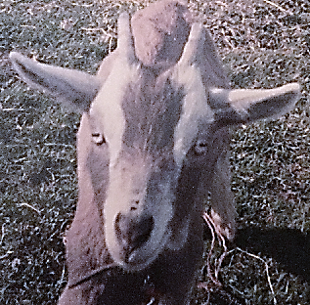
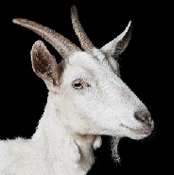
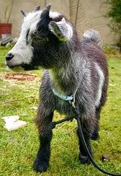
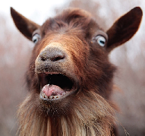
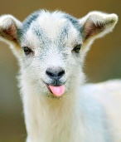
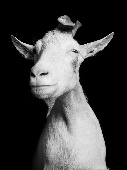
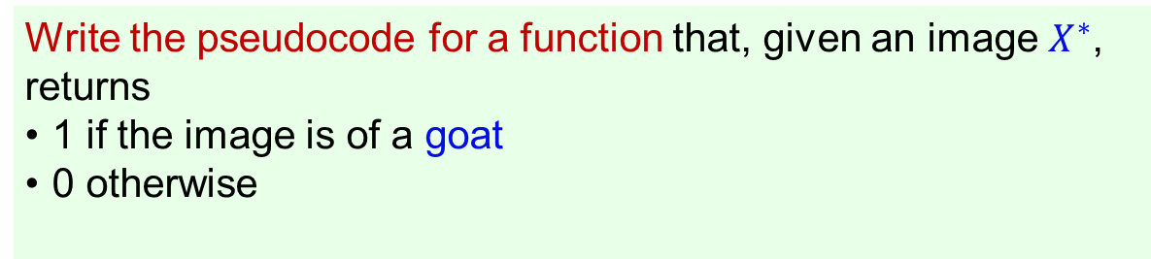
Why Machine Learning?
You may not know the rules to go from data to answers, or they may be too complex to express
Write the pseudocode for a function that, given an image $X^{∗}$, returns
1 if the image is of a goat
0 otherwise
How would we write such a function?
What information would make our lives easier?
A Data-Driven Solution
Notes:
OK, so you can see that this is AN approach, but why is it necessary or better? Basically, you may not know, or be able to express very well or accurately, the rules to go from data to answers. As a non-trivial example - imagine you had to write code to decide whether an image was of a sheep or a goat? How would you even begin to code that? Fortunately we can also use data to define the model that we need – a data-driven solution.

Slide 9
Supervised vs Unsupervised ML
Supervised Learning is where we “know” the answers in our training data.
Detecting fraudulent activity in credit card transactions
The data is a record of the credit card transaction, and the output of a trained model is whether it is likely to be fraudulent or not. Assuming that you are the entity distributing the credit cards, you have a training dataset with the transaction characteristics (amounts, locations, payees etc.) and records of whether users reported the transaction as fraudulent.
Estimating redshifts of galaxies using only their photometry
The data is the photometry of galaxies, and the output of a trained model is an estimate of the redshift. You have a training dataset with the photometry of galaxies and spectroscopic measurements of their redshifts,
Notes:
Broadly, training ML models divides into supervised vs unsupervised learning. In supervised learning we have some data where we KNOW the answers. We use these data to train the model and then apply the model to data where we don’t know the answers. Here are a non-astronomical and an astronomical example. The latter by the way shows that we don’t restrict ourselves to classification problems but can predict things that vary continuously too – known as regression.

Slide 10
Supervised vs Unsupervised ML
UNsupervised Learning is where we are looking for patterns and groups in our data
Segmenting customers into groups with similar preferences
Given a set of customer records, you might want to identify which customers are similar, and whether there are groups of customers with similar preferences. For a shopping site, these might be “parents,” “bookworms,” or “gamers.” Because you don’t know in advance what these groups might be, or even how many there are, you have no known outputs.
Finding clusters of stars in Gaia data
The data is the astrometry (positions, parallaxes, proper motions) of stars. Can you find groups of stars that are co-located and share common motions?
Notes:
For unsupervised learning, we don’t have data with answers. We let an algorithm learn things about the data. Often this is about looking for patterns, groups and clusters. The latter is quite literally where these methods have been deployed extensively in astronomy.

Slide 11
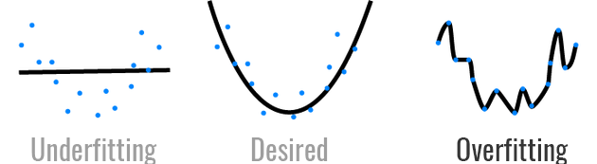
Pitfalls in Supervised Learning?
Is the training data really representative and unbiased?
Does it cover all possibilities or will extrapolation be required?
Is there missing data?
Beware of overfitting the training data – i.e. modelling the noise! Such a model will not “generalize” well.
Notes:
We are going to look together at some supervised learning examples. There are some common problems and traps with these techniques that we must be wary of. The first three are obvious but the last requires some thinking about. It is possible to have such a complex model that it fits the data perfectly – but will that produce good results when applied to new data – probably not. We need a way of regularizing the model to prevent overfitting.

Slide 12
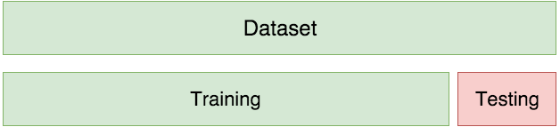
Training and Testing
For example: we collected 640 observations of stars
We train the model on 420 samples
We test on 220
Notes:
A common strategy is to divide our initial training data into two parts – a training set and a test (or validation) set. The model is trained on the training set and then we see how well it does in predicting the labels in the test set. If the perfomance on the training set is much better than the test set, it suggests overfitting.

Slide 13
Steps in a Supervised ML Problem
Analyse the Data - load and check the data; perhaps scale, encode and replace missing values.
Define the features X and the target y.
Divide the data into 2 splits one for training and the other for testing.
Create the machine learning model.
Train your model on the training split.
Evaluate the trained model against the testing split.
Tune all relevant parameters for optimal performance.
Use the final model to make predictions on unseen data.
Notes:
Here is a basic procedure that is common to most ML projects. We obtain our training data, check it, maybe replace missing values or disregard features that aren’t relevant. We may have to encode data into numerical form and we may have to scale our data (e.g. to be between 0 and 1) depending on the algorithm. We define which features we will use and what are the target labels. We divide our data into train and test splits, create an instance of an ML model and train it with the training split. We then evaluate how well the trained model performs on the test split, Do some tuning and then when we’re happy, use the model on unseen/unlabelled data.

Slide 14
Computational Tools
pandas - for analysing and manipulating data tables
matplotlib/pyplot - for creating plots, similar to MATLAB
seaborn – high level graphics for statistics/data science
numpy – numerical routines and arrays
scikit-learn - machine learning algorithms and tools
tensorflow and keras – neural networks
Jupyter notebooks – a nice visual way of presenting and running python code
Notes:
This an incomplete list of the usual tools that people in data science use, particularly with python. Other packages certainly are available, like R or pytorch.

Slide 15
Exercises
Go to https://github.com/robdjeff/ML_Workshop
Download the package as a zip file
Unzip into a location you can see with your Jupyter notebooks installation.
(If you haven’t yet installed jupyter notebooks, scikit-learn, matplotlib, numpy, seaborn, then you need to do so!)

Slide 16
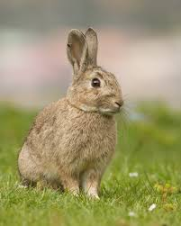
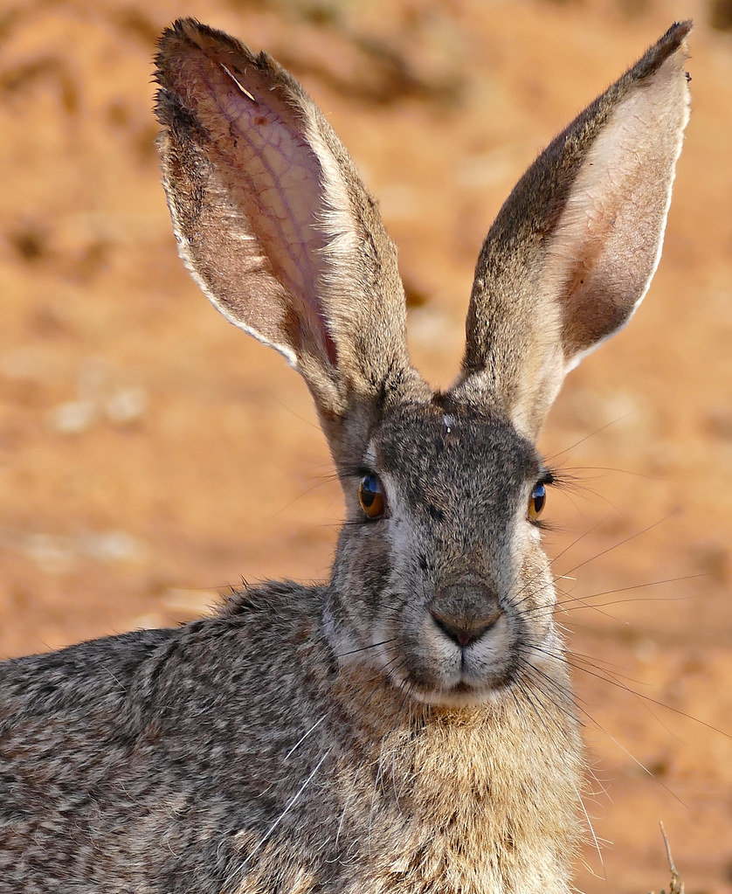





Decision Trees
burrows?
no
yes
hare
ear length
$$burrows$$
hare
rabbit
$>9.4$ cm
$≤9.4$ cm
rabbit
yes
hare
rabbit
no
hare
$$ear (cm)$$
$$9.4$$
Notes:
A decision tree classifier works by testing questions that divide the data at each node into two parts and choosing questions which maximise the purity of the two subsets thus generated. They can be allowed to continue splitting until they end in leaves that contain purely one class. In this simple example you can get a perfect separation between hares and rabbits by asking two questions in the ear length vs burrows? data space. Decision trees are simple and can be visualized easily (so not a black box). They are also quick and don’t need much data preparation (e.g. no scaling needed). However they are very volatile and depend on the exact make-up of the training data. They are also very prone to overfitting if allowed to progress to pure leaves. Whilst each branch is optimised, the end result may not be globally optimal.

Slide 17
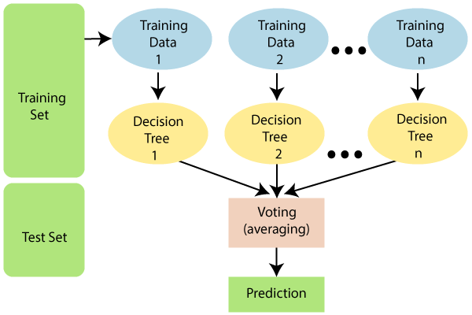
Random Forest Classification
Ensemble Method
Works on random set of data
With a random set of features
Majority voting yields the prediction
Notes:
Random Forest techniques mitigate some of the problems with individual decision trees. They are an ensemble of decision trees, each constructed from a random set of the training data (random selection with replacement) and a random subset of the features. Each tree gives a classification and the final result is found from the majority view of all the decision trees. This final result should have much less variance than for an individual DT and if we have lots of trees then the end result is more likely to be globally optimal.

