Slide 1
So you think you’re Agile? Now Prove It!
rob.moore@readify.net | jess.panni@readify.net
Notes:
Our names are Rob Moore and Jess Panni and we are consultants with Readify.
We aren’t going to be giving you a talk about why you should do Agile, we assume you all know that given that Agile is mainstream now and has been increasingly adopted over the last 10 years. Instead, our intention is to present a thought-provoking exposition about where we think Agile is heading in the next 5 to 10 years.
We believe that decision making at all levels of the business should be driven by hard data. By stringently practicing simple empirical methods organisations can have confidence that they are always delivering the right thing. That’s where the title for this talk came from – it’s a play on words basically saying that you should prove your agility by taking actions based on validated learnings.

Slide 2
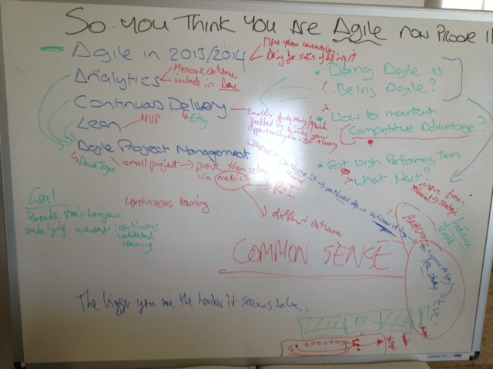
Common Sense
Notes:
In preparing this presentation we brainstormed some ideas on a whiteboard as you can see in this slide. In looking back at the picture we took of the whiteboard the part that stands up the most is the words “Common Sense” and we think that’s very appropriate since Agile principles are essentially common sense – as is everything we will be presenting today.

Slide 3
What we see today…
Planning
Development
Release/Post Release
Waterfall
High Performing Agile Team
Waterfall
Scrumfall
Notes:
We’re often brought into organisations who are struggling with software development and generally this is what we see.
[Transition]
Most development teams start by focusing on the practices of agile.
They assign a Product Owner & Scrum Master. They work iteratively against a backlog and agile ceremonies are followed and Velocity is religiously tracked. We also see teams starting to adopt agile engineering principles, they write unit tests, setup build servers and may even practice TDD and Pair Programming.
At this stage they often do not get the true benefit of agile as they tend to focus on following processes and get caught up in religious agile debate. Rather than embracing the different culture and thinking of Agile teams at this stage are essentially working the same way they always have, but with some different processes.
We are generally able to work with teams over time and with the right people and hard work they will eventually become a high performing Agile team.
[Transition]
A team who focuses on delivering desired OUTCOMES and by addressing right technical PROBLEMS though Continuous Improvement. They understand each other and work to the strengths and weaknesses of the individuals in the team. And importantly, the team will have changed their culture and will approach all problems with an Agile mindset.
This can be likened to what Bruce Tuckman observed in his 4 phases of team dynamics: Forming -> Storming -> Norming -> Performing (See reference at end of deck)
-----
But, if you look outside the development team you will often find that:
[Transition]
Traditional software development management practices book-end the great work the Agile teams deliver.
We see this in almost every organisation that we go into. The initial planning cycle will involve defining and scheduling large projects with large budgets and expectations are set as if everything is known up front about the needs and outcomes of the project.
At first the development team is free to practice agile as they see fit, but as the project progresses the business often puts more and more pressure on the team to deliver to the original plan. This is despite the fact that the team will have made a number of learnings about the project over that time that completely invalidate the original plan.
And then after the development team has done their awesome work it gets even worse as organisations are often reluctant to QA and release until the project is nearing completion – again to fit in with the original plan. The project is often considered complete when the plan ends which is often at the point the software is handed over to the operations and support team to deploy and maintain.
There are two main problems with this:
A divide forms between the development team and the operations team, which causes a whole raft of issues that make it hard to efficiently support and modify your software – this is what the dev ops movement tries to address and we encourage you read up about that (see reference at end of deck)
Also, the project is considered successful if at its closure its on time and on budget, but more importantly the true success is whether the desired outcomes of that project were met – how can you know a project is successful if the end of the project doesn’t measure the outcome of real-world usage?
All these behaviours promote AND REWARD non-agile thinking and make it hard for organisations to truly realise the potential business and strategic value that their Agile teams could be delivering.

Slide 4
The Journey
Technical
Business
Strategic
Notes:
Because organisations are generally structured in this way we usually find that Agile practices are applied at a purely technical level.
To truly realise the advantages that agile thinking can provide, an organisation needs to progress from adopting agile at a technical level to embracing it at a strategic level.
Let’s take a look at the behaviours you are likely to see in each step of this journey:
Technical Behaviours:
Most teams these days practice:
Iterative development – reduce feedback loop of getting feedback about whether the requirements were correctly realised from months or years to weeks
Continuous integration – reduce the feedback loop of whether the code from multiple developers integrates OK from days to minutes
Automated testing – reduce the feedback loop of whether the software functions properly and doesn’t have regressions from days or weeks waiting for manual testers to minutes
We increasingly see teams also use:
Continuous deployment – to automatically deploy their software to a development environment if it passes continuous integration – this helps reduce the feedback loop for testers, product owners and stakeholders inspecting the integrated code

Slide 5
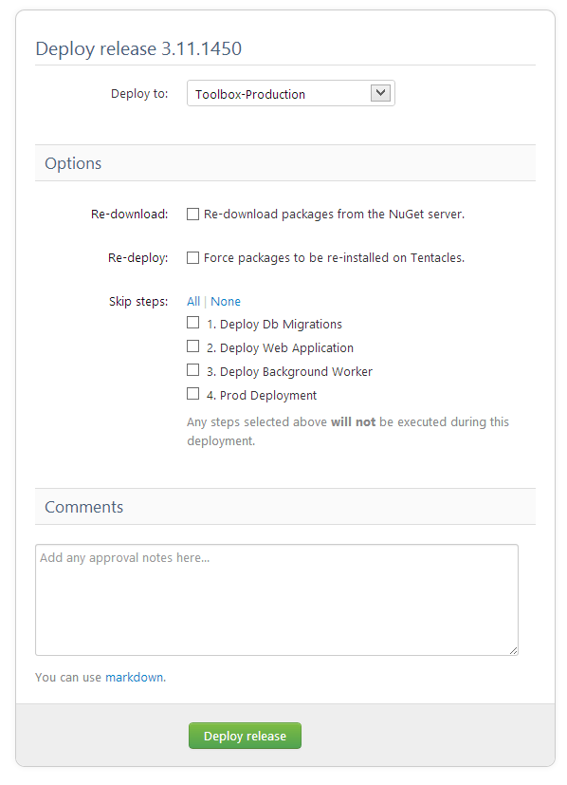
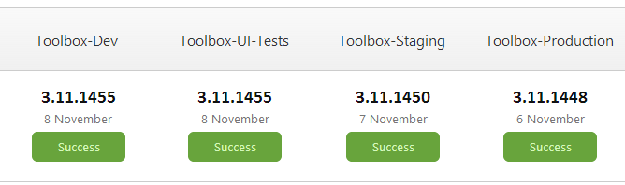

Deployment
Notes:
An example of a deployment pipeline using a tool called OctopusDeploy from a customer service portal we worked with a client to create.
The software is automatically deployed to the dev environment after a successful continuous integration build and the last version of the dev environment to have the automated UI tests pass is displayed. Anyone with access can manually deploy to staging and then production.
Deployment is as easy as a click of a single button.

Slide 6
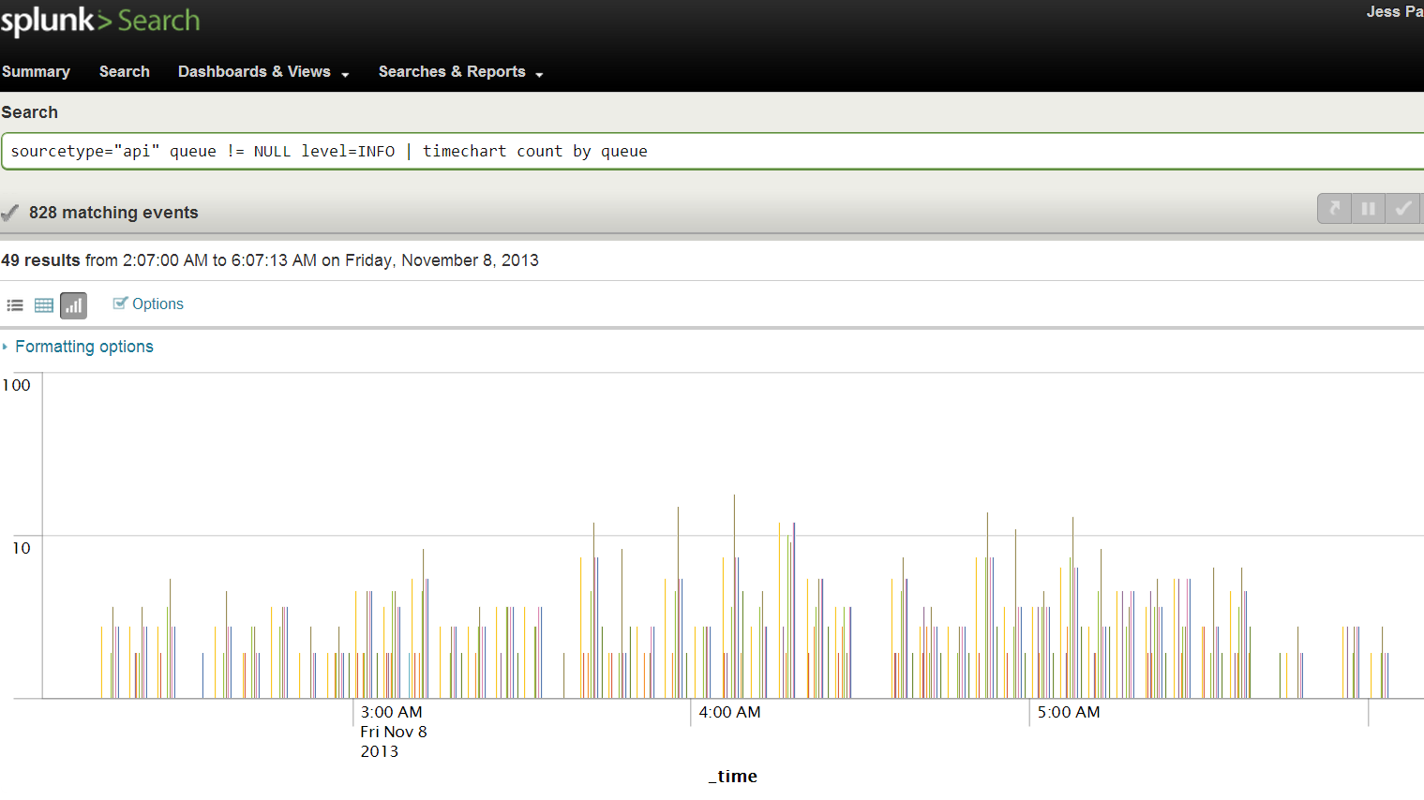
Technical Analytics
Notes:
This is an example from the same application of collecting technical metrics that make it easier to diagnose problems and give visibility to operational performance.
We are using a tool called Splunk to store the data we capture, in this case about api calls. While this query here is a very simple count query by api (queue) different colour for each api – there is a set of data including latency and execution time against each call that can be queried if we need to glean more information or have a question we want answered.
Data like this helps to make technical decisions and make technical learnings about the software being written.

Slide 7
The Journey
Technical
Business
Strategic
Notes:
Once a team truly embraces Agile we find that it leads to a natural progression of:
[Transition]
Enabling the business be smarter about creating and prioritising their backlog.
The easiest way to describe this is by talking about Continuous Delivery as discussed by Martin Fowler and Jezz Humble (see reference at end of deck).

Slide 8
Continuous Delivery
“
“
reduc[ing] the cost, time, and risk of delivering incremental changes to users
Jezz Humble
Principal Consultant, ThoughtWorks
Notes:
According to Jezz continuous delivery in one sentence is:
“reduc[ing] the cost, time, and risk of delivering incremental changes to users”
More specifically it involves ensuring software is constantly in a releasable state on demand and reducing risk by creating confidence and repeatability to take commits that developers push through a consistent, largely automated deployment pipeline to eventually get to production.
It’s important to note that continuous delivery implies cultural change for not only the development team, but operations, project management and product ownership.
While the end result is worth it, it’s not easy to implement and Jezz says in his presentations that it takes AT LEAST 12 months to implement in an organisation. Our experiences in implementing continuous delivery so far confirms that kind of timeframe.
So what kind of behaviours does the implementation of this type of approach yield from the business?
Deploying changes to production become a business decision rather than an IT decision
From our experiences this type of approach leads to the business having more confidence and excitement in releasing software and empowers them to release small changes often at the click of a button as a cheap, easy way to learn something
This allows the business to reduce feedback loops on measuring how end users use the features they are prioritising and take advantage of design techniques like A/B testing
Ultimately, this lets the business learn what makes the product great rather than having to guess when devising and prioritising the product backlog
----

Slide 9
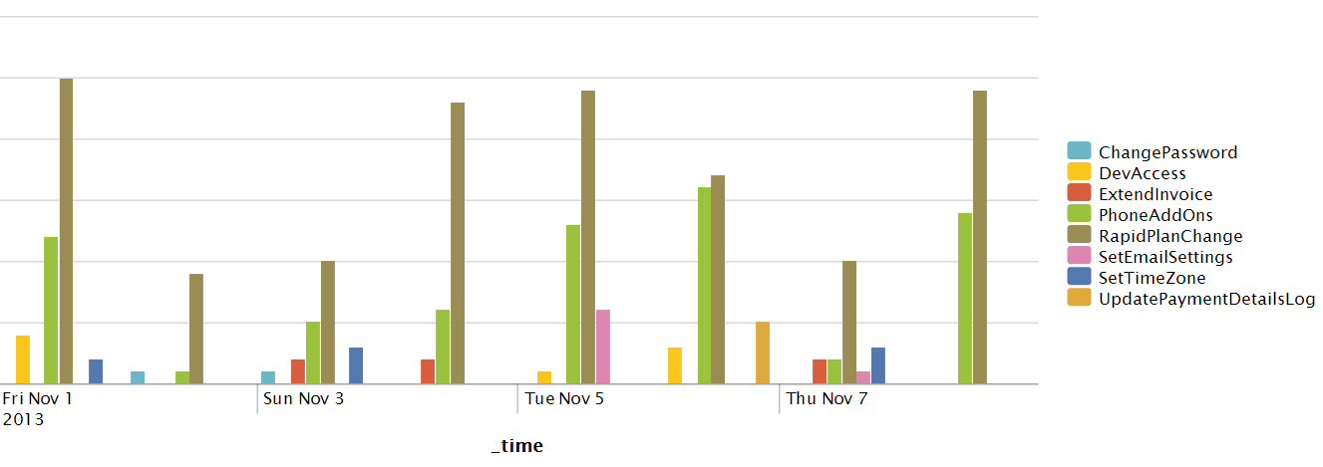
Business Analytics
Notes:
Yet another example from the same application – this time of business analytics in Splunk.
In this case we can see end-user usage counts for a set of different tools in the application.
While this is a simple count query from a low-usage scenario (alpha release), each data point has more information associated with it. For instance, our product owner might have a question he wants answered about how often people move from automatic timezone to a specific timezone for instance and he just needs to look at the entries for the SetTimeZone tool.
Anyone in the business that has access to Splunk can run ad hoc queries against this information to get insights.

Slide 10
The Journey
Technical
Business
Strategic
Reduce Feedback Loops -> Collect Data -> Learn
Notes:
When an organisation can understand what makes a great product the natural progression is to then:
[Transition]
Understand which products and features to build to meet the organisational vision and strategic direction.
There is a lot that organisations can learn from the Lean Startup movement in this regard (see reference at end of deck). Lean Startup places an emphasis on delivering as much value as possible with the least amount of effort. It does this by continuously validating minimum viable products of features against real users.
Using Minimum Viable Products rather than long-running projects as a unit of measurement allows a smaller feedback loop for making informed strategic decisions and will see organisations move away from a project-based culture to a learning-based culture.
-----
The realisation to be had about all of the examples we just gave is that they ALL have one thing in common…
[Transition]
All of them involve behaviours that reduce feedback loops in order to make decisions that are informed by some sort of validated learning.
This acknowledges that risk starts where knowledge ends, so to minimise risk and potential waste organisations should use learning and knowledge to justify all decisions and ensure the outcomes constantly drive strategic goals.
This notion of using validated learning to drive strategic goals is summed up beautifully by David Joyce in his talk about the Agile PMO, which we highly encourage you to watch (see reference at end of deck).

Slide 11
Learning-based Culture
1. Idea / Experiment
2 .Build
3. Measure
4. Learn
Pivot |Continue | Stop
Based on work from Eric Reis, David Joyce
Notes:
We just talked about scary things like cultural change and, depending on your organisation, that might seem like an impossible hurdle.
In reality, it doesn’t have to be tackled all at once, but rather as gradual and continuous improvements leading to a much larger change over a period of time.
Like we mentioned at the start of the presentation – everything we are talking about is really common sense and every behavioural example we just gave actually simply boils down to these four steps: developing an experiment to validate an idea, building it, measuring it through data and finally getting some sort of learning and based on that learning making a decision about what to do next.

Slide 12
At all levels
TECHNICAL
Continuous Integration
Deployment Pipelines
Technical Metrics
BUSINESS
A/B Testing
Continuous Delivery
Usage Analytics
STRATEGIC
Agile PMO
Impact Mapping
Business Goals!
Notes:
To reiterate – what we are trying to describe is a situation where this learning-based culture is applied at all levels – technical, business and strategic.
Some examples include:
Technical – Sprint, CI, TDD
Business – A/B testing, backlog prioritisation based on real-world use
Strategic – MVPs rather than long projects with no learnings, Impact Mapping to identify what MVPs could be worked on

Slide 13
Organisational Focus
TECHNICAL
Continuous Integration
Deployment Pipelines
Technical Metrics
BUSINESS
A/B Testing
Continuous Delivery
Usage Analytics
STRATEGIC
Agile PMO
Impact Mapping
Business Goals!
Notes:
The interesting thing to note here is that the stuff that really matters is towards the strategic end of things so while an organisation that ends up with a learning-based culture might start with a natural progression from technical to strategic if we can:
[Transition]
Invert that thinking and drive things from a strategic point of view then we always know we are always working towards delivering organisational value.
Put another way, if organisations prioritise minimum viable products based on proven ability to contribute towards business goals then it can rely on using their technical and business agility as an enabler.

Slide 14
If you don’t do this then someone else will…
Deliver on Strategic Goals
Deliver the RIGHT Things
Rapid Innovation
Competitive Advantage
Minimise Waste
Notes:
Once an organisation embraces a learning-based culture it can more easily [Transition] deliver on strategic goals and [Transition] deliver the right things.
[Transition]
If your whole organisation is Agile then you have the unique opportunity of being able to identify new markets and opportunities to rapidly innovate and react immediately with quick experiments to validate whether it’s worth investing more resources in that area.
By the time your competitors realise you’ve either already pulled out and are looking at the next opportunity because there is nothing to be gained or you’ve already cornered the market.
Traditionally organisations have focused on delivering one or two ideas, by reducing feedback cycles we can quickly prove or disprove many more ideas, the result being that we are more likely to find the killer feature or product. Now, that is rapid innovation.
[Transition]
All of this adds up to an organisation being able to ensure it has a competitive advantage.
[Transition]
Another great thing is that by only basing decision on validated learning you will minimise waste by not spending resources on activities that don’t deliver on strategic goals.

Slide 15
The next step
Planning
Development
Release/Post Release
1
Waterfall
Scrumfall
Team Doing Agile
Waterfall
2
Waterfall
High Performing Agile Team
Being Agile
Waterfall
3
Organisation Being Agile
Notes:
Taking it all back to the beginning we believe that not only can software teams progress from following Agile processes and “doing Agile” to embracing a shift in culture and “being Agile”.
But, through common sense, reducing feedback loops, and experimentation we can move from just practicing technical agile behaviours to a learning-based culture where everyone in the organisation uses data to drive decisions in order to prove they are delivering strategic outcomes.
That’s why we think that in the next 5-10 years more organisations will undergo the cultural change required to:
[Transition]
“Be truly agile”
Before we end, we wanted to leave you with something to think about. The manufacturing industry went through a period of transformation in the 80s when Lean Manufacturing became the norm because organisations were forced to keep up with their competitors. We believe, that the same opportunities exist now in software development.
We’ve included a lot of references and detailed notes on each slide in this talk so feel free to request the deck from the ACS to review what we’ve presented and to do some further reading.

Slide 16
So you think you’re agile?...
Now Prove It!
rob.moore@readify.net
@robdmoore
jess.panni@readify.net
@jesspanni

Slide 17
Links - Presentations
How Kanban Helps Us Move Beyond Traditional PMO - David Joyce
http://vimeo.com/43036371
Continuous Delivery - Martin Fowler, Jez Humble
http://yow.eventer.com/yow-2011-1004/continuous-delivery-by-martin-fowler-and-jez-humble-1062
Etsy’s Product Development with Continuous Experimentation – Frank Harris and Nellwyn Thomas
http://qconsf.com/sf2012/dl/qcon-sanfran-2012/slides/FrankHarris_and_NellThomas_ProductDevelopmentWithContinuousExperimentation.pdf
Continuous Design - Mary Poppendieck
http://yow.eventer.com/yow-2011-1004/continuous-design-by-mary-poppendieck-1027
Feedback Makes Everything Better: Understanding the Software Engineering Process
- Bjorn Freeman-Benson
http://yow.eventer.com/yow-2011-1004/feedback-makes-everything-better-understanding-the-software-engineering-process-by-bjorn-freeman-benson-1061

Slide 18
Links – Books
Continuous Delivery – Jez Humble, David Farley
http://www.amazon.com/dp/0321601912?tag=contindelive-20
Impact Mapping – Gojko Adzic
http://impactmapping.org/book.php
The Lean Startup – Eric Reis
http://theleanstartup.com/
Theories of Work – David Joyce
http://www.theoriesofwork.com/
Developmental Sequence in Small Groups – Bruce Tuckman
http://aneesha.ceit.uq.edu.au/drupal/sites/default/files/Tuckman%201965.pdf

Slide 19
Links - Case Studies / Articles
Continuous Deployment: The Dirty Details - Mike Brittain
http://channel9.msdn.com/Events/ALM-Summit/ALM-Summit-3/Continuous-Deployment-The-Dirty-Details
Continuous Deployment at Etsy - Ross Snyder
http://www.slideshare.net/500startups/ross-synder-etsy-sxsw-lean-startup-2013
Continuous Deployment: Etsy Case Study - Chad Dickerson
https://www.udemy.com/lectures/continuous-deployment-etsy-case-study-chad-dickerson-73944
Interview with Michael Rembetsy on Etsy's PCI-DSS implementation
http://www.youtube.com/watch?v=nrDH5MVwVN4
Actionable Metrics - Enabling Decision-Making in Netﬂix’s Decentralized Environment
http://www.infoq.com/presentations/Netflix-Metrics
New approaches to IT service management – www.cio.com.au
http://www.cio.com.au/article/529820/new_approaches_it_service_management
10-deploys-per-day-dev-and-ops-cooperation-at-flickr – John Allspaw and Paul Hammond
http://www.youtube.com/watch?v=LdOe18KhtT4

