Slide 1
Advanced Testing Techniques
Tips from the trenches
Graeme Foster and Rob Moore

Slide 3
Unit tests are awesome!
// Arrange
MockIceCreamPriceCalculator.Calculate("ChocTop").Returns(5.75);
MockCustomerProvider.FindByName("Graeme").Returns(new [] {MockCustomer});
var initialBalance = MockCustomer.Balance;
var iceCreamVanUnderTest = new IceCreamVan(MockIceCreamPriceCalculator, MockCustomerProvider);
// Act
iceCreamVanUnderTest.Sell("Graeme", "ChocTop");
// Assert
MockCustomer.IceCreams.Received().Add(Arg.Any<Icecream>(i => i.type == "ChocTop“ ));
MockCustomer.Balance.ShouldBe(initialBalance – 5.75);

Slide 4
Testing behaviour > implementation
Time to implement feature: 20 mins
Time to write new tests: 30 mins
Time to fix broken tests: 4 hours
Confidence of no regression: Medium
Likelihood of hacking feature: High
Fear of refactoring: High
Notes:
Did you see… We were testing implementation. Not behaviour
Change the implementation
Tests Failing 1200
New feature – 5 minutes
Time spent fixing tests – 2 days
Fear of refactoring: 80%
Likelihood of changing feature to ‘work around’ this: 70%
Real example to illustrate

Slide 5
Testing behaviour > implementation
// Arrange
const decimal initialBalance = 10;
var chopTop = Save(ObjectMother.IceCreams.ChopTop.Build());
var graeme = Save(ObjectMother.Customers.Graeme.WithBalance(initialBalance).Build());
// Act
Resolve<IceCreamVan>().Sell(graeme.Name, chopTop.Name);
// Assert
graeme.IceCreams.ShouldContain(chocTop);
graeme.Balance.ShouldEqual(initialBalance – chocTop.Price);
Notes:
Did you see… We were testing implementation. Not behaviour
Change the implementation
Tests Failing 1200
New feature – 5 minutes
Time spent fixing tests – 2 days
Fear of refactoring: 80%
Likelihood of changing feature to ‘work around’ this: 70%
Real example to illustrate

Slide 6
#tdd4lyfe
Notes:
Unit == class right – I’m not doing TDD unless I mock out all the collaborators.
What you're talking about are integration tests, man.
Integration tests are evil. Some dude said that!

Slide 7
Unit != class
"A test-case per class approach fails to capture the ethos for TDD. Adding a new class is not the trigger for writing tests. The trigger is implementing a requirement."
Ian Cooper - "TDD, Where did it all go wrong?"
Notes:
Kent beck said unit tests test individual units (modules, functions, classes) in isolation
Ian Cooper (TDD, where did it all go wrong) said the same thing
Rob and Matt burned a pyramid or something about this.

Slide 8
#UItests4lyfe?

Slide 9
UI tests are hard, time consuming and brittle
Time to implement feature: 20 mins
Time to write new tests: 2 hours
Time to maintain tests: Days
Intermittent false negatives: Daily
Feedback cycle: Hours
Notes:
24 hour test runs
Intermittent false negatives
Not always integrated into the pipeline. Forgotten about. Left to rot!
Graeme’s story about clock VM reset
An afterthought written solely by 'Testers'

Slide 10
Oh!? So we should avoid UI tests?
Notes:
Not for regression testing, use them for increased confidence for the really important parts of the system.

Slide 11
Advanced Testing Techniques
Tips from the trenches
Graeme Foster and Rob Moore

Slide 12
Testing behaviour over implementation
Recap
Behaviour is more useful to test than implementation detail and less brittle to refactor
Unit tests and TDD != testing a single class
Integration tests != testing multiple classes
UI testing is useful, but fragile, and should be used judiciously
Notes:
Segue in recap of convo

Slide 13
How do we test behaviour?
UI
Top-level component / MVC Controller / MVVM View etc.
Subcutaneous Tests
Subcutaneous Test
Domain / Services / Repositories / Sub-components etc.
System-owned Database(s)
External System(s)
https://bit.ly/subc-code-examples

Slide 14

How do we test behaviour?
Shifting gears mindset
Notes:
Gears approach (Ian C) – it’s OK to throw out tests

Slide 15

How do we test behaviour?
Liberated Red / Green / Refactor
Notes:
Write the worst code you can to make it pass. Then refactor... But refactoring should not change the test.

Slide 16
Object Mother and Test Data Builder
https://bit.ly/objectmothertalk

Slide 17
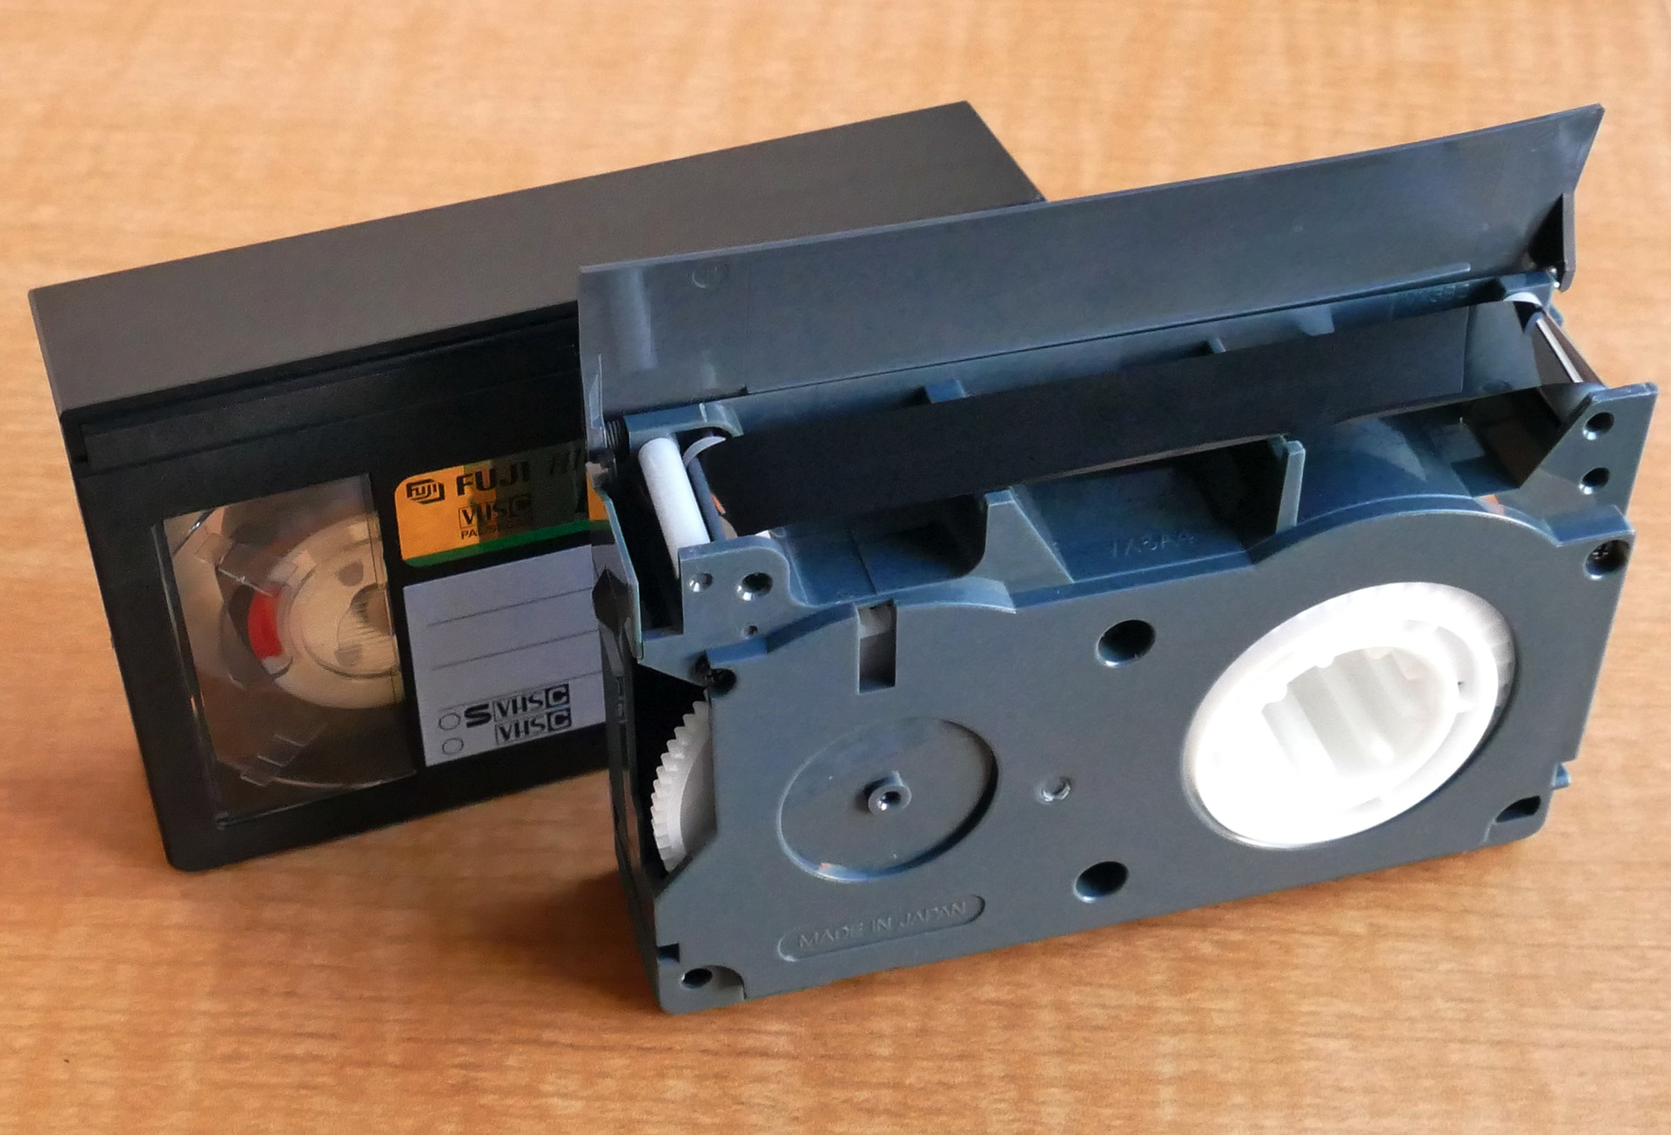
How do we test behaviour?
VCR pattern
Tool examples: github.com/vcr/vcr (Ruby, but has list of ports to other languages)

Slide 18
How do we test behaviour?
Approvals / snapshot tests
Tool examples: Approvaltests.com, Jest (snapshot testing), Shouldly (ShouldMatchApproved)

Slide 19
public class NBNVoipAndInternationalCallsCheckoutScenario : SubcutaneousTest<CheckoutController>
{
public void GivenUserHasAddedNBNVoipAndInternationalCallsBonusOptionsToTheirCart()
{
var session = ObjectMother.Sessions.Default;
session.AddToCart(ObjectMother.Products.NBN);
session.AddToCart(ObjectMother.Products.Voip);
session.AddToCart(ObjectMother.Products.InternationalCallsBonusOption);
SeedContext.Save(session);
}
public void WhenTheUserChecksOutTheirCart()
{
ExecuteControllerAction(c => c.Index(Builder<CheckoutViewModel>.Build()))
}
public void ThenSendRequestToTheProvisioningSystem()
{
var request = Resolve<MockProvisioningSystem>().Requests.Single();
request.ShouldMatchApproved();
}
}

Slide 20
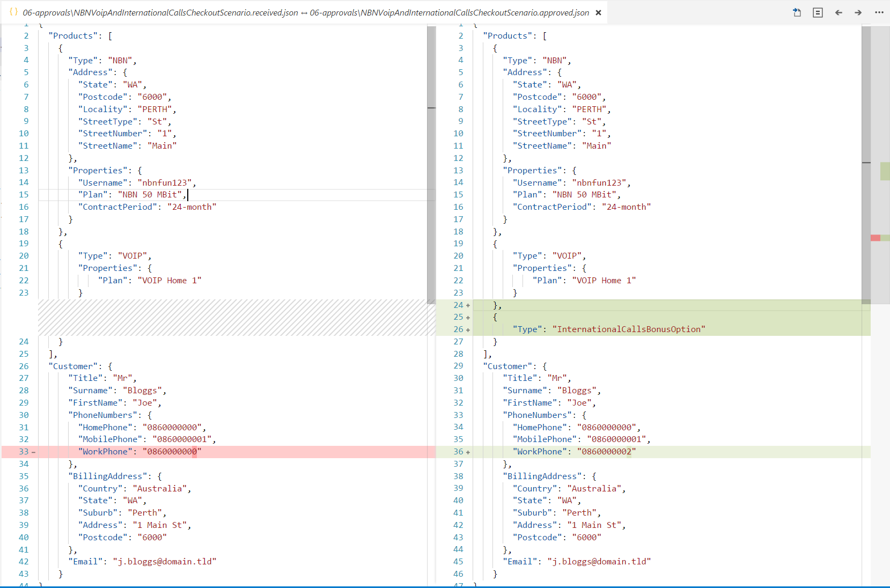

Slide 21
Pragmatic testing
“The ultimate goal here is to ship code it’s not to write tests; tests are just a means to the end of shipping code.” “I can have 100% code coverage and have noone use my product and I can have 0% code coverage and it’s a huge success; there is no correlation between the two things.”
Jimmy Bogard - “Holistic Testing"
Notes:
Tangential to behaviour testing
Start to examine the circumstances under which we decide when and what to testS

Slide 22
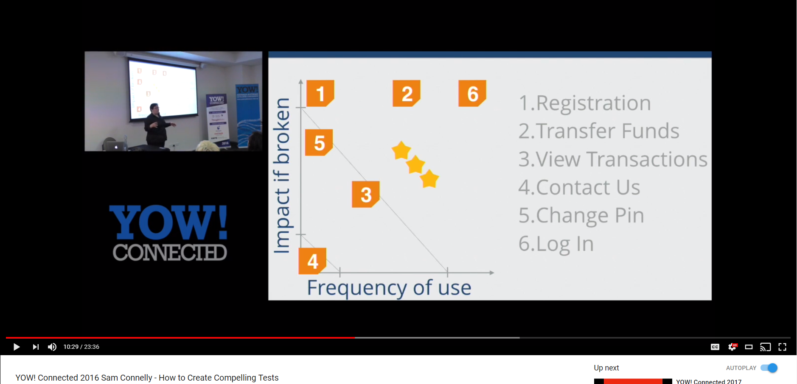
Pragmatic testing
Testing based on impact

Slide 23

Pragmatic testing
Speed vs confidence
?

Slide 24
Speed
implementation tests
real database calls
Automated UI testing
Manual testing
Confidence
Notes:
Metroplex example for tests

Slide 25
Pragmatic testing
Minimum confidence level to deploy feature to prod is a key driver for release.
Challenge yourself to set a minimum confidence level that is as low as possible
Create a testing strategy that meets that confidence level as fast as possible
Adjust the testing strategy over time based on observations (inspect and adapt)
Business Decision
Technical Decision
Both
Notes:
BDDfy example with product owner

Slide 26
Pragmatic testing
Key question:
How do you measure confidence level?
Answer:
Risk-based testing
Notes:
Nomenclature for describing risk coupled with “test framework”
Not just about testing anymore – impacts design, analysis, etc.

Slide 27
Risk-based Testing
Introduce a risk-based model to classify your features and create a common nomenclature between business and technical stakeholders.
Track the risk rating per story in your task-tracking system.
Create a clear way to determine a rating.
Notes:
Talk about how you then match the testing against the risk e.g. UI testing for critical, only manual exploratory testing for trivial etc.

Slide 28
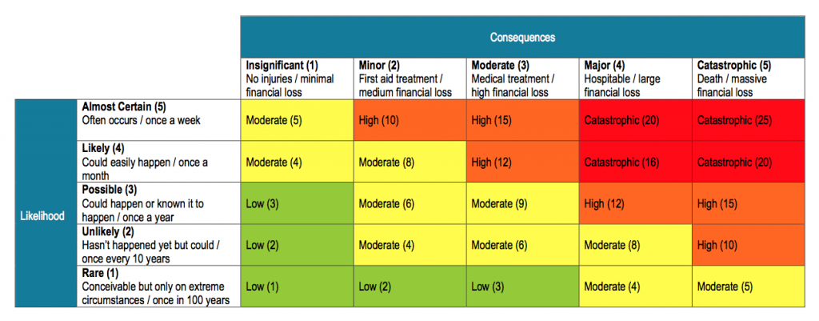
Risk-based Testing
https://safeworkpro.safeworkpro.com/risk-assessment/an-example-of-risk-assessment-matrix
Notes:
Talk about how you then match the testing against the risk e.g. UI testing for critical, only manual exploratory testing for trivial etc.

Slide 29
Risk-based Testing
 | Manual | Unit | UI
Trivial | No | No | No
Low | Once only | No | No
Medium | Once only | Basic coverage | No
High | Once only | Combinatorial coverage | Happy path
Critical | Every release | Combinatorial coverage | Happy and sad path
Notes:
Talk about how you then match the testing against the risk e.g. UI testing for critical, only manual exploratory testing for trivial etc.

Slide 30
What about after we deploy to prod?
Behaviour Driven Infrastructure (BDI)
Testing logs
Blue / Green or canary deployments
Testing In Production (TIP; #yolo :P)
Run tests against production environments
Observability over monitoring
Magic number testing & synthetic transactions
Notes:
Introduce by saying 'Now the software has shipped you might think that we've finished with testing... '
BDI – Graeme
Testing Logs – Graeme
Blue / Green – Graeme
TIP - A/B testing, feature toggling by beta users - Graeme
Observability over monitoring – complex systems may always have components that are down. Could create noise. Need to use techniques like structured logging to make it easier to observe systems in real-time, and prove that the system is functioning.

Slide 31

Final thought – static → dynamic
Notes:
Love. Your. Work :)

Slide 32
Thanks! Questions?

Slide 33
Testing behaviour > implementation
// Arrange
const decimal initialBalance = 10;
SeedContext.Save(ObjectMother.Customers.Graeme.WithBalance(initialBalance));
SeedContext.Save(ObjectMother.IceCreams.ChocTop.PricedAt(5).Build());
// Act
Resolve<IceCreamVan>().Sell("Graeme", "ChocTop");
// Assert
var graeme = VerifyContext.Customers.Single();
graeme.IceCreams.ShouldContain("ChocTop");
graeme.Balance.ShouldEqual(initialBalance - 5);
Notes:
Did you see… We were testing implementation. Not behaviour
Change the implementation
Tests Failing 1200
New feature – 5 minutes
Time spent fixing tests – 2 days
Fear of refactoring: 80%
Likelihood of changing feature to ‘work around’ this: 70%
Real example to illustrate

