Slide 1
Building and Deploying Web Apps in Azure
Azure Web Roles vs Azure Web Sites vs Virtual Machines
Features, Differences, Gotchas and Deployment
Rob Moore
Senior Consultant, Readify
rob.moore@readify.net
@robdmoore
June Tabadero
Principal Consultant, Readify
june.tabadero@readify.net
@jtabadero

Slide 2

Overview
What are Web Sites / Web Roles?
How do they differ?
Things to watch out for
Deployment
Parts of Windows Azure Training Kit used (Apache 2.0 License)
for this presentation: http://windowsazure-trainingkit.github.io/

Slide 3



Windows Azure
Your Datacenter
Virtual Machines
Cloud Services
Web Sites
Applications
Applications
Applications
Applications
Data
Data
Data
Data
Firewall
Firewall Rules
Firewall Rules
Network
Virtual Network
Virtual Network
O/S
O/S
Virtualization
Hardware
Focus on the Application
Notes:
Slide Objectives:
Explain the differences between traditional self-hosting and the three options of Windows Azure hosting.
Notes:
In a traditional environment you must manage the full stack. With Windows Azure you can choose a variety of options depending on your needs.

Slide 4
Web Sites

Slide 5

Windows Azure Web Sites
powerful web sites in seconds
start simple
code smart
go live
start free, scale up and out as you go
Multiple platforms and SDKs, develop on Windows, OSX or Linux
deploy live in seconds, easily monitor performance, rapidly diagnose and fix issues
Notes:
Slide Objectives:
Explain how Windows Azure websites are simple, easy, and open.
Notes:

Slide 6





Supported Web Frameworks OOTB
Or any custom FastCGI Handler
Notes:
Slide Objectives:
Explain that Windows Azure Web Sites supports Classic ASP, ASP.NET, PHP, and Node.js out of the box and that you can also host any custom FastCGI handler.
Notes:

Slide 7
















Windows Azure Web App Gallery
Ready-to-Go Open Source
Web Applications,
Frameworks,
and Templates
Notes:
Slide Objectives:
Highlight the ability to get started quickly with the Windows Azure Web App Gallery
Speaking Points:
Along-side the publishing capabilities, Windows Azure Web Sites also offers the Web App Gallery which provides many turn key solutions based off of well known open source web applications.
Notes:

Slide 8
Architecture
All DBs are running on SQL Azure.
Azure blobs as durable storage.
Windows Azure worker roles.
Monitor resources usage.
Dynamic web activation service.
W3WP.exe IIS application pool process.
IIS ARR (LB)
Web server
Site (W3WP.exe)
Websites DB’s
Runtime DB
Metering
DWAS
Deployment server(s)
Azure LB
Storage controller
Cloud drive
API frontend
Notes:
http://msdn.microsoft.com/en-us/magazine/jj883953.aspx
http://channel9.msdn.com/Events/TechEd/NorthAmerica/2013/WAD-B329/
1. A client makes a request to host http://foo.azurewebsites.net.
2. The request goes through the Windows Azure Network Load Balancer, reaching the appropriate deployment.
3. The Application Request Routing (ARR) module gets info from the runtime database about foo.com, determines which Web servers should host or are currently hosting the Web site, and forwards the request to the corresponding one.
4. The request is processed by the Web server, aided by the storage controller to reach the specific instance of SQL Server in case data is being read or written.
5. Once the request has been processed, a response is sent back to the client.
Inside each of the Web servers, multiple W3WP.exe processes—or sites—are hosted, monitored by a specific process that oversees resource consumption, errors and logging. Also, the Dynamic Web Activation Service (DWAS) is responsible for site activation and deactivation, quota enforcement and deployment of the application files. Two additional components complete the picture: the deployment servers host the FTP and Web Deploy engines, while the API front end provides an interface for automation purposes.

Slide 9
Web Sites
Tiers
Free
Multi-tenant. Daily quotas
Shared
Multi-tenant. Daily quotas
Standard
Dedicated VMs. No quotas
Notes:
Slide Objectives:
Explain the three scale choices on Windows Azure Web Sites.
Notes:
Both free and shared are the same architecture. With standard you isolate your application to your own virtual machines that you can use and pay for whatever resources you choose.
Online Resources:
If you’d like more details on Web Site pricing and quota, see the Windows Azure pricing page here: http://www.windowsazure.com/en-us/pricing/details/web-sites/

Slide 10
Tiers (as at 21 July 2013)
 | FREE | SHARED | STANDARD
CPU | Shared 60 minutes / day | Shared 240 minutes / day | Dedicated
Custom domain support | Not Available | Available | Available
Custom domain SSL | Not Available | Not Available | Yes
Scale-out | Not Available | Up to 6 instances | Up to 10 instances
Sites | 10 | 100 | 500
Storage | 1 GB | 1 GB | 10 GB
Relational database (MySQL or MSSQL) | 20 MB included Standard rates apply for additional capacity | 20 MB included Standard rates apply for additional capacity | 20 MB included Standard rates apply for additional capacity
Outbound data transfer | Up to 165MB per day | Unlimited Standard rates apply | Unlimited Standard rates apply
http://www.windowsazure.com/en-us/pricing/details/web-sites/

Slide 11
Pricing (as at 21 July 2013)
Shared $0.013 per hour (~$10/month)
Standard
SSL SNI SSL $9/month IP SSL $39/month
SIZE | CPU CORES | MEMORY | PRICE / hr
Small | 1 | 1.75 GB | $0.10 (~$75 / month)
Medium | 2 | 3.5 GB | $0.20 (~$149 / month)
Large | 4 | 7 GB | $0.40 (~$298 / month)

Slide 12
Provisioning, deploying and monitoring a Web Site
Demo
Notes:
30 mins - Rob

Slide 13
Cloud Services
(Web Roles)

Slide 14
Platform as a Service
IIS Sites
Worker Role
Load balancer
Firewalled ports
VM sizes
Number of instances
Certificates
Diagnostics
Remote Desktop
File system folders
Caching
Virtual Network

Slide 15
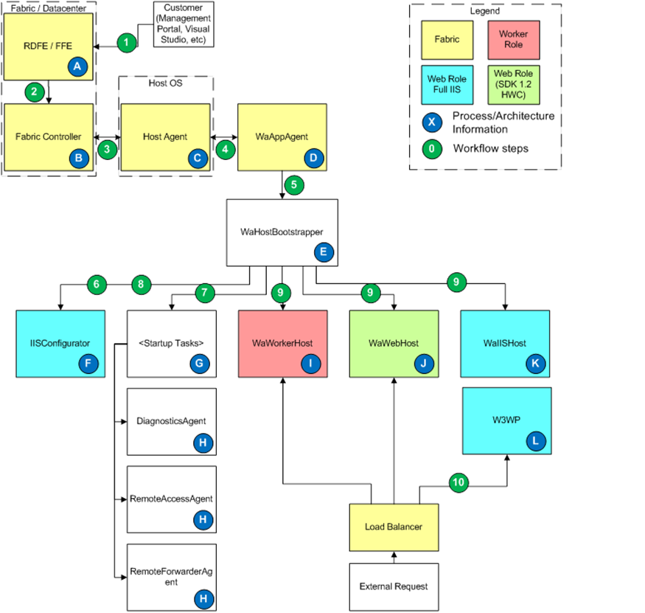
Architecture
Notes:
http://blogs.msdn.com/b/kwill/archive/2011/05/05/windows-azure-role-architecture.aspx
Host Agent is essentially a watchdog timer waiting for heartbeats within 10 min period
WaAppAgent sends heartbeats, watches bootstrapper and configures the guest OS including firewall, ACLs, LocalStorage resources, service package and configuration, certificates
WaWorkerHost/WaIISHost host the RoleEntryPoint in Worker and Web roles respectively

Slide 16
VM Sizes / Pricing (as at 21 July 2013)
NAME | VIRTUAL CORES | RAM | PRICE PER HOUR
Extra Small (A0) | Shared | 768 MB | $0.02 (~$15/month)
Small (A1) | 1 | 1.75 GB | $0.08 (~$60/month)
Medium (A2) | 2 | 3.5 GB | $0.16 (~$119/month)
Large (A3) | 4 | 7 GB | $0.32 (~$238/month)
Extra Large (A4) | 8 | 14 GB | $0.64 (~$476/month)
A6 | 4 | 28 GB | $0.90 (~$670/month)
A7 | 8 | 56 GB | $1.80 (~$1,339/month)

Slide 17
Provisioning, creating and configuring a Web Role
Demo
Notes:
30 mins - Rob

Slide 18
Virtual Machines
Manual Web Farm

Slide 19
Infrastructure as a Service
Provision Virtual Machines with persistent vhds
Use PowerShell to automate everything
Full control over VMs
Can construct a web farm as per on-premise

Slide 20
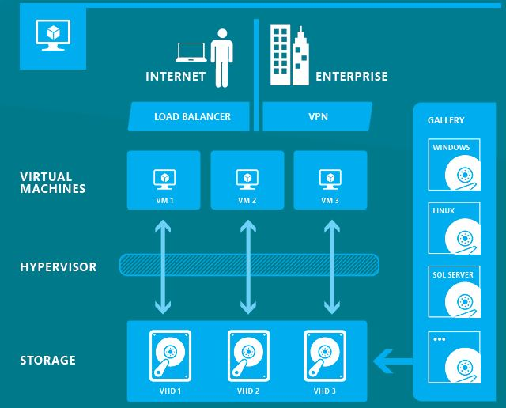
Architecture
Notes:
http://adamsync.wordpress.com/2013/02/28/windows-azure-infrastructure-as-a-service/

Slide 21
VM Sizes / Pricing (as at 21 July 2013)
NAME | VIRTUAL CORES | RAM | PRICE PER HOUR
Extra Small (A0) | Shared | 768 MB | $0.02 (~$15/month)
Small (A1) | 1 | 1.75 GB | $0.09 (~$67/month)
Medium (A2) | 2 | 3.5 GB | $0.18 (~$134/month)
Large (A3) | 4 | 7 GB | $0.36 (~$268/month)
Extra Large (A4) | 8 | 14 GB | $0.72 (~$536/month)
A6 | 4 | 28 GB | $1.02 (~$759/month)
A7 | 8 | 56 GB | $2.04 (~$1,518/month)

Slide 22
Provisioning a Virtual Machine
Demo
Notes:
30 mins - Rob

Slide 23
Differences

Slide 24
Web Sites advantages
OOTB features
Near-instant Git, TFS, FTP, Web Deploy and Dropbox deployments
One-click roll-backs
Multiple websites on a single farm out of the box
Simpler VS solution
Core advantages
Fast provisioning / scaling
One-click blogs and CMSs
Easy monitoring and diagnostics
Deploy time config changes
A-record support
Memory dumps via REST API

Slide 25
Web Sites disadvantages
Can’t use non 80/443 ports
No RDP
No network isolation
No fully fledged bg worker
No arbitrary startup scripts
Can’t use elevated privileges
No Azure Drive
Limited IIS configuration
Limited autoscaling
No XS VMs
No XL/A6/A7 VMs
Custom SSL costs extra
No custom certificates
Get charged when stopped

Slide 26
Web Roles advantages
Azure Diagnostics
Complex autoscaling
Huge scale (100s of VMs)
Cloud Configuration
Affinity Groups
Upgrade/Fault domains
VIP swap deployments

Slide 27
Web Roles disadvantages
OOTB deployments
VS solution complexity
Cloud Configuration

Slide 28
Virtual Machines advantages
Complete flexibility/control
Legacy applications

Slide 29
Virtual Machines disadvantages
Scaling is difficult
No OOTB autoscaling

Slide 30
Things to watch out for

Slide 31
Application development considerations
Also important areas to look at for migrating legacy applications

Slide 32
Data
Multi-tenant or single-tenant
Data storage:
Table storage
Blob storage
Azure drive
SQL server on VMs
Azure SQL Database
Hadoop
Other on VMs
Azure SQL != SQL Server
CDN
Transient errors

Slide 33
Other
Avoid file system access
Avoid registry access
ASP.NET providers
Network latency
Aim for statelessness
Automate deployments
On-premise connections
Consider security
Avoid COM / 32-bit DLLs
Time zone (UTC on server)
Application configuration

Slide 34
Farm configuration

Slide 35
VM Size
Only use XS for test environments – shared CPU
S’s are quite performant
Use M’s for reasonably loaded websites
Dual core has superior performs because .NET does GC on second core
We’ve seen 600 concurrent users on 4 M’s with 30% CPU util (Win2k8)
Use L+ if your website uses a lot of memory
Use L+ if you want to join to a distributed cache

Slide 36
Instance Count
>= 2 instances to ensure your site works on a cluster
>= 2 instances to get 99.95% SLA with Web Roles
>= 2 instances in same availability set to get 99.95% SLA with Virtual Machines

Slide 37
Testing

Slide 38
Local Development and Testing
Don’t use Azure Compute Emulator
(Except for testing Worker Roles)
Use IIS for web applications
Use SQL Express for Azure SQL
Use Azure Storage Emulator for Azure Storage
Use nssm on C:\Program Files\Microsoft SDKs\Windows Azure\Emulator\devstore\DSServiceSQL.exe to get it running constantly on CI server

Slide 39
Test environment
Have a test environment in Azure so you can check:
Latency
Azure SQL
Database Migrations
Deployment
Clustering
Load Balancer

Slide 40
Test environment (cont.)
Mimic production setup (but feel free to use XS Web Roles / VMs or shared tier Web Sites)

Slide 41
Diagnostics and Monitoring

Slide 42

Web Sites
HTTP Logs
Error Logs
Portal Monitoring
Log Streaming
New Relic
Notes:
Git Deployment is Native, or through a Service hook from CodePlex, GitHub or BitBucket

Slide 43
Web Roles
Azure Diagnostics
New Relic
MetricsHub

Slide 44
Azure Diagnostics
You can capture and collate from all servers
Azure Infrastructure logs
Application logs (via Trace listener or logging library)
IIS Crash Dumps
IIS Failed Request Logs
IIS Request Logs
Custom logs from the file system
Performance counter values over time
Anything in Windows Event Log
Stored to Windows Azure Storage
Programmatic or XML configuration
Can change configuration dynamically
Notes:
http://www.windowsazure.com/en-us/develop/net/common-tasks/diagnostics/

Slide 45
Virtual Machines
New Relic
MetricsHub
System Centre
Whatever you do on-premise

Slide 46
Scaling up / out

Slide 47




Web Sites - tiers
shared
standard
1
0
standard
Shared instances
Standard instance
:-)
:-)
:-)
Notes:
Slide Objectives:
Explain how you can move to standard instances for additional scale.
Notes:

Slide 48
Web Sites - instances
shared
standard
2
shared
Shared instances
:-)
:-)
Notes:
Slide Objectives:
Explain how you can scale your site to multiple shared instances.
Notes:

Slide 49


Web Sites - instances
shared
standard
2
standard
Standard instance
Standard instance
:-)
:-)
:-)
:-)
:-)
:-)
:-)
:-)
Notes:
Slide Objectives:
Explain how you can host multiple sites that you own on a your standard instances.
Notes:

Slide 50
Web Sites autoscaling
standard
cpu utilization
Standard instance
Standard instance
Standard instance
:-)
:-)
:-)
Notes:
Slide Objectives:
Explain how you can host multiple sites that you own on a your standard instances.
Notes:

Slide 51
Web Roles
Instance configuration
CPU autoscaling
Queue autoscaling
WASABi
REST API
Cerebrata Azure Management Studio
Paraleap AzureWatch

Slide 52
Virtual Machines
Manual
Use REST API / API SDKs to spin up new VM and create and run script to set up the server
No different to what you would need to do on-premise, however most companies don’t have a rich programmatic API to provision VMs
Third-party devops software
e.g. http://www.gigaspaces.com/cloudify-devops-cloud-application-management/meet-cloudify

Slide 53
Deployment

Slide 54
Web Sites
FTP://
TFS
WebDeploy
DropBox
Notes:
Git Deployment is Native, or through a Service hook from CodePlex, GitHub or BitBucket

Slide 55
Web Roles
Package and deploy via Portal
Package and deploy via API
Web Deploy via AzureWebFarm

Slide 56

AzureWebFarm
nuget.org/packages/azurewebfarm
Create a load-balanced web farm using Web Roles
Enables MsDeploy deployments
Takes care of syncing files across roles
Takes care of configuring IIS with your sites when role restarts or new one is scaled up
Includes a background worker execution model
Automatically runs console applications included with your web app

Slide 57
Virtual Machines
Manual
Shared drive
OctopusDeploy
Web Deploy via IIS Web Farm Framework
Web Deploy to each server individually
Web Deploy and DFSR syncing

Slide 58
When should I use what?

Slide 59
Application Scenarios
Web Sites
Web Roles (Cloud Services)
Virtual Machines
Modern web apps
Perfect if your app consists of client side markup and scripting, server side scripting and a database. Powerful capability to scale out and up as needed
Multi-tier or large-scale applications
Applications that separate application logic into multiple tiers using both Web and Worker Roles, need enormous scale, need CDN on content in the website or need large amounts of memory
Enterprise server applications
Run your existing enterprise applications to the cloud, such as SQL Server, SharePoint Server or Active Directory
Continuous development
Deploy directly from your source code repository, using Git or Team Foundation Service
Apps that require advanced administration
Applications that require RDP, elevated permissions, advanced IIS configuration, complex diagnostics or cost effectiveness if sometimes-on
Legacy applications
Deploy legacy web applications that aren’t compatible with Web Sites or Web Roles (e.g. file system access, COM/32-bit DLLs, proprietary software install required, etc.) + you can’t convert
Popular open source apps
Launch a professional looking site with a few clicks using apps like WordPress, Joomla!, Drupal, DotNetNuke and Umbraco
Apps that require advanced networking
Applications that require network isolation, geo-redundancy/scaling via Traffic Manager or need to be deployed to SE Asia for latency reasons
Ultimate control / Linux OS
If you have operational staff that can maintain the OSs and you want full control from the OS level up (be it Windows Server or Linux)

Slide 60

Tonight’s event sponsored by:
application development specialists
Notes:
2 mins

Slide 61
Thank You…
Questions?
Rob Moore
Senior Consultant, Readify
rob.moore@readify.net
@robdmoore
June Tabadero
Principal Consultant, Readify
june.tabadero@readify.net
@jtabadero

Slide 62
Further Reading
https://github.com/robdmoore/AzureWebAppsPresentation
http://robdmoore.id.au/blog/2012/06/09/windows-azure-web-sites-vs-web-roles/
http://msdn.microsoft.com/en-us/library/windowsazure/jj218759.aspx
https://github.com/robdmoore/azurewebfarm
http://michaelwasham.com/2012/06/08/understanding-windows-azure-virtual-machines/
http://channel9.msdn.com/Events/TechEd/NorthAmerica/2013/WAD-B329/
http://msdn.microsoft.com/en-us/magazine/jj883953.aspx
http://blogs.msdn.com/b/kwill/archive/2011/05/05/windows-azure-role-architecture.aspx
http://www.windowsazure.com/en-us/develop/net/common-tasks/diagnostics/

