Slide 1
Time management and project planning/management
Rob Moore
Principal Consultant, Readify
rob.moore@readify.net
@robdmoore

Slide 2
Why is it important?
Do you ever feel overwhelmed with:
Uni classes
Uni assignments and tests
Work (multiple jobs?)
Extracurricular activities
Maintaining relationships (friends, family, lovers)
Housework
Leisure, quiet time, exercising, reading, etc.)
Do you have competing deadlines?

Slide 3
Why is it important?
You need these skills in the workforce
These skills are important to get right
They help ensure you have a work-life balance

Slide 4
How can I plan a project and manage my time effectively?

Slide 5
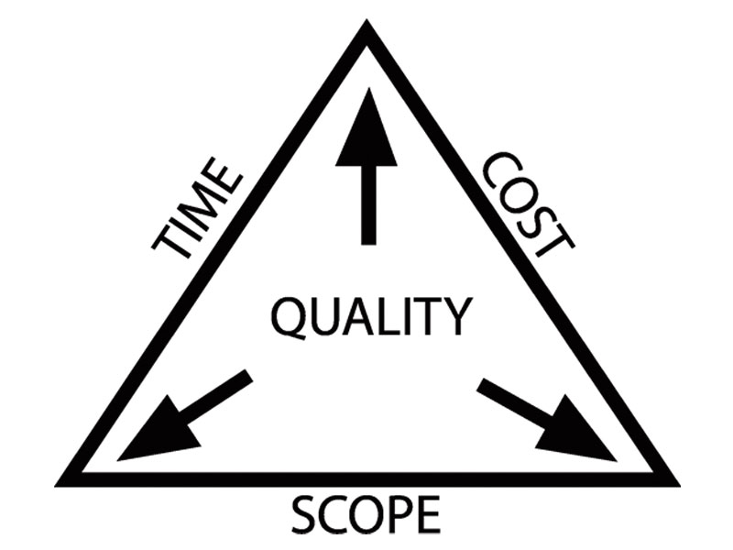
Golden Triangle

Slide 6
Continuous loop
Understand
Prioritise
Plan
Execute
Evaluate

Slide 7
Understand
What are the goal(s)?
Identify high level tasks
What are the deadline(s)?
Breakdown tasks to be prioritisable

Slide 8
Prioritise
Within and across activities in your life
Prioritisation is the key to avoiding context switching overhead
Decide what to prioritise on:
Deadline?
Importance?
Complexity?

Slide 9
Plan
Estimate tasks:
May affect the priority – that’s OK
Ensure clear scope
Schedule and assign tasks; consider:
Dependencies
Deadlines and estimates
Skillsets
Remember: things change

Slide 10
Execute
Plan each week
Consider non-negotiable things
Consider what tasks are due soon
Consider how much time is needed for them
Each day review the activities you planned to refresh your memory
Keep revisiting the goals you are trying to achieve; make sure activity is focussed

Slide 11
Evaluate
Regularly evaluate your progress
Consider planned vs actual work
Things never go to plan – expect it
Consider what new things you have learnt
Loop back for another planning cycle
Communicate
Be retrospective – continuously improve

Slide 12
Continuous loop
Understand
Prioritise
Plan
Execute
Evaluate

Slide 13
Understand: Example
Project: organise a networking event
Goal: Run event with 50 people from 2 universities
High-level tasks:
Organise a venue, get people to register, organise food and drinks, secure keynote speaker, etc.
Deadlines:
Event will be at date (X), Venue needs to be booked (X-4 weeks), people can register by (X-3 weeks), etc.
Breakdown: get people to register:
Create poster (dependency: secure keynote speaker?), Put up posters, advertise on facebook, create registration page, etc.

Slide 14
Prioritise: Example
High level prioritisation
Secure keynote speaker (X-6)
Create reg. page / create poster (X-5)
Organise venue (X-4)
Put up posters / create fb page (X-3)
Organise catering (X-1)
etc.

Slide 15
Plan: Example
High-level task: Secure keynote speaker
(X-8) Joe and Sally – 1 hour meeting
Decide on list of potential keynote speakers
(X-8/7) Sally and John – 2 hours each ad hoc
Contact the keynote speakers to see if they are available
(X-6) Joe and Sally – 1 hour meeting
Decide which speaker to run
Confirm with the speaker
Items to plan later:
get bio from speaker (X-4?)
get slides from speaker (X-2?)
add introduction to slides and confirm with MC (X-1?)
confirm with speaker (X-1?)
send thankyou note and bottle of wine (X+1?)

Slide 16
Useful tips/techniques

Slide 17
Effective behaviours
Strive for continuous improvement
Break down complexity
Visualise work in progress
Pragmatically detail-oriented

Slide 18
Timeboxing
Set aside an appropriate amount of time to complete something in based on it’s importance or how much time you can spare
Cut yourself off if you go over the timebox or re-evaluate if you need more time (and can spare it)
Work backwards from constraints and deadlines

Slide 19
Communicate at high level; plan and act in detail
Roll-up details to a high level when communicating with others so everyone doesn’t need to be across everything
Allows you to see at a glance where progress is at – less chance of getting lost in detail

Slide 20
Set expectations
Set minimum expectations of everyone
Create a communication plan
Specify what happens when someone can’t make a commitment

Slide 21
Sustainable pace
Consistently sacrificing sleep and weekends isn’t sustainable
The quality and efficiency of your work drops and you get less done
Get help if you need an unsustainable pace to get everything done!

Slide 22

Task visualisation
Visualising your prioritised todo list helps you focus
It helps you and your team be more efficient and helps context switching
trello.com

Slide 23

Pomodoro / Timeboxing
Procrastination is damaging to efficiency
Ensure focus by setting aside a specific amount of time
Take a small break after that time and reflect on what you did
pomodorotechnique.com
workawesome.com/productivity/timeboxing

Slide 24

Real-world example

Slide 25
Good project manager attributes
Follow intent rather than letter of the plan
Servant leader
Strike a good balance between being engaged / supportive and micromanaging
Set expectations early and often
Minimise governance overhead
Start small and inspect and adapt
Create an autonomy, mastery, purpose environment

Slide 26
Thankyou
Rob Moore
Principal Consultant, Readify
rob.moore@readify.net
@robdmoore

