Slide 1
Windows Azure SQL Databases
The ins and outs of developing using Azure SQL Database
Rob Moore
Senior Consultant, Readify
rob.moore@readify.net
@robdmoore
June Tabadero
Principal Consultant, Readify
june.tabadero@readify.net
@jtabadero
Matt Davies
Team Leader, Curtin University
matthew.davies@curtin.edu.au
@mdaviesnet

Slide 2

Overview
What is it?
How is it different from SQL Server?
Things to watch out for
Live demonstration
Parts of Windows Azure Training Kit used (Apache 2.0 License)
for this presentation: http://windowsazure-trainingkit.github.io/

Slide 3
What is it?

Slide 4

The Basics
SQL Database
MSSQL-as-a-service hosted in Azure
Fully Managed:
Updates
Vertical scaling
Server and disk management
Configuration and optimisation
High-availability – 3 copies
99.9% uptime SLA
SQL Azure => Azure SQL Database

Slide 5
A Server Is Not A Machine
SQL Server
A Machine
SQL Database Server
A TDS Endpoint
Notes:
While Windows Azure SQL Database is MSSQL, we do not interact with them in the same physical manner. In an on-premises environment, we typically have physical access to the actual SQL Server server whereas in Windows Azure, we do not have physical access to the actual server.
In the background Microsoft is running physical server with SQL Server 2012 Enterprise Edition, but you talk to a TDS endpoint and the implementation of that endpoint is hidden from you in order to provide a high-availability, scalable, fully-managed service.
It’s worth noting that there is a logical concept in SQL Azure called a server that you create your databases under, but this doesn’t mean that the databases you create under that server will be hosted on the same machine – it’s just used as a grouping for security purposes.
Server in SQL Azure gives you a grouping of databases with: a single set of firewall rules, a single set of user accounts, in a single data centre.

Slide 6
How It Works
Client Layer
PHP
SQL Server
Applications
and Tools
WCF Data Services
Architecture
Client Layer - Used by application to communicate directly with SQL Database.
Services Layer – Gateway between Client layer and Platform layer.
Platform Layer – Includes physical servicers and services that support the Services layer.
Infrastructure Layer – IT administration of the physical HW and OS.
ODBC
ADO.NET
Tabular Data Stream (TDS)
TDS+SSL
Services Layer
Provisioning
Provisioning
Provisioning
…
Billing and Metering
Billing and Metering
Billing and Metering
…
Connection Routing
Connection Routing
Connection Routing
…
Platform Layer
SQL Server
SQL Server
SQL Server
…
SQL Database Fabric
SQL Database Fabric
SQL Database Fabric
…
Management Services
Management Services
Management Services
…
Infrastructure Layer

Slide 7
SQL Azure Network Topology
Applications use standard SQL client libraries: ODBC, ADO.Net, PHP, …
Application
Internet
Azure Cloud
TDS (tcp)
Security Boundary
Load balancer forwards ‘sticky’ sessions to TDS protocol tier
LB
TDS (tcp)
Gateway
Gateway
Gateway
Gateway
Gateway
Gateway
Gateway: TDS protocol gateway, enforces AUTHN/AUTHZ policy; proxy to CloudDB
TDS (tcp)
SQL
SQL
SQL
SQL
SQL
SQL
Scalability and Availability: Fabric, Failover, Replication, and Load balancing

Slide 8
SQL Database Billing Rates (As of May 2013)
Database Size | Price Per Database Per Month
0 to 100 MB | Flat $4.995
100 to 1 GB | Flat $9.99
1GB to 10 GB | $9.99 for first GB, $3.996 per additional GB
10 GB to 50 GB | $45.954 for first 10 GB, $1.996 for each additional GB
50 GB to 150 GB | $125.874 for first 50 GB, $0.999 for each additional GB
Charged at monthly rate per database
Amortized over month -> calculated on daily basis
Cheaper if you commit to a 6/12 month plan (20-32% off)
Any outbound data transfers at the regular Data Transfer rates
Notes:
10 mins – Matt or June
Give examples?

Slide 9
How is it different from SQL Server?

Slide 10

Feature Limitations
SSAS
SSIS
MDS
SQL Agent
SQL Replication
Full Text Search
CDC
Windows Authentication
TDE
Cross Database Queries
Distributed Transactions
CLR
Service Broker
Filestream
Database Mirroring
Backup and Restore
Extended Events
Extended Stored Procs

Slide 11
Pros
Latest version of SQL Server
Quick to provision
Managed service – ops taken care of
State-of-the-art datacentre and security
Highly available and backed by SLA
Rich programmatic management / provisioning
DoS protection

Slide 12
Pros
Pay for use (don’t need to buy a license)
You can store backups in Blob storage on the other side of the world easily
Existing tools / libs can connect to it

Slide 13
Differences
Must have single clustered index on all tables
Subset of TSQL for SQL Server
Subset of system views available
Connections will be automatically closed
Logical vs Physical Administration

Slide 14
Cons
Max 150 GB
No performance guarantees
Feature limitations
No long-running queries / transactions
Backups

Slide 15
Things to watch out for

Slide 16
Connection String
Connecting To SQL Database
TDS (Tabular Data Stream) protocol over TCP/IP
SSL is required
SQL server authentication only
Add any non-Azure client IP address to the firewall
<connectionStrings>
<add name="AdventureWorks" connectionString="
Data Source=tcp:[server].database.windows.net;
Initial Catalog=ProductsDb;
User Id=[login]@[server];
Password=[password];
Trusted_Connection=False;
Encrypt=true;"
providerName="System.Data.SqlClient" />
</connectionStrings>

Slide 17
Security
Per-”server” firewall
User accounts with privileges
Server admin account: special privileges
TDS connection is encrypted
Protect your database passwords
e.g. config encryption
Notes:
20 mins - June

Slide 18
Performance and Scalability

Slide 19
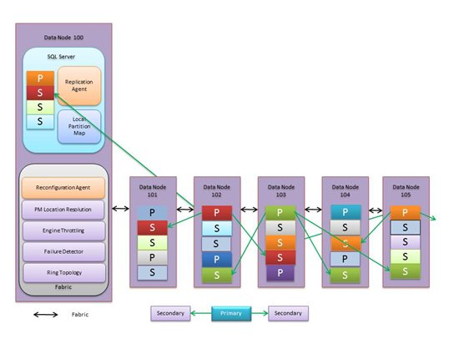
High Availability
Has Availability Guarantees
3 copies of database
1 primary
2 secondary
Automatic
Failure Detection
Failover
Reconfiguration

Slide 20
Performance
No Performance Guarantees
Shared Commodity H/W, Multi-tenant
Load Balancer
Quorum Commit – at least 2 replicas must commit
Latency

Slide 21
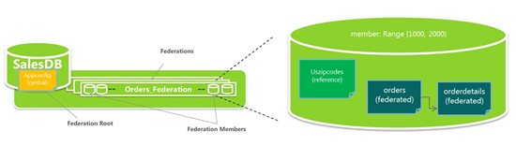
Scalability
Scale vertically up to 150GB
Horizontal Scaling
Sharding
Federations
Notes:
10 mins - June

Slide 22
Backups

Slide 23
Why backup?
Infrastructure failures
High Availability
Disaster Recovery
Software errors
User error / accidents

Slide 24
Microsoft Recommendation
BACPAC
Geographical redundancy Not transactionally consistent
CREATE DATABASE AS COPY OF
Transactionally consistent Charges a full day
http://msdn.microsoft.com/en-us/library/jj650016.aspx

Slide 25
Other options
Red Gate Cloud Services
Cerebrata Powershell Commandlets
bcp Utility
Azure migration wizard
SQL Data Sync
DAC Framework
Sync Framework

Slide 26
No transaction logs
Manual changes are risky
Use migrations
Have a test environment in Azure
Make it difficult to log into server manually
Automate your backups
Notes:
10 mins - Rob

Slide 27
Transient Faults

Slide 28
What are transient faults?
Faults that occur “sometimes”
If you retry the failed operation it will usually succeed
Examples:
Closing idle connections
Throttling excessive connections
Timeouts when the resource isn’t able to respond

Slide 29
Why do transient faults occur?
Cloud computing == shared resources
SLAs dictate expectations
No guarantees outside of SLAs
Optimisations improve overall performance / availability
Remember: Azure SQL != SQL Server

Slide 30
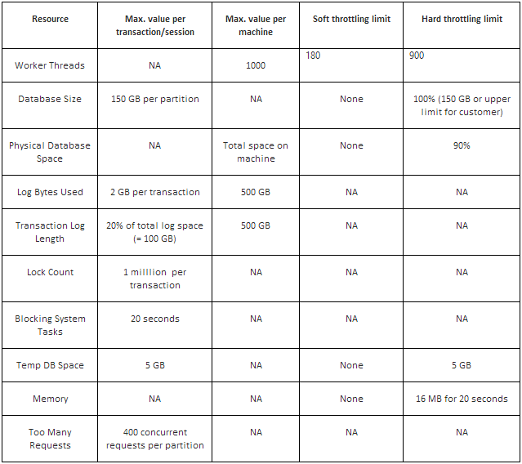
Limits

Slide 31
How to deal with transient faults?
Detect transient error codes (http://go.microsoft.com/fwlink/?LinkId=267637)
Connection and command retries (and transactions)
Consider timeouts
Implement a retry strategy
Exponential-backoff
Fixed interval
Incrementing interval

Slide 32
Transient Fault Handling library
Patterns & Practices: Transient Fault Handling Application Block
Provides ReliableConnection in place of SqlConnection
Part of Enterprise Library
Be careful: Lots of bad documentation / code snippets

Slide 33
NHibernate.SqlAzure library
If you use NHibernate we’ve done the work for you:
Install-Package NHibernate.SqlAzure
Change driver to the SqlAzureClientDriver
https://github.com/robdmoore/NHibernate.SqlAzure for more info / advanced usage
Notes:
10 mins – Matt or Rob

Slide 34
Transient Fault Handling
Demo
Notes:
30 mins - Rob

Slide 35
When should I use it?

Slide 36
When should I use it?
Basic use cases (relational DB)
You don’t have a high load
Small number of databases
Multi-tenanted
Web-scale relational DB
you can re-architect for federations
you can afford the number of databases required
You don’t have operations staff with SQL Server exp.
Notes:
2 mins
These are all “or”’s not “and”’s.

Slide 37
Right tool for the job
Azure SQL Database isn’t applicable for everything
Other options:
Azure Table Storage
Azure Blob Storage
Hadoop (big data)
IaaS VM with SQL server
Worker Role or IaaS VM with Neo4J, Raven, etc.
Hybrid
Notes:
5 mins - Rob

Slide 38

Tonight’s event sponsored by:
application development specialists
Notes:
2 mins

Slide 39
Thank You…
Questions?

Slide 40
Further Reading
https://github.com/robdmoore/SQLAzureDemo
http://social.technet.microsoft.com/wiki/contents/articles/2267.windows-azure-sql-database-technet-wiki-articles-index.aspx
http://social.technet.microsoft.com/wiki/contents/articles/995.windows-azure-sql-database-faq.aspx
http://social.technet.microsoft.com/wiki/contents/articles/3507.windows-azure-sql-database-performance-and-elasticity-guide.aspx
http://msdn.microsoft.com/en-us/library/windowsazure/ee730906.aspx
http://www.windowsazure.com/en-us/develop/net/fundamentals/cloud-storage-scenarios/
http://www.windowsazure.com/en-us/develop/net/architecture/
http://social.technet.microsoft.com/wiki/contents/articles/1541.windows-azure-sql-database-connection-management.aspx
http://social.technet.microsoft.com/wiki/contents/articles/1695.inside-windows-azure-sql-database.aspx

