Slide 1
Test West 2014 Presents:
Test Data re-usability and sustainability
Rob Moore (@robdmoore)
Lead Consultant, Readify

Slide 2
Overview
What are we trying to avoid?
What are the properties of a good test?
Object Generation
Test Structure

Slide 3
What do we want to avoid?
Large projects have a tendency to end up with test projects where:
Additions and modifications are tedious
They are complex to understand and hard to maintain
There is a lot of repetition within and between tests

Slide 4
Properties of good tests
Readable
Understandable
Documentation
Maintainable
Consistency
Clear intent

Slide 5
Object Generation
Maintainability
  Avoid constructor calls
Clarity of intent
  Only specify meaningful values for each test
Consistency
  Have a consistent way of constructing objects

Slide 6
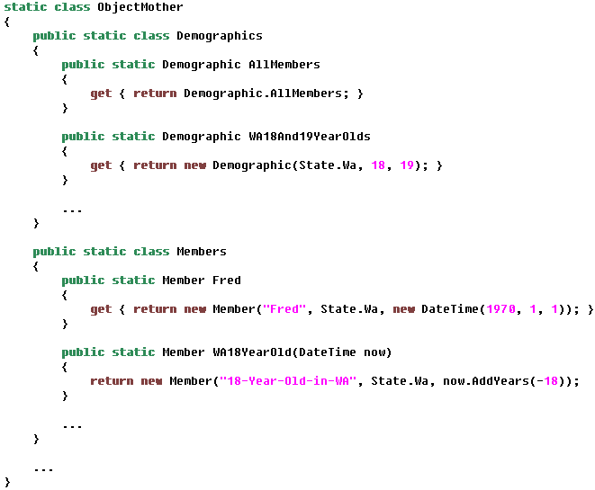
Object Generation > ObjectMother Pattern

Slide 7
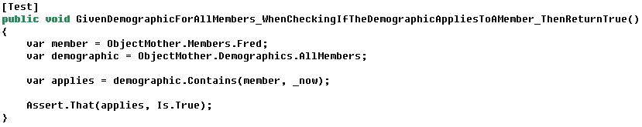
Object Generation > ObjectMother Pattern

Slide 8
Object Generation > ObjectMother Pattern
Avoids some constructor calls
Allows you to specify important values by name
  Can lead to crazy long names
Provides consistent way to get objects
Still lots of constructor calls
God objects – complex
Awkward for data-driven tests

Slide 9
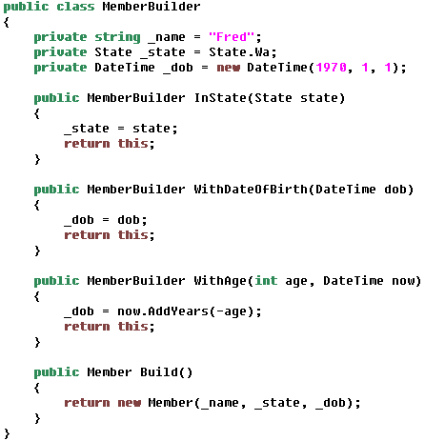
Object Generation > TestDataBuilder Pattern

Slide 10
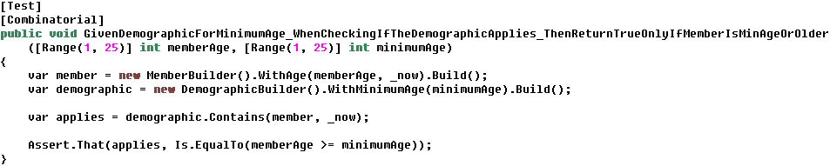
Object Generation > TestDataBuilder Pattern

Slide 11
Object Generation > TestDataBuilder Pattern
Only 1 constructor call
Only specify data relevant to test!
Can call actions after construction
Expressive; forms documentation
Noise / verbosity
Repetition across tests with similar objects
Infrastructure code

Slide 12
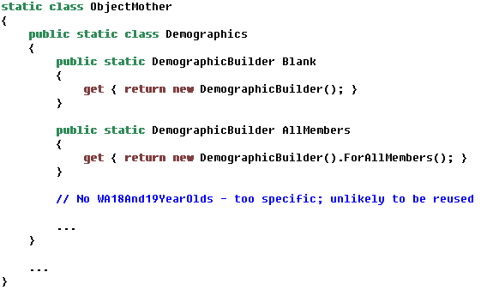
Object Generation > Combining both patterns

Slide 13
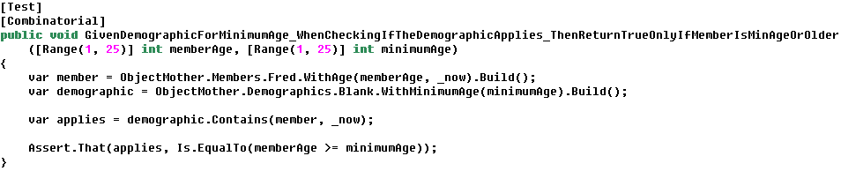
Object Generation > Combining both patterns

Slide 14
Object Generation > Combining both patterns
Only 1 constructor call
Only specify data relevant to test!
Can call actions after construction
Expressive; forms documentation
Consistency of ObjectMother
Remove repetition across tests by grouping reused objects
More infrastructure code

Slide 15
Object Generation > Data Generation Reuse
Unit tests
Integration tests
Automated UI tests
Seeding for manual tests

Slide 16
Test Structure
The way tests are structured helps highlight or de-emphasise the data
This affects readability of the tests and helps or hinders clarity of intent

Slide 17
Test Structure > Derived Values
Showing a clear relationship between the test data and the assertions is important for readability
  Proximity
  Clarity of intent
Data-driven tests sometimes fulfil this
Derived values is the act of explicitly showing how the assertion is calculated
  Try and avoid simply copying the implementation

Slide 18
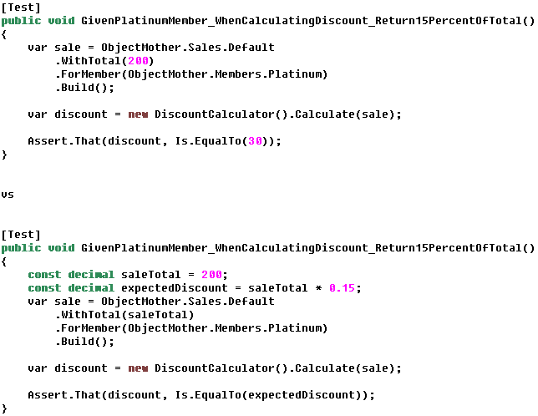
Test Structure > Derived Values

Slide 19
Test Structure > Anonymous Values
Some values are not important to the test
  Explicit values gives false importance
  Instead, identify as an anonymous value
Specify an equivalence class to increase readability
  This is known as constrained non-determinism

Slide 20
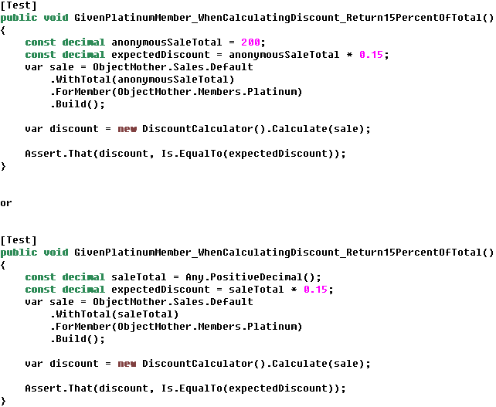
Test Structure > Anonymous Values

Slide 21
Questions?
Rob Moore
rob.moore@readify.net | @robdmoore
Lead Consultant, Readify

