Slide 1


Test data re-usability and sustainability
Rob Moore / Principal Consultant / @robdmoore

Slide 2
Agenda
01
04
Properties of a good automated test
Reuse of generated test data
02
05
Problems we often have with automated tests
Test structure
03
Generating data/objects for automated tests

Slide 3
Properties of good tests
Maintainability
Tests as documentation
Readable
Understandable
Consistent
Clear in intent

Slide 4
Common problems
Large projects have a tendency to end up with test projects where:
Additions and modifications are tedious
They are complex to understand and hard to maintain
There is a lot of repetition within and between tests

Slide 5
Data/Object generation

Slide 6
Data/Object generation
Consistency
Have a consistent way of constructing objects
Clarity of intent
Only specify meaningful values for each test
Maintainability
Avoid constructor calls

Slide 7
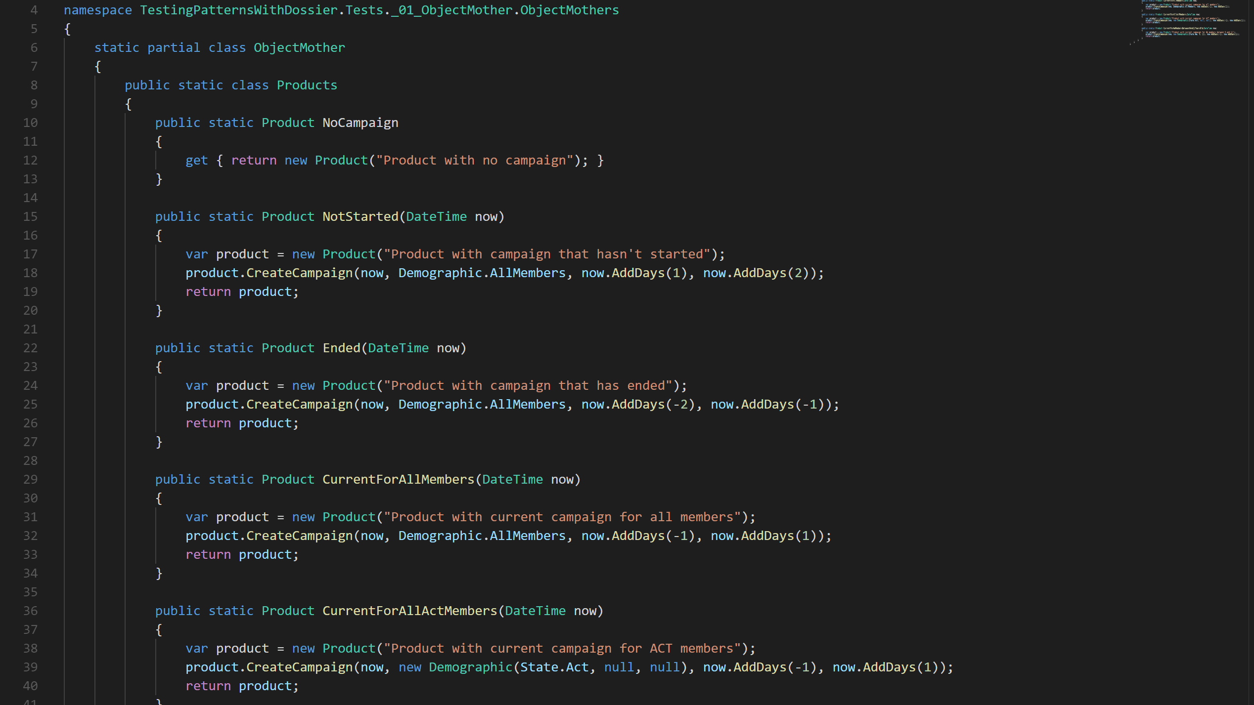
ObjectMother pattern
Reduced ctor calls
Important values named
Consistency
Still lots of ctor calls
Loooong names
God objects (complex)
Data-driven tests harder

Slide 8
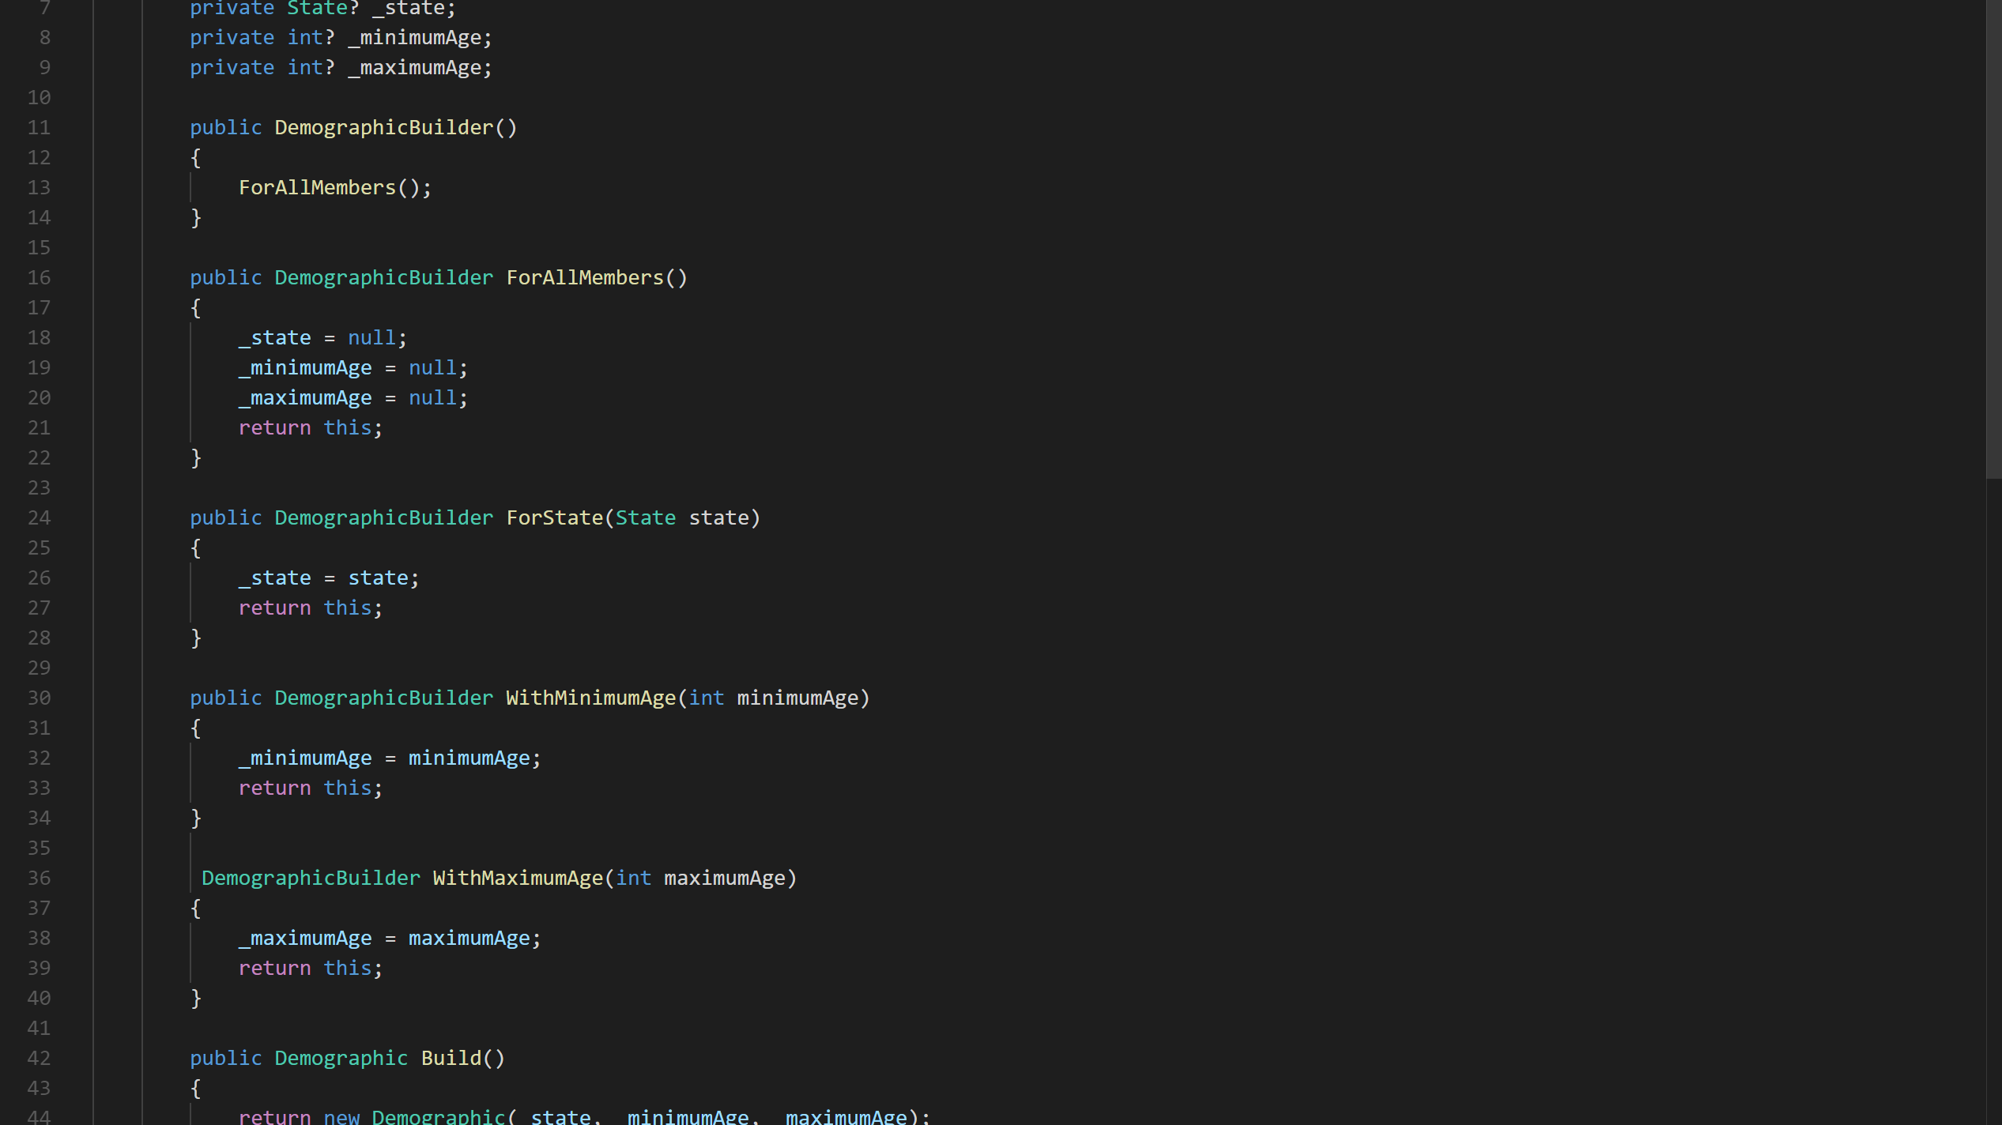
TestDataBuilder pattern
Only 1 ctor call ☺
Remove data noise
Non-ctor actions
Expressive (doco)
Noise/verbosity
Repetition across tests
Infrastructure code

Slide 9
TestDataBuilderMother pattern
Consistent
Only 1 ctor call ☺
Remove data noise
Non-ctor actions
Expressive (doco)
No repetition
No god objects
More infrastructure code

Slide 10
Data generation reuse
These techniques are not just useful for unit tests.
In reality you can also use it for:
Integration tests
Automated UI tests
Seeding for manual tests
It’s the same single infrastructure code for all of them and is maintained without extra

Slide 11
Test structure

Slide 12
Test structure
The way tests are structured helps highlight or de-emphasise the data
This affects readability of the tests and helps or hinders clarity of intent
There are a number of patterns we can use…

Slide 13
Derived values
Showing a clear relationship between the test data and the assertions is important for readability
Proximity
Clarity of intent
Data-driven tests sometimes fulfil this
Derived values is the act of explicitly showing how the assertion is calculated
Try and avoid simply copying the implementation

Slide 14
Anonymous values
Some values are not important to the test
Explicit values gives false importance
Instead, identify as an anonymous value

Slide 15
Equivalence classes
Specify an equivalence class for anonymous values to increase readability
This also helps with the goal of tests as documentation
It also allows us to make use of constrained non-determinism

Slide 16
Thankyou!
Rob Moore / @robdmoore

