Slide 1
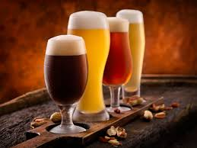
Where to Open a Brewery
ROB, SINA, LUIS

Slide 2
Objectives
With our analysis of both csv files pertaining to the beers and brewery data, our hope was to better understand a few major variables.
- Most brewed Beer Styles
Cities with Most breweries
Alcohol content compared to style
Alcohol content compared to state
Number of breweries in each state
Alcohol content probability
Understanding the results of these questions would best help us formulate a reasonable answer backed by statistics.

Slide 3
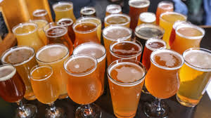
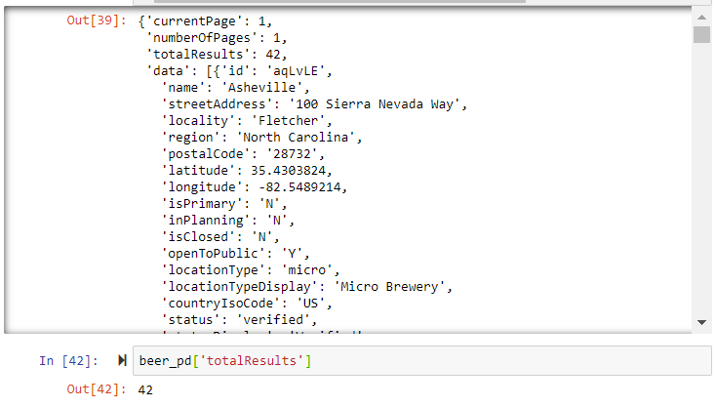
Gathering Data
Searching for API’s
Open Beer Database
Beer Spot
Brewery DB
Brewery DB required payment
Only offers a sample database

Slide 4
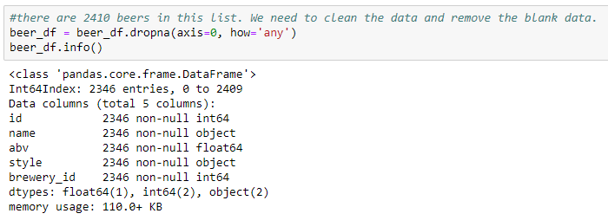
Gathering Data
Found data at keggle.com
2,410 beers
588 breweries
After clean-up
2,346

Slide 5
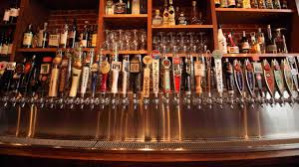
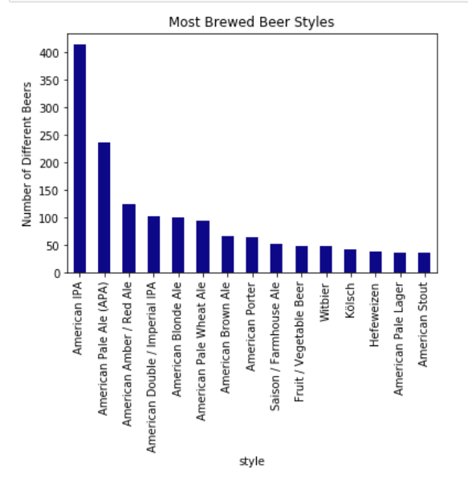
Most Brewed Beer Styles

Slide 6
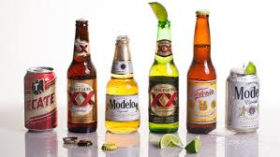
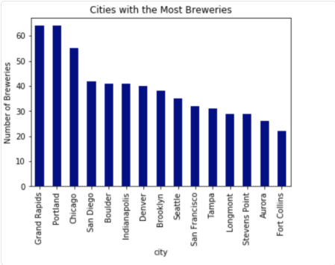
Cities With Most Breweries

Slide 7
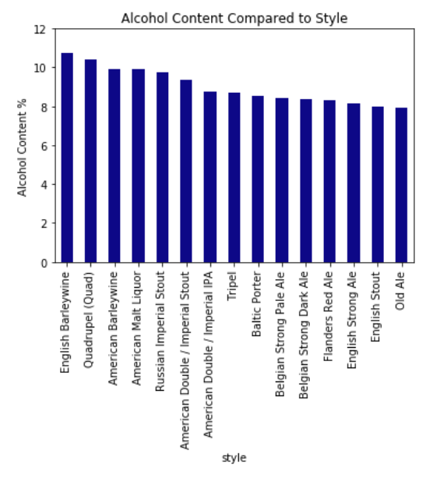
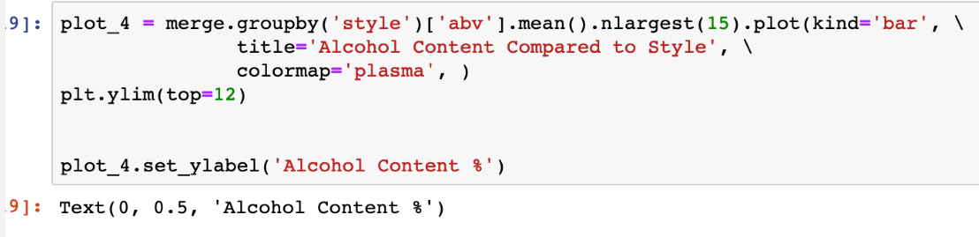

Slide 8
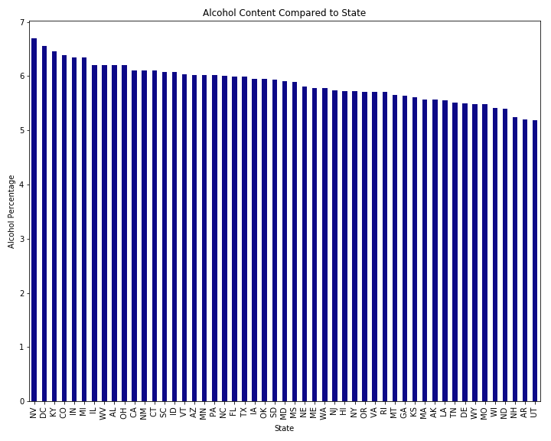
Average Alcohol Content by State

Slide 9

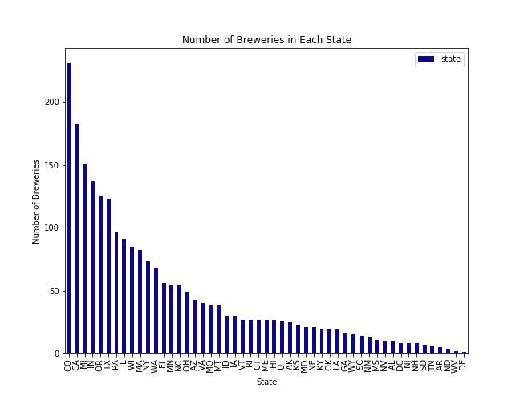

Slide 10
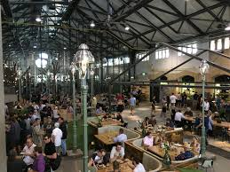
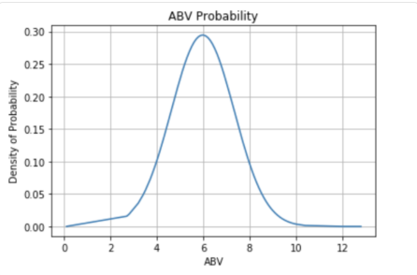
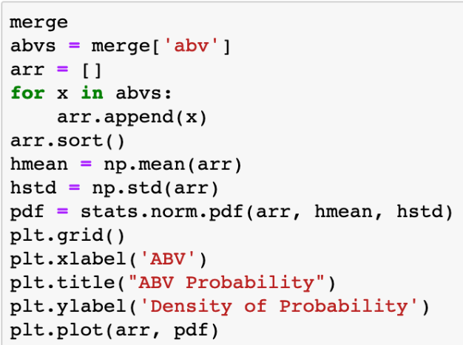

Slide 11
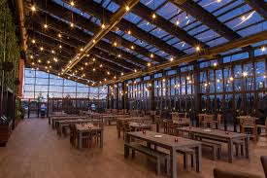
Summary of Findings
Top 5 sates for number of breweries
Colorado, California, Michigan, Indiana, and Oregon
Top 5 Beer Styles
American IPA, American Pale Ale, American Amber, American Blonde, American Pale wheat Ale
Top 5 cities with most breweries
Grand Rapids, Portland, Chi-Town, San Diego, Boulder
Average alcohol content is about 6%

Slide 12
Conclusion
We would open our brewery in San Diego, CA where we would brew the 3 most popular beers, and then 2 less popular to differentiate ourselves from competition. The list offers beers with both high and lower alcohol content, providing an additional layer of variety.
Most popular: IPAs, APAs, Ambers
Less popular: Hefeweizens and Stouts
San Diego has an established brewing industry and with about 40 breweries, we do not think that the market there is saturated.
Having an established brewing industry:
Supply of materials would not be an issue
Hops, barley, yeast, hardware, etc…
Local community of beer enthusiasts
Established annual festivals that are well-attended.

Slide 13

THE END
https://youtu.be/gql9220Qon8

Slide 14
