Slide 1

Software Requirement Specification for Trucking Company Management System CS 425 Software Engineering August 2020 Robel Tecleyesus 110467

Slide 2

Title and Content Layout
Vision Document
Introduction
Problem Statement
Software Requirements Specification
Use Case Model
System Architecture Analysis
System Architecture Analysis Diagram
Key Abstractions
Use Case Analysis
Sequence Diagram
Class Diagram
E-R Diagram

Slide 3

1. Vision Document
Contents
Introduction
Problem Statement

Slide 4
Introduction
Trucking companies are the ones that physically take goods from one place to another on behalf of a shipper.
Usually the Company owner manage the company by him/herself via a manual process.
All the tasks like hiring a driver, viewing available shipments, listing available trucks, payments, filling up and sending/emailing documents, advertising were done by a single person.
Company growth/expansion is leading the company to request for an automated system to run their business.
things like employee management, maintenance, and payments are becoming out of control and it is requiring hiring more office workers to handle the job for you. And increasing number of employees is causing the company to spend more money.
Some task to be handled to search available loads from Brokers website and post it as available loads for their own drivers.
To hire drivers, approve drivers and give access to the website
To let new drivers to apply for job opening and sign contract prior to start working.
To Maintain budgets and optimize expenses

Slide 5
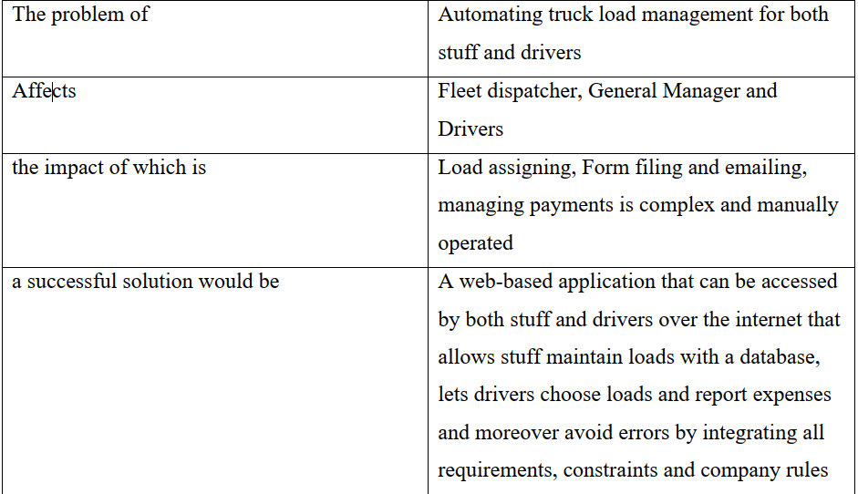
Problem Statement

Slide 6

2. Software Requirements Specification
Content
Use Case Model
Use Case Diagram

Slide 7
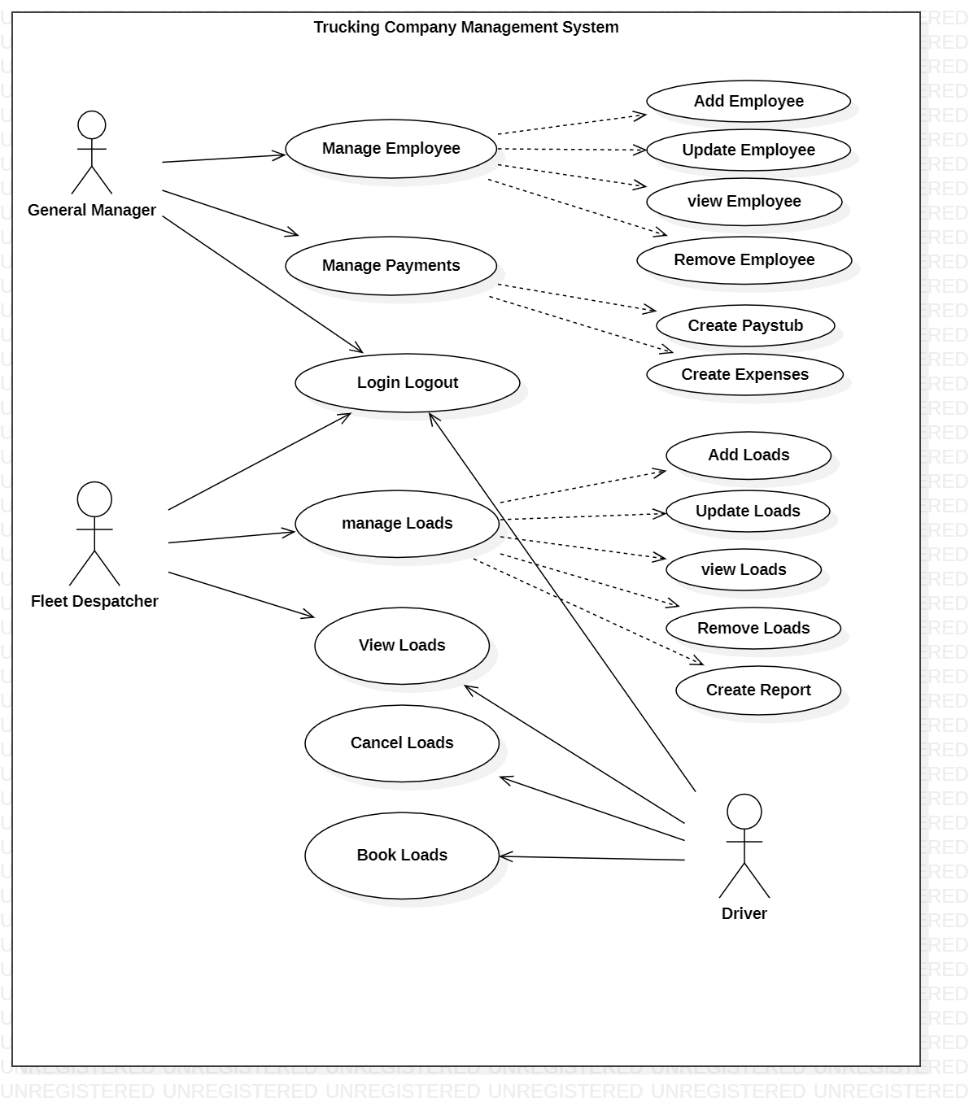
First Use Case Diagram

Slide 8
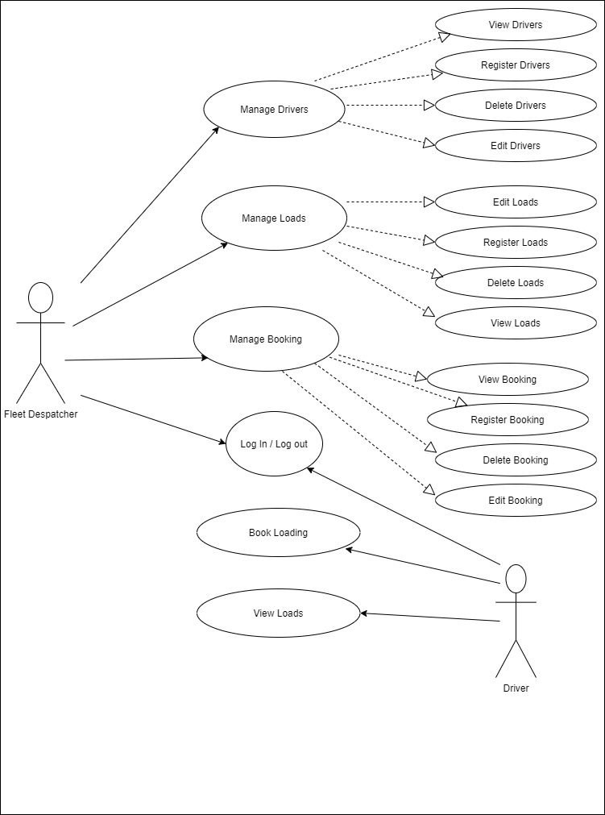
Updated Use Case Diagram

Slide 9
3. System Architecture Analysis
Content
System Architecture Analysis Diagram
Key Abstractions

Slide 10
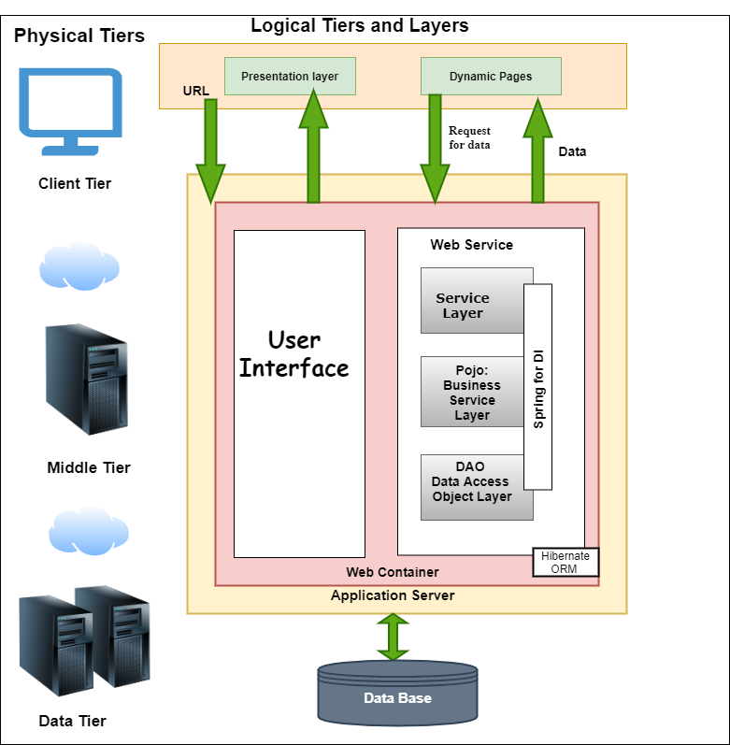
System Architecture Analysis Diagram

Slide 11
Key Abstractions
Vehicle
Driver
Staff
Loads
Paystub
Expenses
Booking
Classification

Slide 12
4. Use Case Analysis
Content
Sequence Diagram
Register a Load : Use Case Sequence Diagram
Cancel booked Loads :Use Case Sequence Diagram

Slide 13
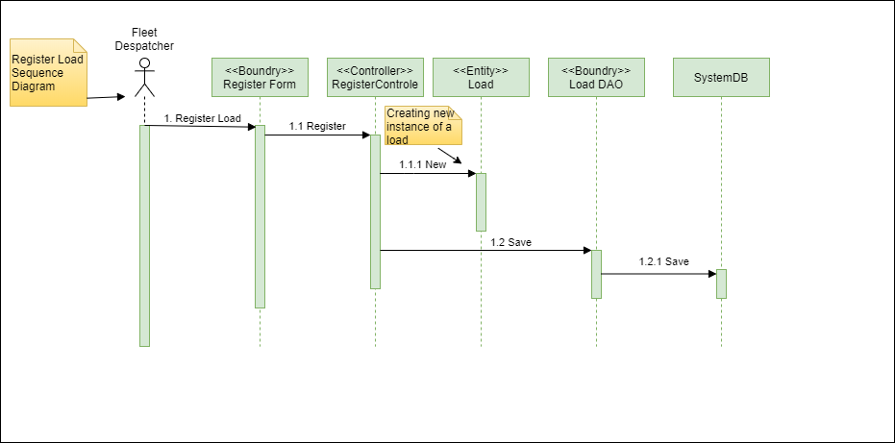
Register a Load: Use Case Sequence Diagram

Slide 14
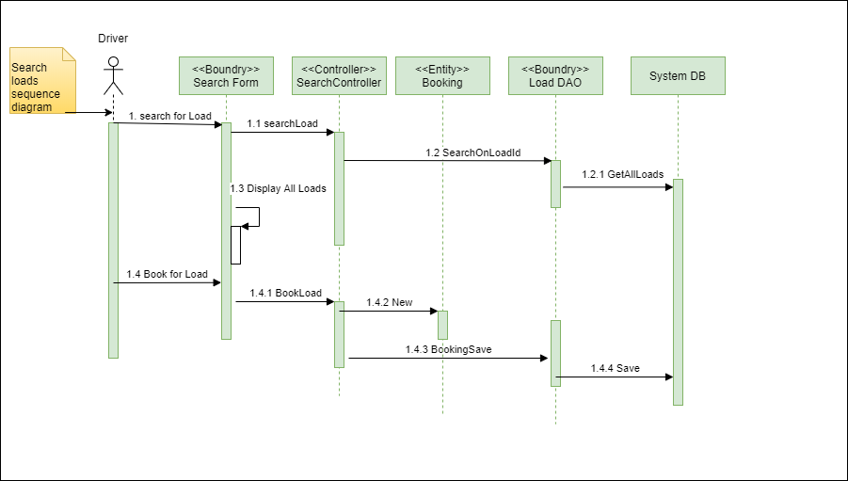
Search Loads: Use Case Sequence Diagram

Slide 15
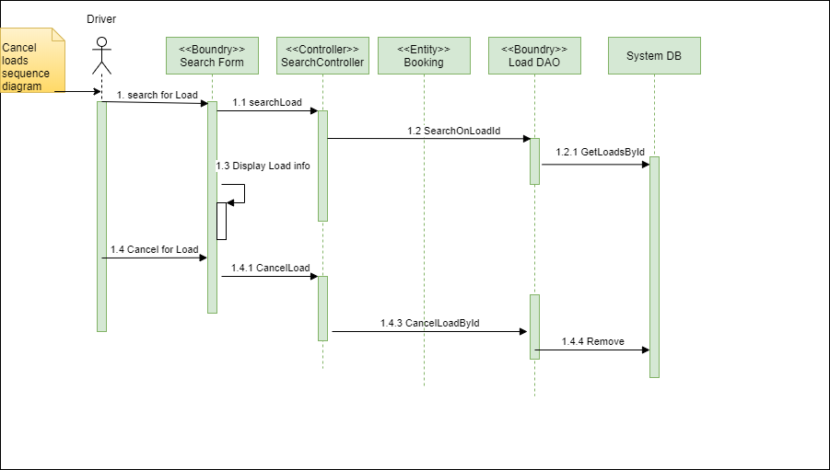
Cancel Load: Use Case Sequence Diagram

Slide 16
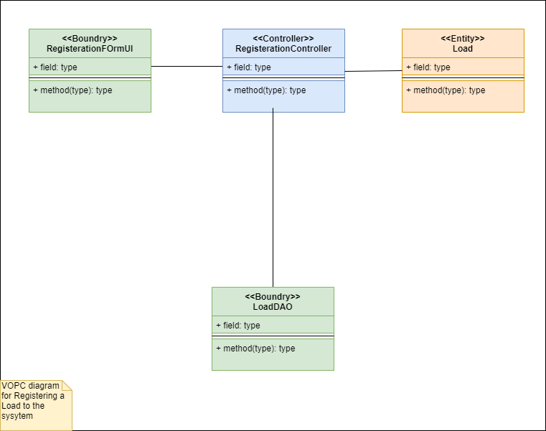
VOPC Diagram

Slide 17
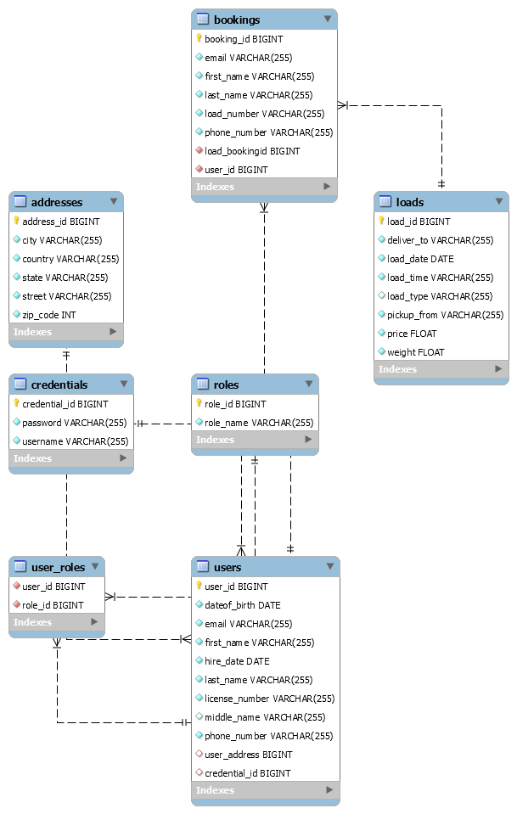
ER Diagram

Slide 18
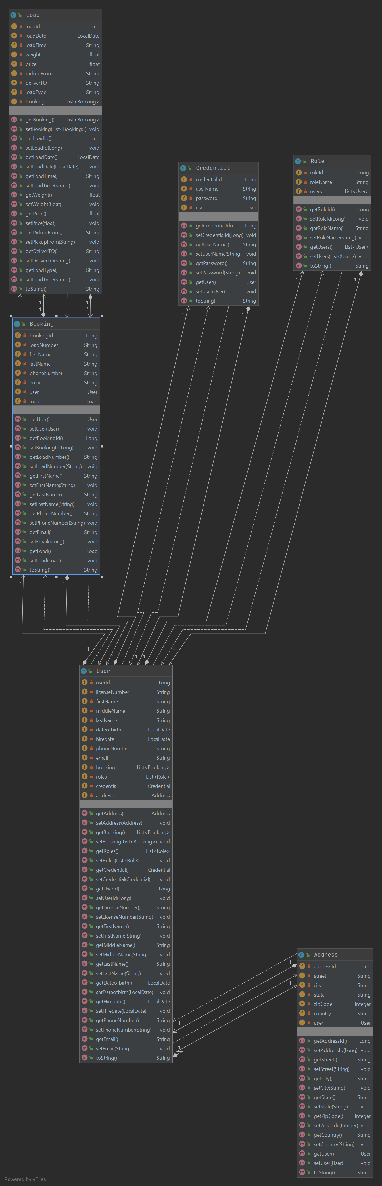
Static Model: Main Class Diagram

Slide 19

Thank You

