Slide 1
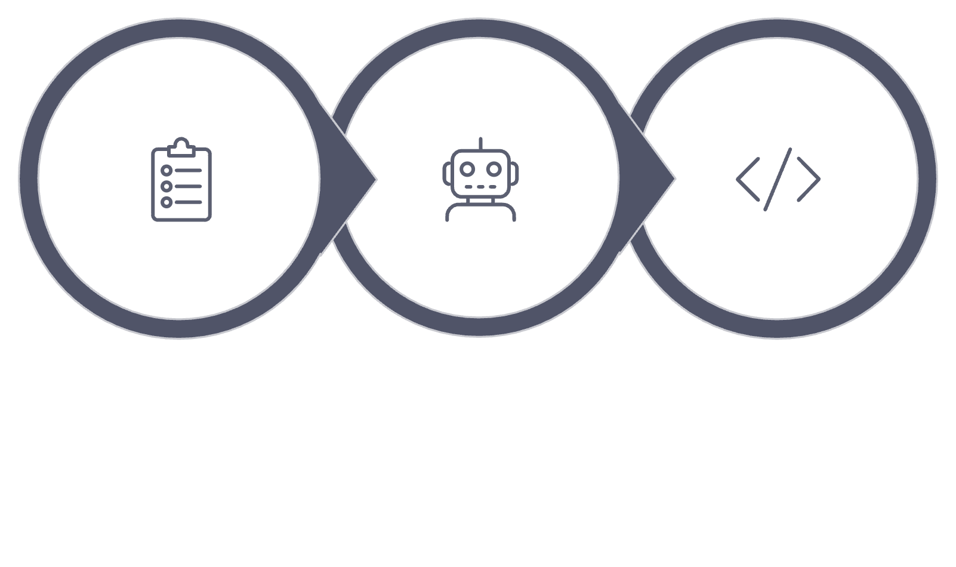
AI-Based Code Development Automation Using
Test-Driven Development
Tests & Spec
AI Agent
Code
Presented by: Michael Obeid · Rober Saliba
Project: 26-2-D-3
Supervisors: Dr. Katerina Korenblat · Dr. Dan Lemberg
Advisors: Dr. Elena Ravve · Dr. Elena Kleiman
1

Slide 2
What We Are Going to Do
Design and implement an IDE for automated TDD development.
Investigate AI-driven TDD - Investigate whether AI can generate and maintain source code inside using TDD approach.
Structured Inputs - Use a specification file, ordered unit tests, an empty project or previous existing code as input.
Incremental & Controlled - Guide the AI to make only the minimal changes needed for the current TDD step.
Protect Previous Work - Preserve previous functionality and prevent unnecessary full rewrites.
2

Slide 3

Why TDD and AI?
Artificial Intelligence
Test-Driven Development
Generates source code quickly
Analyzes existing projects
Supports debugging
Modify multiple files
Defines expected behavior before implementation
Validates each step automatically
Requires incremental development
Protects against regression errors
Core idea: Use TDD to guide reliable, incremental AI code generation.
3
Notes:
In our project 2 main things, using AI and TDD (introduction point)

Slide 4
Why Is This Not Trivial?
• Tests provide examples, but do not fully explain the
intended logic, structure, or edge cases.
• The AI must “understand” the specification, previous tests, current source code, and project history.
• LLMs often rewrite entire files instead of changing only the necessary code.
• Every update must pass the new test without
breaking previous tests.
4

Slide 5
Project Objectives
Determine correct Input
Achieve Code Consistency
Compare AI-driven TDD with manual development
Automate the TDD Lifecycle
Goal: Study when AI can safely maintain code — not just generate it once.
5

Slide 6
Algorithmic Challenges & Solutions
Eliminate Full-file rewriting
Eliminate Breaking previous behavior
Pass current source code every iteration
Run the full test suite after every update
Eliminate Unsupported functionality
Eliminate Loss of long-term context
Use an immutable specification file
Save changes and session history
6
Notes:
ONE BELOW ANOTHER

Slide 7
Implementation Challenges & Solutions
⚠ Missing Java, Maven, or Gradle
✓ Solution: Detect build environment and install required tools
⚠ Changes may affect multiple source files
✓ Solution: Synchronize updates across related files and classes
⚠ The generated code could fail to compile or not terminate
✓ Solution: Use isolated execution with timeouts
⚠ External API usage and rate limits
✓ Solution: Preserve session state and allow retry
7

Slide 8
Choosing a Tool for the Demo
We evaluated existing tools that could demonstrate our AI-driven TDD approach.
Standard LLMs
GitHub Copilot Workspace
Diffblue Cover
Generate code from prompts but lack TDD approach control and persistent workspace awareness.
Uses codebase context and natural language to plan changes — but not TDD approach.
Generates unit tests from Java source — the reverse of our approach.
Aider ✓ Selected
Reads existing code and test errors, then applies incremental modifications — matches our workflow.
8
Notes:
Add an introduction sentence.

Slide 9
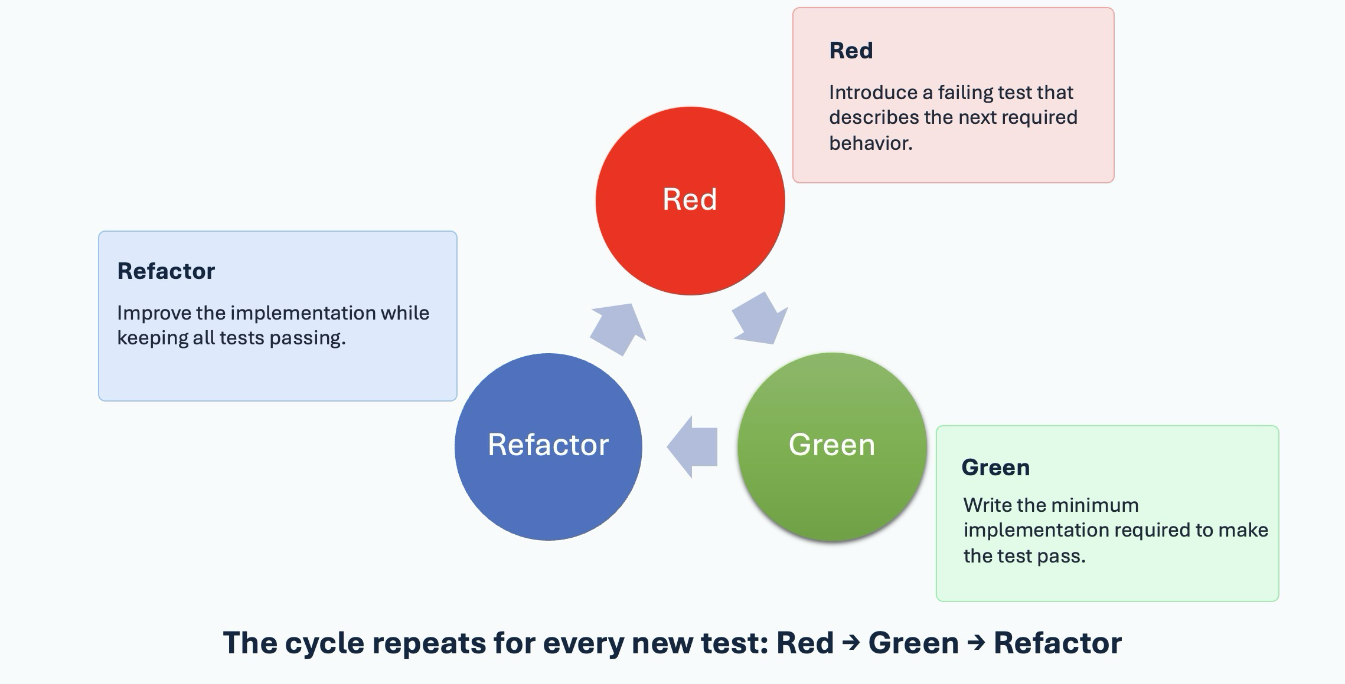
Test-Driven Development
9
Notes:
Add an introduction sentence. For every new “req” -> test

Slide 10
System Inputs and Outputs
Inputs
Output: Proposed Incremental Code Update
Immutable Specification
Ordered sequence of unit tests
✅ Passes the current test
✅ Preserves all previous tests
Existing or empty Java project
Current source code
✅ Respects the specification
✅ Avoids unnecessary rewrites
Compiler and test feedback
11

Slide 11
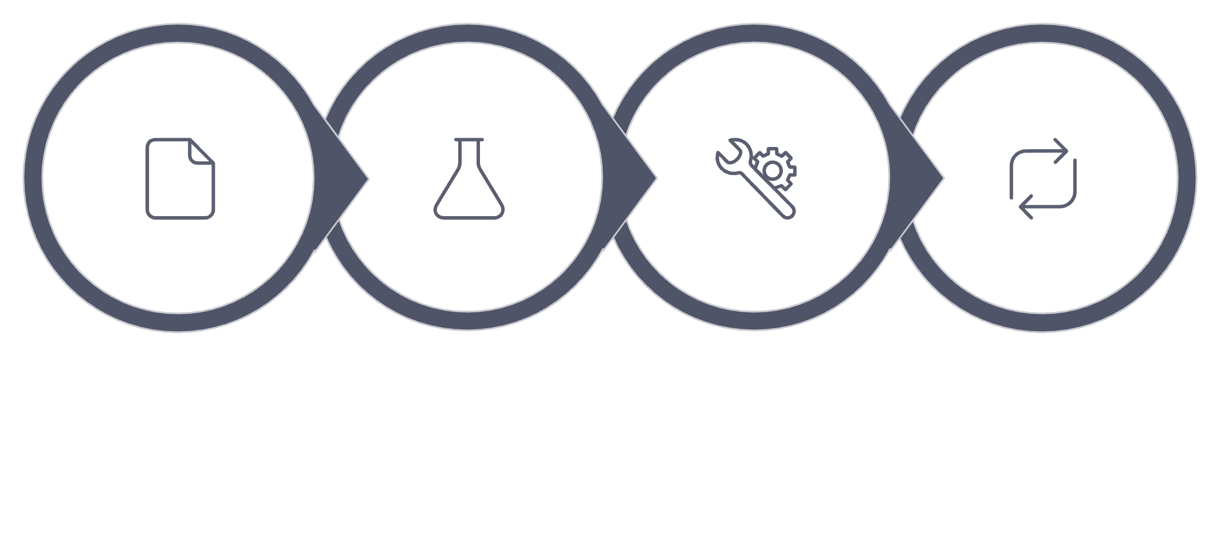
Our Approach: Sequential AI-Driven TDD
Step 0
Step 1
Step 2
Step i
Step 0 — Base Case
Step i — Iteration
Input: Test Case 0, Specification.txt, empty source file.
Output: Code 0.
Input: previous tests, new Test i, immutable spec, Code i−1.
Output: incrementally updated Code i.
10

Slide 12
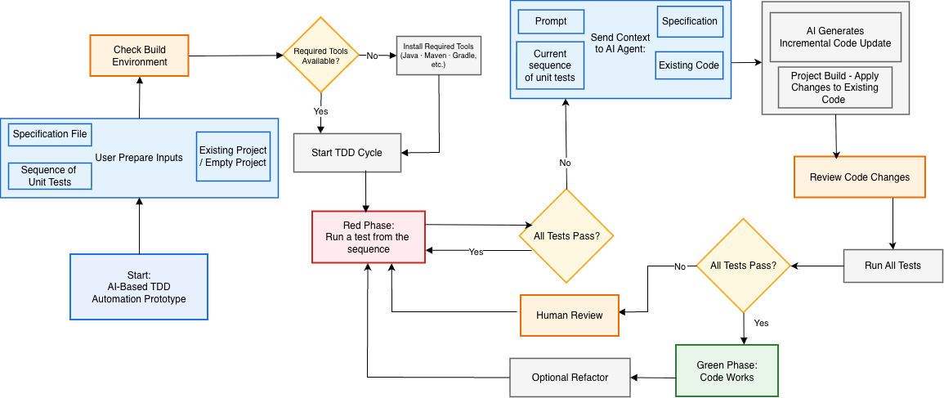
System Workflow Flowchart
12

Slide 13
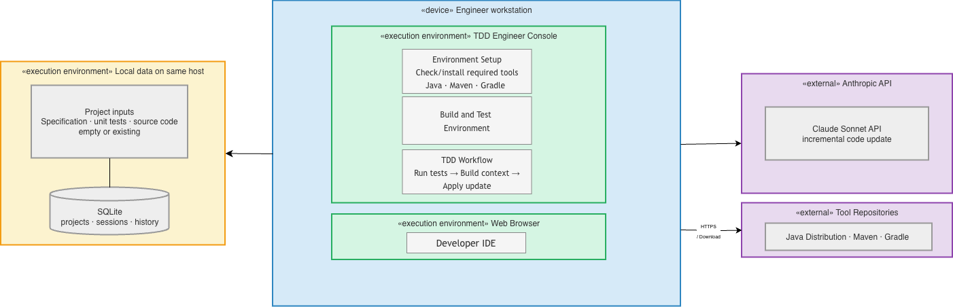
Deployment Diagram
13

Slide 14
Experimental Setup
Domain
Dev Environment
Project Files
Real Java Project
Java · Maven · JUnit Jupiter · Git & GitHub
Specification.txt · SourceFiles · TestFiles · Changes.md
AI Configurations
TDD Principle
Aider + OpenAI o3-mini
Aider + Claude Sonnet
Each new test drives the next incremental implementation step.
15
Notes:
An introduction sentence

Slide 15
Key Findings & Evaluation Criteria
Key Findings
Evaluation Criteria
Model choice strongly affects performance
Does the new test pass?
Do all previous tests still pass?
Incremental editing is achievable
What percentage of code changed?
Was unrelated code preserved?
Human-written changes can be preserved
Was the specification respected?
Surgical edit or full rewrite?
AI may anticipate future functionality
Passing tests does not guarantee good design
17

Slide 16
Limitations & Future Work
Current Limitations
Future Work
Results depend heavily on the selected model
AI may anticipate future functionality
Test more complex Java projects
Evaluate API and database scenarios
Passing tests do not guarantee good architecture
Large repositories may exceed context limits
Compare multiple LLMs systematically
Measure rewrite percentages automatically
External APIs introduce latency, cost, and rate limits
Compare AI-driven TDD with manual development
Build a dedicated IDE
18

Slide 17

Conclusion
This project investigates whether an LLM can act as a disciplined developer inside a TDD lifecycle approach.
Our approach combines
Initial experiments show
Sequential unit tests
Immutable specification
Existing source code
Compiler feedback
Incremental AI-generated changes
Human approval
Persistent history
Capable models can perform targeted updates and preserve previous behavior, but model dependency, anticipatory coding, and architectural quality remain key challenges.
Final message: the goal is not only to generate code, but to make AI maintain code safely, incrementally, and transparently.
19

Slide 18
Thank You for Listening!
Questions & Discussion
Can AI become a reliable participant in the Test-Driven Development lifecycle?
20

Slide 19
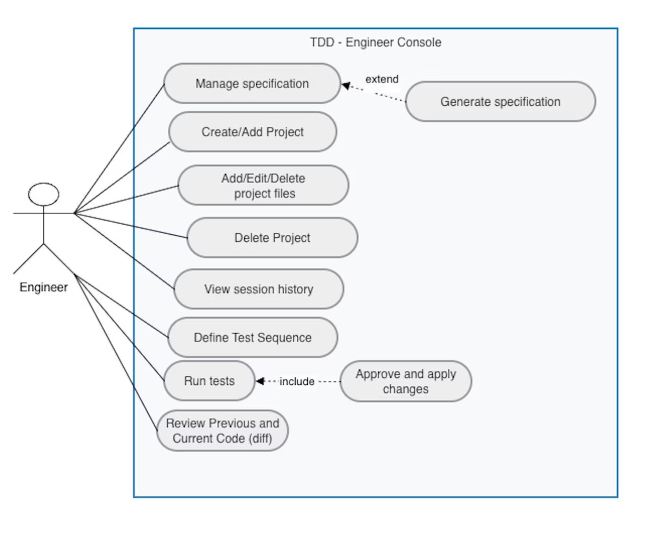
Use Case Diagram
14

