Slide 1
FrameBlock

Slide 2
¿La Misión FrameBlock?
“Nuestra misión es definir, implementar y poner a disposición un framework que simplifique los puntos críticos de tu idea de negocio.”
Agnostic Blockchain Path
Simplified blockchain
Siguiendo el camino de la descentralización sin restriccionesa.
"Simplificamos lo complicado: fácil para ti, eficiente para todos.”
Notes:
Como marco de trabajo en blockchain, FrameBlock define, implementa y pone a disposición un "Agnostic Blockchain Path" que simplifica el uso de tu aplicación.

Slide 3
Agnostic Blockchain Path
Con el objetivo de lograr esto, hemos creado Agnostic Blockchain Path, un framework que permite a tu aplicación integrarse con módulos de Onboarding utilizando redes sociales y de pago utilizando tarjetas de crédito.
¿Cómo lo conseguimos?
Agnostic Blockchain Path
Social Network
By Card
APP
Wallet
By Cripto
Blockchain Path
ONBOARDING
PAYMENT
Notes:
Para lograrlo, FrameBlock define el "Agnostic Blockchain Path", un marco de trabajo que permite a tu aplicación integrarse con los módulos de Onboarding mediante redes sociales y pagos a través de tarjetas..

Slide 4
Smart Contract Wallets
Los "smart contract wallets" son billeteras para criptomonedas que se implementan como "smart contracts" en una blockchain.
Mutiple Keys: Los "smart contract wallets" permiten la utilización de múltiples claves privadas para compartir el acceso de forma segura.
Key Rotation: Además de permitir múltiples claves, permiten la rotación de las mismas. Esto significa que se pueden cambiar las claves de forma regular para aumentar la seguridad y prevenir ataques malintencionados.
Pay fees using ERC20 Tokens: permiten pagar tarifas de transacción con tokens almacenados en la billetera.
Upgradeability: son actualizables para mejorar su funcionalidad y seguridad con el tiempo.
Social recovery support: permiten recuperación social en caso de pérdida de acceso.
Meta-transactions: son transacciones que no requieren que el usuario que las inicia pague la tarifa de transacción.
More flexible design space: ofrecen un diseño más flexible en comparación con las billeteras tradicionales. Debido a que se implementan como "smart contracts", los desarrolladores tienen una mayor libertad para crear billeteras con funcionalidades personalizadas y adaptadas a necesidades específicas.
https://docs.sequence.xyz/wallet/wallet-contracts/why/

Slide 5
Card Payments
¿Cómo lo conseguimos?
Desplegamos un contrato en una red testnet para estimar el gasto de gas.
Precio se calcula multiplicando la cantidad de gas necesaria por el valor de la criptomoneda correspondiente (por ejemplo, 1500 para Ether, 300 para BNB, 1.30 para Matic ).
https://stripe.com/es como pasarela de pago.

Slide 6

DEPLOYMENT DIAGRAM

Slide 7
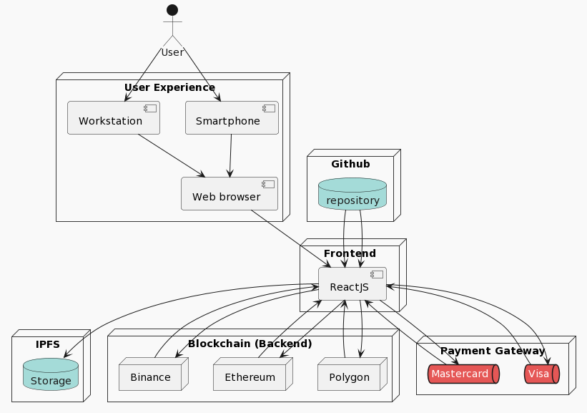
DEPLOYMENT DIAGRAM

Slide 8
HOW TO DEPLOYMENT DIAGRAM DRAWING?
@startuml
!theme mars
actor User
node "User Experience" {
component "Smartphone" as smartphone
component "Workstation" as workstation
component "Web browser" as web
}
node "Frontend" {
component "ReactJS" as reactjs
}
node "Github" {
database "repository" as repository
}
node "IPFS" {
database "Storage" as ipfs
}
node "Blockchain (Backend)" {
node "Polygon" as polygon
node "Ethereum" as ethereum
node "Binance" as binance
}
node "Payment Gateway" {
queue "Visa" as visa
queue "Mastercard" as mastercard
}
User --> smartphone
User --> workstation
smartphone --> web
workstation--> web
web --> reactjs
repository --> reactjs
reactjs --> ipfs
repository --> reactjs
reactjs --> polygon
polygon --> reactjs
reactjs--> ethereum
ethereum --> reactjs
reactjs --> binance
binance --> reactjs
reactjs --> visa
visa --> reactjs
reactjs --> mastercard
mastercard --> reactjs
@enduml
We have used PlantUML an opensource tool http://www.plantuml.com

Slide 9

UML SECUENCE

Slide 10
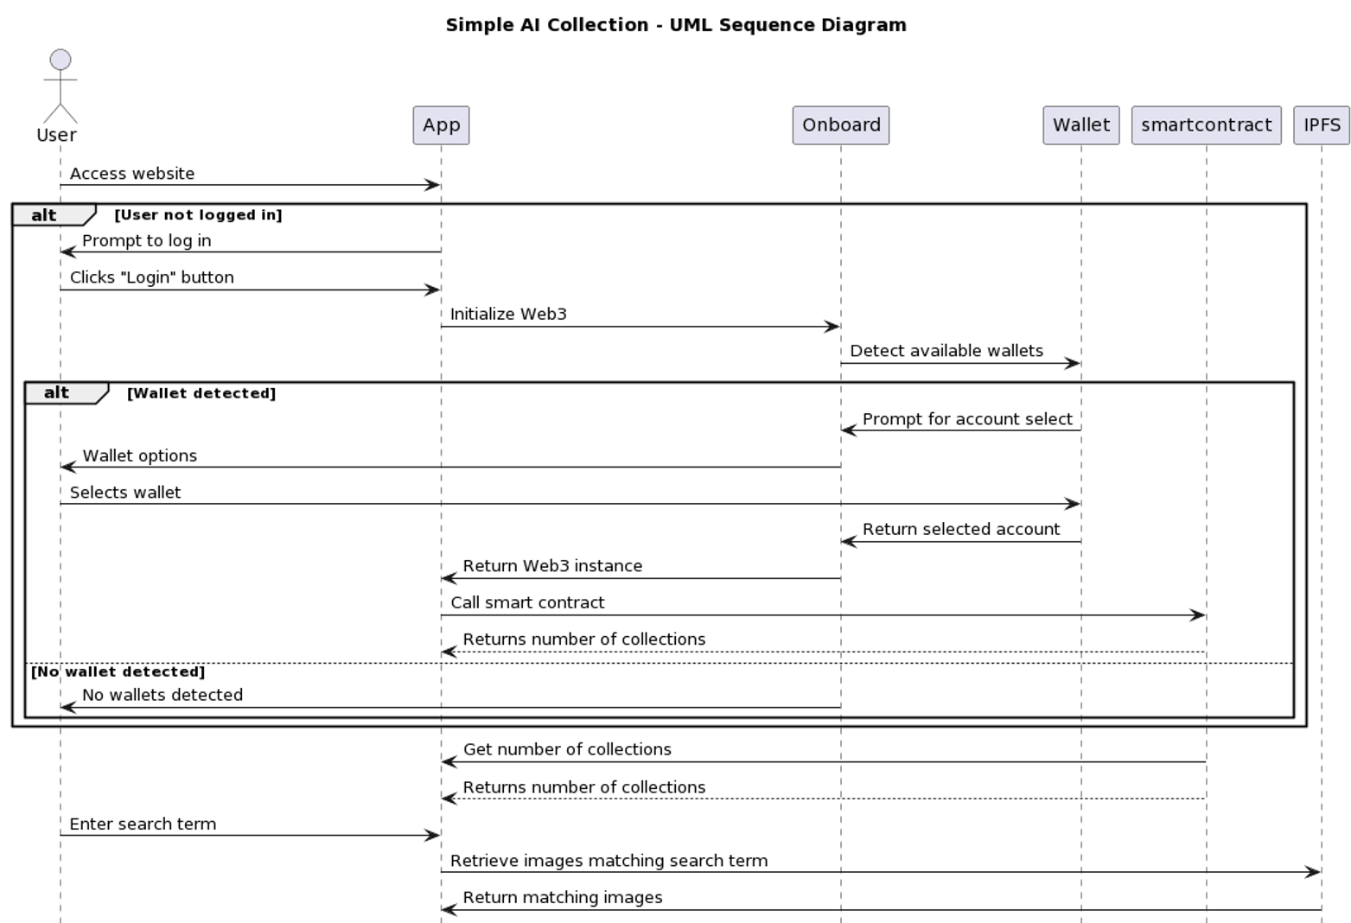
UML SECUENCE 01 02 03

Slide 11
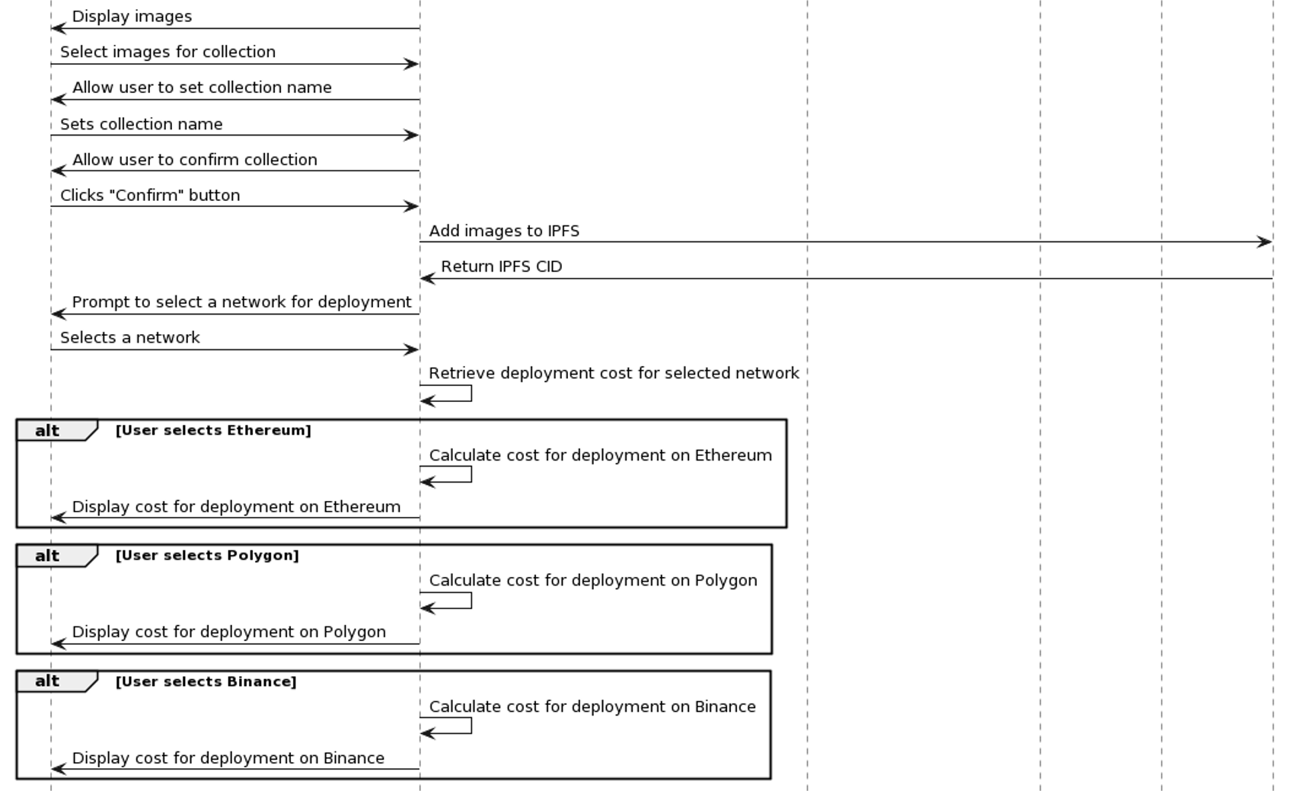
UML SECUENCE 01 02 03

Slide 12
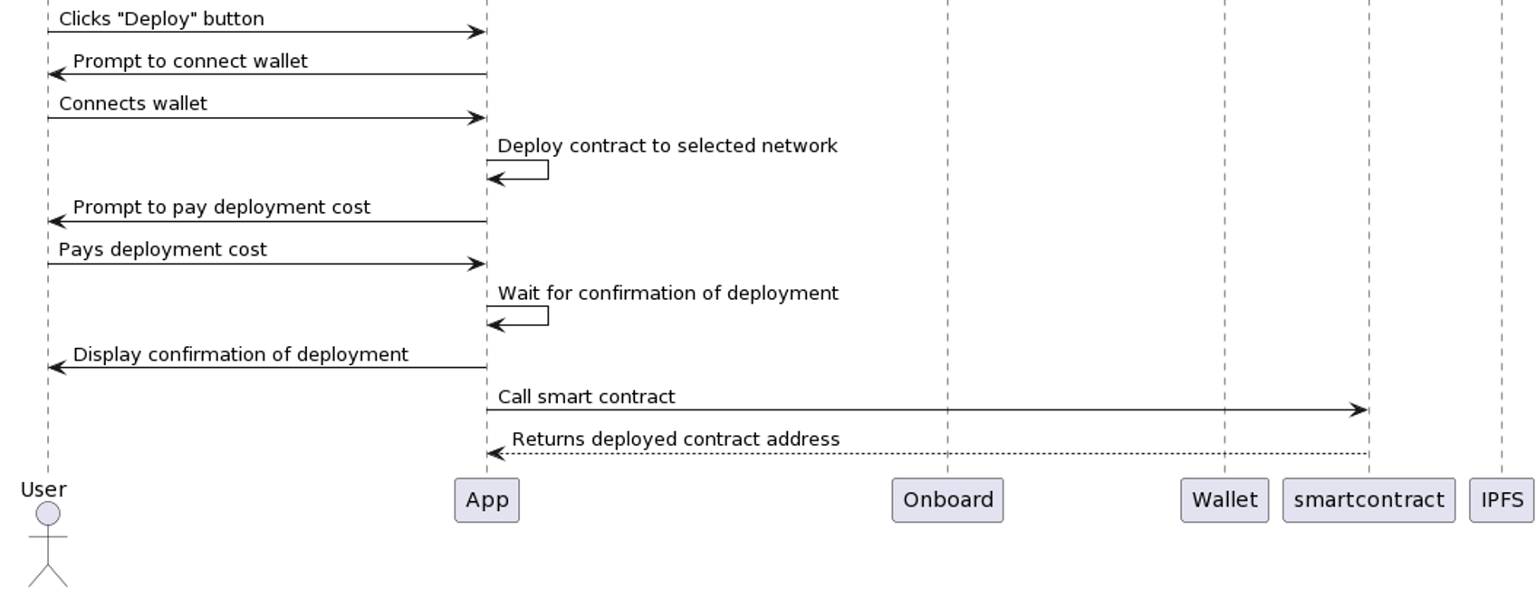
UML SECUENCE 01 02 03

Slide 13
HOW TO CREATE AN UML DRAWING?
@startuml
title Simple AI Collection - UML Sequence Diagram
actor User
User -> App: Access website
alt User not logged in
App -> User: Prompt to log in
User -> App: Clicks "Login" button
App -> Onboard: Initialize Web3
Onboard -> Wallet: Detect available wallets
alt Wallet detected
Wallet -> Onboard: Prompt for account select
Onboard -> User: Wallet options
User -> Wallet: Selects wallet
Wallet -> Onboard: Return selected account
Onboard -> App: Return Web3 instance
App -> smartcontract: Call smart contract
smartcontract --> App: Returns number of collections
else No wallet detected
Onboard -> User: No wallets detected
end
end
smartcontract -> App: Get number of collections
smartcontract --> App: Returns number of collections
User -> App: Enter search term
App -> IPFS: Retrieve images matching search term
IPFS -> App: Return matching images
App -> User: Display images
User -> App: Select images for collection
App -> User: Allow user to set collection name
User -> App: Sets collection name
App -> User: Allow user to confirm collection
User -> App: Clicks "Confirm" button
App -> IPFS: Add images to IPFS
IPFS -> App: Return IPFS CID
App -> User: Prompt to select a network for deployment
User -> App: Selects a network
App -> App: Retrieve deployment cost for selected network
alt User selects Ethereum
App -> App: Calculate cost for deployment on Ethereum
App -> User: Display cost for deployment on Ethereum
end
alt User selects Polygon
App -> App: Calculate cost for deployment on Polygon
App -> User: Display cost for deployment on Polygon
end
alt User selects Binance
App -> App: Calculate cost for deployment on Binance
App -> User: Display cost for deployment on Binance
end
User -> App: Clicks "Deploy" button
App -> User: Prompt to connect wallet
User -> App: Connects wallet
App -> App: Deploy contract to selected network
App -> User: Prompt to pay deployment cost
User -> App: Pays deployment cost
App -> App: Wait for confirmation of deployment
App -> User: Display confirmation of deployment
App -> smartcontract: Call smart contract
smartcontract --> App: Returns deployed contract address
@enduml
We have used PlantUML an opensource tool http://www.plantuml.com

Slide 14

SMART CONTRACT

Slide 15
SMART CONTRACT (Collection.sol)
// SPDX-License-Identifier: MIT
// Specifies the license under which the contract is published.
pragma solidity ^0.8.0;
// Import the Ownable contract from OpenZeppelin.
import "https://github.com/OpenZeppelin/openzeppelin-solidity/contracts/access/Ownable.sol";
contract MapStore is Ownable {
// Define a struct to hold user data.
struct UserData {
string name;
address collection;
string network;
string paymentId;
string date;
string transactionId;
}
// A mapping from addresses to arrays of UserData structs.
mapping (address => UserData[]) public storedValues;
// A mapping from addresses to the number of times they've been updated.
mapping (address => uint) public updateCounts;
// A function to add a new UserData struct to the storedValues mapping.
function addValue(address key, string memory name, address collection, string memory network, string memory paymentId, string memory date, string memory transactionId) public {
// Only the contract owner can add values.
require(msg.sender == owner(), "Only the contract owner can add values.");
// Add the new struct to the array and increment the update count.
storedValues[key].push(UserData(name, collection, network, paymentId, date, transactionId));
updateCounts[key]++;
}
// A function to get an array of UserData structs for a given address.
function get(address key) public view returns (string[] memory, address[] memory, string[] memory, string[] memory, string[] memory) {
uint count = updateCounts[key];
string[] memory names = new string[](count);
address[] memory collections = new address[](count);
string[] memory networks = new string[](count);
string[] memory paymentIds = new string[](count);
string[] memory dates = new string[](count);
// Loop through the storedValues array and extract the relevant fields.
for (uint i = 0; i < count; i++) {
UserData memory data = storedValues[key][i];
names[i] = data.name;
collections[i] = data.collection;
networks[i] = data.network;
paymentIds[i] = data.paymentId;
dates[i] = data.date;
}
// Return the arrays of fields.
return (names, collections, networks, paymentIds, dates);
}
}

Slide 16
SMART CONTRACT (CollectionAirdrop.sol)
// SPDX-License-Identifier: MIT
// Specifies the license under which the contract is published.
pragma solidity ^0.8.9;
import "@openzeppelin/contracts/token/ERC721/ERC721.sol";
import "@openzeppelin/contracts/access/Ownable.sol";
import "@openzeppelin/contracts/token/ERC721/extensions/ERC721Enumerable.sol";
contract CollectionAirdrop is ERC721, ERC721Enumerable, Ownable {
// Optional mapping for token URIs
// A mapping that associates token IDs with their respective URIs.
mapping(uint256 => string) private _tokenURIs;
// The base URI for the token metadata.
string public _uri;
// Constructor to initialize the contract with a name, symbol, number of tokens, base URI and recipient address.
constructor(string memory name_, string memory symbol_, uint256 num_, string memory uri_, address recipient) ERC721(name_, symbol_) {
_uri = uri_;
// To airdrop the total amount of NFTs (10 NFTs) within the constructor
for (uint i = 1; i <=num_; i++){
_safeMint(recipient, i);
}
}
// Function to return the base URI for the token metadata.
function _baseURI() internal view override returns (string memory) {
return _uri;
}
/**
* @dev See {ERC721-safeMint}.
* Mints a new token to the specified address.
*/
// Function to safely mint a new token to the specified address.
function safeMint(address to, uint256 tokenId) public onlyOwner {
_safeMint(to, tokenId);
}
/**
* @dev See {IERC721Metadata-tokenURI}.
* Returns the token URI for a given token ID.
*/
// Function to return the token URI for a given token ID.
function tokenURI(uint256 tokenId) public view virtual override returns (string memory) {
require(
_exists(tokenId),
"ERC721URIStorage: URI query for nonexistent token"
);
string memory base = _baseURI();
return string(abi.encodePacked(base,'/',Strings.toString(tokenId),'.json'));
}
// The following functions are overrides required by Solidity.
/**
* @dev See {ERC721-_beforeTokenTransfer}.
* Called before any token transfer operation.
*/
// Override function called before any token transfer operation.
function _beforeTokenTransfer(address from, address to, uint256 tokenId, uint256 batchSize)
internal
override(ERC721, ERC721Enumerable)
{
super._beforeTokenTransfer(from, to, tokenId, batchSize);
}
/**
* @dev See {ERC165-supportsInterface}.
* Checks if a given interface is supported by the contract.
*/
// Override function to check if a given interface is supported by the contract.
function supportsInterface(bytes4 interfaceId) public view override(ERC721, ERC721Enumerable) returns (bool){
return super.supportsInterface(interfaceId);
}
}

Slide 17
FrameBlock
Gracias!!!

