Slide 1
FrameBlock

Slide 2

UML SECUENCE

Slide 3
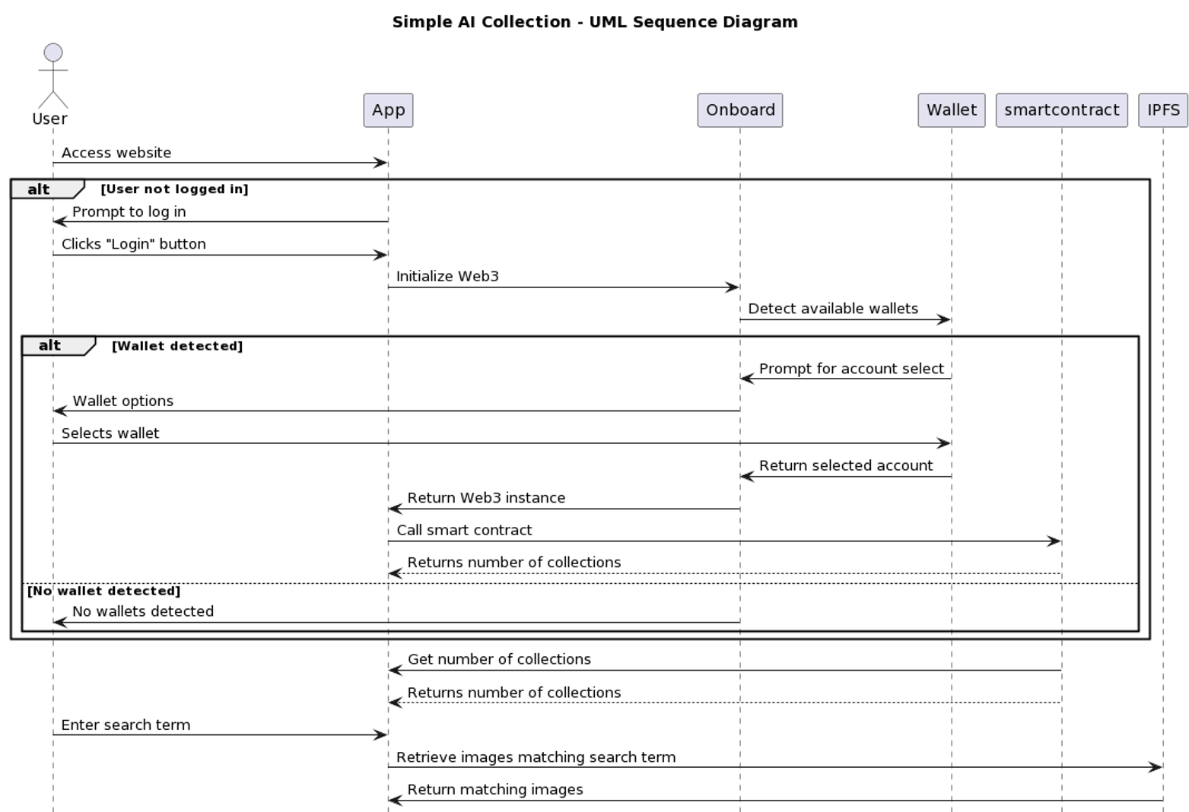
UML SECUENCE 01 02 03

Slide 4
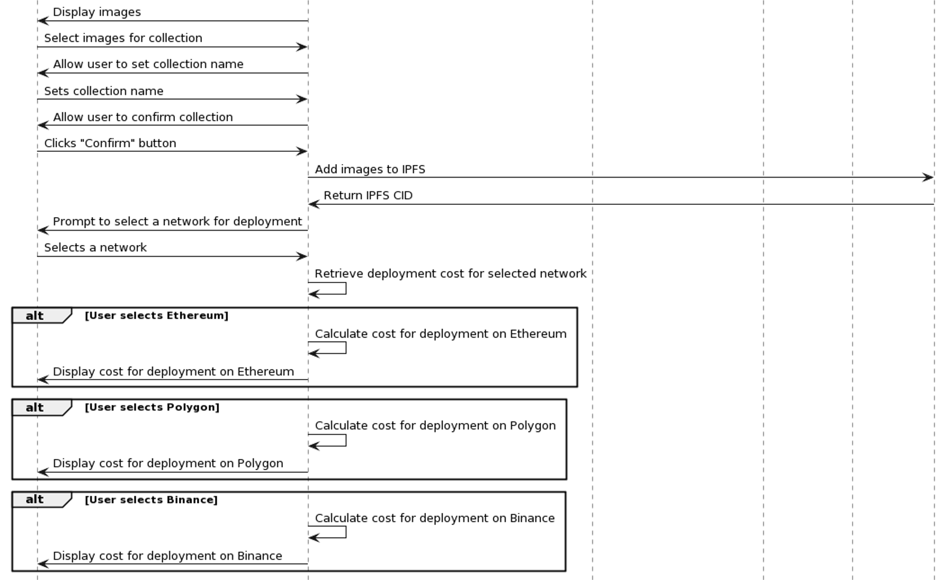
UML SECUENCE 01 02 03

Slide 5
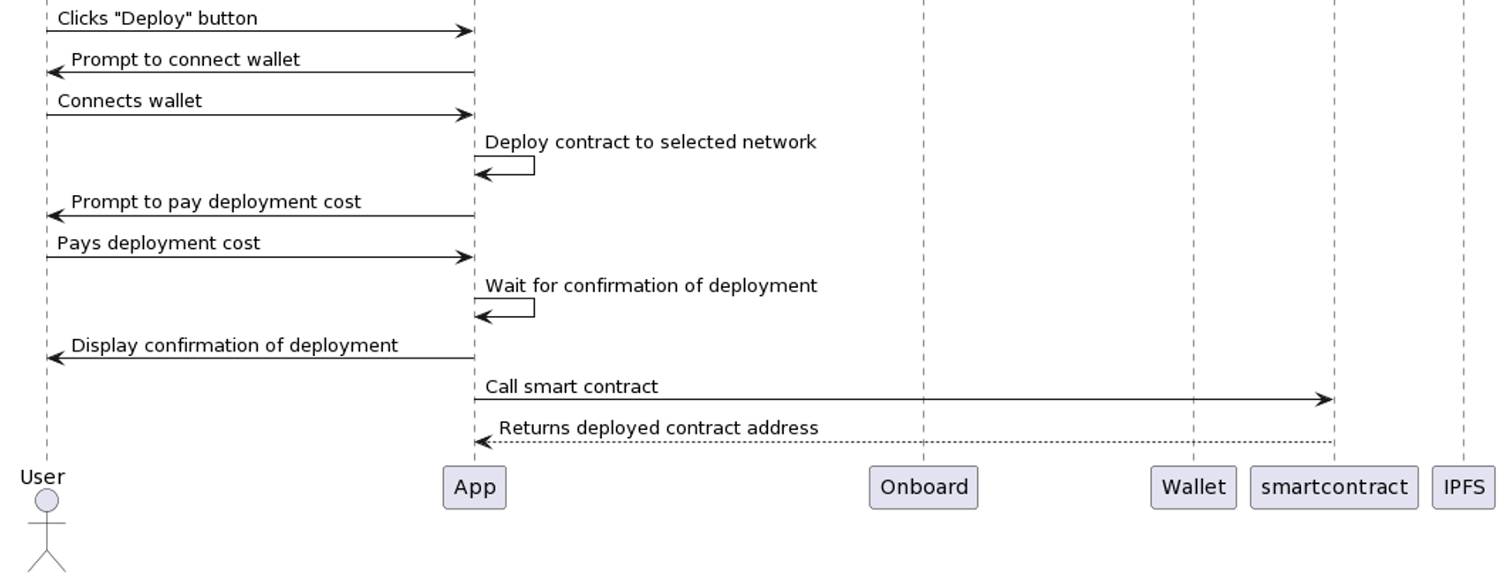
UML SECUENCE 01 02 03
REFERENCES: Non-custodial wallets: https://medium.com/0xsequence/beyond-custodial-non-custodial-wallets-cdeadc41eaf Payment Gateway: https://stripe.com/es

Slide 6
HOW TO CREATE AN UML DRAWING?
@startuml
title Simple AI Collection - UML Sequence Diagram
actor User
User -> App: Access website
alt User not logged in
App -> User: Prompt to log in
User -> App: Clicks "Login" button
App -> Onboard: Initialize Web3
Onboard -> Wallet: Detect available wallets
alt Wallet detected
Wallet -> Onboard: Prompt for account select
Onboard -> User: Wallet options
User -> Wallet: Selects wallet
Wallet -> Onboard: Return selected account
Onboard -> App: Return Web3 instance
App -> smartcontract: Call smart contract
smartcontract --> App: Returns number of collections
else No wallet detected
Onboard -> User: No wallets detected
end
end
smartcontract -> App: Get number of collections
smartcontract --> App: Returns number of collections
User -> App: Enter search term
App -> IPFS: Retrieve images matching search term
IPFS -> App: Return matching images
App -> User: Display images
User -> App: Select images for collection
App -> User: Allow user to set collection name
User -> App: Sets collection name
App -> User: Allow user to confirm collection
User -> App: Clicks "Confirm" button
App -> IPFS: Add images to IPFS
IPFS -> App: Return IPFS CID
App -> User: Prompt to select a network for deployment
User -> App: Selects a network
App -> App: Retrieve deployment cost for selected network
alt User selects Ethereum
App -> App: Calculate cost for deployment on Ethereum
App -> User: Display cost for deployment on Ethereum
end
alt User selects Polygon
App -> App: Calculate cost for deployment on Polygon
App -> User: Display cost for deployment on Polygon
end
alt User selects Binance
App -> App: Calculate cost for deployment on Binance
App -> User: Display cost for deployment on Binance
end
User -> App: Clicks "Deploy" button
App -> User: Prompt to connect wallet
User -> App: Connects wallet
App -> App: Deploy contract to selected network
App -> User: Prompt to pay deployment cost
User -> App: Pays deployment cost
App -> App: Wait for confirmation of deployment
App -> User: Display confirmation of deployment
App -> smartcontract: Call smart contract
smartcontract --> App: Returns deployed contract address
@enduml
We have used PlantUML an opensource tool http://www.plantuml.com

Slide 7

DEPLOYMENT DIAGRAM

Slide 8
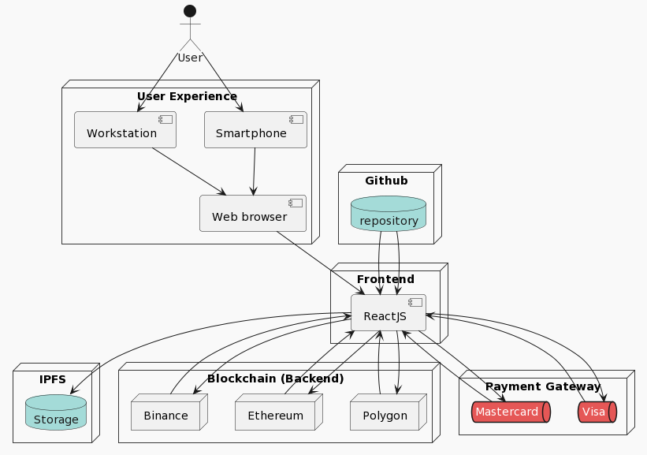
DEPLOYMENT DIAGRAM

Slide 9
HOW TO DEPLOYMENT DIAGRAM DRAWING?
@startuml
!theme mars
actor User
node "User Experience" {
component "Smartphone" as smartphone
component "Workstation" as workstation
component "Web browser" as web
}
node "Frontend" {
component "ReactJS" as reactjs
}
node "Github" {
database "repository" as repository
}
node "IPFS" {
database "Storage" as ipfs
}
node "Blockchain (Backend)" {
node "Polygon" as polygon
node "Ethereum" as ethereum
node "Binance" as binance
}
node "Payment Gateway" {
queue "Visa" as visa
queue "Mastercard" as mastercard
}
User --> smartphone
User --> workstation
smartphone --> web
workstation--> web
web --> reactjs
repository --> reactjs
reactjs --> ipfs
repository --> reactjs
reactjs --> polygon
polygon --> reactjs
reactjs--> ethereum
ethereum --> reactjs
reactjs --> binance
binance --> reactjs
reactjs --> visa
visa --> reactjs
reactjs --> mastercard
mastercard --> reactjs
@enduml
We have used PlantUML an opensource tool http://www.plantuml.com

Slide 10

SMART CONTRACT

Slide 11
SMART CONTRACT (Collection.sol)
// SPDX-License-Identifier: MIT
// Specifies the license under which the contract is published.
pragma solidity ^0.8.0;
// Import the Ownable contract from OpenZeppelin.
import "https://github.com/OpenZeppelin/openzeppelin-solidity/contracts/access/Ownable.sol";
contract MapStore is Ownable {
// Define a struct to hold user data.
struct UserData {
string name;
address collection;
string network;
string paymentId;
string date;
string transactionId;
}
// A mapping from addresses to arrays of UserData structs.
mapping (address => UserData[]) public storedValues;
// A mapping from addresses to the number of times they've been updated.
mapping (address => uint) public updateCounts;
// A function to add a new UserData struct to the storedValues mapping.
function addValue(address key, string memory name, address collection, string memory network, string memory paymentId, string memory date, string memory transactionId) public {
// Only the contract owner can add values.
require(msg.sender == owner(), "Only the contract owner can add values.");
// Add the new struct to the array and increment the update count.
storedValues[key].push(UserData(name, collection, network, paymentId, date, transactionId));
updateCounts[key]++;
}
// A function to get an array of UserData structs for a given address.
function get(address key) public view returns (string[] memory, address[] memory, string[] memory, string[] memory, string[] memory) {
uint count = updateCounts[key];
string[] memory names = new string[](count);
address[] memory collections = new address[](count);
string[] memory networks = new string[](count);
string[] memory paymentIds = new string[](count);
string[] memory dates = new string[](count);
// Loop through the storedValues array and extract the relevant fields.
for (uint i = 0; i < count; i++) {
UserData memory data = storedValues[key][i];
names[i] = data.name;
collections[i] = data.collection;
networks[i] = data.network;
paymentIds[i] = data.paymentId;
dates[i] = data.date;
}
// Return the arrays of fields.
return (names, collections, networks, paymentIds, dates);
}
}

Slide 12
SMART CONTRACT (CollectionAirdrop.sol)
// SPDX-License-Identifier: MIT
// Specifies the license under which the contract is published.
pragma solidity ^0.8.9;
import "@openzeppelin/contracts/token/ERC721/ERC721.sol";
import "@openzeppelin/contracts/access/Ownable.sol";
import "@openzeppelin/contracts/token/ERC721/extensions/ERC721Enumerable.sol";
contract CollectionAirdrop is ERC721, ERC721Enumerable, Ownable {
// Optional mapping for token URIs
// A mapping that associates token IDs with their respective URIs.
mapping(uint256 => string) private _tokenURIs;
// The base URI for the token metadata.
string public _uri;
// Constructor to initialize the contract with a name, symbol, number of tokens, base URI and recipient address.
constructor(string memory name_, string memory symbol_, uint256 num_, string memory uri_, address recipient) ERC721(name_, symbol_) {
_uri = uri_;
// To airdrop the total amount of NFTs (10 NFTs) within the constructor
for (uint i = 1; i <=num_; i++){
_safeMint(recipient, i);
}
}
// Function to return the base URI for the token metadata.
function _baseURI() internal view override returns (string memory) {
return _uri;
}
/**
* @dev See {ERC721-safeMint}.
* Mints a new token to the specified address.
*/
// Function to safely mint a new token to the specified address.
function safeMint(address to, uint256 tokenId) public onlyOwner {
_safeMint(to, tokenId);
}
/**
* @dev See {IERC721Metadata-tokenURI}.
* Returns the token URI for a given token ID.
*/
// Function to return the token URI for a given token ID.
function tokenURI(uint256 tokenId) public view virtual override returns (string memory) {
require(
_exists(tokenId),
"ERC721URIStorage: URI query for nonexistent token"
);
string memory base = _baseURI();
return string(abi.encodePacked(base,'/',Strings.toString(tokenId),'.json'));
}
// The following functions are overrides required by Solidity.
/**
* @dev See {ERC721-_beforeTokenTransfer}.
* Called before any token transfer operation.
*/
// Override function called before any token transfer operation.
function _beforeTokenTransfer(address from, address to, uint256 tokenId, uint256 batchSize)
internal
override(ERC721, ERC721Enumerable)
{
super._beforeTokenTransfer(from, to, tokenId, batchSize);
}
/**
* @dev See {ERC165-supportsInterface}.
* Checks if a given interface is supported by the contract.
*/
// Override function to check if a given interface is supported by the contract.
function supportsInterface(bytes4 interfaceId) public view override(ERC721, ERC721Enumerable) returns (bool){
return super.supportsInterface(interfaceId);
}
}

Slide 13
FrameBlock
Gracias!!!

