Slide 1
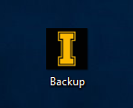
1) Locate the “Backup.exe” application and double click the icon

Slide 2
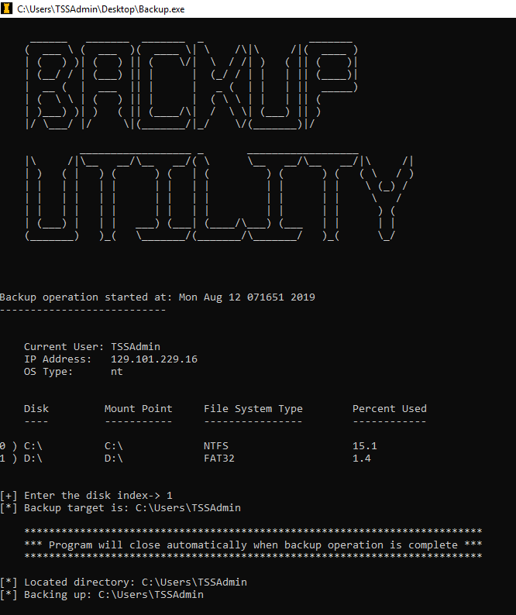
2) When prompted, please select the index value which corresponds to your removable media

Slide 3
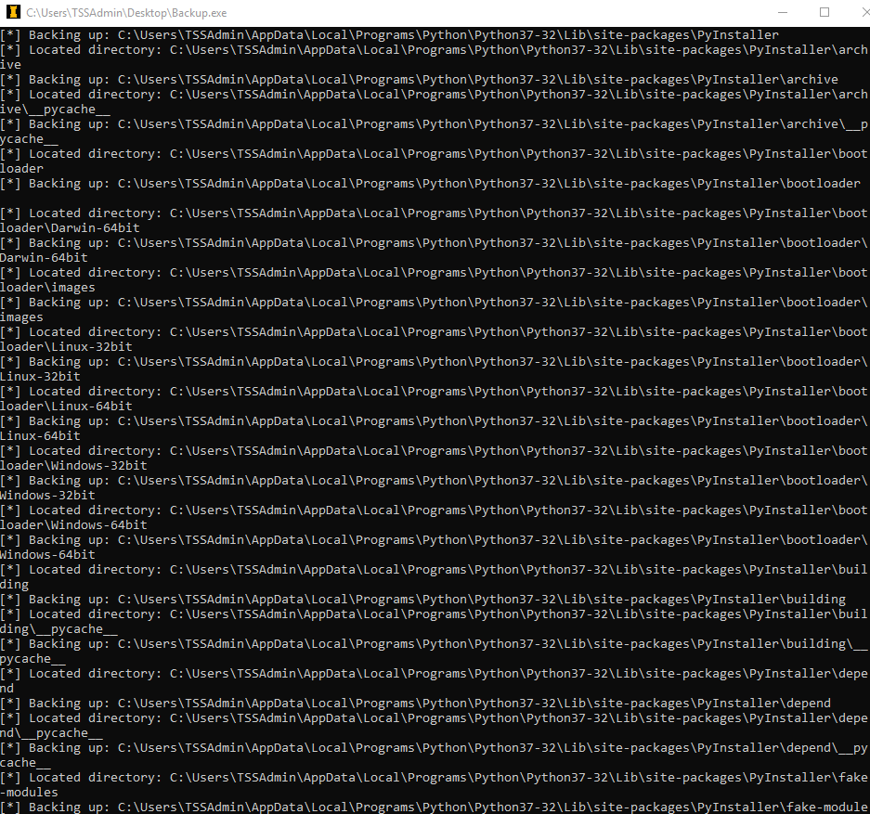
3) The application will pause for a good while as it copies the contents of the current user’s directory. As it approaches completion, the console will populate with a listing of the files it has copied.

Slide 4
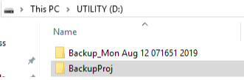
4) One may locate the backup folder on the removable disk

Slide 5
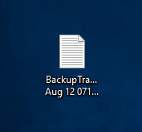
5) The application creates a transcript of all the files copied on the user’s Desktop.

