Slide 2
Damn Vulnerable UEFI
Stanislav (Stas) Lyakhov and Mickey Shkatov

Slide 3
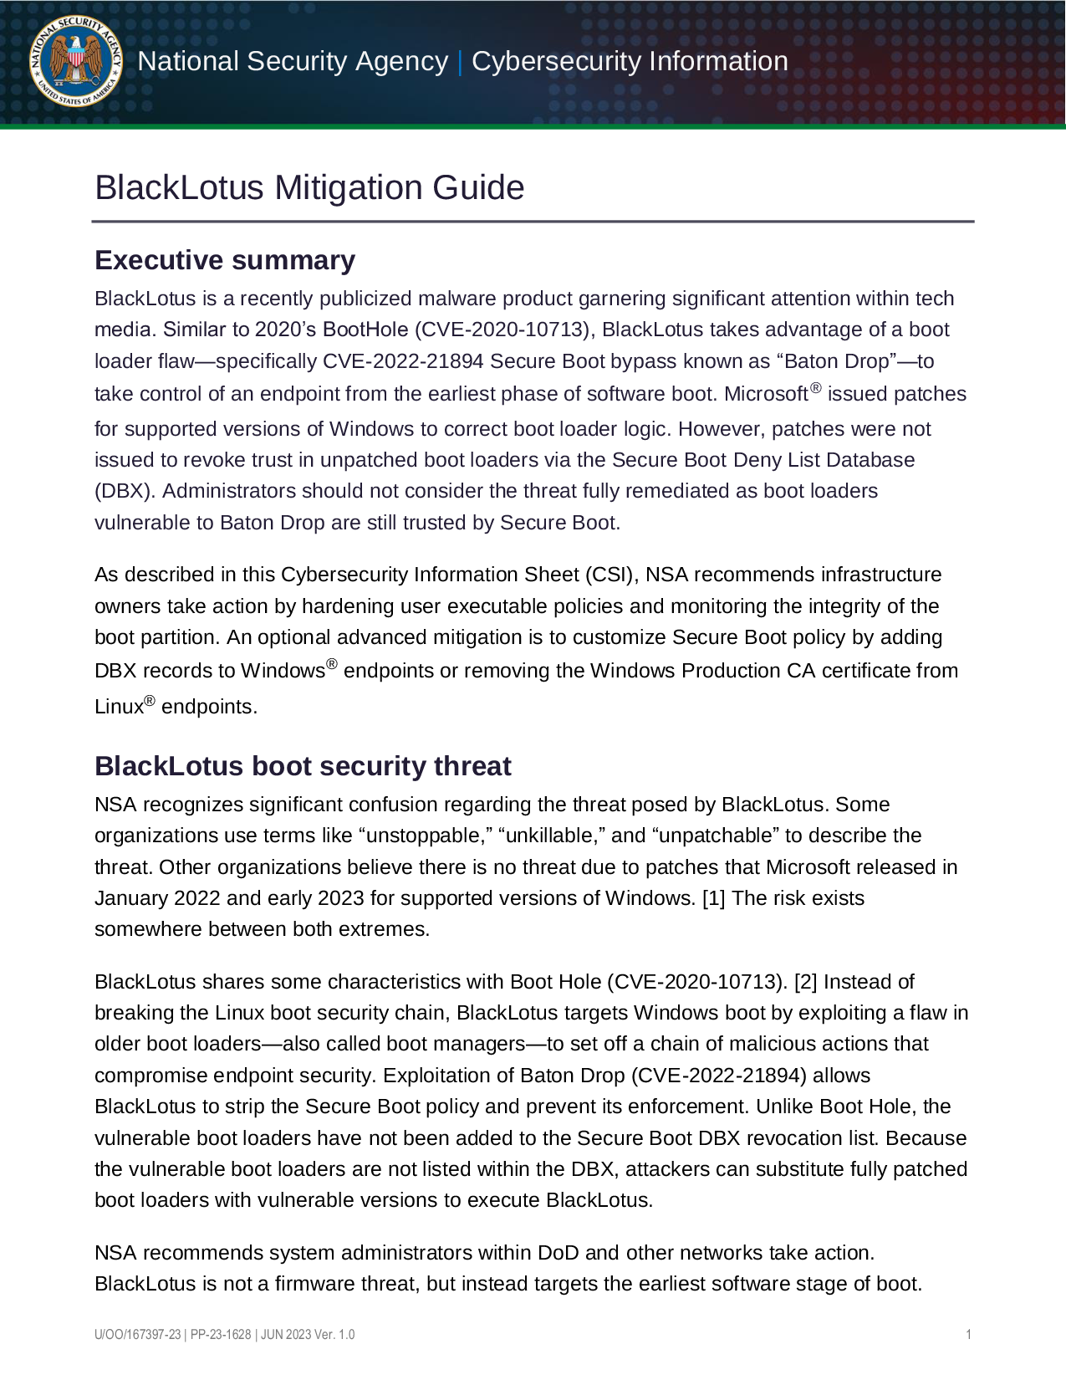
UEFI Security: why care?
Highly privileged systems
  Attackers can execute privileged code and gain persistence
  Difficult to detect and remove UEFI Malware
Critical attack surface
  Confluence of platform initializes, drivers, bootloaders, etc.
  Complex code + minimal protections
Sophisticated malware already targets pre-boot environments
  Lojax
  BlackLotus

Slide 4



DVUEFI Motivation
Learning UEFI hacking: high barrier to entry
  Complex environment (how to interact with BIOS?)
  Scattered documentation
  Lots of folklore techniques and tools
  No definitive “exploitation guide” (see OWASP Vulnerable App)
Difficult to reproduce vulnerabilities
  “Is my environment vulnerable to this?”
  “Is my DBX too new?”
  Exploits that work with one environment are unlikely to work on another without modification

Slide 5

UEFI doesn’t have to be difficult!
Little to no binary protections make exploitations easier!
  Stack canaries disabled by default!
  No ASLR!
Lots of strong options for virtualization freely available
  QEMU (with or without KVM)
  VMWare

Slide 6

DVUEFI In a Nutshell
Intentionally vulnerable UEFI platform
  Guided challenges that increase in difficult and complexity
  Covers a diverse set of vulnerabilities within UEFI
Easy-to-setup UEFI exploitation Environment
  Thorough instructions for setting up full exploitation environment
  Multiplatform support (both Linux and Windows)
  Consistent setup across users/installations
Community contribution encouraged!
  Easy to add new custom vulnerabilities and challenges
  Growing body of knowledge: information sharing and discussion

Slide 7
Who is DVUEFI for?
Everyone interested in learning about UEFI hacking
  No prior firmware experience required
  Environment setup made simple
  Guides explain vulnerability concepts
UEFI/Firmware Developers
  Learn how to identify and prevent vulnerabilities during development
  Learn about existing mitigation techniques: https://github.com/jyao1/SecurityEx
Experienced Firmware Researchers
  Community contribution! New challenges and guides welcome
  Publish research and demonstrate how to exploit in the DVUEFI environment!

Slide 8
Talk Outline
The DVUEFI blueprint
Level 1 Challenges: Simple UEFI Apps
Level 2 Challenges: Real-world UEFI Apps (with SecureBoot!)
Level 3 Challenges: Hacking on UEFI booting Windows
Plans for the future: Level 4 and Beyond

Slide 9
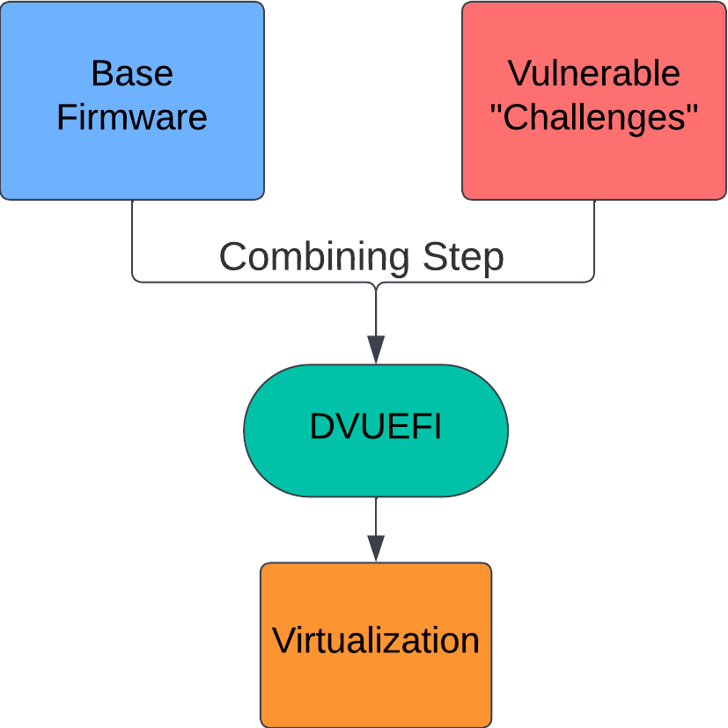
Level 0: DVUEFI Environment
DVUEFI is divided into Environments/Levels with increasing complexity
Each level follows the same blueprint
  Start with a base firmware image (e.g. EDK II)
  Insert vulnerable “challenges” into the environment
  Provide instructions for running (and debugging) the challenges
  Guidance on triggering vulnerabilities (no spoilers for full exploit!)
General Philosophy:
  Environment setup should be as simple and automatic as possible
  Adding more challenges (and modifying existing ones) should be easy
  Keep a consistent tool-chain

Slide 10
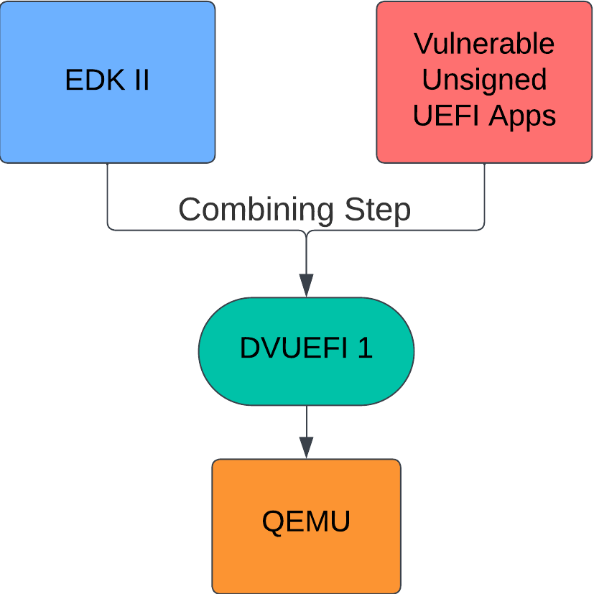
Level 1: Simple UEFI Apps
Compilation and Setup
  Full docker environment to reliably compile EDK II
  Guide on setting up and lunching challenges
Start exploring: Interact with simple application in UEFI Shell
  Making sure everything is properly compiled and DVUEFI is setup
  Getting comfortable with QEMU environment and UEFI Shell
Apps increase in complexity, but vulnerabilities remain simple
  Start with simple buffer overflow
  Move on to exploiting vulnerable network apps, image parsers, etc.

Slide 11
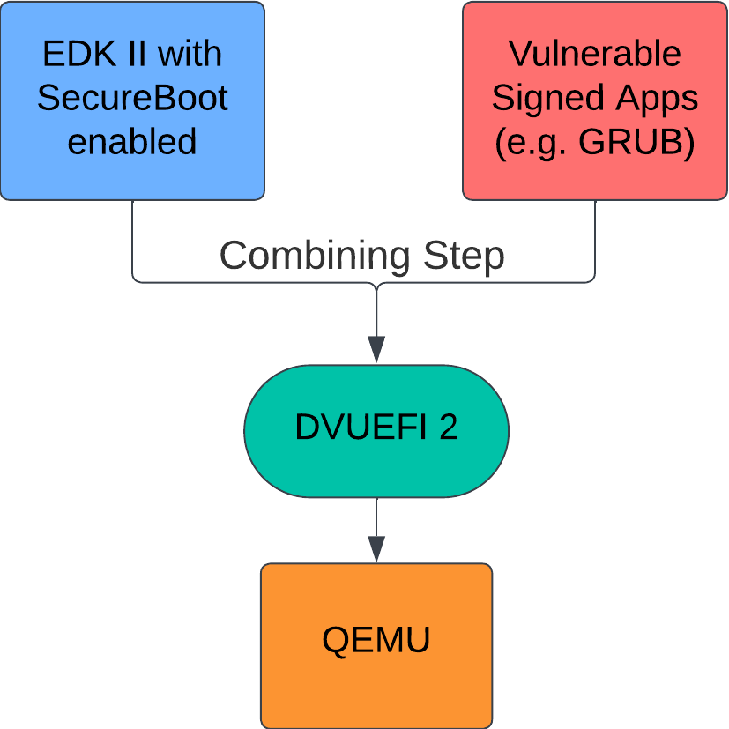
Level 2: Signed UEFI Apps
SecureBoot Bypass Required
  More realistic scenarios
  Can’t run any off-the-shelf vulnerable app! Must be signed
More Complex Applications
  Exploiting Bootloaders
  Boothole, BatonDrop, HTTP Boot etc.
Automatic Environment Setup
  Compile EDK II
  Enroll keys automatically
  Load pre-signed vulnerable apps

Slide 12
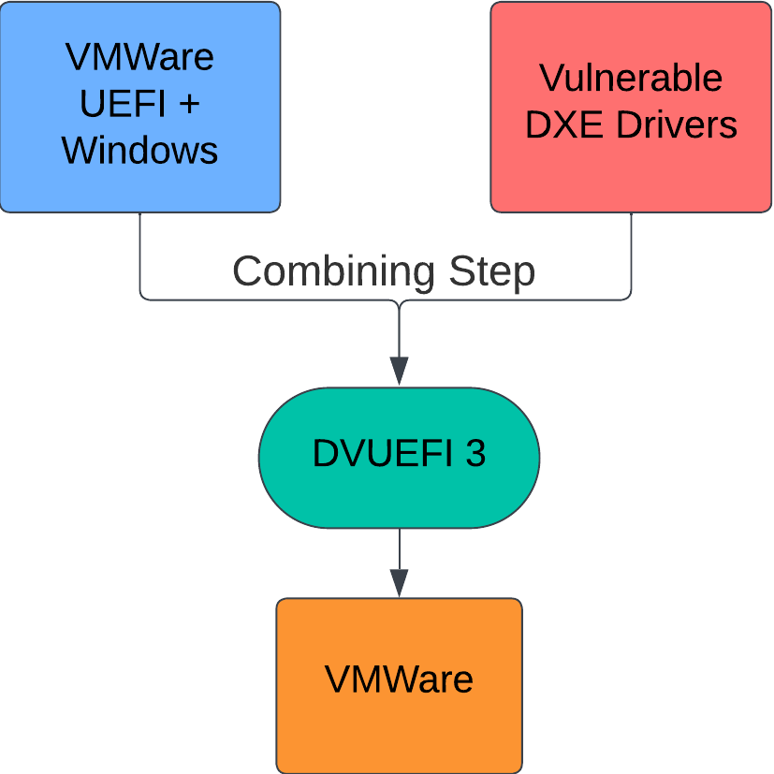
Level 3: UEFI + Guest OS
End-to-end Exploitation Environment
  UEFI Firmware
  Bootloader
  Windows OS
Setup using VMWare for Virtualization
  Graphics at last!
  Need better performance than QEMU
Base firmware image provided by VMware
  Custom techniques for automatically modding firmware/injecting drivers
  Teaching how to modify firmware (without compiling from source)

Slide 13
Roadmap: Level 4 and Beyond
Short-term
  Integrate latest binary protection into challenges (togglable)
  Increase catalog of real-world vulnerabilities
  Increase diversity of vulnerable apps to teach more vulnerability vectors
Longer-term
  SMI Emulation environment to showcase exploits for SMM drivers
  Bare-metal deployment (no virtualization needed!)

Slide 14
Hope to see you at DVUEFI soon!
https://github.com/hacking-support/DVUEFI

