Slide 1


CITX1003 Introduction to Cybersecurity Revision

Slide 2
Information Security
All human endeavour relies on information
Business, Government, Education, Research, Personal life
Information security is about protecting this information from “unauthorised access, harm or misuse”¹
This is done by preserving Confidentiality, Integrity and Availability of information (so-called CIA triad)

Slide 3
Cybersecurity
CIA is sometimes extended to include
Authentication
Authorisation
Accountability
Non-Repudiation
Privacy is part of confidentiality but is also independent. It is possible to infringe privacy without breaking confidentiality

Slide 4
Confidentiality
The property of information security that information is not made available or disclosed to unauthorised individuals, entities, or processes.
What information is deemed confidential is subjective (other than Personally Identifiable Information PII) and arises out of an agreement between parties
May be any information relating to the company (Apple) that staff are obliged not to disclose
Specific disclosures to staff and customers covered by Non-Disclosure Agreements (NDA)
Information relating to national security
May also be information that a consumer wants protecting e.g. credit card transactions

Slide 5
Integrity
Protects the reliability and correctness of data
Prevents unauthorized alterations of data
Examples:
You deposit $200 into your account which holds $1,000 : you want to be certain that after the transaction, it holds $1,200
You have submitted a legal contract and you want to know that it will not be altered after it has been submitted
Protection against errors as well as deliberate changes
List of dependencies:
Accuracy, Truthfulness, Authenticity, Validity, Nonrepudiation, Accountability, Responsibility, Completeness, Comprehensiveness

Slide 6
Availability
Authorized subjects get timely and uninterrupted access to objects (the data and information they need)
Threats to availability include:
Device failures
Software errors
Environmental issues; Fire, Flood, Wind, Power loss)
Distributed Denial of Service (DDoS) attacks
Ransomware attacks
Mitigation: Fault tolerance, backups, disaster recovery sites, protections against attacks

Slide 7
Identity and Authentication
Identity is about being able to prove to a system that you are who you say you are
Authentication verifies the identity using authentication factors:
Passwords, Smartcards, Tokens, Biometrics
Can you multiple factors especially 2FA (Two Factor Authentication)
Factors sometimes defined as:
Type 1: Something you know
Type 2: Something you have
Type 3: Something you are or something you do
Somewhere you are
Context-Aware Authentication
Process of registration is important – proving your identity
Identity Management Systems manage accounts and implement authentication schemes

Slide 8




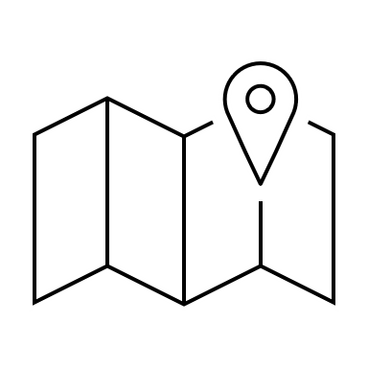
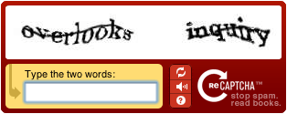
Identity and Authentication
beidou@pirates.liyue.com

Slide 9
Authorization
Determines what actions a subject can carry out on an object
Actions may be context dependent
Computer systems most commonly:
Read, Write, eXecute
CRUD: Create, Read, Update/Insert, Delete
Series of other access control schemes:
Discretionary Access Control (DAC)
Mandatory Access Control (MAC)
Role-Based Access Control (RBAC)
Rule-Based Access Control
Attribute Based Access Control

Slide 10
Accountability
To be able to identify all relevant information regarding actions in a system
Relies on identity and authorisation
Implemented with monitoring and logging
In order to reduce the volume of logging information may use machine learning to detect anomalous behaviours
Carry out audits

Slide 11
Non-repudiation
Scenario:
John: I sent you an email to change the appointment that is why I wasn’t there
Joanna: No you didn’t
Stops a subject from claiming that an event or action did not occur
Essential part of accountability
Needs proof of identity
Usually implemented through digital signatures

Slide 12
Terms: Asset, Vulnerability, Threat
Asset: Anything of value to an organisation whose loss, or degradation of function would cause the organisation economic loss.
Files, processes, programs, databases,
Disks, Servers, Mobile phones, laptops
Personnel, property
Vulnerability: weakness in an organisation’s assets that when exploited will lead to economic loss
Threat: anything that can exploit a vulnerability in a way that leads to a negative impact

Slide 13
Terms: Risk, Threat Actors, Threat Actions
Risk: Is the probable frequency and probable magnitude of future loss from a threat acting on a vulnerability.
Threat Actor: Person, group or external force responsible for threats.
Can be internal and external.
External actors can be environmental: earthquakes, fire, flood, wind, etc.
Internal actors may have motivation that is malicious or simply error
Threat Action: What the threat actor did or caused e.g. malware, hacking, social, etc
Control: measures that mitigate a risk. Can be:

Slide 14
Terms: Risk Responses
Once a risk has been identified, it can be:
Reduced or mitigated
Assigned or transferred
Accepted
Deterred
Avoided
Rejected or ignored

Slide 15
Risk Analysis
Qualitative: Assess risk in terms of rating risk on a scale
Although simpler, it is not granular and so loses usefulness because of that
How do you know what High, Medium, Low or 3.5/5 means? How much will you lose if you have a loss? How much will you spend to control this risk?
Quantitative: Work out numbers for frequency of risk events based on detailed understanding of assets, threats and vulnerabilities
More complicated
Needs maturity and access to detailed organisational information
Need to understand:
Assets of organisation
Threat analysis
Vulnerability assessment

Slide 16
Controls
Controls are applied to mitigate cybersecurity risk
Types:
Physical
Technical
Administrative
Functions
Preventative
Detective
Corrective

Slide 17
Control Examples
 |  | Control Functions
 |  | Preventative | Detective | Corrective
Control Types | Physical | Fences, gates, locks | CCTV and surveillance camera logs | Repair physical damage, re-issue access cards
 | Technical | Firewall, IPS, MFA, AV | IDS, Honeypots | Patching, Reboot systems, Quarantine malware
 | Administrative | Hiring and Firing practices, Separation of Duties, Data Classification | Review access rights, audit logs, review unauthorised changes | Implement Business Continuity Plan, Incident response plan

Slide 18
The Essential Eight
Can implement Australian Signals Directorate (ASD) Essential Eight:
Application control: prevent the execution of unapproved/malicious programs
Configure Microsoft Office macro settings
Restrict administration privileges
Multi-factor Authentication
Daily backups
Patching applications
Application hardening
Patch Operating Systems

Slide 19
Threat Analysis and modeling
Threat models ask the following basic questions with reference to a system:
Who is the attacker
Why are they attacking
How are they attacking
Ultimately allows for calculation of risk for which there must be a vulnerability, a threat and some impact
Threat models need to be applied to systems as a whole, not just to specific parts of a machine learning pipeline in isolation
They need to be based on realistic scenarios with credible threat actors and credible goals and motivations

Slide 20
Incidents and Incident Response
Any event that has compromised confidentiality, integrity or availability of an organisation’s assets
From a VERIS perspective, an incident is the result of an Actor, taking some Action, on an Asset, resulting in the Attributes of an incident, i.e., how it was affected. In this case, the action exploits a vulnerability in the asset
An incident is when there is actual loss or imminent threat of loss. Otherwise, it is an Event
Standard for incident handling is NIST SP800-61 it defines an incident as:
“A computer security incident is a violation or imminent threat of violation of computer security policies, acceptable use policies, or standard security practices”

Slide 21
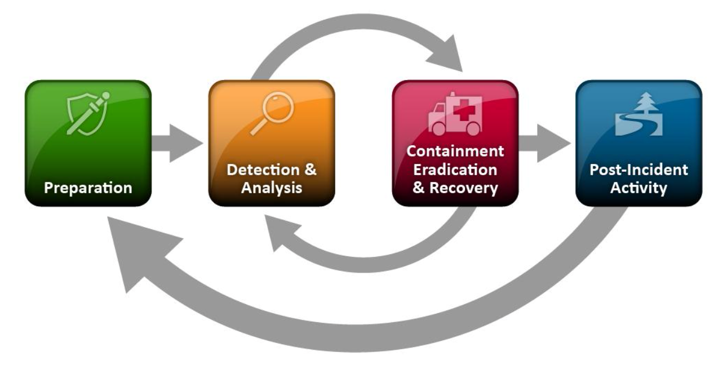
Handling an Incident

Slide 22
Digital Forensics
The discipline of collecting digital evidence that is related to an incident in such a way as to be able to be used in criminal and civil proceedings
Criminal investigations
Intelligence gathering
eDiscovery in relation to civil law
Incident response

Slide 23
Digital Forensics
Digital data may be present on a range of devices such as
Hard drives
Computer memory
Peripheral device memory (such as in printers) ,
Removable drives like USB drives
Smartphones
IoT,
Cars - through navigation and entertainment systems.

Slide 24
Digital Forensics
Collecting this data involves doing so in a way that maintains the integrity of the data and its associated metadata such as creation and modification times and dates
Digital forensics specialists use specific devices that can image a disk or extract memory without the possibility of writing to the disk at the same time. This prevents any metadata from being changed.

Slide 25
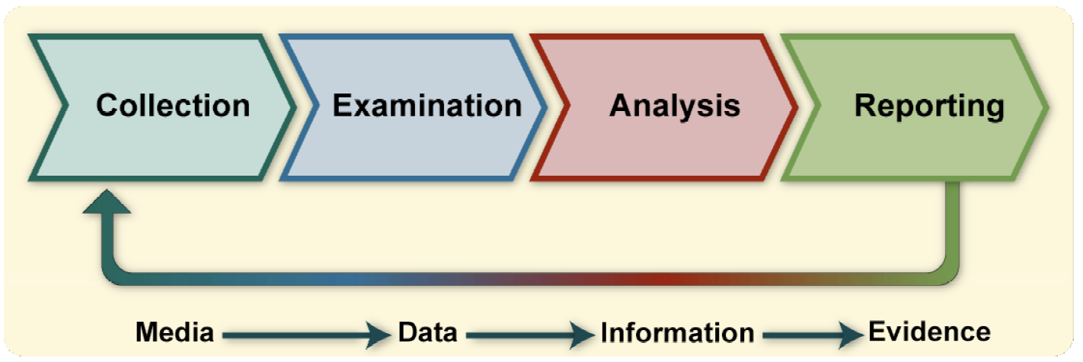
The Forensic Process
From NIST SP800-86 Guide to Integrating Forensic Techniques into Incident Response

Slide 26
Collection of Data
Establishing data provenance and maintaining integrity
Identify possible sources of data
Other than devices, there may be 3rd Party records of activity such as ISP metadata retention, mobile phone company records, social media company information
Securing devices before someone is able to delete files or tamper with evidence is critical – although it is often possible to recover files that the user has thought they deleted
Data may be in encrypted forms which are potentially recoverable through access to memory where it is held in plaintext, decryption by knowing the keys or through some other technique

Slide 27
Collection of Data
Data can be collected from live machines and also from disks and memory devices that are “dead”
Data is copied from storage and other devices in a bitwise manner i.e. getting an image of raw data
Usually done in 512 byte chunks that equate to a “sector” on a disk
This avoids changing the file system in any way during the reads
Can use a write-blocked device to copy data
We don’t use a logical data acquisition process using other layers to access or copy files
This presents some problems if the data is stored in proprietary way
Main decisions in data acquisition
Likely value of the data to achieve its objectives
Volatility being aware that data may disappear if machines are powered down, files may be updated etc
Focus on amount of effort required
Once data is acquired, needs to be verified

Slide 28
Steganography
Steganography is Greek for steganos (στεγανός) which means “covered” and graphia (γραφή), which means “writing”
Message is hidden in another medium such as images, audio or webpage so that the message is hidden even in plain view
The other medium is the carrier file
Two forms
Insertion: hidden text is added to the existing carrier
Substitution: bits of the carrier are replaced with the bits from the message

Slide 29
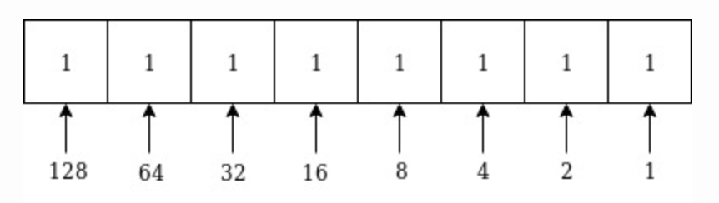
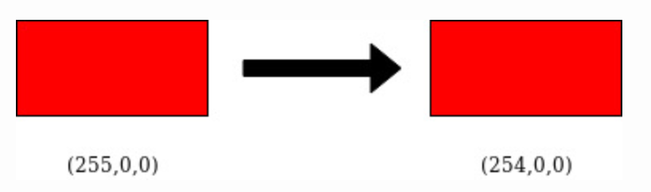
LSB Substitution
In a byte, the bit representing 1 is the least significant bit (LSB)
128 is the most significant bit (MSB)
We can change the bit without changing the colour to the human eye

Slide 30
Example
01010010 01001010 10010111 11001100 11010101 01010111 00100110 01000011
To hide the letter Z whose ASCII code is 10110101
01010011
01001010
10010111
11001101
11010100
01010111
00100110
01000011

Slide 31
Steganalysis
Steganalysis approaches:
Steganography-only attack: The steganography medium is the only item available for analysis.
Known-carrier attack: The carrier and steganography media are both available for analysis.
Known-message attack: The hidden message is known.
Chosen-steganography attack: The steganography medium and algorithm are both known.
Chosen-message attack: A known message and steganography algorithm are used to create steganography media for future analysis and comparison.
Known-steganography attack: The carrier and steganography medium, as well as the steganography algorithm, are known.
Can try and find the tool that was used by trial-and-error (brute force) or use tool that will look for steg program signatures (StegSpy)
If the original image is available, there may be a difference in size and hash value
Complex analysis can look at frequency distributions of pixels
Neural networks can be used

Slide 32
Cryptography Today
Two types of encryption used:
Symmetric key cryptography: Both parties share the same single key
Eg, AES
Asymmetric key cryptography: Each party has 2 keys: public key and private key
Eg. PGP
Both types or encryption are used for different purposes and have different benefits and drawbacks
In addition to the above, there are other cryptographic functions that do not require a key e.g. Hash functions

Slide 33





Public Key Cryptography
Alice
Bob
Bob’s Public Key
Bob’s Private Key
Encryption
Decryption
Plaintext
Ciphertext
Plaintext

Slide 34
Non-Repudiation
To prove that Alice was the one that sent the message
Alice encrypts the document with her private key and Bob decrypts it with Alice’s public key
It must be Alice because only she would have her private key
This also authenticates Alice
In practice, we don’t need to encrypt the entire document but can do a hash of the document

Slide 35
Non-Repudiation
Alice
Alice’s Private Key
Alice’s Public Key
Bob
Encryption
Decryption
Plaintext
Ciphertext
Plaintext

Slide 36
Confidentiality and Authentication
Combine the two processes
Alice encrypts the document with her private key
Alice then encrypts again with Bob’s public key
Bob decrypts the document with Bob’s private key
Bob decrypts the document with Alice’s public key

Slide 37
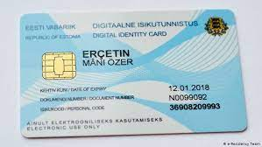
Asymmetric Cryptography: Public Key Distribution
Distributing public keys is much easier than sharing private keys amongst people
However, still have an issue about verifying that a public key belongs to the person it says
Decentralised models: PGP, OpenPGP
Centralised models: Estonian ID-Card
PGP (Pretty Good Privacy) Phil Zimmerman 1991
Uses variety of symmetric and public key ciphers
Uses Web of Trust
Estonian model needs proof of identification (passport, driving license, etc) also can only be collected in person

Slide 38
Cryptographic Hash Functions
Algorithm that maps data of arbitrary size to a bit string of a fixed size
Designed to operate only one way (can’t be inverted)
Properties:
deterministic - the same message results in the same hash
fast to compute
very difficult to generate a message from its hash
small changes to message result in large changes to hash
two different messages are very unlikely to generate the same hash
MD5 was invented by Ron Rivest in 1992 and very common but proved flawed
SHA-2 recommended now although it comes from the NSA – can output various sizes of hash (224, 256, 384 and 512 bits)
SHA-3 released by NIST in 2015

Slide 39
Hash Functions: Password storage
Used for password storage and verification
Password + Salt (random bytes) is hashed and the hash stored for verification
Never store the plaintext
Linux stores passwords in a file called shadow:
openssl passwd -6 -salt randomtext mysecretpassword
$6$randomtext$SqJRpIQLI4zewKY2NPupGyKBZpzND3yl7sbqi1qachbATjFBafjHeQqfzvAeSS2FKb7WuJWV/SSCWD/lba7G//
In practice, Linux will do the hash 5000 times in an attempt to stop brute forcing passwords

Slide 40
Vulnerability
Vulnerability: weakness in an organisation’s assets that when exploited by a threat will lead to economic loss

Slide 41
Vulnerability Reporting
When a vulnerability is discovered, it is usually reported to the organisation responsible for the product and they are given time to fix
Zero Day vulnerability is one that is unknown (or unfixed) by the manufacturer of the product when it is exploited
Vulnerabilities that are reported and then fixed, by a patch or upgrade of the software or product, is then reported for inclusion in public databases:
CVE Common Vulnerabilities and Exposures (https://cve.mitre.org/index.html)
NVD National Vulnerability Database (https://nvd.nist.gov/)
VulDB (https://vuldb.com/)
Disclosure comes with problems because it may help disseminate and promote exploits
There is a market for bug finding (Bug Bounties) and also for selling Zero Days

Slide 42
Network Vulnerabilities and Attacks 1
Vulnerabilities that directly involve networks and their protocols:
Network traffic is vulnerable to interception, being read and manipulated
Network services are vulnerable to poor availability by being overloaded
Sniffing: listening to traffic on a wired or wireless network (WiFi, Bluetooth, NFC)
May involve a “man-in-the-middle” attack
Wireless can be passively sniffed because it is broadcast
Spoofing: altering communications to pretend to be a different sender
e.g. Caller ID on an SMS or phone call, senders of emails
Usually done at the network level altering TCP/IP packets
Part of a man-in-the-middle attack

Slide 43
Network Vulnerabilities and Attacks 2
Denial of service
Flooding a service with fake requests so that real users can not access the service
Distributed Denial of Service (DDoS)
Using many sources for denial of service attacks including Internet of Things (IoT) devices
Man-in-the-middle attacks
Intercept network traffic to sniff the packets before passing them to the legitimate destination or to a destination under the attacker’s control
Hacking: Initial Access and Lateral Movement
Access a machine through the use of remote access services or through exploitation of vulnerabilities in a network service
Use a machine to “pivot” to other machines on the same, or different networks

Slide 44
SCADA Security Weaknesses
Not built with security in mind
Thought to be secure because they were isolated and not internet connected
No encryption
Security through obscurity – proprietary systems
Updates are not cryptographically secure

Slide 45
OWASP Top 10
Open Web Application Security project maintains a list of top 10 vulnerabilities:
They can be split into the following types of error:
Programming errors
Authentication
Input sanitization: Injection, Cross-Site Scripting (XSS)
Security and access
Configuration errors
Insufficient logging or monitoring
Security configuration
3rd party programming errors
Using components with known vulnerabilities

Slide 46
OWASP Top 10
Broken Access Control
Cryptographic Failures
Injection
Insecure Design
Security Misconfiguration
Vulnerable and Outdated Components
Identification and Authentication Failures
Software and Data Integrity Failures
Security Logging and Monitoring Failures
Server-Side Request Forgery (SSRF)

Slide 47
AI Risks
AI attack surface is massive and growing.
As AI becomes more embedded in critical infrastructure and cyber-physical systems, it becomes an increasingly vulnerable to attack
Although attacks on AI have been known for some time, threats are largely ignored
Our understanding of threat models of AI is poor
AI is usually a “black box” and so attacks are hard to detect
There has been a focus on weaknesses of machine learning and AI without credible threats that would exploit them
This is changing as machine learning is increasingly used in cybersecurity defense
Spam, phishing, network intrusion, AV, threat detection, vulnerability scanning

Slide 48
Attacks: Adversarial inputs
A non-visible alteration of an image that causes the neural network to misclassify the image
The exact perturbation depends on whether the attacker has access to the underlying neural network model
Vulnerability that has received much attention from researchers

