Slide 1


By –
Radhika Shukla
Ashrith Grandi
Shakshi Goswami
Prerna Prasad

Slide 2




Introduction and Target Variable
Patient Portal Sign On Probability and Frequency of Sign Ons.
Objective – Track proportion of adults who use Information technology (IT) to track health care data or communicate with providers.
Purpose – People who use information technology (IT) to keep track of their health information and talk with health care providers are more likely to have better health. There are disparities in use of IT for health care by income, age, and sex.
Assumption – Target Variable Data available in the given dataset, is a categorical binary variable

Slide 3
Data Modelling Phases
Data Cleaning
Model Fitting
Quantity Extraction
Reshaping
Missing Values
Factors
Transformations
Aggregation
Possible Models
Model Compatibility
Model Fit
Problem Type Super vised or Unsupervised
Dependent Variable Identification
Coefficients
Marginal Effects
Predictions
Conditional Effects
Goodness of Fit

Slide 4
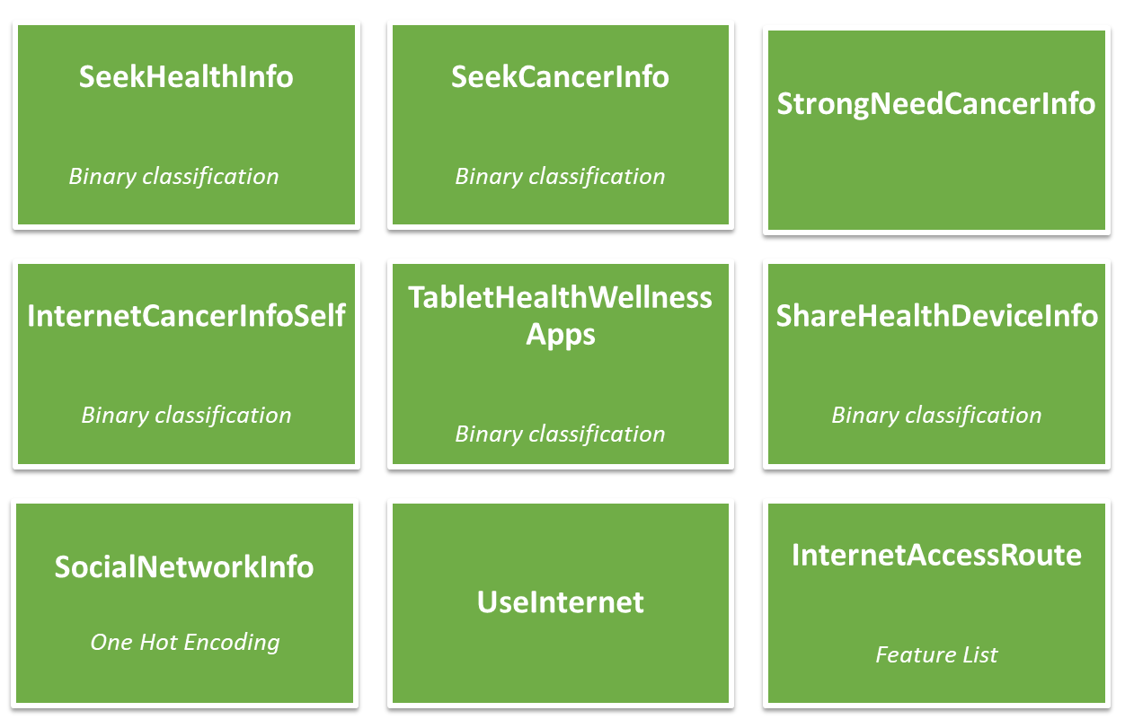
Independent Variables - Section A and B
Notes:
SeekHealthInfo - looked for information about health or medical topics from any source
SeekCancerInfo - looked for information about cancer from any source?
StrongNeedCancerInfo - had a strong need to get information about cancer. Where would you go first?
InternetCancerInfoSelf - you used the Internet to look for information about cancer for yourself?
TabletHealthWellnessApps - do you have any "apps" related to health and wellness
SharedHealthDeviceInfo - shared health information from either an electronic monitoring device or smartphone with a health professional within the last 12 months?
SocialNetworkInfo - In the past 12 months, have you used the Internet for any of the following reasons?
UseInternet - go on-line to access the Internet or World Wide Web, or to send and receive e-mail?
Internet_Access_Route =When you use the Internet, do you access it
through... if true append to list

Slide 5
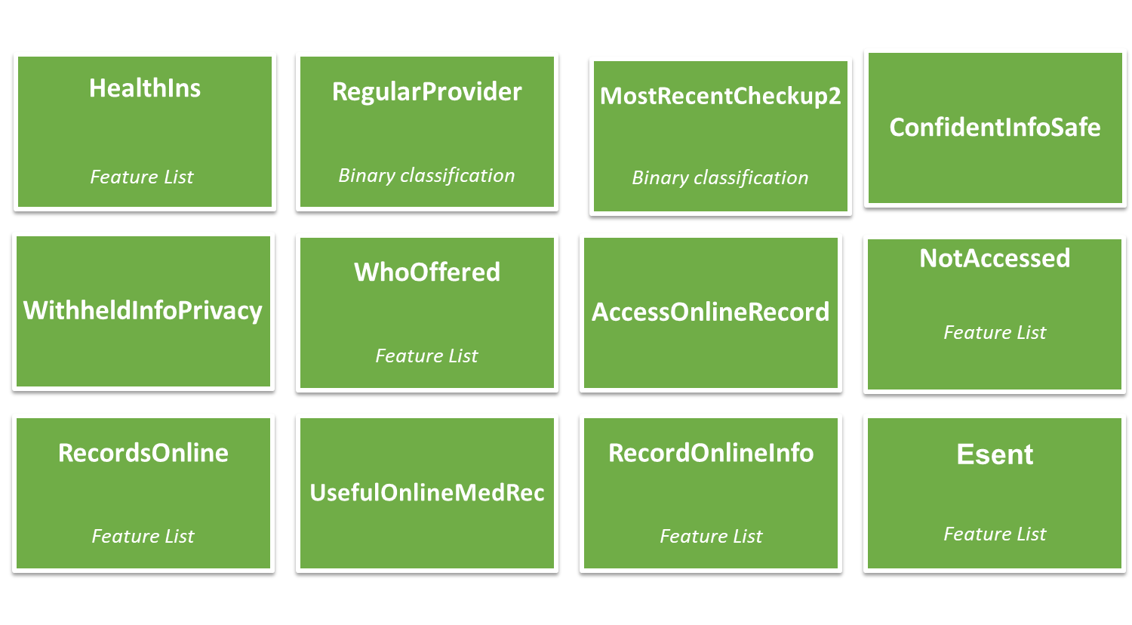
Independent Variables – Section C and D
Notes:
HealthIns - currently covered by any of the following types of health insurance or health coverage plans?
RegularProvider - is there a particular doctor, nurse, or other health professional that you see most often
MostRecentCheckup2 - how long has it been since you last visited a doctor for a routine checkup?
ConfidentInfoSafe - confident are you that safeguards (including the use of technology) are in place to protect your medical records from being seen by people who aren’t permitted to see them
WithheldInfoPrivacy - kept information from your health care provider because you were concerned about the privacy or security of your medical record?
WhoOffered - Who offered you online access to your medical records?
AccessOnlineRecord - How many times did you access your online medical record in the last 12 months?
NotAccessed - Why have you not accessed your medical record online? (if AccessOnlineRecord ==0, Make a Feature List Variable of all NotAccessed Reason Codes
)
RecordsOnline - In the past 12 months, have you used your online medical record to... (if AccessOnlineRecord <>0, Make a Feature List Variable of all RecordsOnline Reason Codes)
UsefulOnlineMedRec - how useful is your online medical record for monitoring your health?
RecordsOnlineInfo – (f RecordsOnline, Make a Feature List Variable of all RecordsOnlineInfo Reason Codes) Do any of your online medical records include the following types of medical information?
Esent - electronically sent your medical information to….?

Slide 6
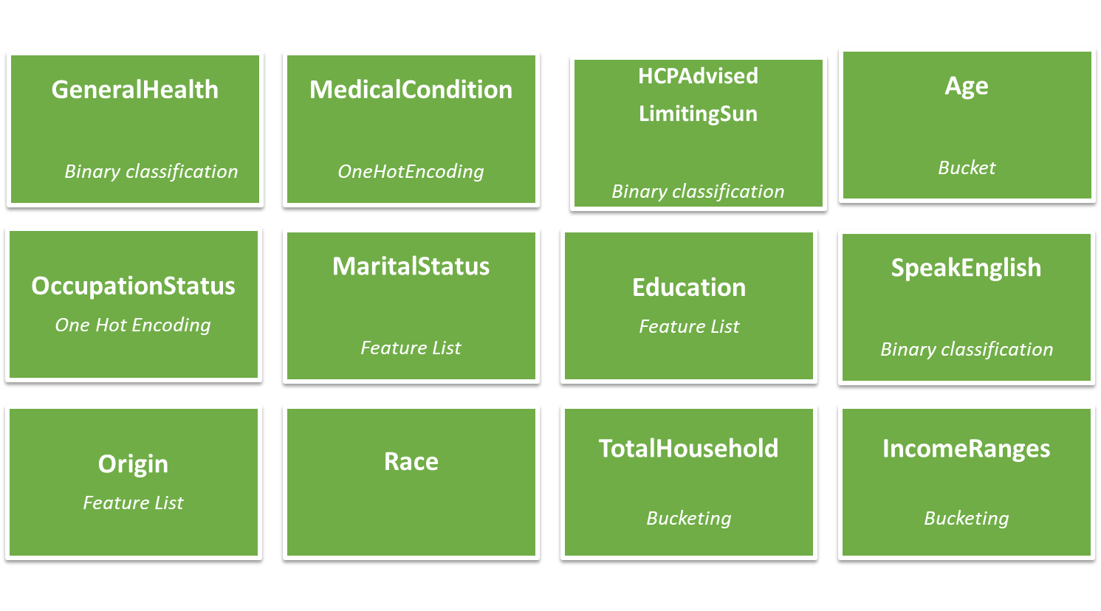
Independent Variables – Section G, I and O

Slide 7

Data Cleaning
Missing Data
Mean/Median/Mode based on similar kind of attributes (subset of the sample data)
Nearest Neighbour imputation - kNN (average value of each attribute in the clusters).
Outlier Handling - Check the Quartile Plots, and see if they are valid outliers.
Invalid Data - Example: Text in place of numbers
Data inconsistency – Example: String/ Float/ int
Duplicate Removal - It might affect the distribution of the outcome, so remove based on how the distribution is affected.
Multicollinearity –Reduced the model’s performance- (OccupationStatus, IncomeRanges).

Slide 8

Feature Engineering
Scaling
Over Sampling
Under Sampling
Transformations - Skewness (Symmetry left side/Right side) and Kurtosis (Outliers/ Heavy tailed/Lightly tailed)
Log Transforms – Log Transform
Box-cox transformations - Transformation into a normal distribution.
PCA Analysis
Reduce the number of features/dimensions, by creating new feature vectors which are dependent on the existing features.

Slide 9

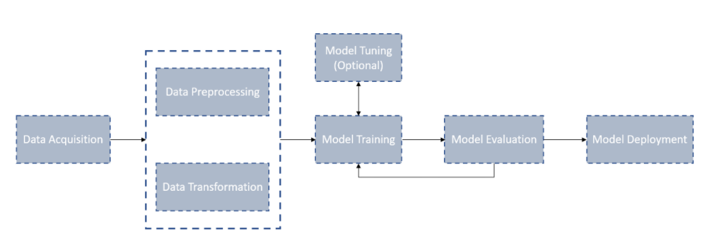
Workflow of Data Modelling
HINTS5 – Cycle 2 Poses with a Classification Problem statement
Approach: Split Dataset into Train, Test and Validation datasets.

Slide 10
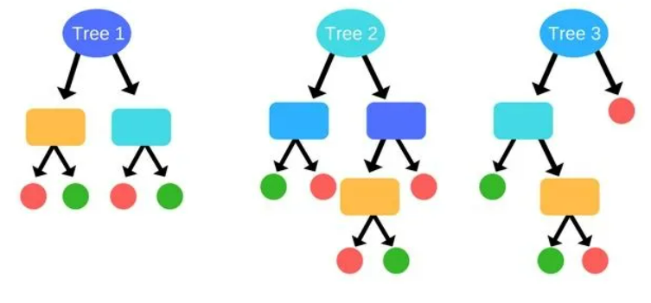

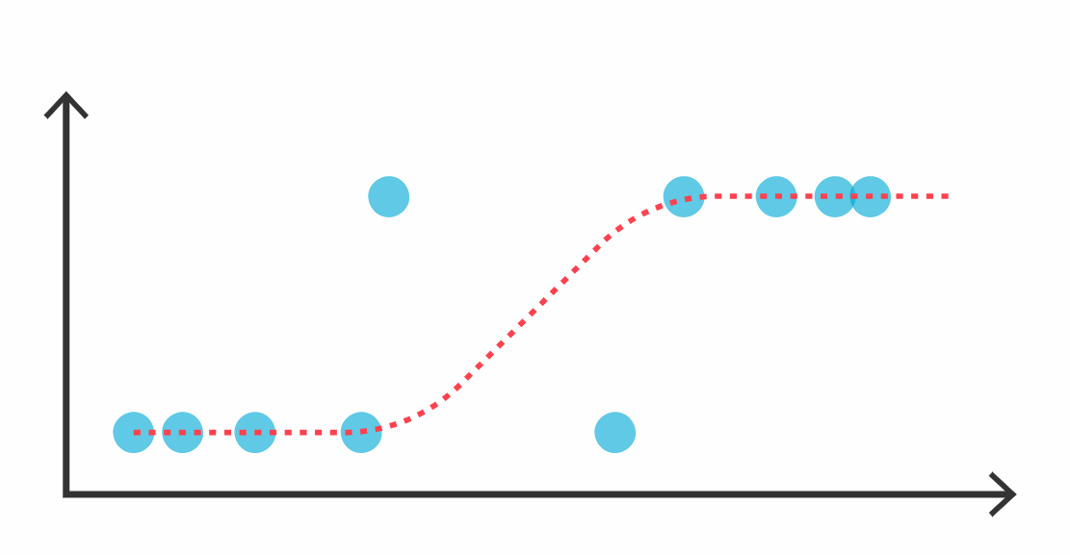

Proposed Models for HINTS5 C2
Random Forest
Feature Ranking
Single DT which are likely suffer from high variance or high [Bias]
Ensemble of trees
Logistic Regression
Supervised Learning technique
Describe relationships between two variables or among several variables
The identification of prognostically relevant risk factors
Risk Scores Calculation

