Slide 1


Abhijit Zarekar
Samridhi Sachdeva
Shubhangi Goyal
Sai Nischith Vangala

Slide 2


Section A – Looking for Health Information
Health Information is helping us understand the need of patients for health information and their interest towards the health-related knowledge
Variable Name | Variable Description | Intuition Behind Choosing
AdultsInHH | If more than one adult (>18 yrs) in household (Y/N) | Adults have high chances of using app
MailHHAdults | How many adults (Integer) | Adults have high chances of using app
SeekHealthInfo | Whether looked info about health topics from any source (Y/N) | Tells about interest for health information
WhereSeekHealthInfo | First go-to for seeking health info (Multiclass categorical var - 12 classes that can be bucketed into 3: Paper based, Internet based and care provider) | People with internet as first preference will be willing to register on app
SeekCancerInfo | Whether looked ino about cancer (Y/N) | Person in need of cancer related information can be signing up or using the app more
Notes:
paper based : books, magazines, brochures, newspapers

Slide 3



Section B – Using Internet to Find Information
To provide a sentinel view of how the public is interacting with information
in the environment to address their health needs
Variable Name | Variable Description | Intuition Behind Choosing
Internet_Cell | Access to cellular n/w (Y/N) | Accessibility to internet is valid for app usage
Internet_WiFi | Access to wireless n/w (Y/N) | Accessibility to internet is valid for app usage
WhereUseInernet_MobileDevice | How often internet is used on mobile device (Daily/ Sometimes/ Never/ NA) | Indicates internet use of people
HaveDevice_Tablet | Have tablet computer | If people do not have device, they won’t sign up for app
HaveDevice_SmartPh | Have smart phone | If people do not have device, they won’t sign up for app
HaveDevice_CellPh | Have basic cell phone only | If people do not have device, they won’t sign up for app
HaveDevice_None | None of the devices owned | If people do not have device, they won’t sign up for app
TabletHealthWellnessApps | Whether any health app on device (Y/N/Don’t know) | To analyze if person is aware about health awareness apps
Tablet_AchieveGoal | Whether health app helped to track progress on health goal (Y/N) | To analyze the impact of their past usage of any other health app
Tablet_MakeDecision | Whether health app helped to treat an illness or condition (Y/N) | To analyze the impact of their past usage of any other health app
Tablet_DiscussionsHCP | Whether health app helped in discussion with care provider (Y/N) | To analyze the impact of their past usage of any other health app
SharedHealthDeviceInfo | If any health info shared with a health professional (Y/N) | To analyze if the user has any privacy concerns which may reduce chances of signing up
IntRsn_SharedSocNet | Whether visit social networking sites (Y/N) | Analyze social media interaction and activity
Notes:
health goal: losing weight; quit smoking

Slide 4
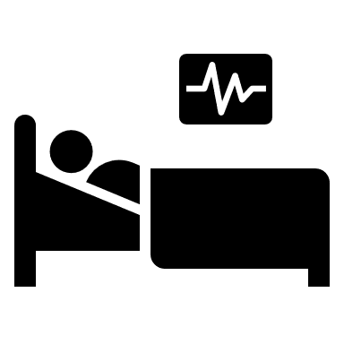



Section C – Your Health Care
Health Information is helping us understand the need of patients for health information and their interest towards the health-related knowledge
Variable Name | Variable Description | Intuition Behind Choosing
HealthIns_InsuranceEmp | Insurance through current or former employer or union (Y/N) | To analyze type of insurance that increases likelihood of registration
HealthIns_InsurancePriv | Insurance directly purchased from company (Y/N) | To analyze type of insurance that increases likelihood of registration
HealthIns_Medicare | Medicare insurance (Y/N) | To analyze type of insurance that increases likelihood of registration
HealthIns_Medicaid | Medicaid insurance (Y/N) | To analyze type of insurance that increases likelihood of registration
HealthIns_Tricare | Tricare or other military health care (Y/N) | To analyze type of insurance that increases likelihood of registration
HealthIns_VA | Used or enrolled for VA health care (Y/N) | To analyze type of insurance that increases likelihood of registration
HealthIns_IHS | Used or enrolled in Indian Health Service (Y/N) | To analyze type of insurance that increases likelihood of registration
HealthIns_Other | Any other insurance (Y/N) | To analyze type of insurance that increases likelihood of registration
ProbCare_BringTest | If had to carry test result to appt (Y/N) | Might help in analyzing the reason of people engaging with the app
ProbCare_WaitLong | If had to wait longer for test results (Y/N) | Might help in analyzing the reason of people engaging with the app
ProbCare_RedoTest | If had to repeat tests because of non availability of previous (Y/N) | Might help in analyzing the reason of people engaging with the app
ProbCare_ProvideHist | If had to provide history again because of loss of chart (Y/N) | Might help in analyzing the reason of people engaging with the app
QualityCare | Rating to quality of healthcare (Multiclass ordinal - classes can be reduced) | Poor quality increases likelihood of patient registration
FreqGoProvider | How many times visited a doctor, nurse (multiclass - can be bucketed accorded to frequency in data) | Frequently visiting patients will sign up/use app more
MostRecentCheckup2 | How long it’s been since last routine checkup | Person who recently visited a doctor will sign up/use app
Notes:
FreqGoProvider: 1 time, 2,3,4,5-9,10 or more
QualityCare: Excellent, V Good, Good, Fair, Poor

Slide 5







Section D – Medical Records
To explore the diffusion of new health communication channels within and between segments of the national population.
Variable Name | Variable Description | Intuition Behind Choosing
ProviderMaintainEMR2 | If provider maintain medical records in computerized system (Y/N/Don’t know) | Patient might sign up to access records that provider is using
ConfidentInfoSafe | Confidence about your medical records being protected | If concerned about privacy patient may not install the app
AccessOnlineRecord | How many times online health record accessed | Analyze frequency of accessing records
NotAccessed_SpeakDirectly | If prefer to speak to provider directly (Y/N) | Might not sign up if prefers communicating directly
NotAccessed_NoInternet | If no way to access the website (Y/N) | Won’t sign up if no access to internet
NotAccessed_NoNeed | If no need for online medical record (Y/N) | Won’t sign up if does not feel the need to access record online
NotAccessed_ConcernedPrivacy | If not accessed info due to privacy concern (Y/N) | Won’t sign up if concerned about privacy
NotAccessed_NoRecord | If not accessed because no online record (Y/N) | Won’t sign up if has no online record
RecordsOnline_RefillMeds | If accessed, for medical refill or medications (Y/N) | Analyze purpose of accessing online records
RecordsOnline_Paperwork | If accessed, for filing paperwork (Y/N) | Analyze purpose of accessing online records
RecordsOnline_RequestCorrection | If accessed, for requesting correction in info (Y/N) | Analyze purpose of accessing online records
RecordsOnline_MessageHCP | If accessed, for securely messaging care provider (Y/N) | Analyze purpose of accessing online records
RecordsOnline_DownloadHealth | If accessed, for downloading info to device (Y/N) | Analyze purpose of accessing online records
RecordsOnline_AddHealthInfo | If accessed for adding info to share with care provider (Y/N) | Analyze purpose of accessing online records
RecordsOnline_MakeDecision | If accessed, did it help you treat illness (Y/N) | Analyze purpose of accessing online records
Esent_AnotherHCP | If medical info shared to HCP (Y/N) | Efficient to share electronically available records
Esent_Family | If medical info shared with family member (Y/N) | Efficient to share electronically available records
Esent_HealthApp | If app helped to manage and store health info (Y/N) | Efficient to share electronically available records
UsefulOnlineMedRec | How useful was online record in monitoring health | Efficient to share electronically available records
WithheldInfoPrivacy | If health info not shared with HCP because of privacy or security concern (Y/N) | Won’t sign up if concerned about privacy
EverOfferedAccessRec | If offered online access by provider or insurer (Y/N/Don’t know) | To analyze who can be more influential in sign ups
WhoOffered_HCP | If offered, by whom: HCP? (Y/N) | To analyze who can be more influential in sign ups
WhoOffered_Insurer | If offered, by whom: Insurer? (Y/N) | To analyze who can be more influential in sign ups
WhoOffered_Other | If offered, by whom: Any other? (Y/N) | To analyze who can be more influential in sign ups
Notes:
ConfidentInfoSafe: Very/ Somewhat or not\
UsefulOnlineMedRec: not/somewhat/not at all

Slide 6








Section G and I – Your Overall Health
To generate research questions and hypotheses for further exploration using complementary methodologies
Variable Name | Variable Description | Intuition Behind Choosing
GeneralHealth | Rate own health (Excellent/ V Good/ Good/ Fair or Poor) | A healthy person might be more concerned and using the app more
OwnAbilityTakeCareHealth | Confidence on taking own care (Completely/ Very/ Somewhat/ Little) | If person is not confident then would sign up in order to take assistance of the app
Height_Feet | Height in feet | Helps in BMI calculation; can be compelling reason to sign up
Height_Inches | Height in inches | Helps in BMI calculation; can be compelling reason to sign up
Weight | Weight in pounds | Helps in BMI calculation; can be compelling reason to sign up
MedConditions_Diabetes | If patient has diabetes (Y/N) | Track which group of chronic disease people sign up and use app more
MedConditions_HighBP | If patient has High Blood Pressure (Y/N) | Track which group of chronic disease people sign up and use app more
MedConditions_HeartCondition | If patient has a Heart Condition (Y/N) | Track which group of chronic disease people sign up and use app more
MedConditions_LungDisease | If patient has Lung Disease(Y/N) | Track which group of chronic disease people sign up and use app more
MedConditions_Arthritis | If patient has Arthritis (Y/N) | Track which group of chronic disease people sign up and use app more
MedConditions_Depression | If patient has Depression (Y/N) | Track which group of chronic disease people sign up and use app more
TimesModerateExercise | How many days in a week the patient exercises | More health freak, more the chances of signing up

Slide 7





Section O – Household and You
Variable Name | Variable Description | Intuition Behind Choosing
Age | Age in yrs | Analyze which age group is more likely to sign up the app
OccupationStatus | Occupational Status - Multiclass categorical | Analyze what is the most common occupation of users
MaritalStatus | Marital Status - Multiclass categorical | Analyze which status is more likely to sign up the app
Education | Highest level of schooling - Multiclass categorical | Analyze which education group is more likely to sign up
SpeakEnglish | How well speak English - Multiclass categorical | Analyze if English proficiency is the reason of not sign up
SelfGender | Gender: Male/ Female | Details out the gender of the person filling forum
IncomeRanges | Annual Income | Analyze income relation with sign up and usage
ChildrenInHH | No of children (<18yrs) in household (Integer) | Analyze whether parents sign up or use the app
ReceivedCareVA | If received care from VA hospital or clinic (Y/N) | To analyze Veteran status
NotHisp Mexican PuertoRican Cuban OtherHisp | Origin | Race Diversity for signup and usage of the app
White Black American AsInd Chinese Filipino Japanese Korean Vietnamese OthAsian Hawaiian Guamanian Samoan OthPacIsl | Race | Race Diversity for signup and usage of the app

Slide 8
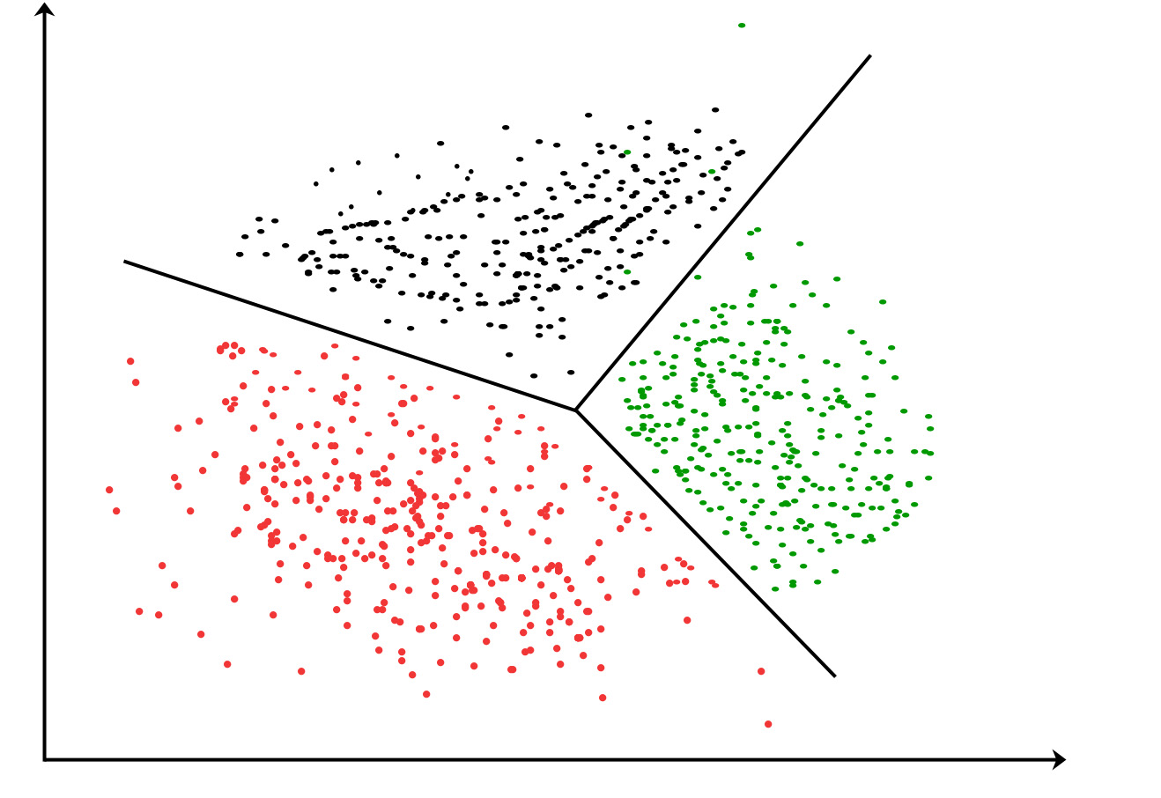
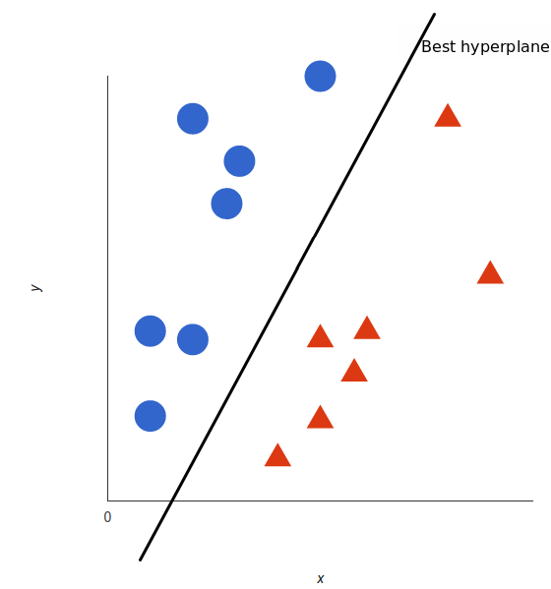
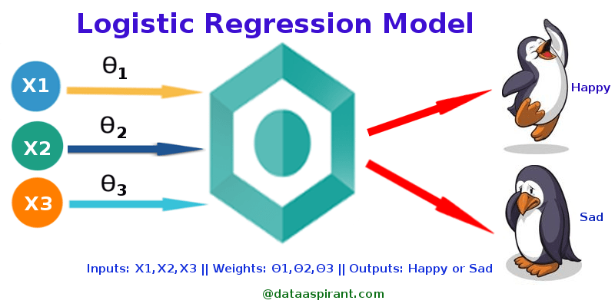
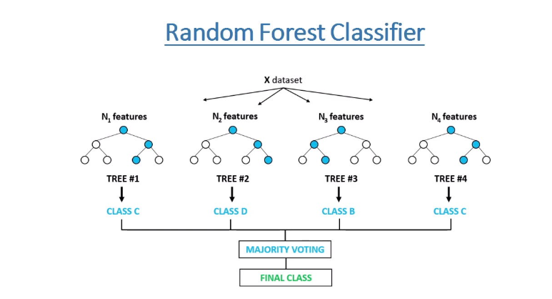
Modeling
PROBLEM 1
Find the predictors that determine whether the user will sign up for the app or not.
For Finding the feature importance we can use –
Decision Tree Classifier, or Random Forest Classifier or Gradient Boosting Model.
Other Factor that will be taken into consideration for choosing a particular model –
Since dataset will be imbalanced the output might be impacted
Checking linearity of the data : If residual error of logistic regression is high then we will go for complex model like SVM Kernel.
PROBLEM 2
To classify or cluster the users based on the frequency of use of the app
1. In case the dataset by HINTS does not have a target/dependent variable then we will apply Clustering for Unsupervised Modeling Analysis. We can implement K-means model to cluster the users based on their use of the app.
2. Now if, the dataset by HINTS does have a target or dependent variable then we can go for multiclass classification models like Support Vector Machine (SVM) or KNN for supervised Modeling Analysis.
Notes:
* We assume that our dataset has a binary target variable.
* Our problem is to find the important predictors that determine users’ signing up behavior

