Slide 1


Abhijit Zarekar
Samridhi Sachdeva
Shubhangi Goyal
Sai Nischith Vangala

Slide 2


Section A – Looking for Health Information
Health Information is helping us understand the need of patients for health information and their interest towards the health-related knowledge
Variable Name | Variable Description | Intuition Behind Choosing
AdultsInHH | If more than one adult (>18 yrs) in household (Y/N) | Adults have high chances of using app
MailHHAdults | How many adults (Integer) | Adults have high chances of using app
SeekHealthInfo | Whether looked info about health topics from any source (Y/N) | Tells about interest for health information
WhereSeekHealthInfo | First go-to for seeking health info (Multiclass categorical var - 12 classes that can be bucketed into 3: Paper based, Internet based and care provider) | People with internet as first preference will be willing to register on app
SeekCancerInfo | Whether looked ino about cancer (Y/N) | Person in need of cancer related information can be signing up or using the app more
Notes:
paper based : books, magazines, brochures, newspapers

Slide 3



Section B – Using Internet to Find Information
To provide a sentinel view of how the public is interacting with information
in the environment to address their health needs
Variable Name | Variable Description | Intuition Behind Choosing
Internet_Cell | Access to cellular n/w (Y/N) | Accessibility to internet is valid for app usage
Internet_WiFi | Access to wireless n/w (Y/N) | Accessibility to internet is valid for app usage
WhereUseInernet_MobileDevice | How often internet is used on mobile device (Daily/ Sometimes/ Never/ NA) | Indicates internet use of people
HaveDevice_Tablet | Have tablet computer | If people do not have device, they won’t sign up for app
HaveDevice_SmartPh | Have smart phone | If people do not have device, they won’t sign up for app
HaveDevice_CellPh | Have basic cell phone only | If people do not have device, they won’t sign up for app
HaveDevice_None | None of the devices owned | If people do not have device, they won’t sign up for app
TabletHealthWellnessApps | Whether any health app on device (Y/N/Don’t know) | To analyze if person is aware about health awareness apps
Tablet_AchieveGoal | Whether health app helped to track progress on health goal (Y/N) | To analyze the impact of their past usage of any other health app
Tablet_MakeDecision | Whether health app helped to treat an illness or condition (Y/N) | To analyze the impact of their past usage of any other health app
Tablet_DiscussionsHCP | Whether health app helped in discussion with care provider (Y/N) | To analyze the impact of their past usage of any other health app
SharedHealthDeviceInfo | If any health info shared with a health professional (Y/N) | To analyze if the user has any privacy concerns which may reduce chances of signing up
IntRsn_SharedSocNet | Whether visit social networking sites (Y/N) | Analyze social media interaction and activity
Notes:
health goal: losing weight; quit smoking

Slide 4
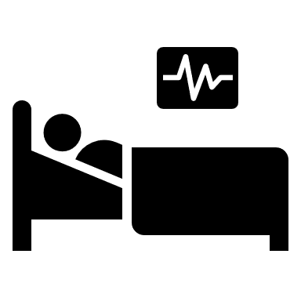



Section C – Your Health Care
Health Information is helping us understand the need of patients for health information and their interest towards the health-related knowledge
Variable Name | Variable Description | Intuition Behind Choosing
HealthIns_InsuranceEmp | Insurance through current or former employer or union (Y/N) | To analyze type of insurance that increases likelihood of registration
HealthIns_InsurancePriv | Insurance directly purchased from company (Y/N) | To analyze type of insurance that increases likelihood of registration
HealthIns_Medicare | Medicare insurance (Y/N) | To analyze type of insurance that increases likelihood of registration
HealthIns_Medicaid | Medicaid insurance (Y/N) | To analyze type of insurance that increases likelihood of registration
HealthIns_Tricare | Tricare or other military health care (Y/N) | To analyze type of insurance that increases likelihood of registration
HealthIns_VA | Used or enrolled for VA health care (Y/N) | To analyze type of insurance that increases likelihood of registration
HealthIns_IHS | Used or enrolled in Indian Health Service (Y/N) | To analyze type of insurance that increases likelihood of registration
HealthIns_Other | Any other insurance (Y/N) | To analyze type of insurance that increases likelihood of registration
ProbCare_BringTest | If had to carry test result to appt (Y/N) | Might help in analyzing the reason of people engaging with the app
ProbCare_WaitLong | If had to wait longer for test results (Y/N) | Might help in analyzing the reason of people engaging with the app
ProbCare_RedoTest | If had to repeat tests because of non availability of previous (Y/N) | Might help in analyzing the reason of people engaging with the app
ProbCare_ProvideHist | If had to provide history again because of loss of chart (Y/N) | Might help in analyzing the reason of people engaging with the app
QualityCare | Rating to quality of healthcare (Multiclass ordinal - classes can be reduced) | Poor quality increases likelihood of patient registration
FreqGoProvider | How many times visited a doctor, nurse (multiclass - can be bucketed accorded to frequency in data) | Frequently visiting patients will sign up/use app more
MostRecentCheckup2 | How long it’s been since last routine checkup | Person who recently visited a doctor will sign up/use app
Notes:
FreqGoProvider: 1 time, 2,3,4,5-9,10 or more
QualityCare: Excellent, V Good, Good, Fair, Poor

Slide 5







Section D – Medical Records
To explore the diffusion of new health communication channels within and between segments of the national population.
Variable Name | Variable Description | Intuition Behind Choosing
ProviderMaintainEMR2 | If provider maintain medical records in computerized system (Y/N/Don’t know) | Patient might sign up to access records that provider is using
ConfidentInfoSafe | Confidence about your medical records being protected | If concerned about privacy patient may not install the app
AccessOnlineRecord | How many times online health record accessed | Analyze frequency of accessing records
NotAccessed_SpeakDirectly | If prefer to speak to provider directly (Y/N) | Might not sign up if prefers communicating directly
NotAccessed_NoInternet | If no way to access the website (Y/N) | Won’t sign up if no access to internet
NotAccessed_NoNeed | If no need for online medical record (Y/N) | Won’t sign up if does not feel the need to access record online
NotAccessed_ConcernedPrivacy | If not accessed info due to privacy concern (Y/N) | Won’t sign up if concerned about privacy
NotAccessed_NoRecord | If not accessed because no online record (Y/N) | Won’t sign up if has no online record
RecordsOnline_RefillMeds | If accessed, for medical refill or medications (Y/N) | Analyze purpose of accessing online records
RecordsOnline_Paperwork | If accessed, for filing paperwork (Y/N) | Analyze purpose of accessing online records
RecordsOnline_RequestCorrection | If accessed, for requesting correction in info (Y/N) | Analyze purpose of accessing online records
RecordsOnline_MessageHCP | If accessed, for securely messaging care provider (Y/N) | Analyze purpose of accessing online records
RecordsOnline_DownloadHealth | If accessed, for downloading info to device (Y/N) | Analyze purpose of accessing online records
RecordsOnline_AddHealthInfo | If accessed for adding info to share with care provider (Y/N) | Analyze purpose of accessing online records
RecordsOnline_MakeDecision | If accessed, did it help you treat illness (Y/N) | Analyze purpose of accessing online records
Esent_AnotherHCP | If medical info shared to HCP (Y/N) | Efficient to share electronically available records
Esent_Family | If medical info shared with family member (Y/N) | Efficient to share electronically available records
Esent_HealthApp | If app helped to manage and store health info (Y/N) | Efficient to share electronically available records
UsefulOnlineMedRec | How useful was online record in monitoring health | Efficient to share electronically available records
WithheldInfoPrivacy | If health info not shared with HCP because of privacy or security concern (Y/N) | Won’t sign up if concerned about privacy
EverOfferedAccessRec | If offered online access by provider or insurer (Y/N/Don’t know) | To analyze who can be more influential in sign ups
WhoOffered_HCP | If offered, by whom: HCP? (Y/N) | To analyze who can be more influential in sign ups
WhoOffered_Insurer | If offered, by whom: Insurer? (Y/N) | To analyze who can be more influential in sign ups
WhoOffered_Other | If offered, by whom: Any other? (Y/N) | To analyze who can be more influential in sign ups
Notes:
ConfidentInfoSafe: Very/ Somewhat or not\
UsefulOnlineMedRec: not/somewhat/not at all

Slide 6








Section G and I – Your Overall Health
To generate research questions and hypotheses for further exploration using complementary methodologies
Variable Name | Variable Description | Intuition Behind Choosing
GeneralHealth | Rate own health (Excellent/ V Good/ Good/ Fair or Poor) | A healthy person might be more concerned and using the app more
OwnAbilityTakeCareHealth | Confidence on taking own care (Completely/ Very/ Somewhat/ Little) | If person is not confident then would sign up in order to take assistance of the app
Height_Feet | Height in feet | Helps in BMI calculation; can be compelling reason to sign up
Height_Inches | Height in inches | Helps in BMI calculation; can be compelling reason to sign up
Weight | Weight in pounds | Helps in BMI calculation; can be compelling reason to sign up
MedConditions_Diabetes | If patient has diabetes (Y/N) | Track which group of chronic disease people sign up and use app more
MedConditions_HighBP | If patient has High Blood Pressure (Y/N) | Track which group of chronic disease people sign up and use app more
MedConditions_HeartCondition | If patient has a Heart Condition (Y/N) | Track which group of chronic disease people sign up and use app more
MedConditions_LungDisease | If patient has Lung Disease(Y/N) | Track which group of chronic disease people sign up and use app more
MedConditions_Arthritis | If patient has Arthritis (Y/N) | Track which group of chronic disease people sign up and use app more
MedConditions_Depression | If patient has Depression (Y/N) | Track which group of chronic disease people sign up and use app more
TimesModerateExercise | How many days in a week the patient exercises | More health freak, more the chances of signing up

Slide 7





Section O – Household and You
Variable Name | Variable Description | Intuition Behind Choosing
Age | Age in yrs | Analyze which age group is more likely to sign up the app
OccupationStatus | Occupational Status - Multiclass categorical | Analyze what is the most common occupation of users
MaritalStatus | Marital Status - Multiclass categorical | Analyze which status is more likely to sign up the app
Education | Highest level of schooling - Multiclass categorical | Analyze which education group is more likely to sign up
SpeakEnglish | How well speak English - Multiclass categorical | Analyze if English proficiency is the reason of not sign up
SelfGender | Gender: Male/ Female | Details out the gender of the person filling forum
IncomeRanges | Annual Income | Analyze income relation with sign up and usage
ChildrenInHH | No of children (<18yrs) in household (Integer) | Analyze whether parents sign up or use the app
ReceivedCareVA | If received care from VA hospital or clinic (Y/N) | To analyze Veteran status
NotHisp Mexican PuertoRican Cuban OtherHisp | Origin | Race Diversity for signup and usage of the app
White Black American AsInd Chinese Filipino Japanese Korean Vietnamese OthAsian Hawaiian Guamanian Samoan OthPacIsl | Race | Race Diversity for signup and usage of the app

Slide 8
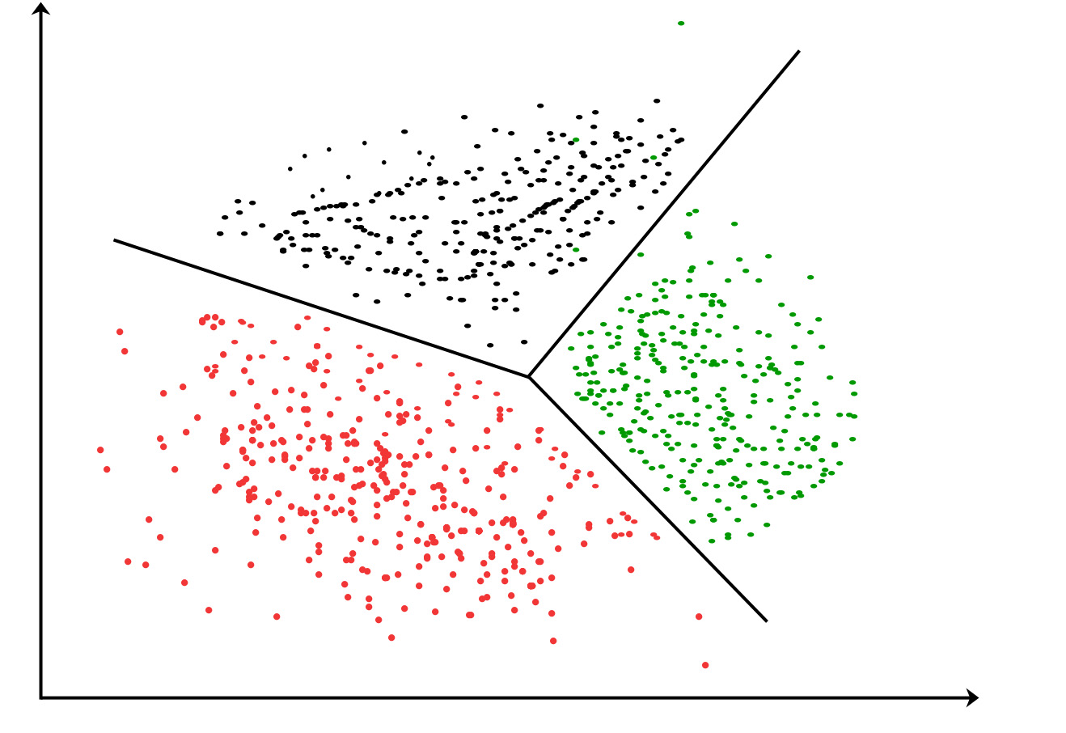
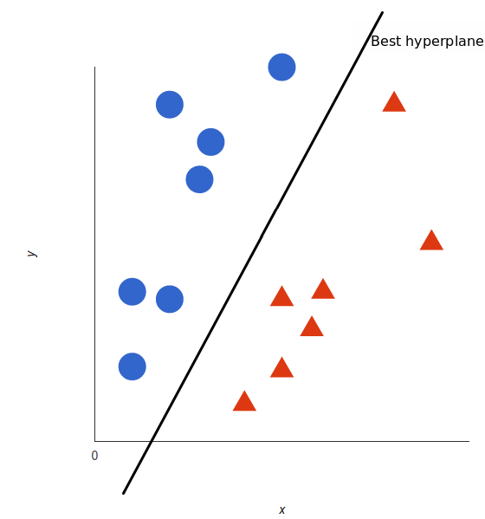
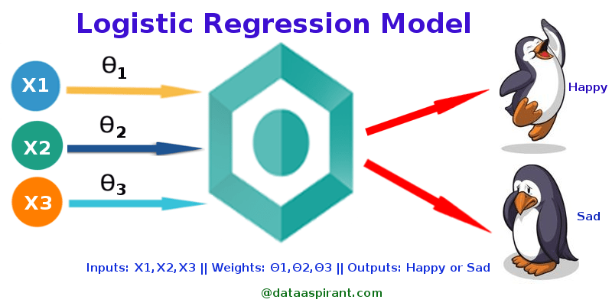
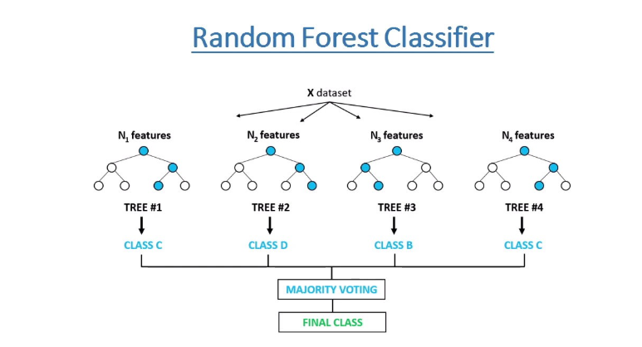
Modeling
PROBLEM 1
Find the predictors that determine whether the user will sign up for the app or not.
For Finding the feature importance we can use –
Decision Tree Classifier, or Random Forest Classifier or Gradient Boosting Model.
Other Factor that will be taken into consideration for choosing a particular model –
Since dataset will be imbalanced the output might be impacted
Checking linearity of the data : If residual error of logistic regression is high then we will go for complex model like SVM Kernel.
PROBLEM 2
To classify or cluster the users based on the frequency of use of the app
1. In case the dataset by HINTS does not have a target/dependent variable then we will apply Clustering for Unsupervised Modeling Analysis.
Here, the target variable indicates frequency of use of the app then we can implement a clustering algorithm like K-means.
2. Now if, the dataset by HINTS does have a target or dependent variable then we can go for Support Vector Machine (SVM) for supervised Modeling Analysis.
Here, the target variable indicates frequency of use of the app then we can implement KNN or SVM models.
Notes:
* We assume that our dataset has a binary target variable.
* Our problem is to find the important predictors that determine users’ signing up behavior

