Slide 1
Accept your assignment from GitHub Classroom
Davis Ranney
09/08/2024

Slide 2
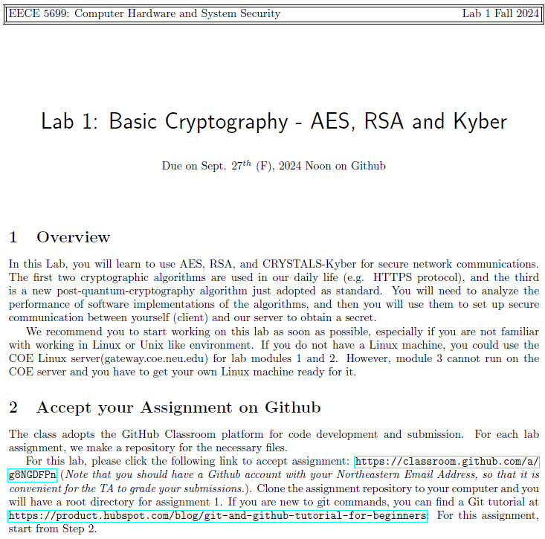
Go to your Lab instruction (.pdf)
Click following link

Slide 3
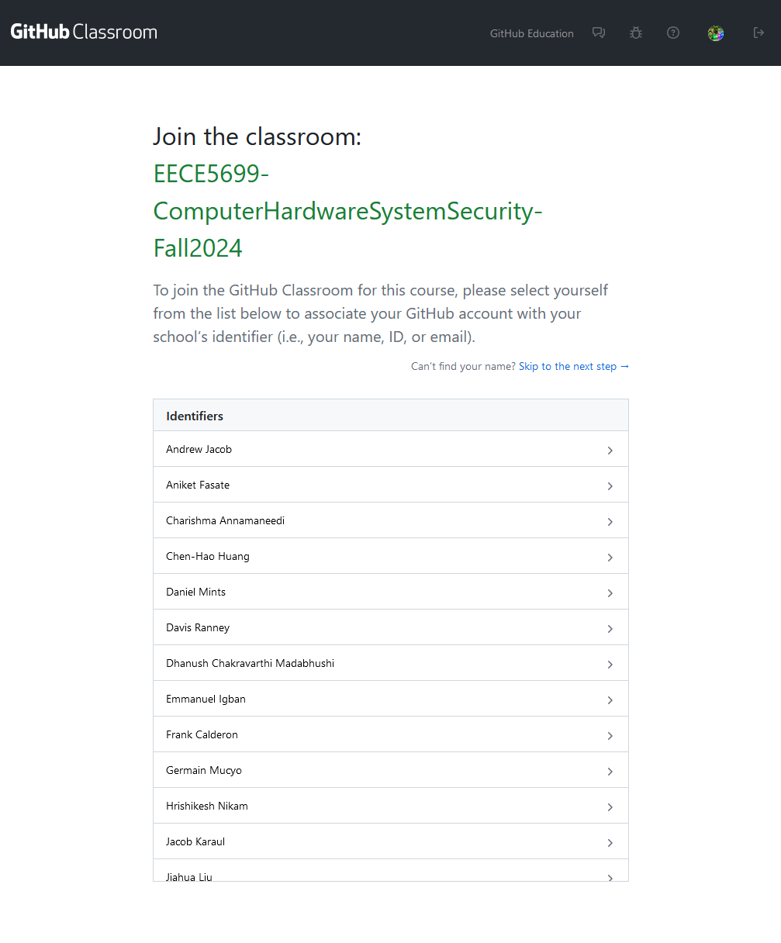
After logging in with your GitHub account, you will see this page.
Find your name in the list
If you cannot find your name, please email to TA and skip to the next step.

Slide 4
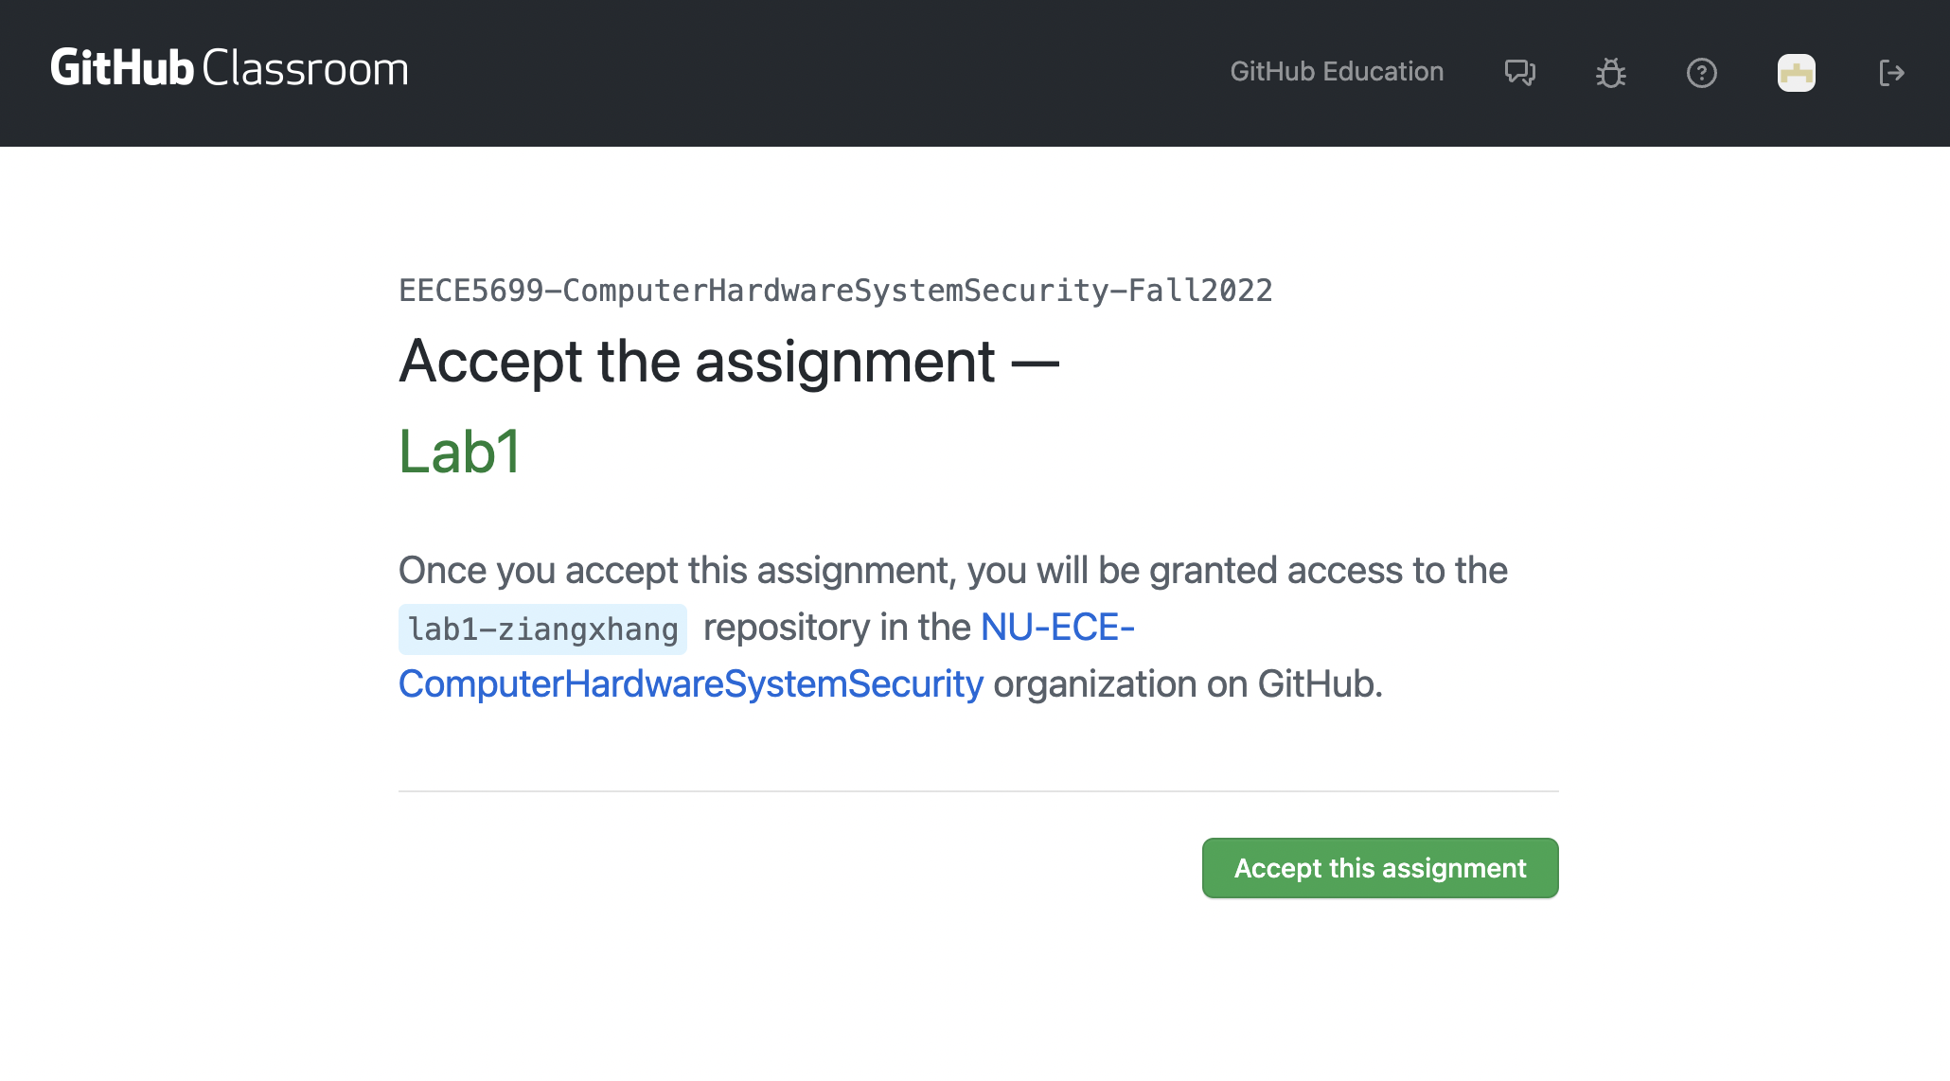
Click ”Accept this assignment”
Note that the suffix will be your account name.

Slide 5
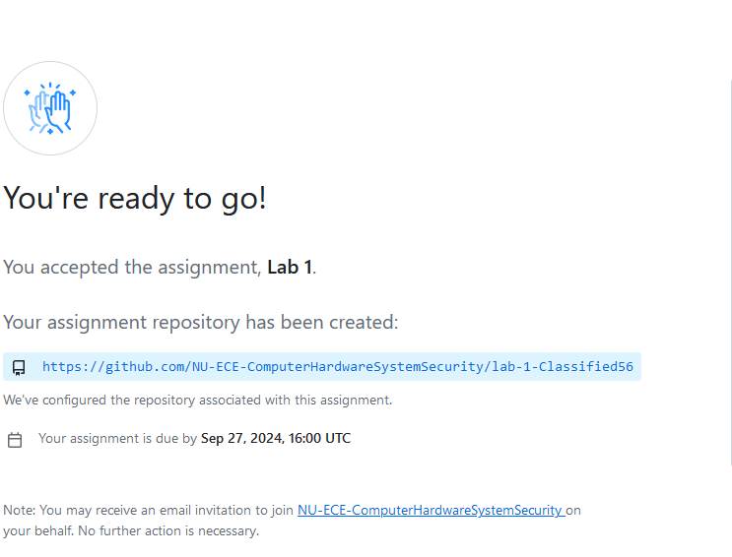
After refreshing, you will see your GitHub link on this page.
Click the link, you will be redirected to your GitHub repository

Slide 6
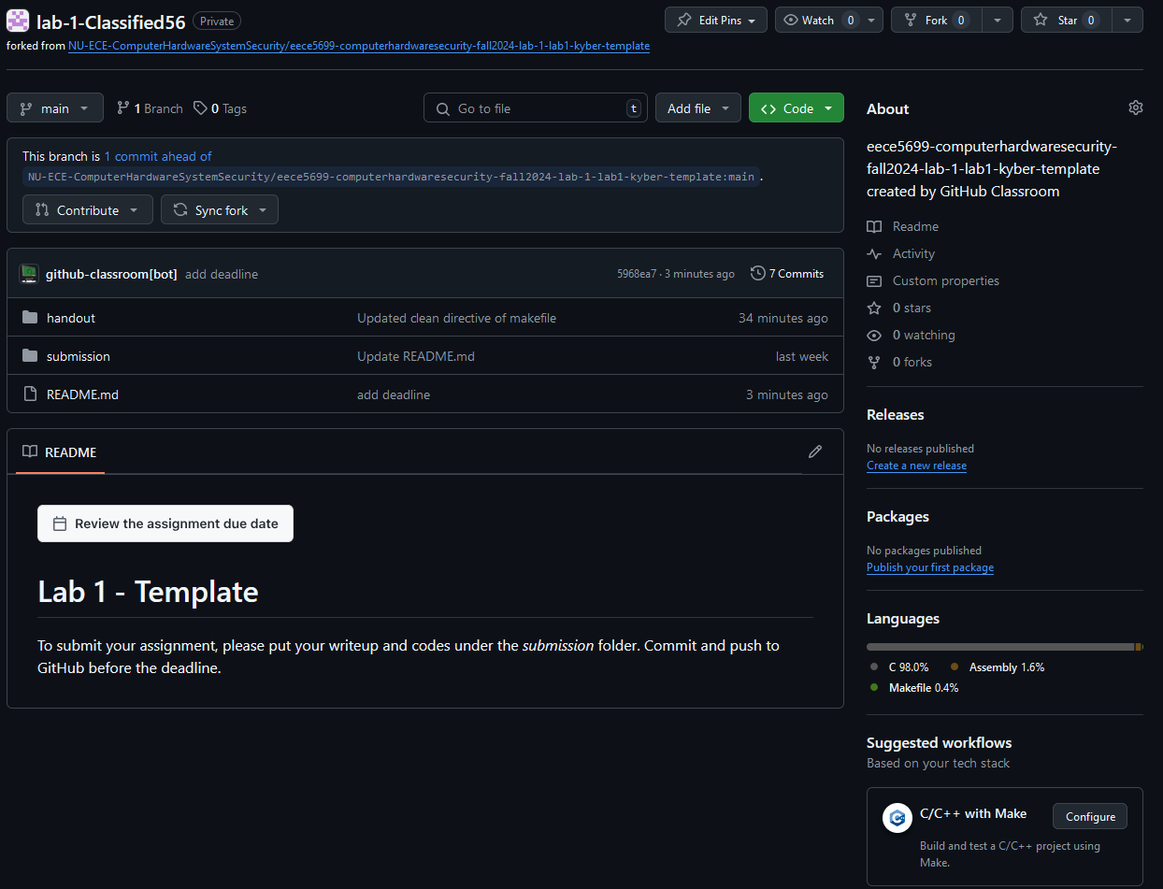
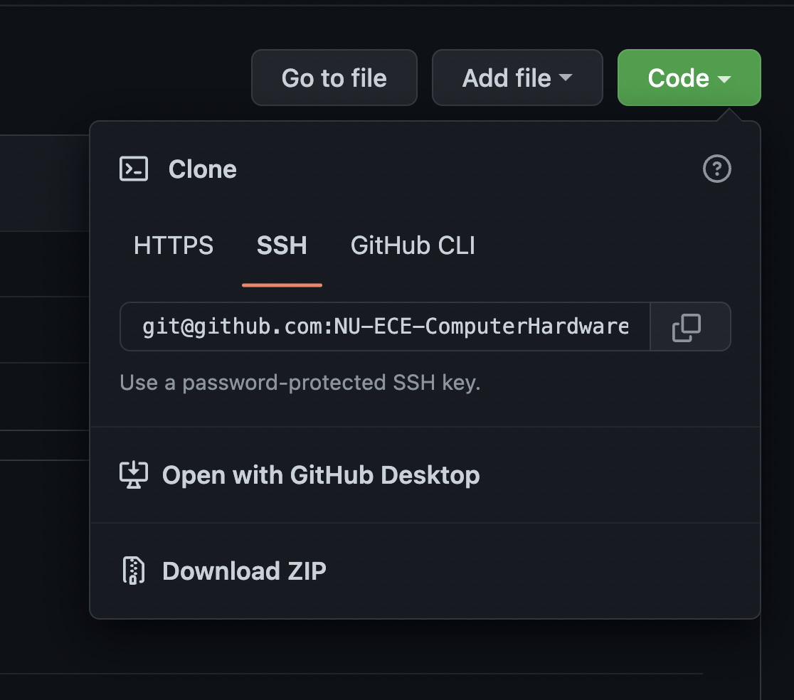
Then you will see this page.
Click “Code”, and you can see the Git link.

Slide 7
Git Commands
I would suggest you add an SSH-key to your GitHub account, which will be more convenient when you pull or push your work.
Please follow this link for adding SSH-key: https://docs.github.com/en/authentication/connecting-to-github-with-ssh/adding-a-new-ssh-key-to-your-github-account
For any other questions, feel free to reach me by Email or MS Teams.
My Email: ranney.d@northeastern.edu

