Slide 1
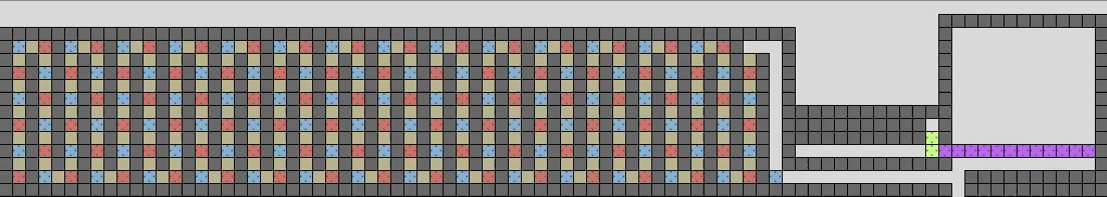
Full Tilt: Universal Constructors for General Shapes
with Uniform External Forces.
January 9, 2019
Jose Balanza-Martinez, David Caballero, Angel Cantu, Luis Garcia,
Austin Luchsinger, Rene Reyes, Robert Schweller, Tim Wylie
University of Texas – Rio Grande Valley

Slide 2
Robotic Motion Planning
Global Signals
Aaron T. Becker, Erik D. Demaine, Sandor P. Fekete, Golnaz Habibi, and James McLurkin,
Reconguring massive particle swarms with limited, global control,
Algorithms for Sensor Systems (2014).

Slide 3
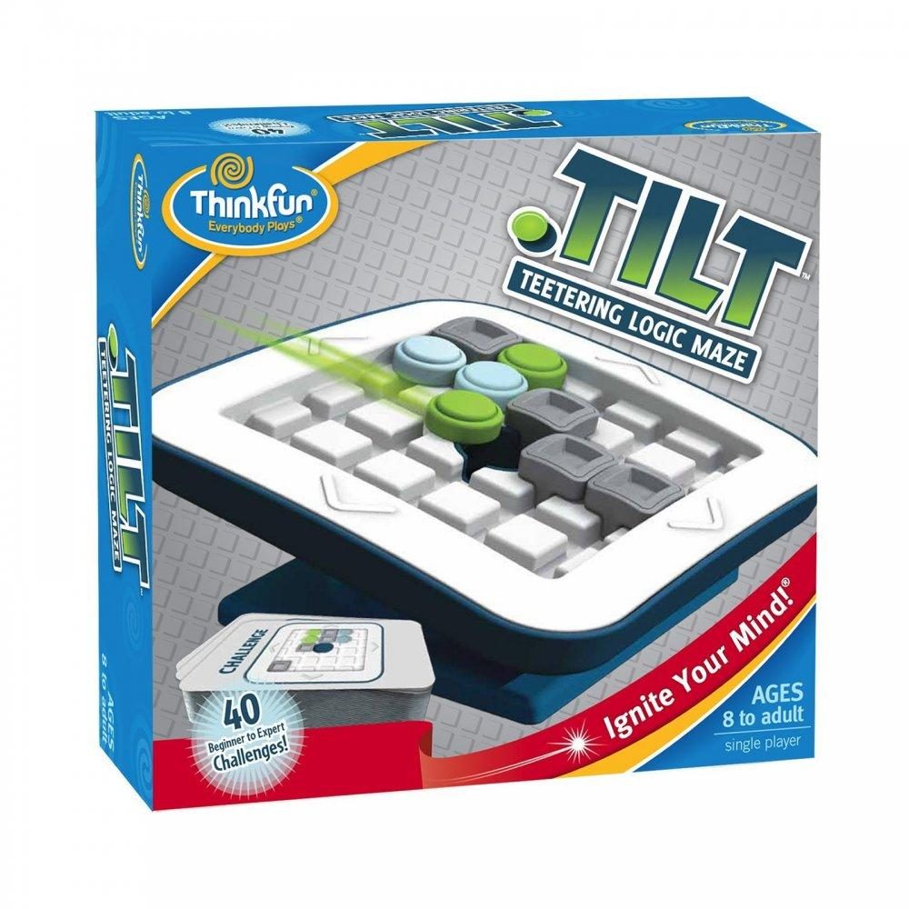
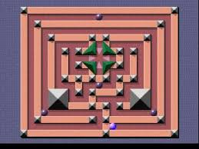
Robotic Motion Planning
Mega Maze – Phillips Media
Tilt – Thinkfun
Aaron T. Becker, Erik D. Demaine, Sandor P. Fekete, Golnaz Habibi, and James McLurkin,
Reconguring massive particle swarms with limited, global control,
Algorithms for Sensor Systems (2014).

Slide 4

Tilt Assembly Model
Elements:
Commands:
Board:
- Free
- Blocked
Polyominoes:
- Red
- Blue
- Combine
Configuration C
- Don’t Combine
- Don’t Combine
Notes:
This is most similar to the gravity-fed logic maze Tilt TM, invented by Vesa Timonen and Timo Jokitalo and distributed by ThinkFun since 2010.

Slide 5
Tilt Assembly Model
Elements:
Commands:
Board:
- Free
- Blocked
Polyominoes:
- Red
- Blue
Configuration C
- Combine
Configuration C′
- Don’t Combine
- Don’t Combine

Slide 6
Micro-Factories
Drop Shapes
Aaron T. Becker, Sandor P. Fekete, Phillip Keldenich, Dominik Krupke, Christian Rieck, Christian Scheer, and Arne Schmidt,
Tilt Assembly: Algorithms for Micro-Factories that Build Objects with Uniform External Forces
28th International Symposium on Algorithms and Computation (ISAAC 2017)

Slide 7
Results Tables
Result | Shape Class | Universal | Tilts | Size | Bonding Complexity | Geometry Complexity | Published
Fixed Shape | DROP | No | O(wh) | O(w³h³) | 2 labels | Complex | (ISAAC 2017)
Problem | Shapes | Complexity | Published

Slide 8
Shape Representation
Weak:
Strong:
Some polyominoes exist
in the configuration which
do not count towards the
shape.
This configuration
represents an ‘A’ shape.
Configuration consists
of a single polyomino.

Slide 9
Shape Construction
We want to transform some initial configuration
into another (via a sequence of tilts) which
represents a desired shape.
⟨ ←, ↑ , … ,↓, → ⟩
C₀
C_{k}

Slide 10
Universal Configuration
A configuration C′ is considered universal to
a set of configurations C = {C₁, C₂, ..., C_{k}} if and only if
C′ can be reconfigured into C_{i} ∀C_{i} ∈ C .
(Strong or weak)
{
}
, …,
⟨ ↑ , ↓ , … , ←, → ⟩
C₁
C_{k}
C′

Slide 11
Pattern Construction
Given two integers w and h, there exists a configuration which is weakly universal for all w x h rectangular binary patterns.
{
}
, …,
C′

Slide 12
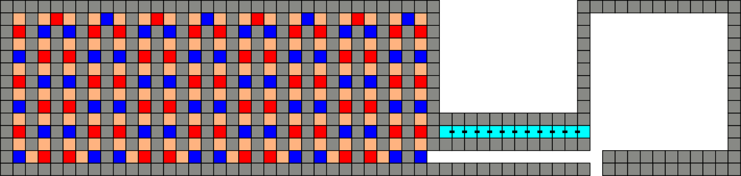
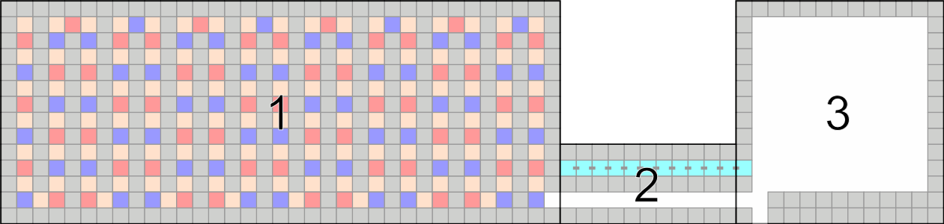
Pattern Construction

Slide 13
Pattern Construction

Slide 14

Pattern Construction
Add Tile:

Slide 15
Pattern Construction
Add Tile:
Remove Tile:

Slide 16
Pattern Construction
Add Tile:
Remove Tile:

Slide 17
Pattern Construction
Add Tile:
Remove Tile:
Add Row:

Slide 18
Weakly Universal Pattern Construction

Slide 19
Results Tables
Result | Shape Class | Universal | Tilts | Size | Bonding Complexity | Geometry Complexity | Published
Fixed Shape | DROP | No | O(wh) | O(w³h³) | 2 labels | Complex | (ISAAC 2017)
Universal Pattern | All | Weakly | O(whk) | O(whk) | k labels | Simple | (SODA 2019)
Problem | Shapes | Complexity | Published

Slide 20
Weakly Universal Shape Constructor
Given two integers w and h, there exists a configuration which is weakly universal for all shapes which fit inside a w x h bounding box.
{
}
, …,
C′

Slide 21
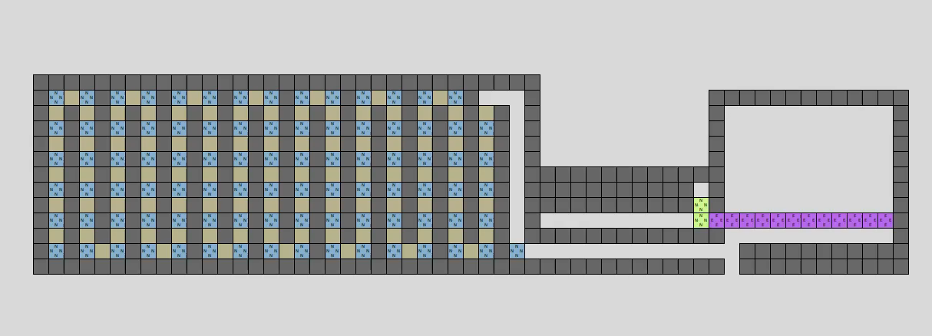
Weakly Universal Shape Constructor

Slide 22
Results Tables
Result | Shape Class | Universal | Tilts | Size | Bonding Complexity | Geometry Complexity | Published
Fixed Shape | DROP | No | O(wh) | O(w³h³) | 2 labels | Complex | (ISAAC 2017)
Universal Pattern | All | Weakly | O(whk) | O(whk) | k labels | Simple | (SODA 2019)
Universal Shapes | All | Weakly | O(wh) | O(wh) | 1 label | Simple | (SODA 2019)
Problem | Shapes | Complexity | Published

Slide 23
Strongly Universal Drop-Shape Constructor
Given two integers w and h, there exists a configuration which is strongly universal for all shapes which fit inside a w x h bounding box.
{
}
, …,
C₁
C_{k}
C′

Slide 24
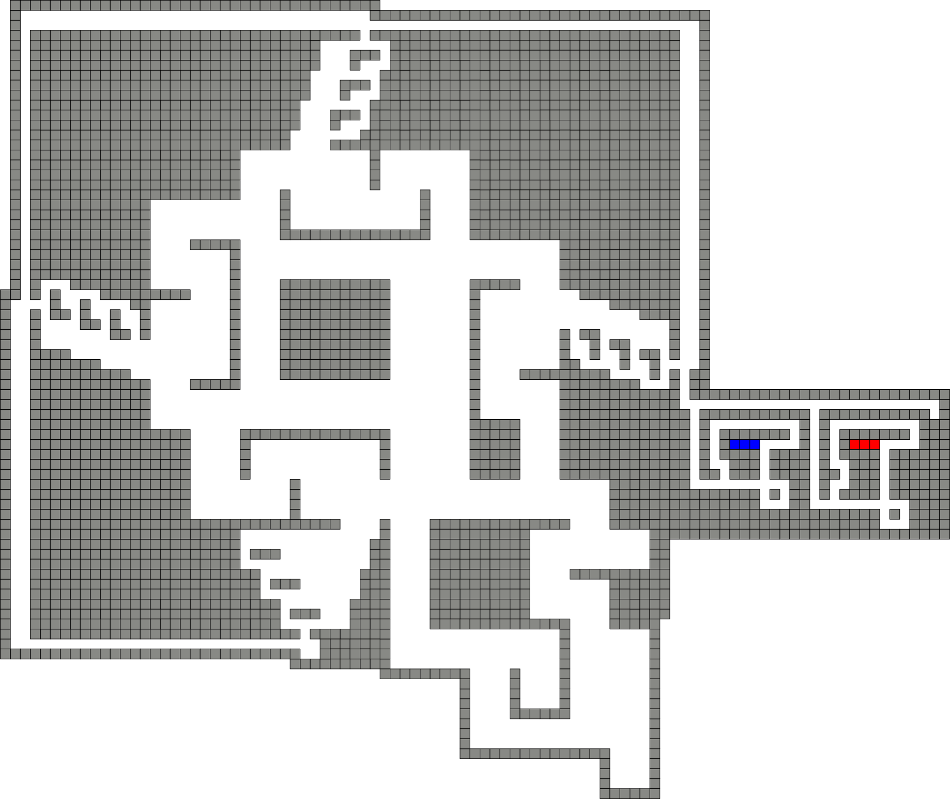
Strongly Universal Drop-Shape Constructor

Slide 25
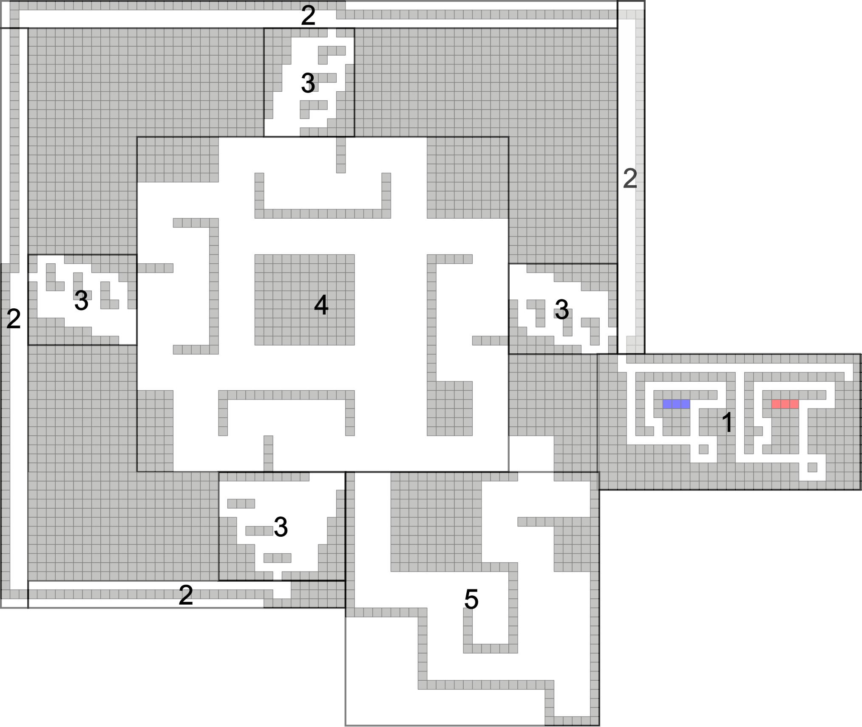
Strongly Universal Drop-Shape Constructor

Slide 26
Strongly Universal Drop-Shape Constructor

Slide 27
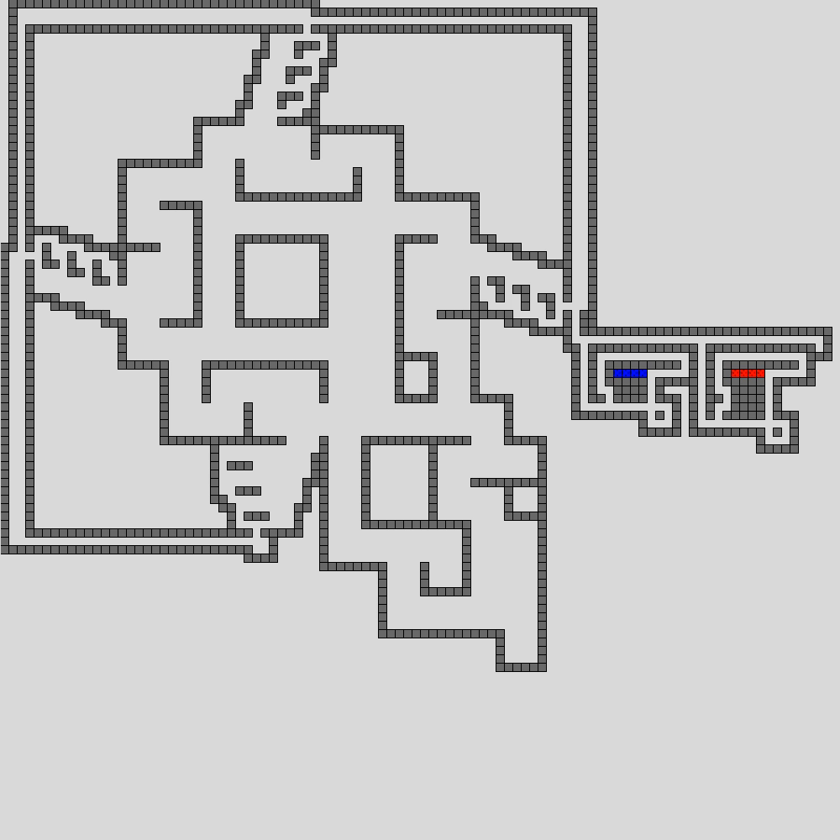
Strongly Universal Drop-Shape Constructor

Slide 28
Results Tables
Result | Shape Class | Universal | Tilts | Size | Bonding Complexity | Geometry Complexity | Published
Fixed Shape | DROP | No | O(wh) | O(w³h³) | 2 labels | Complex | (ISAAC 2017)
Universal Pattern | All | Weakly | O(whk) | O(whk) | k labels | Simple | (SODA 2019)
Universal Shapes | All | Weakly | O(wh) | O(wh) | 1 label | Simple | (SODA 2019)
Universal Shapes | DROP | Strongly | O(wh²) | O(wh²) | 2 labels | Complex | (SODA 2019)
Problem | Shapes | Complexity | Published

Slide 29
Relocation Decision Problem
Relocation Problem. Given an initial configuration C and a specified goal location g, decide if a tilt sequence exists ends with some tile t in g.
?
g
g
⟨ ←, ↑ , … ,↓, → ⟩
C

Slide 30
Reconfiguration Decision Problem
Reconfiguration Problem. Given an initial configuration C and a goal configuration D, decide if a tilt sequence exists that will reconfigure C into D.
?
⟨ ←, ↑ , … ,↓, → ⟩
C
D

Slide 31
Previous Complexity Work
Result | Shape Class | Universal | Tilts | Size | Bonding Complexity | Geometry Complexity | Published
Fixed Shape | DROP | No | O(wh) | O(w³h³) | 2 labels | Complex | (ISAAC 2017)
Universal Pattern | All | Weakly | O(whk) | O(whk) | k labels | Simple | (SODA 2019)
Universal Shapes | All | Weakly | O(wh) | O(wh) | 1 label | Simple | (SODA 2019)
Universal Shapes | DROP | Strongly | O(wh²) | O(wh²) | 2 labels | Complex | (SODA 2019)
Problem | Shapes | Complexity | Published
Relocation | 1x1 | NP-hard | (Natural Computing 2017)
Tilt-minimization | 1x1 | PSPACE-complete | (Natural Computing 2017)
Aaron T. Becker, Erik D. Demaine, Sandor P. Fekete, Jarrett Lonsford, and Rose Morris-Wright,
Particle computation: complexity, algorithms, and logic
Natural Computing (2017).

Slide 32
Toggle Gadgetry
Crossing 2-toggle (C2T)
Erik D. Demaine, Isaac Grosof, Jayson Lynch, and Mikhail Rudoy,
Computational complexity of motion planning of a robot through simple gadgets,
9th International Conference on Fun with Algorithms, (FUN 2018)

Slide 33
Toggle Gadgetry
S
T
Reduced from
3QSAT to show
PSPACE-complete.
Erik D. Demaine, Isaac Grosof, Jayson Lynch, and Mikhail Rudoy,
Computational complexity of motion planning of a robot through simple gadgets,
9th International Conference on Fun with Algorithms, (FUN 2018)

Slide 34
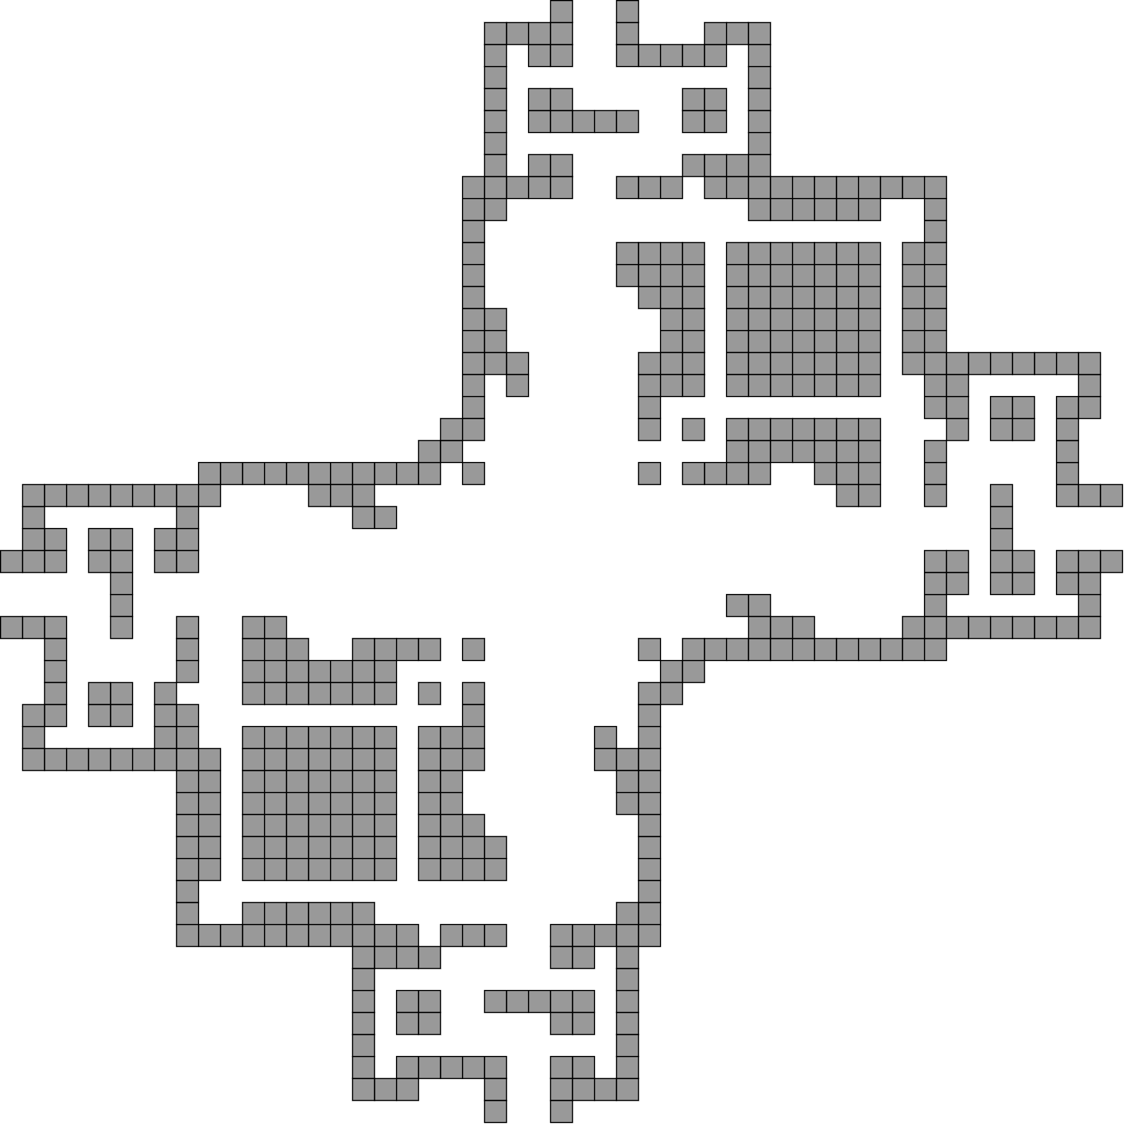
Relocation Complexity

Slide 35
Relocation Complexity

Slide 36
Relocation Complexity

Slide 37
Relocation Complexity

Slide 38
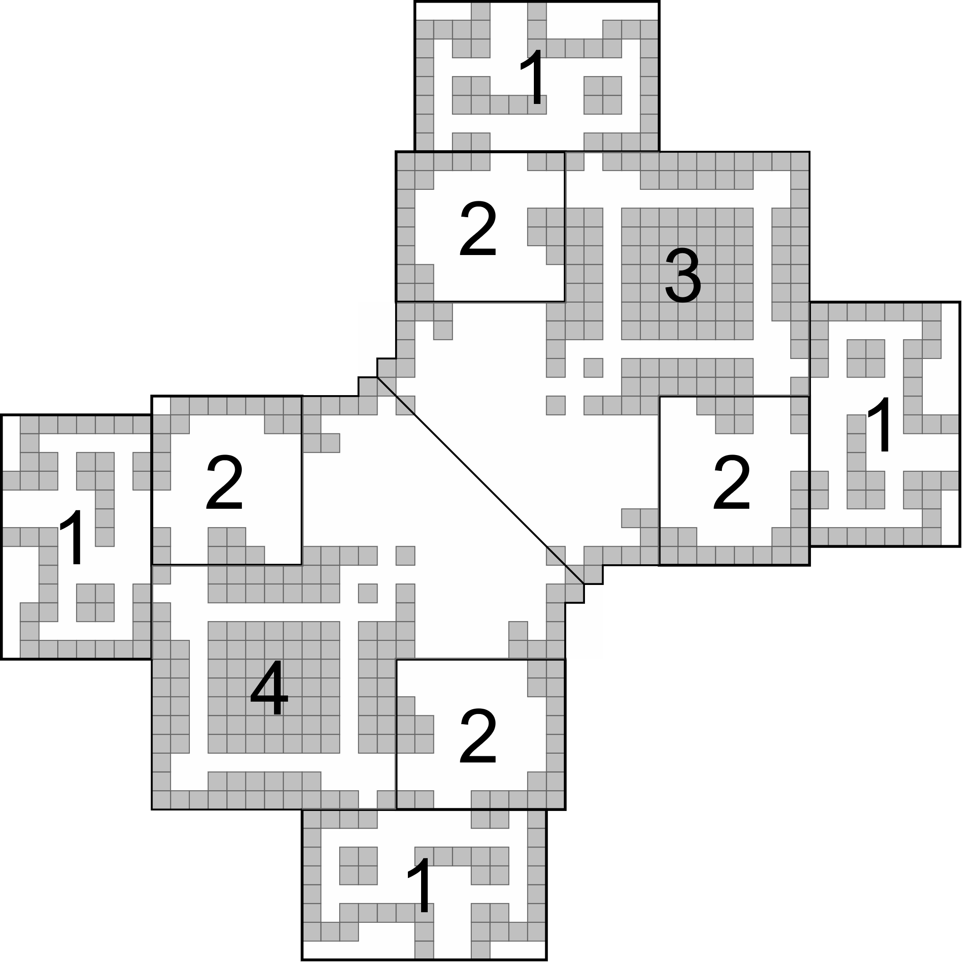
Relocation Complexity

Slide 39
Relocation Complexity

Slide 40
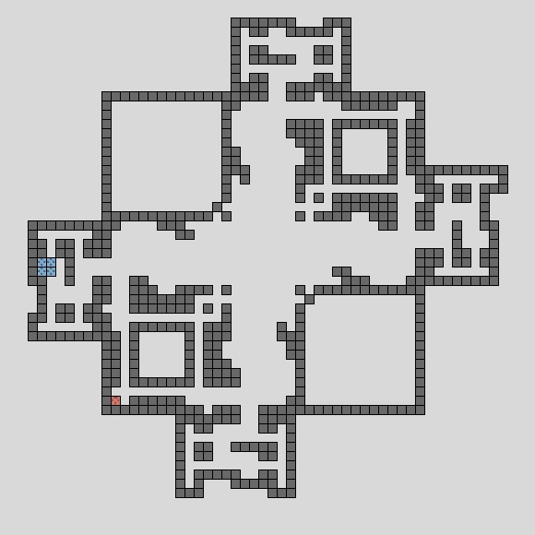
Relocation Complexity

Slide 41
Relocation Complexity Verification
C₁
C₂
C₇
C₆
C₅
C₃
C₈
C₄
C₉
Initial configs.
Valid toggle configs.
Invalid toggle configs.

Slide 42
Results Tables
Result | Shape Class | Universal | Tilts | Size | Bonding Complexity | Geometry Complexity | Published
Fixed Shape | DROP | No | O(wh) | O(w³h³) | 2 labels | Complex | (ISAAC 2017)
Universal Pattern | All | Weakly | O(whk) | O(whk) | k labels | Simple | (SODA 2019)
Universal Shapes | All | Weakly | O(wh) | O(wh) | 1 label | Simple | (SODA 2019)
Universal Shapes | DROP | Strongly | O(wh²) | O(wh²) | 2 labels | Complex | (SODA 2019)
Problem | Shapes | Complexity | Published
Relocation | 1x1 | NP-hard | (Natural Computing 2017)
Tilt-minimization | 1x1 | PSPACE-complete | (Natural Computing 2017)
Relocation | 1x1, 2x2 | Weakly | (SODA 2019)

Slide 43
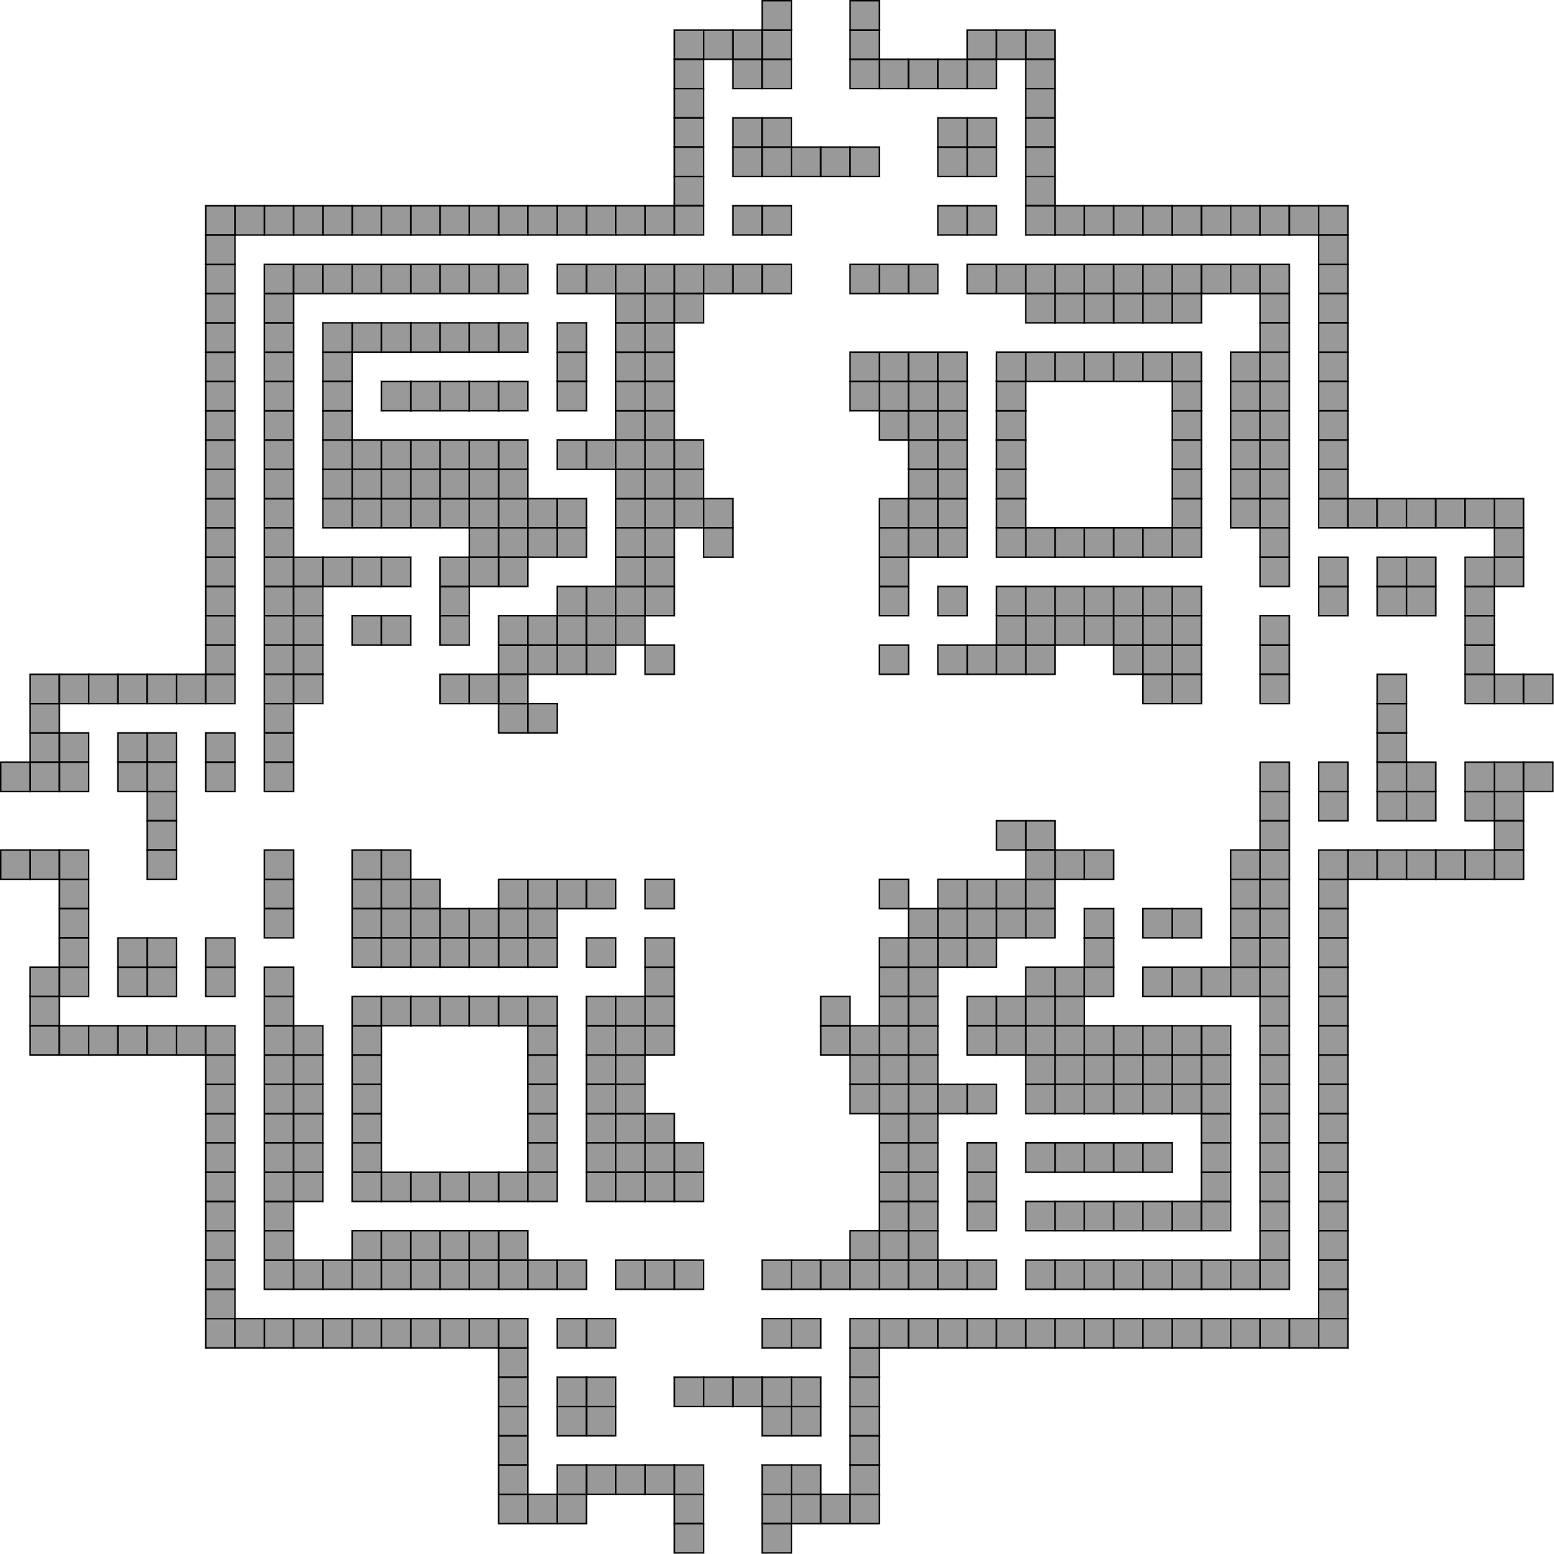
Reconfiguration Complexity

Slide 44
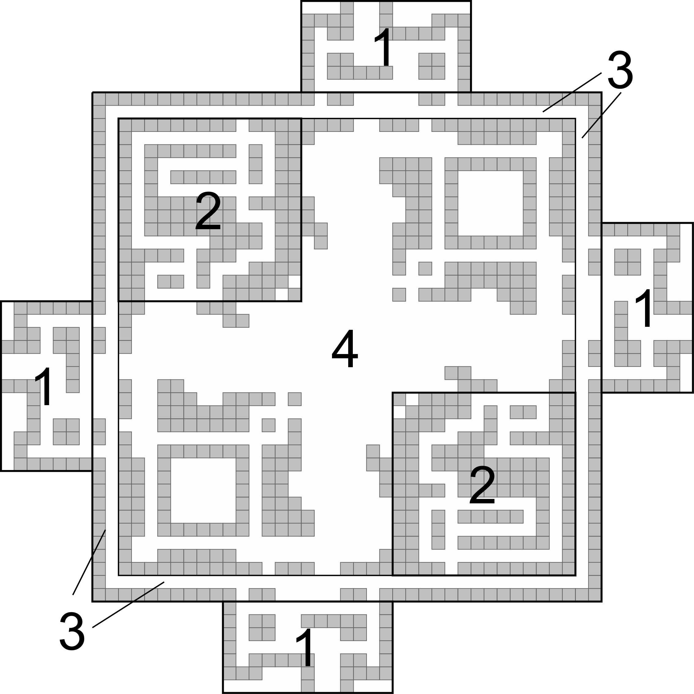
Reconfiguration Complexity

Slide 45
Reconfiguration Complexity

Slide 46
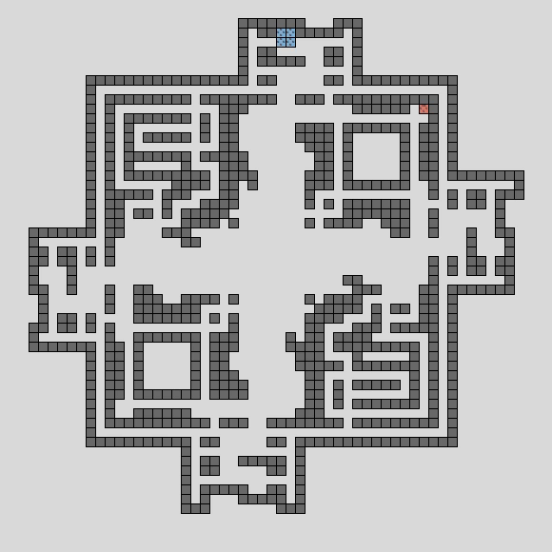
Reconfiguration Complexity

Slide 47
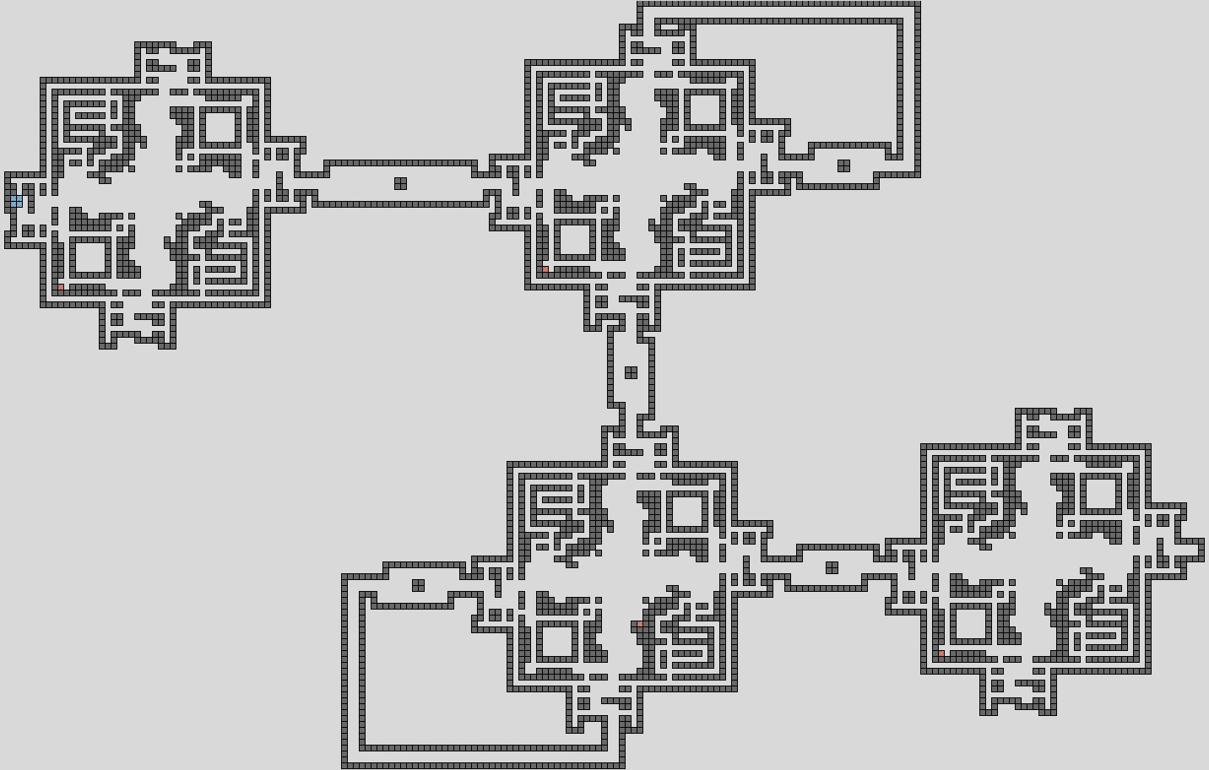
Reconfiguration Complexity

Slide 48
Results Tables
Result | Shape Class | Universal | Tilts | Size | Bonding Complexity | Geometry Complexity | Published
Fixed Shape | DROP | No | O(wh) | O(w³h³) | 2 labels | Complex | (ISAAC 2017)
Universal Pattern | All | Weakly | O(whk) | O(whk) | k labels | Simple | (SODA 2019)
Universal Shapes | All | Weakly | O(wh) | O(wh) | 1 label | Simple | (SODA 2019)
Universal Shapes | DROP | Strongly | O(wh²) | O(wh²) | 2 labels | Complex | (SODA 2019)
Problem | Shapes | Complexity | Published
Relocation | 1x1 | NP-hard | (Natural Computing 2017)
Tilt-minimization | 1x1 | PSPACE-complete | (Natural Computing 2017)
Relocation | 1x1, 2x2 | PSPACE-complete | (SODA 2019)
Reconfiguration | 1x1, 2x2 | PSPACE-complete | (SODA 2019)

Slide 49
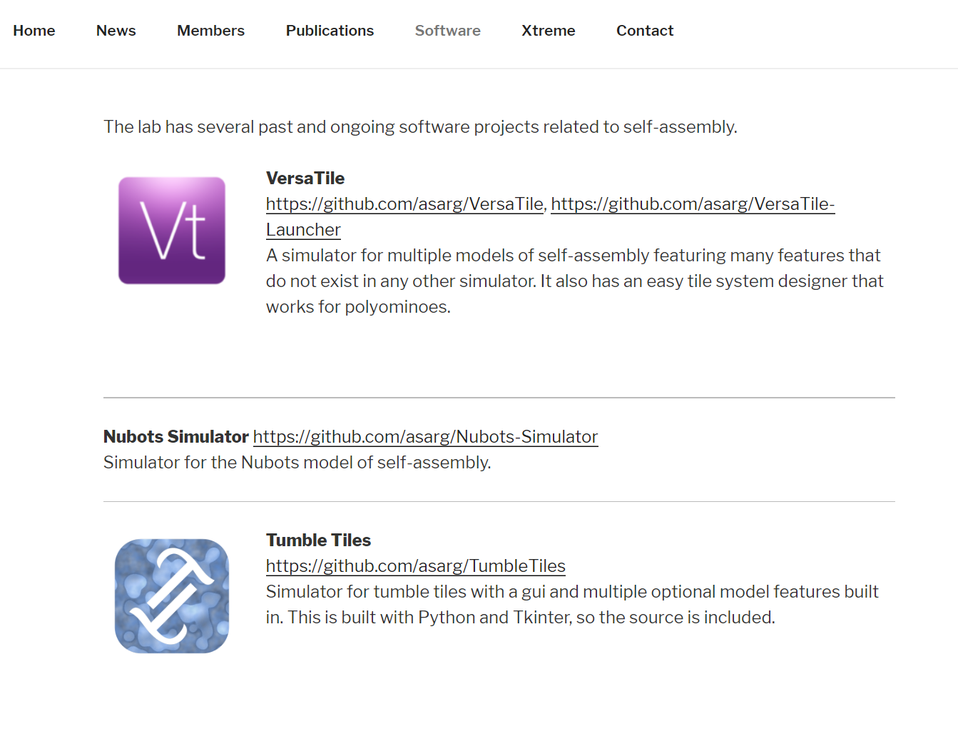
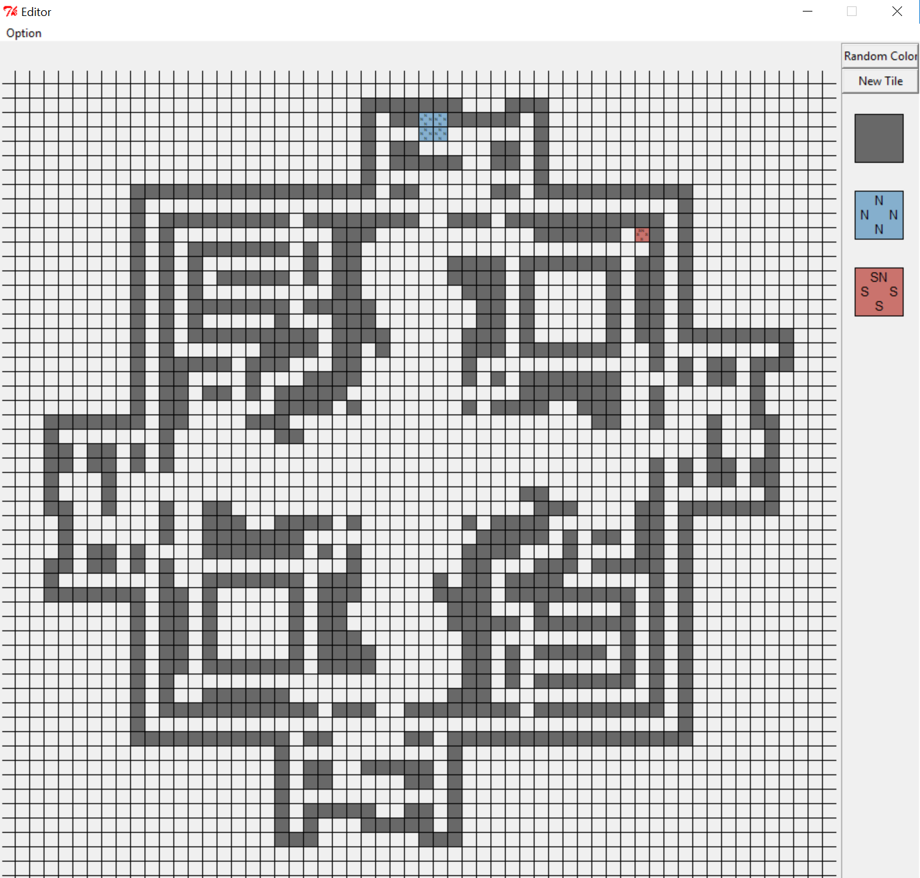
Simulator
https://asarg.hackresearch.com/main/software/.

Slide 50
Future Work
Create a strongly universal constructor for ALL shapes?
Relocation/Reconfiguration Complexity with all 1x1’s?
Single Step rather than maximal movement?
Limit the directions in which the board can tilt?

Slide 51
Thank You!

