Slide 1
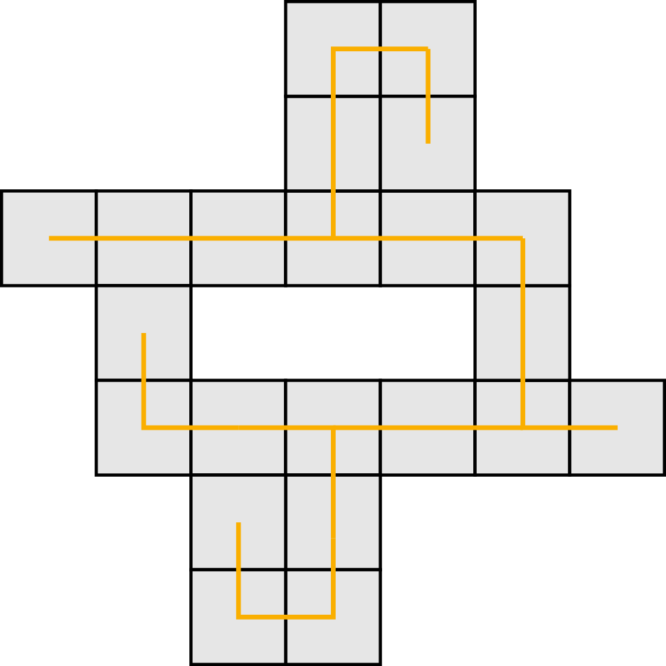
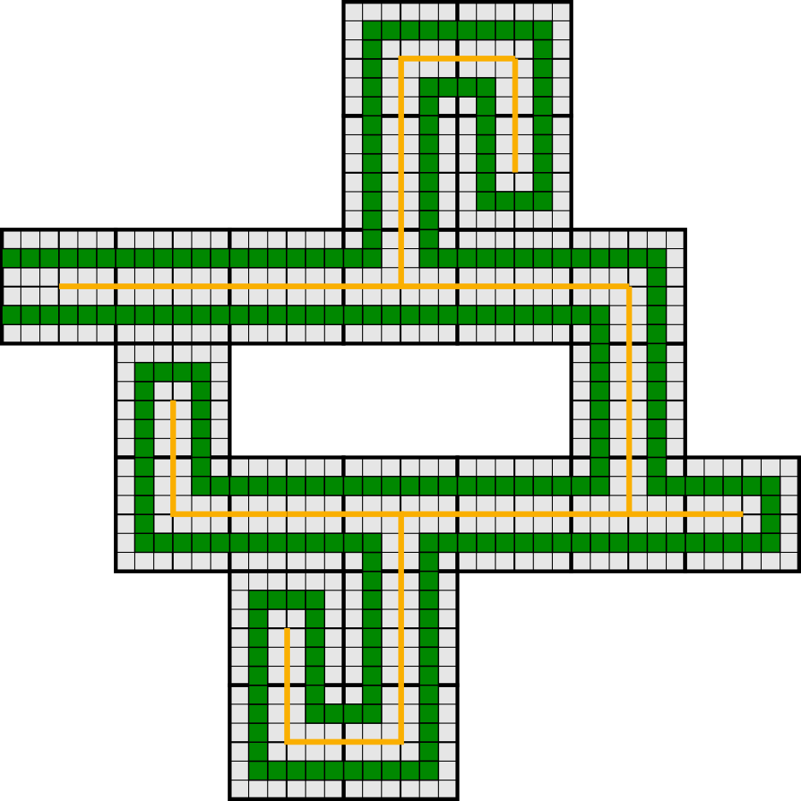
Self-Assembly of Shapes at Constant Scale
Using Repulsive Forces
June 9, 2017
Austin Luchsinger¹, Robert Schweller¹, Tim Wylie¹
¹University of Texas – Rio Grande Valley

Slide 2
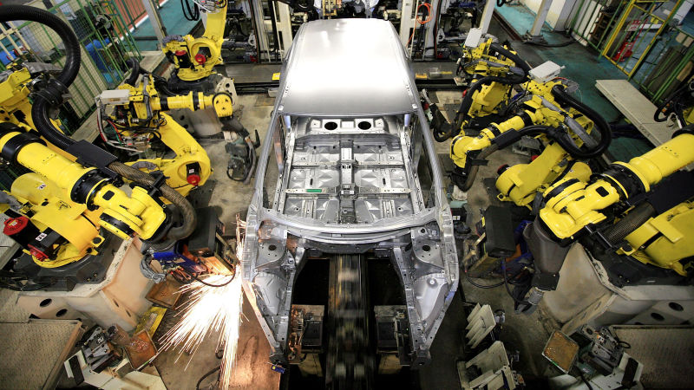
Motivation
Relatively large items are fabricated
in a sort of “top-down” fashion.
That is, an outside actor manipulates
the components to build the object.
auto.howstuffworks.com

Slide 3
Motivation
But what if you want to build something with a width of just a few atoms?

Slide 4
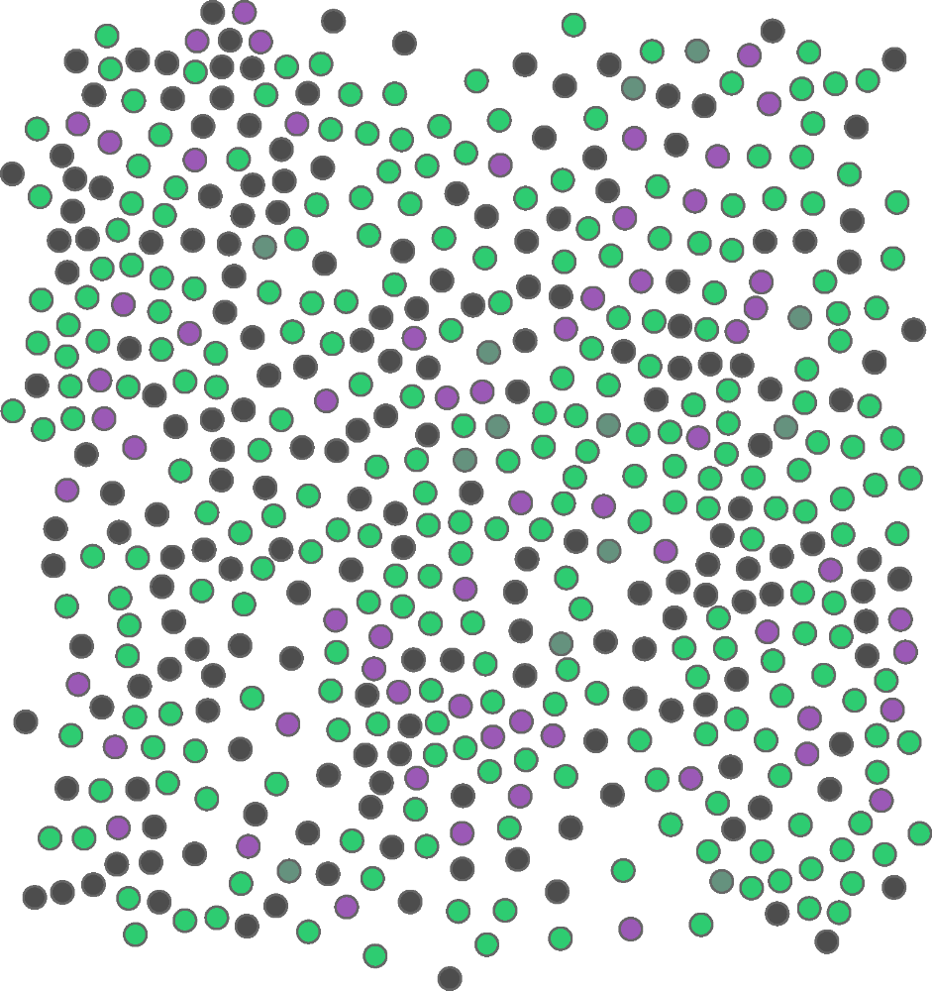
Self-Assembly
Simple particles autonomously come
together to form complex structures.

Slide 5
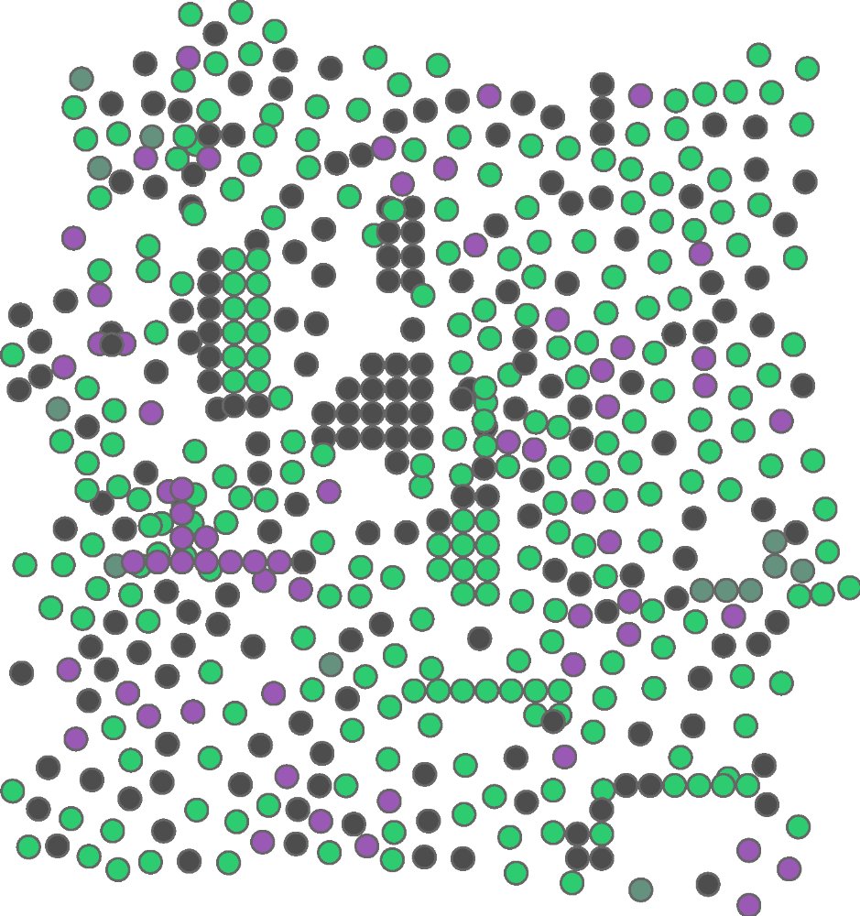
Self-Assembly
Simple particles autonomously come
together to form complex structures.

Slide 6
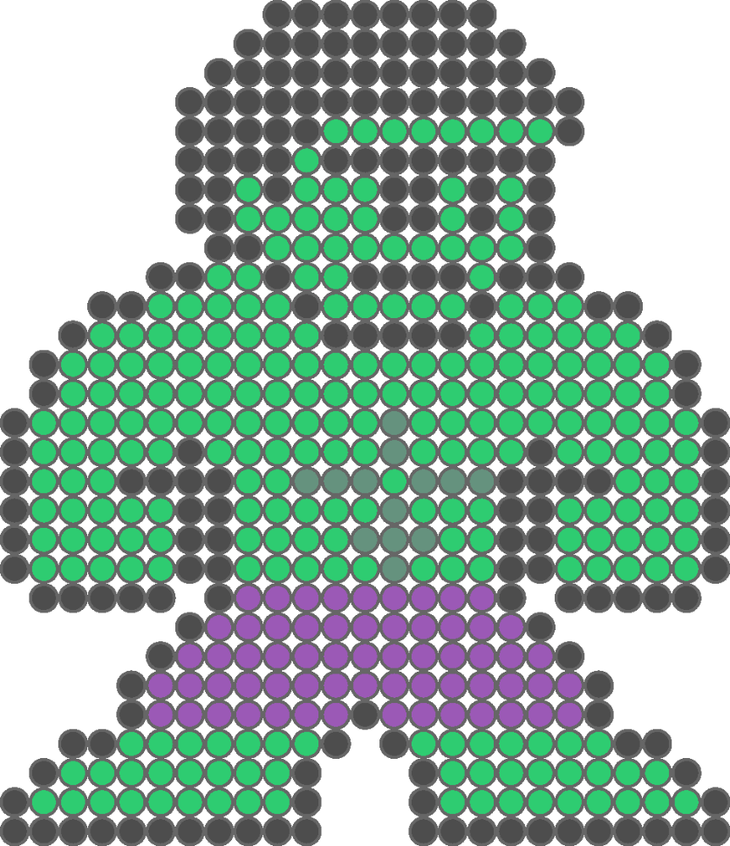
Self-Assembly
Simple particles autonomously come
together to form complex structures.
Courtesy of Eric Martinez

Slide 7
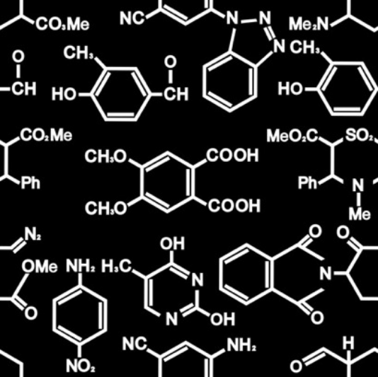
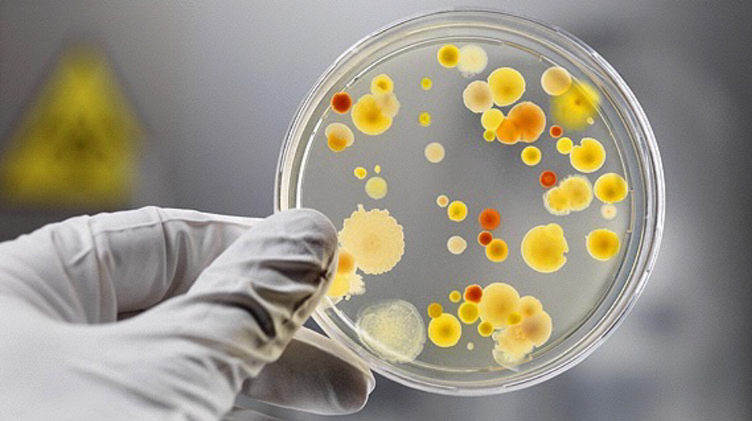
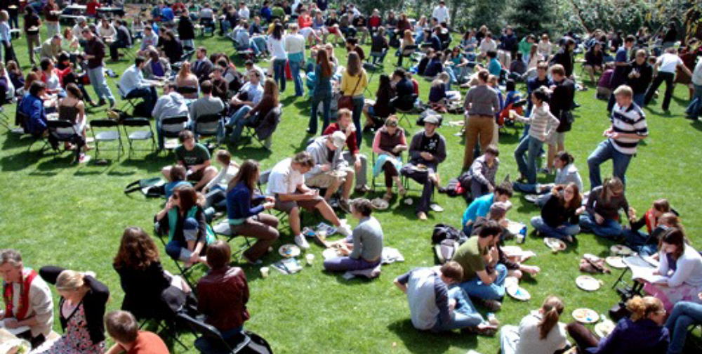
Self-Assembly
Chemistry
Biology
Sociology

Slide 8
Self-Assembly
Biology

Slide 9
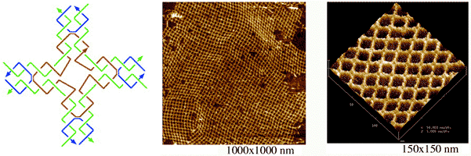
Self-Assembly
- Yan, H., Park, S.H., Ginkelstein, G., Reif, J.H. & LaBean, T.H.

Slide 10
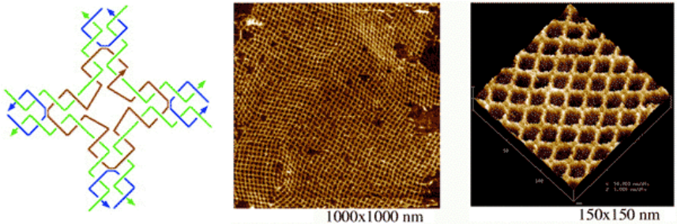
Self-Assembly
(Winfree, 1998)

Slide 11
Tile Self-Assembly
Type = green
Type = purple

Slide 12
Tile Self-Assembly
Strength = 2
Strength = 1

Slide 13
Tile Self-Assembly
Rotation
Translation

Slide 14
Tile Self-Assembly (2HAM)
(Rothemund, Winfree, Adleman)
Tileset:
Temperature:
2
1
∞ counts of each
tile type

Slide 15
Tile Self-Assembly (2HAM)
Tileset:
Temperature:
2
1

Slide 16
Tile Self-Assembly (2HAM)
Tileset:
Temperature:
2
1

Slide 17
Tile Self-Assembly (2HAM)
Tileset:
Temperature:
2
1

Slide 18
Tile Self-Assembly (2HAM)
Tileset:
Temperature:
2
1

Slide 19
Tile Self-Assembly (2HAM)
Tileset:
Temperature:
2
1

Slide 20
Tile Self-Assembly (2HAM)
Tileset:
Temperature:
2
1

Slide 21
Tile Self-Assembly (2HAM)
Tileset:
Temperature:
2
1

Slide 22
Tile Self-Assembly (2HAM)
Tileset:
Temperature:
2
1

Slide 23
Tile Self-Assembly (2HAM)
Tileset:
Temperature:
2
1

Slide 24
Tile Self-Assembly (2HAM)
Tileset:
Temperature:
Terminal
2
1

Slide 25
Tile Self-Assembly (2HAM)
This system produces
a 3x3 square:
Tileset:
Temperature:
2
1
Tile Complexity = 6

Slide 26
Tile Self-Assembly (2HAM)
This system produces
a 3x3 square:
Tileset:
Temperature:
2
1
Goal: What is the minimum tile complexity for assembling an
n x n square?
Tile Complexity = 6

Slide 27
Tile Self-Assembly (2HAM)
This system produces
a 3x3 square:
Tileset:
Temperature:
2
1
Ω( )
Tile Complexity = 6
n x n squares:
log n
log log n
(Rothemund, Winfree, 2000)

Slide 28
Negative Glues
(Patitz, Schweller, Summers, 2011)
Tileset:
Temperature:
2
1

Slide 29
Negative Glues
Tileset:
Temperature:
2
1

Slide 30
Negative Glues
Tileset:
Temperature:
2
1

Slide 31
Negative Glues
Tileset:
Temperature:
2
1

Slide 32
Negative Glues
Tileset:
Temperature:
2
1

Slide 33
Negative Glues
No stages
No enzymes
Simply adding negative glues
We want the ability to
break things apart
+

Slide 34
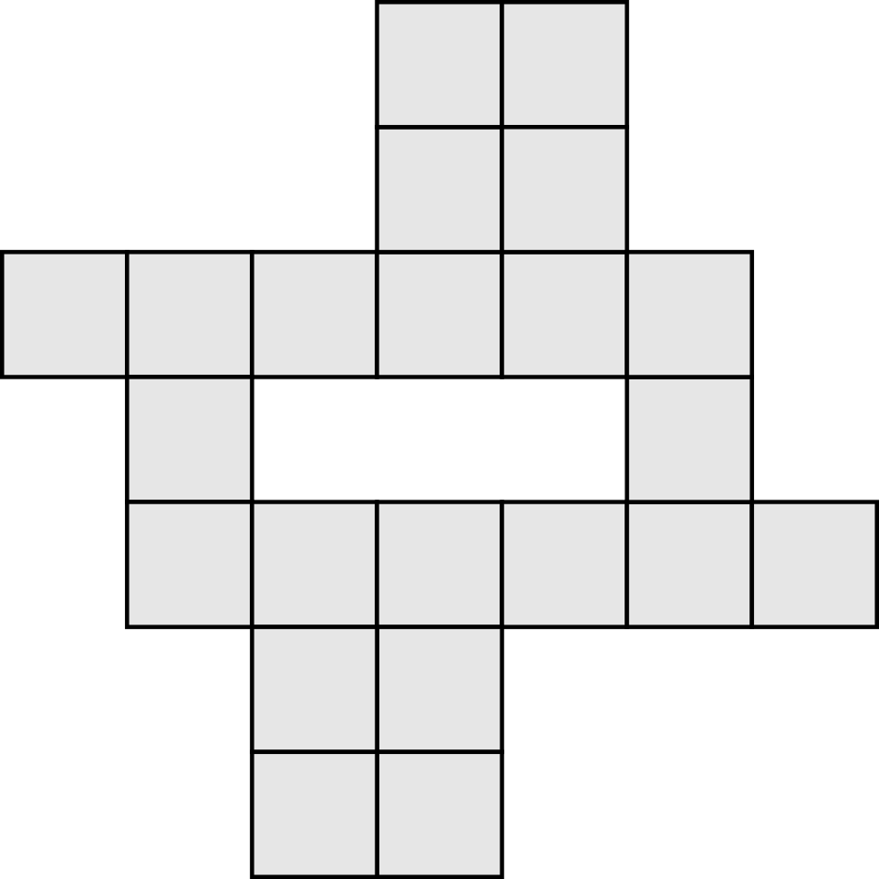
Self-Assembly of Shapes
What if you wanted to assemble an arbitrary shape (S)?
S =

Slide 35
Self-Assembly of Shapes
What if you wanted to assemble an arbitrary shape (S)?
Goal: What is the minimum tile complexity for assembling arbitrary shapes?
S =

Slide 36
Self-Assembly of Shapes
What if you wanted to assemble an arbitrary shape (S)?
Ω( )
K(S)
S =
log(K(S))
(Soloveichik, Winfree, 2007)

Slide 37
Self-Assembly of Shapes
Model | Tile Complexity | Scale Factor
aTAM (Soloveichik, Winfree, 2007)
Staged RNAse (Demaine, Patitz, Schweller, and Summers, 2010)
Negative Glue 2HAM
O( )
K(S)
arbitrary
log(K(S))

Slide 38
Self-Assembly of Shapes
Model | Tile Complexity | Scale Factor
aTAM (Soloveichik, Winfree, 2007)
Staged RNAse (Demaine, Patitz, Schweller, and Summers, 2010)
Negative Glue 2HAM
O( )
K(S)
arbitrary
log(K(S))
O( )
K(S)
logarithmic
log(K(S))

Slide 39
Self-Assembly of Shapes
Model | Tile Complexity | Scale Factor
aTAM (Soloveichik, Winfree, 2007)
Staged RNAse (Demaine, Patitz, Schweller, and Summers, 2010)
Negative Glue 2HAM
O( )
K(S)
arbitrary
log(K(S))
O( )
K(S)
logarithmic
log(K(S))
O( )
K(S)
constant
log(K(S))

Slide 40
Self-Assembly of Shapes
Input
Optimal description
of shape S:

Slide 41
Self-Assembly of Shapes
Input
Optimal description
of shape S:
Tileset
Temperature
10

Slide 42
Self-Assembly of Shapes
Input
Optimal description
of shape S:
Tileset
Temperature
10

Slide 43
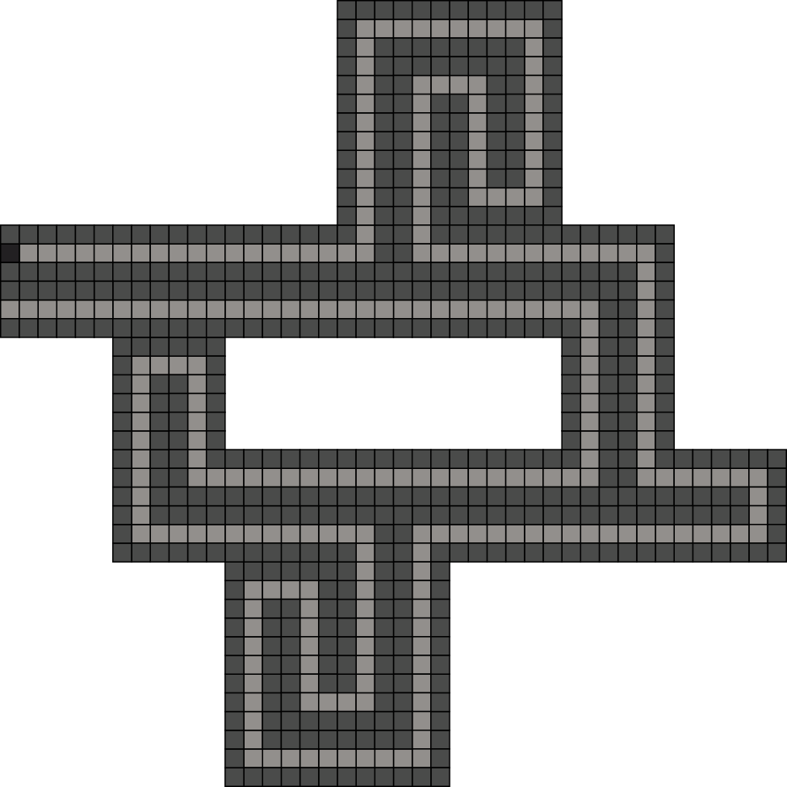
Self-Assembly of Shapes
Input
Output
Optimal description
of shape S:
Tileset
Temperature
10
An assembly of shape S at constant scale

Slide 44
Shape Scaling
Target Shape S

Slide 45
Shape Scaling
Spanning Tree of S

Slide 46
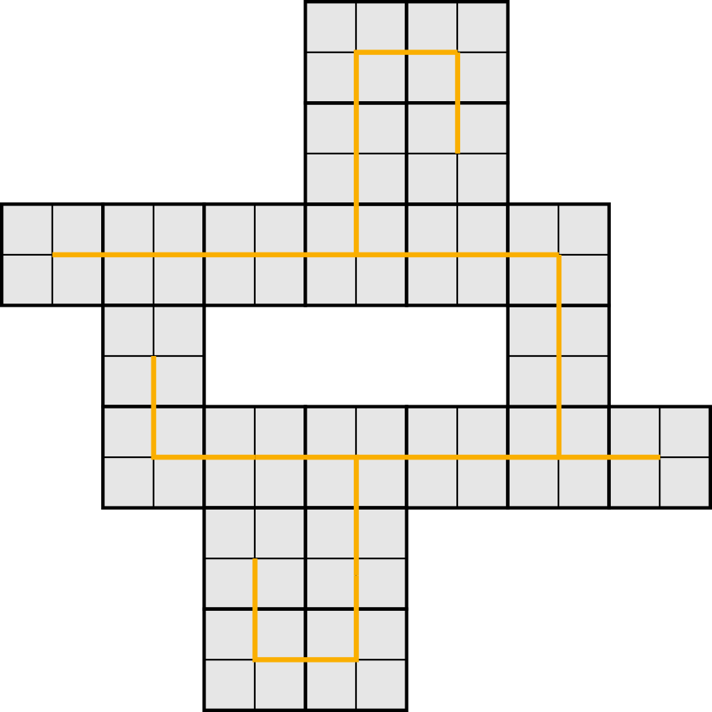
Shape Scaling
Shape S at scale 2
x2

Slide 47
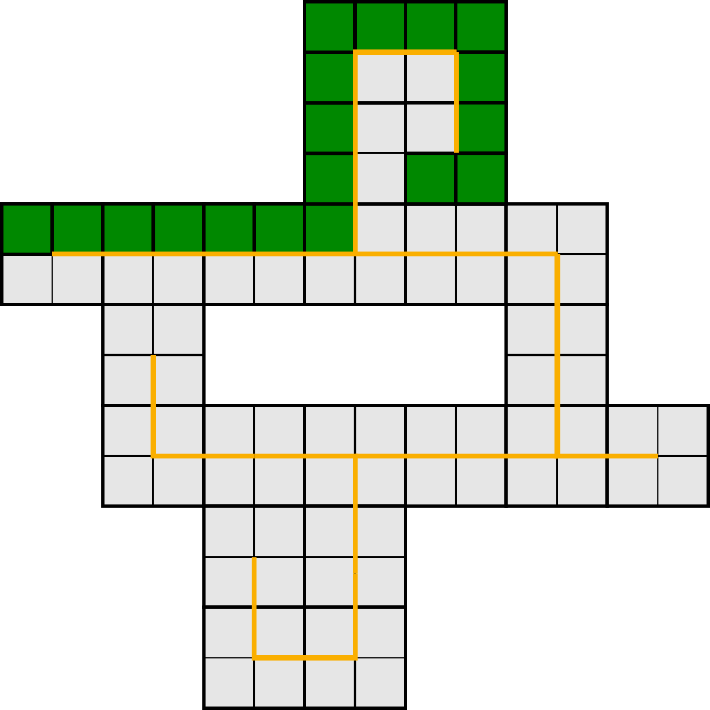
Shape Scaling
Path around spanning tree of S

Slide 48
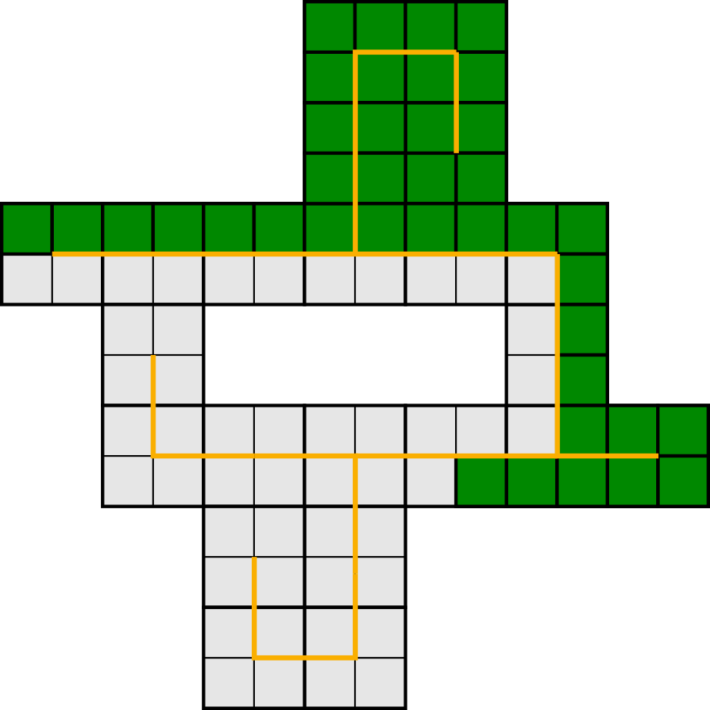
Shape Scaling
Path around spanning tree of S

Slide 49
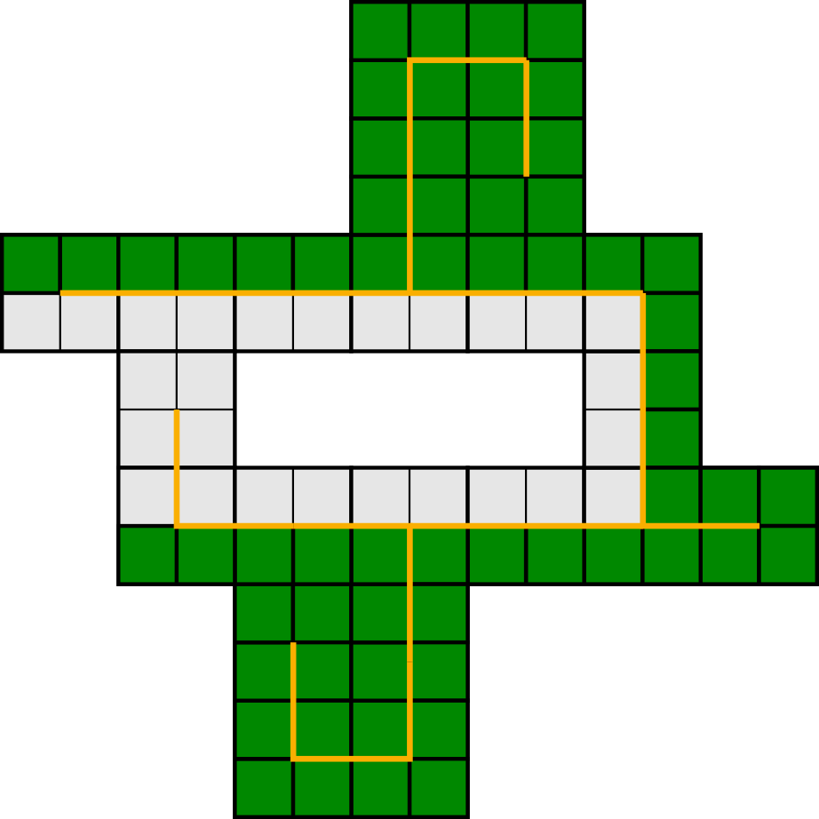
Shape Scaling
Path around spanning tree of S

Slide 50
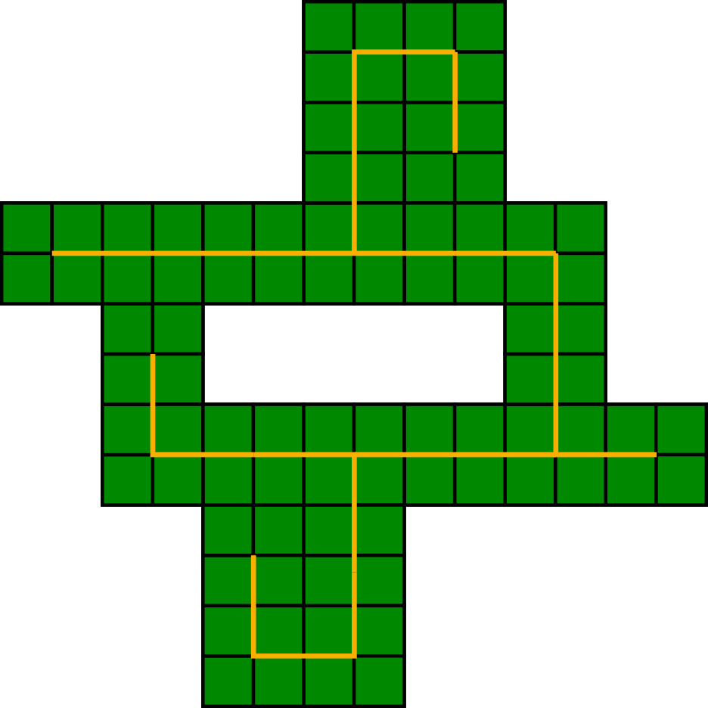
Shape Scaling
Path around spanning tree of S

Slide 51
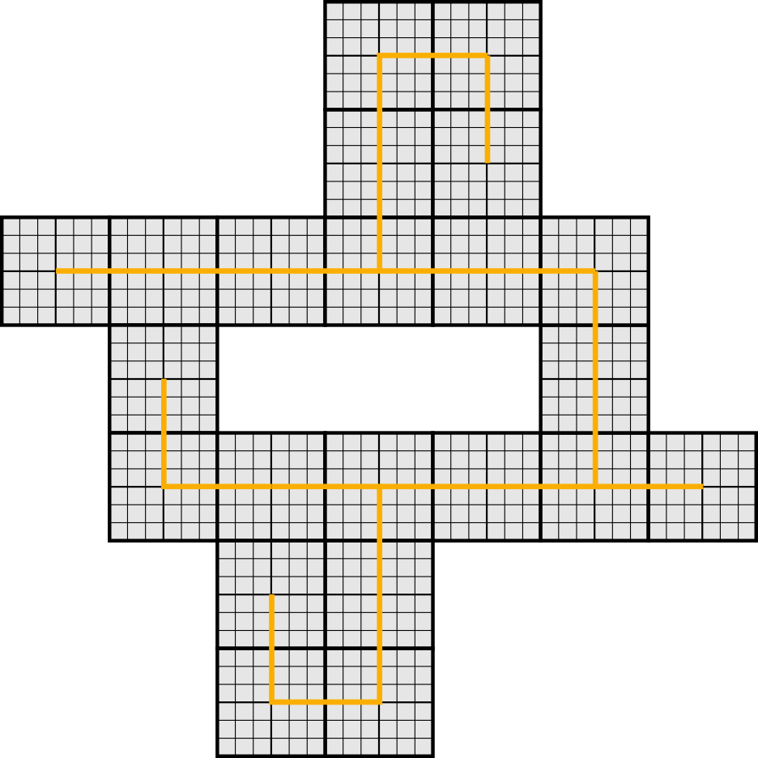
Shape Scaling
Shape S at scale 6
x3

Slide 52
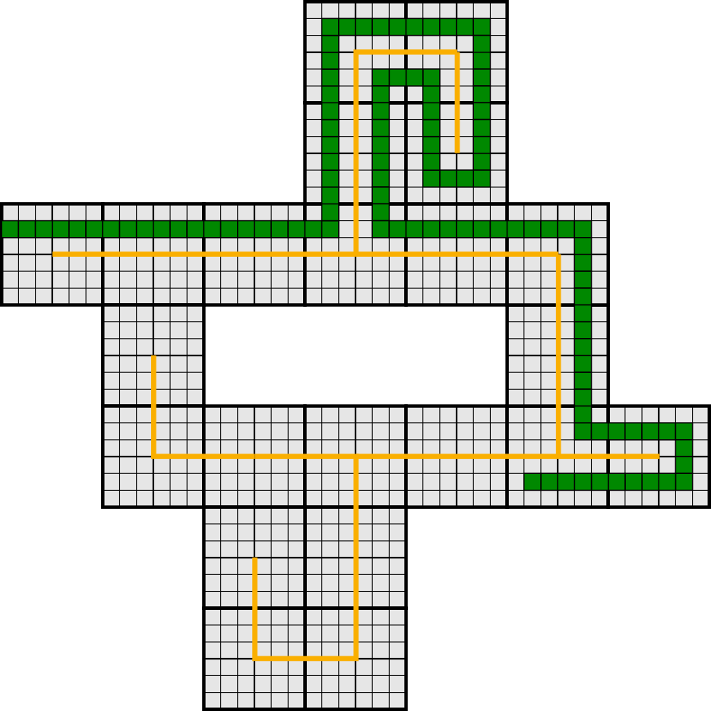
Shape Scaling
Path around spanning tree of S with “buffer”

Slide 53
Shape Scaling
Path around spanning tree of S with “buffer”

Slide 54
Process Overview
O( )
K(S)
distinct tile types
log(K(S))

Slide 55
Process Overview
O( )
K(S)
distinct tile types
log(K(S))
Higher-Base Representation
4
4
1
1
7
7
3
3
0
0
2
2
8
8
1
1
Self Assembles

Slide 56
Process Overview
O( )
K(S)
distinct tile types
log(K(S))
Higher-Base Representation
4
4
1
1
7
7
3
3
0
0
2
2
8
8
1
1
Binary Representation of length K(S)
Self Assembles
1
0
0
1
0
1
1
1
0
1
0
1
0
1
1
0
O( )
TM using
K(S)
tile types
log(K(S))

Slide 57
Process Overview
O( )
K(S)
distinct tile types
log(K(S))
Higher-Base Representation
4
4
1
1
7
7
3
3
0
0
2
2
8
8
1
1
Binary Representation of length K(S)
Self Assembles
1
0
0
1
0
1
1
1
0
1
0
1
0
1
1
0
O( )
TM using
K(S)
tile types
log(K(S))
Method introduced by (Soloveichik, Winfree)

Slide 58
Process Overview
O( )
K(S)
distinct tile types
log(K(S))
Higher-Base Representation
4
4
1
1
7
7
3
3
0
0
2
2
8
8
1
1
Binary Representation of length K(S)
Self Assembles
1
0
0
1
0
1
1
1
0
1
0
1
0
1
1
0
Explicit Encoding
O( )
TM using
K(S)
tile types
log(K(S))
F
F
F
L
F
F
F
R
F
F
F
R
F
F
F
L
TM using O(1) tile types

Slide 59
Process Overview
O( )
K(S)
distinct tile types
log(K(S))
Higher-Base Representation
4
4
1
1
7
7
3
3
0
0
2
2
8
8
1
1
Binary Representation of length K(S)
Self Assembles
1
0
0
1
0
1
1
1
0
1
0
1
0
1
1
0
Explicit Encoding
O( )
TM using
K(S)
tile types
log(K(S))
F
F
F
L
F
F
F
R
F
F
F
R
F
F
F
L
Scaled Shape
TM using O(1) tile types
O(1) tile types

Slide 60
Process Overview
O( )
K(S)
distinct tile types
log(K(S))
Higher-Base Representation
4
4
1
1
7
7
3
3
0
0
2
2
8
8
1
1
Binary Representation of length K(S)
Self Assembles
1
0
0
1
0
1
1
1
0
1
0
1
0
1
1
0
Explicit Encoding
O( )
TM using
K(S)
tile types
log(K(S))
F
F
F
L
F
F
F
R
F
F
F
R
F
F
F
L
Scaled Shape
TM using O(1) tile types
O( )
O(1) tile types
K(S)
log(K(S))

Slide 61
Process Overview
Path-walking instructions

Slide 62
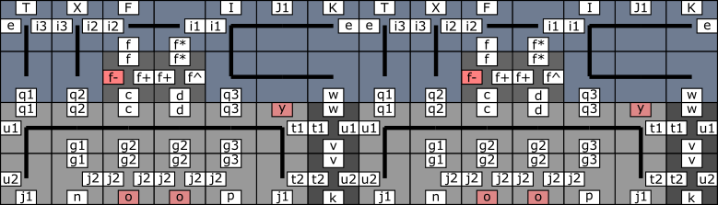
Process Overview
Inspired by (Schweller, Sherman, 2013)

Slide 63
Process Overview
Information Block

Slide 64
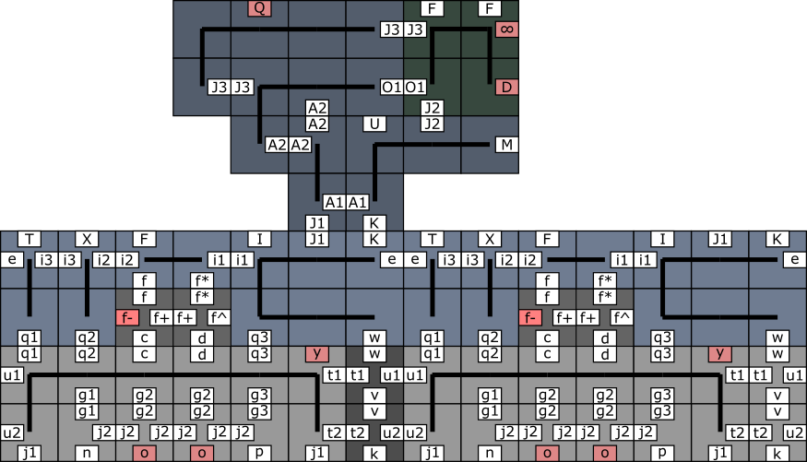
Process Overview

Slide 65
Process Overview

Slide 66
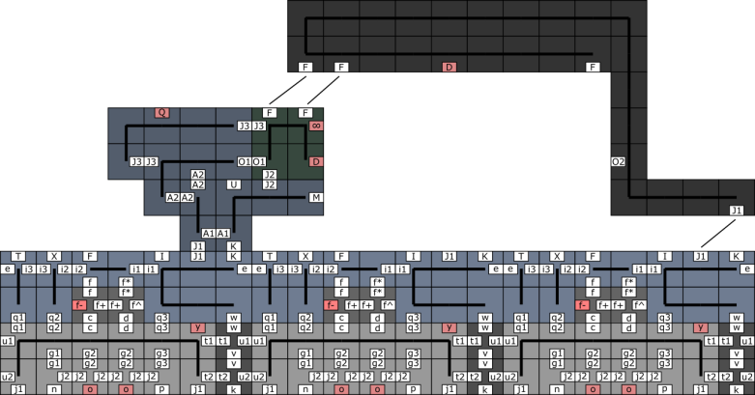
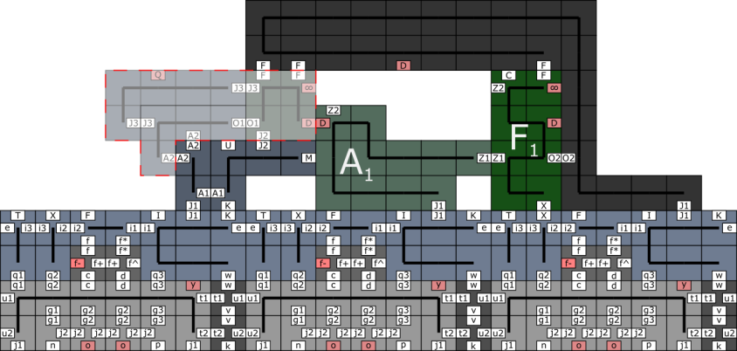
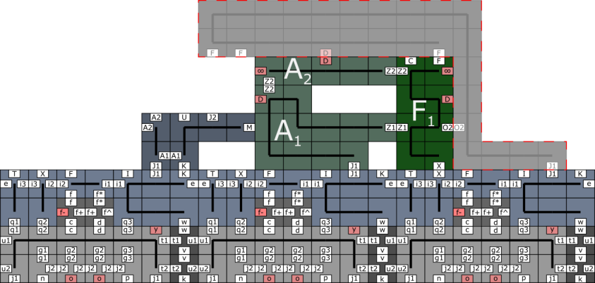
Process Overview

Slide 67
Process Overview

Slide 68
Process Overview
Outlining Path

Slide 69
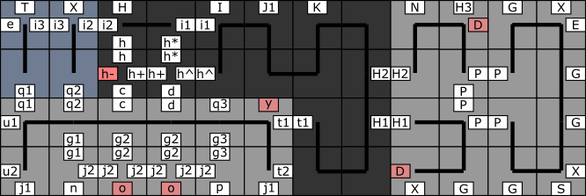
Process Overview

Slide 70
Process Overview

Slide 71
Process Overview

Slide 72
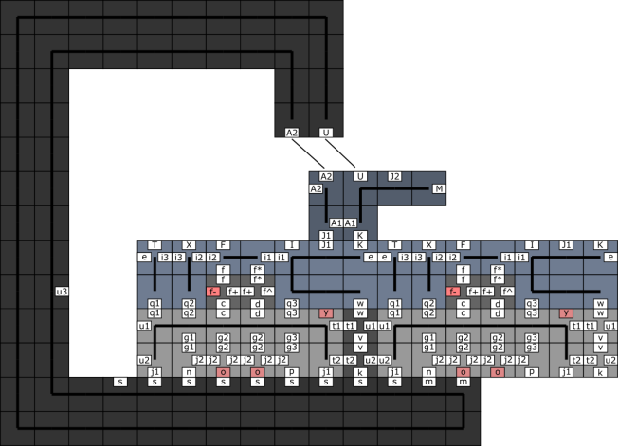
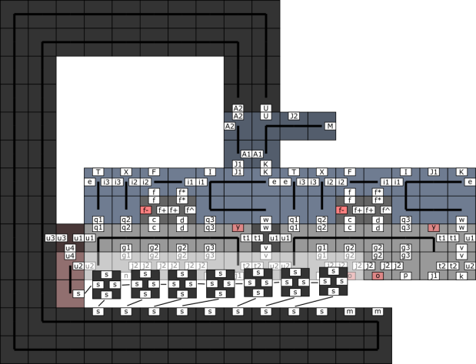
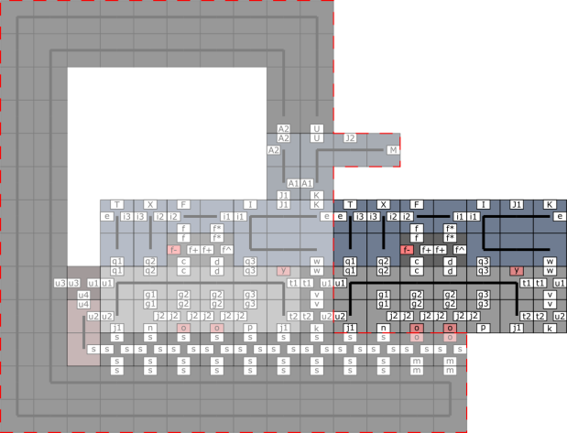
Process Overview

Slide 73
Process Overview

Slide 74
Process Overview

Slide 75
Process Overview

Slide 76
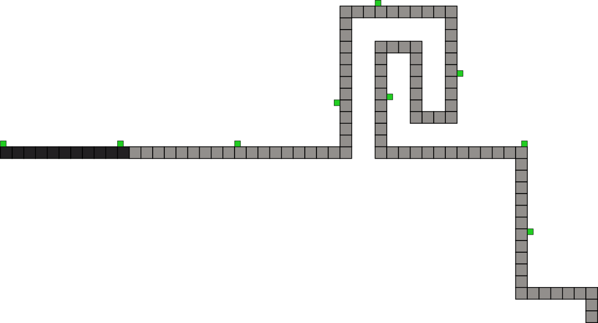
Process Overview

Slide 77
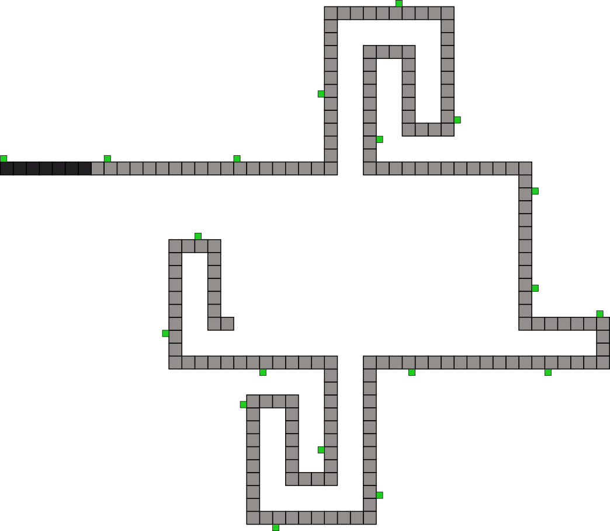
Process Overview

Slide 78
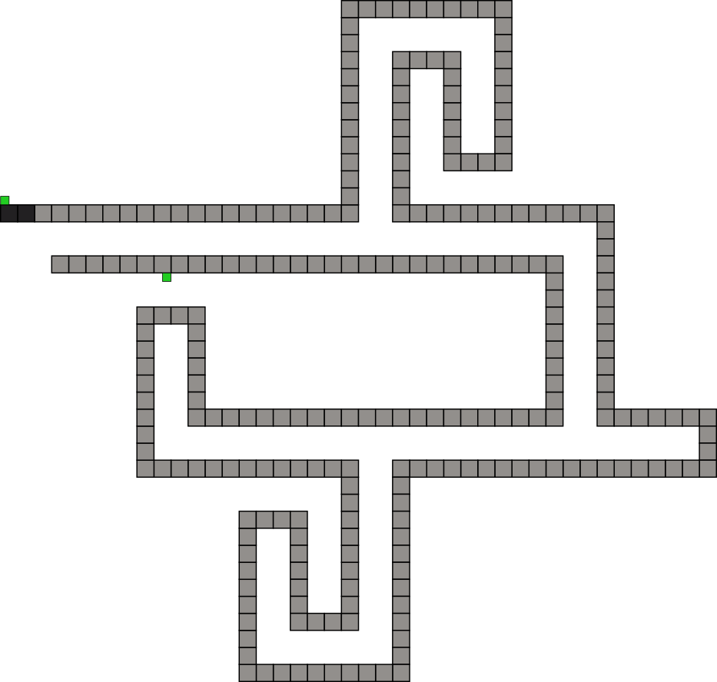
Process Overview

Slide 79
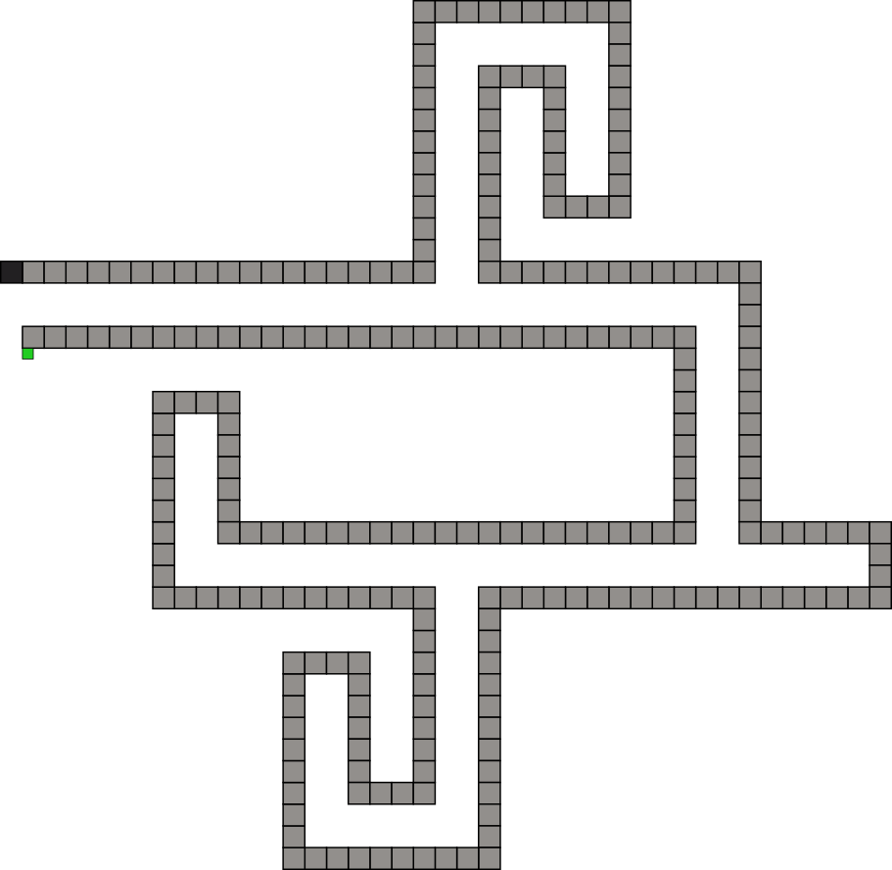
Process Overview

Slide 80
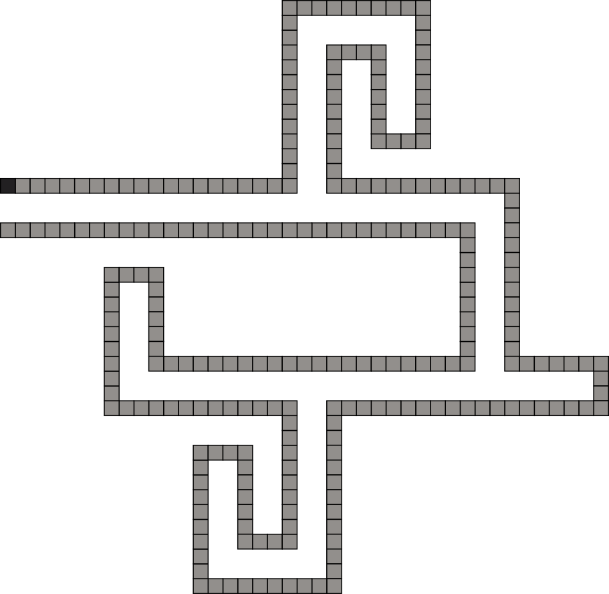
Process Overview

Slide 81
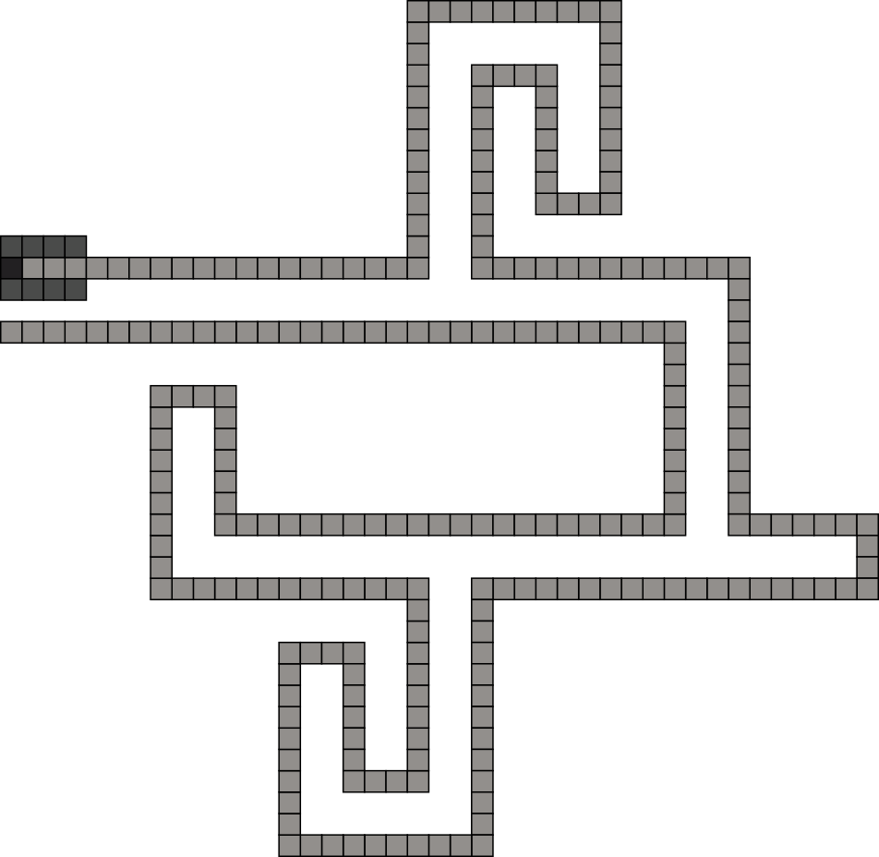
Process Overview

Slide 82
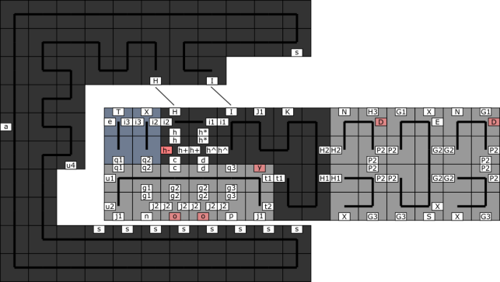
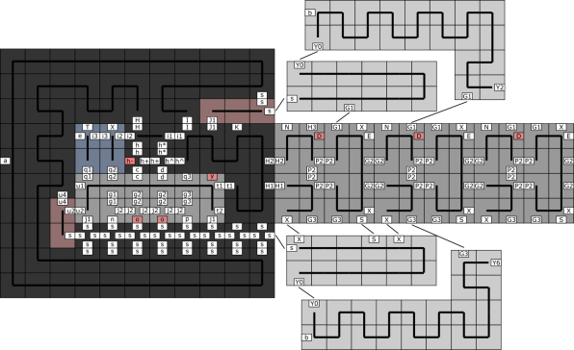
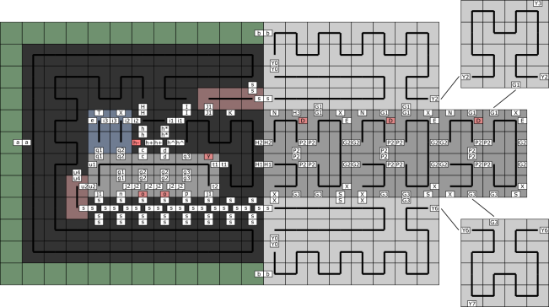
Process Overview

Slide 83
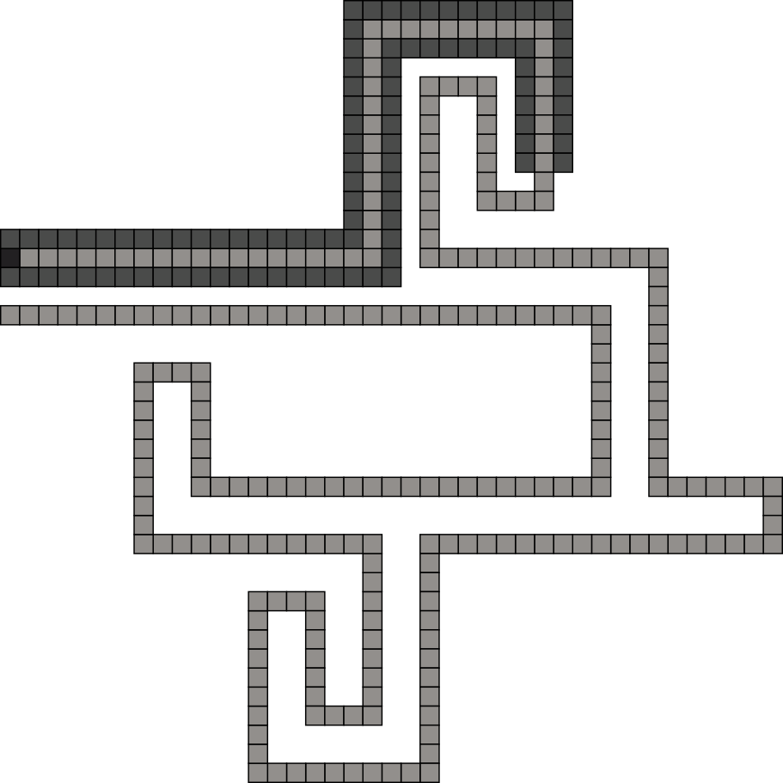
Process Overview

Slide 84
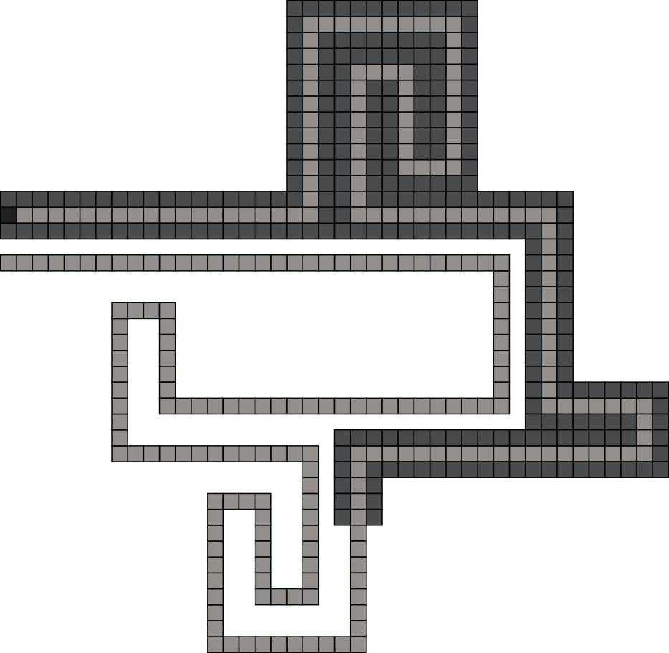
Process Overview

Slide 85
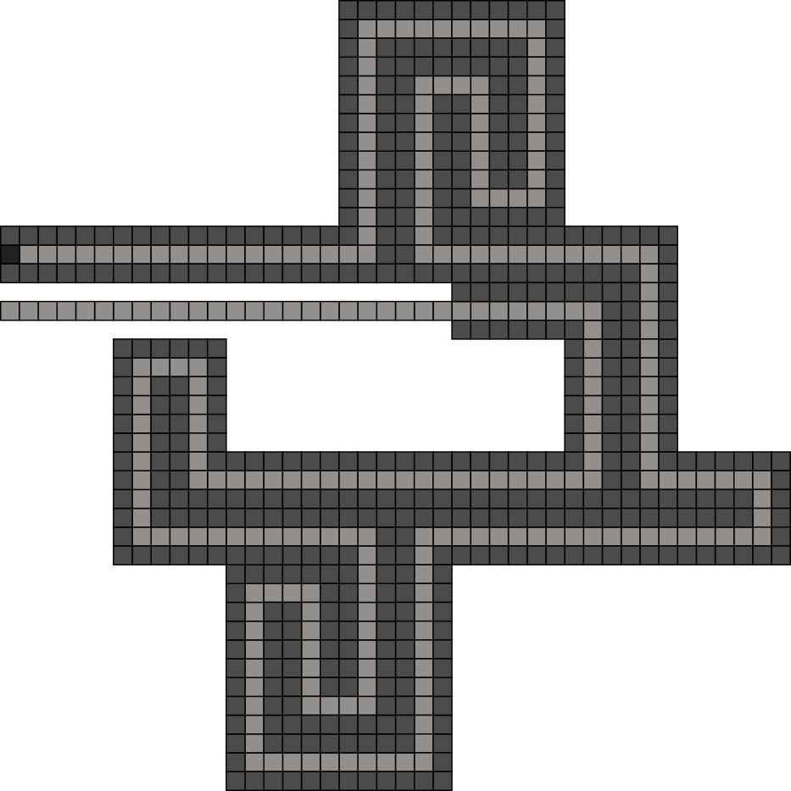
Process Overview

Slide 86
Process Overview

Slide 87
Process Overview
Optimal description
of shape S:

Slide 88
Summary
Model | Tile Complexity | Scale Factor
aTAM (Soloveichik, Winfree, 2007)
Staged RNAse (Demaine, Patitz, Schweller, and Summers, 2010)
Negative Glue 2HAM
O( )
K(S)
arbitrary
log(K(S))
O( )
K(S)
logarithmic
log(K(S))
O( )
K(S)
constant
log(K(S))
Future Work
Can we lower the temperature?
- currently a temperature 10 system
- high temperatures allow for
varying degrees of interaction

Slide 89
Thank You!

