Slide 1
Fuel Efficient Computation in Passive Self-Assembly
Proceedings of the 24th Annual ACM-SIAM Symposium on Discrete Algorithms
January, 2013
Robert Schweller University of Texas Pan-American
Michael Sherman University of Texas Pan-American

Slide 2
Tile Assembly Model
(Rothemund, Winfree, Adleman)
G(y) = 100%
G(g) = 100%
G(r) = 100%
G(b) = 100%
G(p) = 50%
G(w) = 50%
T =
a
b
c
Glue
Function:
x
d
e
Tile Set:

Slide 3
Tile Assembly Model
(Rothemund, Winfree, Adleman)
G(y) = 100%
G(g) = 100%
G(r) = 100%
G(b) = 100%
G(p) = 50%
G(w) = 50%
T =
a
b
c
x
d
e
e
d

Slide 4
Tile Assembly Model
(Rothemund, Winfree, Adleman)
G(y) = 100%
G(g) = 100%
G(r) = 100%
G(b) = 100%
G(p) = 50%
G(w) = 50%
T =
a
b
c
x
d
e
e
d

Slide 5
Tile Assembly Model
(Rothemund, Winfree, Adleman)
G(y) = 100%
G(g) = 100%
G(r) = 100%
G(b) = 100%
G(p) = 50%
G(w) = 50%
T =
a
b
c
x
d
e
e
d
b
c

Slide 6
Tile Assembly Model
(Rothemund, Winfree, Adleman)
G(y) = 100%
G(g) = 100%
G(r) = 100%
G(b) = 100%
G(p) = 50%
G(w) = 50%
T =
a
b
c
x
d
e
e
d
b
c

Slide 7
Tile Assembly Model
(Rothemund, Winfree, Adleman)
G(y) = 100%
G(g) = 100%
G(r) = 100%
G(b) = 100%
G(p) = 50%
G(w) = 50%
T =
a
b
c
x
d
e
e
d
b
c

Slide 8
Tile Assembly Model
(Rothemund, Winfree, Adleman)
G(y) = 100%
G(g) = 100%
G(r) = 100%
G(b) = 100%
G(p) = 50%
G(w) = 50%
T =
a
b
c
x
d
e
e
d
a
b
c

Slide 9
Tile Assembly Model
(Rothemund, Winfree, Adleman)
G(y) = 100%
G(g) = 100%
G(r) = 100%
G(b) = 100%
G(p) = 50%
G(w) = 50%
T =
a
b
c
x
d
e
e
d
a
b
c

Slide 10
Tile Assembly Model
(Rothemund, Winfree, Adleman)
G(y) = 100%
G(g) = 100%
G(r) = 100%
G(b) = 100%
G(p) = 50%
G(w) = 50%
T =
a
b
c
x
d
e
e
d
a
b
c

Slide 11
Tile Assembly Model
(Rothemund, Winfree, Adleman)
G(y) = 100%
G(g) = 100%
G(r) = 100%
G(b) = 100%
G(p) = 50%
G(w) = 50%
T =
a
b
c
x
d
e
e
d
a
b
c

Slide 12
Tile Assembly Model
(Rothemund, Winfree, Adleman)
G(y) = 100%
G(g) = 100%
G(r) = 100%
G(b) = 100%
G(p) = 50%
G(w) = 50%
T =
a
b
c
x
d
e
e
d
a
b
c

Slide 13
Tile Assembly Model
(Rothemund, Winfree, Adleman)
G(y) = 100%
G(g) = 100%
G(r) = 100%
G(b) = 100%
G(p) = 50%
G(w) = 50%
T =
a
b
c
x
d
e
e
x
d
a
b
c

Slide 14
Tile Assembly Model
(Rothemund, Winfree, Adleman)
G(y) = 100%
G(g) = 100%
G(r) = 100%
G(b) = 100%
G(p) = 50%
G(w) = 50%
T =
a
b
c
x
d
e
e
d
x
a
b
c

Slide 15
Tile Assembly Model
(Rothemund, Winfree, Adleman)
G(y) = 100%
G(g) = 100%
G(r) = 100%
G(b) = 100%
G(p) = 50%
G(w) = 50%
T =
a
b
c
x
d
e
e
d
x
x
a
b
c

Slide 16
Tile Assembly Model
(Rothemund, Winfree, Adleman)
G(y) = 100%
G(g) = 100%
G(r) = 100%
G(b) = 100%
G(p) = 50%
G(w) = 50%
T =
a
b
c
x
d
e
e
x
d
x
x
a
b
c

Slide 17
Tile Assembly Model
(Rothemund, Winfree, Adleman)
G(y) = 100%
G(g) = 100%
G(r) = 100%
G(b) = 100%
G(p) = 50%
G(w) = 50%
T =
a
b
c
x
d
e
e
x
x
d
x
x
a
b
c

Slide 18
Tile Assembly Model
(Rothemund, Winfree, Adleman)
G(y) = 100%
G(g) = 100%
G(r) = 100%
G(b) = 100%
G(p) = 50%
G(w) = 50%
T =
a
b
c
x
d
e
e
x
x
What is this model capable above?
-efficient assembly of shapes/patterns
-shape and pattern replication
-computation
d
x
x
a
b
c

Slide 19
BEAKER
State: q₃
State: q₂
State: q₂
State: q₃
0
1
1
0
1
1
1
0
_
Goal: Scalable, universal molecular computation
-More than just a (really cool) computer
-Algorithmic manipulation of matter at the nanoscale
Notes:
-More than just a (really cool) computer
-Algorithmic manipulation of matter at the nanoscale

Slide 20
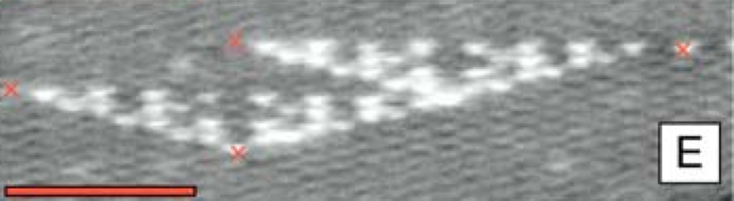
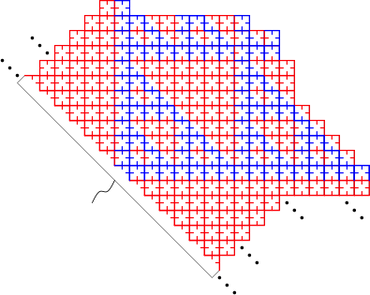
Simulation of Cellular Automata
[Rothemund, Papadakis, Winfree, 2004]
Slide stolen from: Andrew Winslow
Notes:
Construct a sophisticated circuit layout programmed with rule 110?

Slide 21
Turing Machine simulation in the TAM
[Rothemund, Winfree, 2000]
State: q₀
State: q₃
State: q₂
State: q₂
State: q₃
State: q₇
State: q₇
0
1
1
1
0
-
-
-
0
1
1
1
0
-
-
0
0
1
1
0
-
0
1
1
0
1
1
1
0
_
1
0
1
1
0
Slide stolen from: Matt Patitz

Slide 22
Turing Machine simulation in the TAM
[Rothemund, Winfree, 2000]
State: q₃
State: q₂
State: q₂
State: q₃
0
1
1
1
0
-
-
-
0
1
1
1
0
-
-
0
0
1
1
0
-
0
1
1
0
1
1
1
0
_
1
0
1
1
0
Limited Scalability
Space in-efficient
-Entire history of computation
stored in assembly
Fuel Guzzling
- Each computation step
burns many tiles
Goal: Fuel efficient, space efficient universal computation

Slide 23
Negative Glues
Goal: Fuel efficient, space efficient universal computation
Problem: Assemblies only grow larger
Solution: Negative strength glues
Our Result: Tile assembly is capable of space efficient, fuel efficient universal computaion with the use of negative and positive strength glues.

Slide 24
Negative Glues - Example
Negative glues previously
considered in:
[Reif, Sahu, Yin 2005]
[Doty, Kari, Masson 2010]
[Patitz, Schweller, Summers, 2011]
100%
100%
100%
200%
Notes:
Model with negative glues, need a good simple example system…

Slide 25
Negative Glues - Example
-50%
100%
-50%
100%
100%
200%
-Negative glues can prevent attachments.
-Can they do anything deeper?
Notes:
It might seem that negative glues just make things not grow as big and could be replicated with weaker positive glues….

Slide 26
Negative Glues - Example
-100%
200%
-100%
Increase strength
200%
100%
200%
Notes:
Model with negative glues, need a good simple example system…

Slide 27
Negative Glues - Example
Key Idea:
-Stable assemblies can combine to form unstable assemblies
-Allows “diss-assembly”
-100%
100%
200%
200%
Notes:
Model with negative glues, need a good simple example system…

Slide 28
High Level Sketch of Universal Computation
0
1
0
0
1

Slide 29
High Level Sketch of Universal Computation
0
1
0
0
1

Slide 30
High Level Sketch of Universal Computation
1
0
0
1

Slide 31
High Level Sketch of Universal Computation
1
0
0
1

Slide 32
High Level Sketch of Universal Computation
1
1
0
0
1

Slide 33
High Level Sketch of Universal Computation
1
1
0
0
1

Slide 34

Bit Flipping
1
25%
75%
-30%
0
-30%
30
90
70

Slide 35
Bit Flipping
1
-30%
25
0
25%
-30%
30
75
90
70

Slide 36
Bit Flipping
1
90%
-30%
40%
25
0
25%
-30%
30
75
90
70

Slide 37
Bit Flipping
1
90
25
0
25%
-30%
30
75
40
90
70

Slide 38
Bit Flipping
1
90
25
0
75
40
70

Slide 39
Bit Flipping
1
30%
90
15%
90%
70%
75
40

Slide 40
Bit Flipping
1
90
15
30%
70%
75
40
90

Slide 41
Bit Flipping
90
15
90%
90%
1
30
10%
-60%
75
40
90
70

Slide 42
Bit Flipping
90
15
90
90%
1
30
10
90%
-60%
75
40
90
70

Slide 43
Bit Flipping
90
15
15
15
90
90
1
30
10
10
90
75
-60
75
40
90
70
-60
40

Slide 44
Oscillator
Expended fueld
0
1

Slide 45
Oscillator
Expended fueld
0
1
Expended fueld
0
1

Slide 46
Graph Walking
Simple Example of Graph Walking:
0
1
0
1
0
1
More General Result:
Theorem: For any directed graph G=(V,E), there exists a size O(V+E) tile set that walks graph G in a fuel-efficient manner.

Slide 47
Extension: Double Bit Flipping
1
0
0
1

Slide 48
Turing Machine Simulation
Current bit: 0
State: GREEN
→ Flip bit to 1, move right, change to state PURPLE
Current bit: 0
State: PURPLE
→ Flip bit to 1, move left, change to state ORANGE
Current bit: 1
State: ORANGE
→ Flip bit to 0, move left, change to state GREEN
0
1
0
0
1
1
0
0
0
1
1
O(1) garbage produced per computation step

Slide 49
Tape Extension Gadget
Also: need an infinite tape
1
0
0
1
0

Slide 50
Universal Tile Self-Assembly
Space Fuel
Old Way
Negative Glues
O(Tape*Steps) O(Tape)
O(Tape) O(1)
[Rothemund, Winfree, 2000]
0
1
0
0
1
1
0
0
0
1
1

Slide 51
Why is Passive, Fuel Efficient Computation Important?
Passive Self-Assembly
  Most active models have no current implementation at the nanoscale
  Informs when more active components are truly necessary
  May lead to connection to active self-assembly: Implement an active model within a passive model
Fuel Efficiency
  Particle starvation a practical problem in experimentation
  Necessary for a scalable molecular computer
Negative Glues
  Informs experimentalists that negative glues implementation should be fruitful
  Sheds light on natural computation and phenomena
    Charged particles, magnets
    Protein folding
    ATP Synthases

Slide 52
Open Problems
Compact Graph Walking
  Many graphs can likely be fuel efficiently walked by sub linear sized tile systems.
  O(log |V|) tiles?
Negative Glues: Necessary?
  Amortized fuel-efficiency?
Two-tape Turing machine simulation
Simulation of active models
  Signal tiles?
Fuel Rods?
  No depletion of monomers

