Slide 1
Randomized Self-Assembly for Approximate Shapes
35th International Colloquium on Automata, Languages and Programming
July 8, 2008
  Robert Schweller University of Texas – Pan American
  In collaboration with
  Ming-Yang Kao Northwestern University

Slide 2
Outline
Assembly Model
Basic Constructions
Probabilistic Assembly Model
Main Result

Slide 3
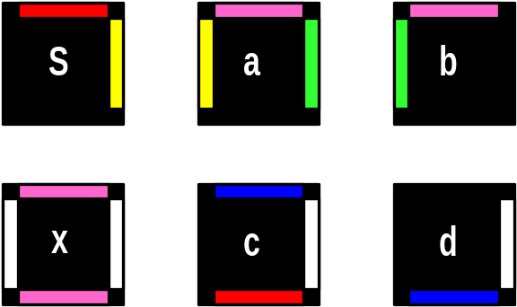
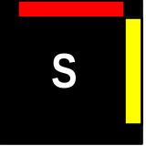
Tile Assembly Model
(Rothemund, Winfree, Adleman)
G(y) = 2
G(g) = 2
G(r) = 2
G(b) = 2
G(p) = 1
G(w) = 1
t = 2
T =
Glue
Function:
Tile Set:
Temperature:
Seed Tile:

Slide 4
Tile Assembly Model
(Rothemund, Winfree, Adleman)
G(y) = 2
G(g) = 2
G(r) = 2
G(b) = 2
G(p) = 1
G(w) = 1
t = 2
T =

Slide 5
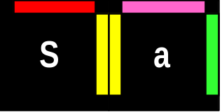
Tile Assembly Model
(Rothemund, Winfree, Adleman)
G(y) = 2
G(g) = 2
G(r) = 2
G(b) = 2
G(p) = 1
G(w) = 1
t = 2
T =

Slide 6
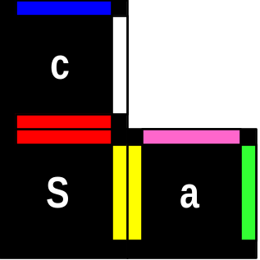
Tile Assembly Model
(Rothemund, Winfree, Adleman)
G(y) = 2
G(g) = 2
G(r) = 2
G(b) = 2
G(p) = 1
G(w) = 1
t = 2
T =

Slide 7
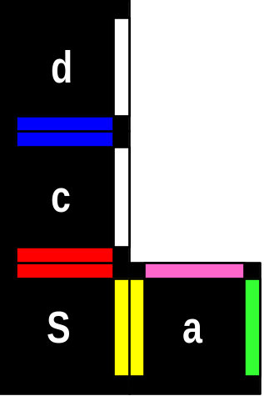
Tile Assembly Model
(Rothemund, Winfree, Adleman)
G(y) = 2
G(g) = 2
G(r) = 2
G(b) = 2
G(p) = 1
G(w) = 1
t = 2
T =

Slide 8
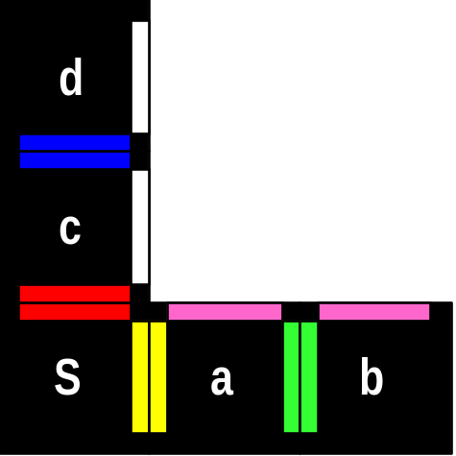
Tile Assembly Model
(Rothemund, Winfree, Adleman)
G(y) = 2
G(g) = 2
G(r) = 2
G(b) = 2
G(p) = 1
G(w) = 1
t = 2
T =

Slide 9
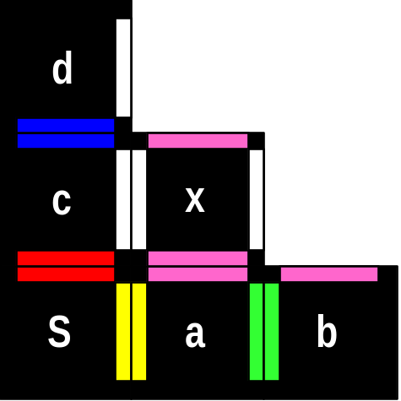
Tile Assembly Model
(Rothemund, Winfree, Adleman)
G(y) = 2
G(g) = 2
G(r) = 2
G(b) = 2
G(p) = 1
G(w) = 1
t = 2
T =

Slide 10
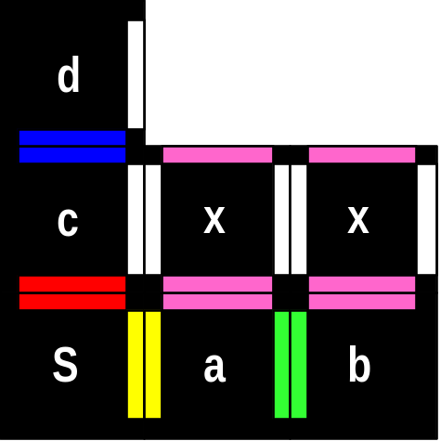
Tile Assembly Model
(Rothemund, Winfree, Adleman)
G(y) = 2
G(g) = 2
G(r) = 2
G(b) = 2
G(p) = 1
G(w) = 1
t = 2
T =

Slide 11
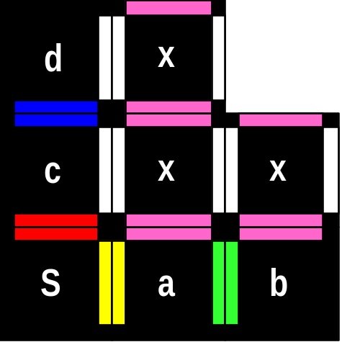
Tile Assembly Model
(Rothemund, Winfree, Adleman)
G(y) = 2
G(g) = 2
G(r) = 2
G(b) = 2
G(p) = 1
G(w) = 1
t = 2
T =

Slide 12
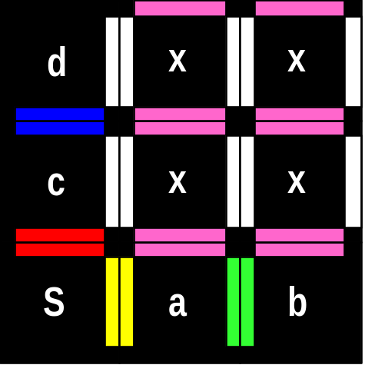
Tile Assembly Model
(Rothemund, Winfree, Adleman)
G(y) = 2
G(g) = 2
G(r) = 2
G(b) = 2
G(p) = 1
G(w) = 1
t = 2
T =
Notes:
In the basic model, only unique terminal assemblies are considered. This supertile is the unique sink state for this system.

Slide 13
How efficiently can you build an n x n square?
s

Slide 14
How efficiently can you build an n x n square?
n
s

Slide 15
How efficiently can you build an n x n square?
Tile Complexity:
2n
n
x
s

Slide 16
How efficiently can you build an n x n square?
s

Slide 17
How efficiently can you build an n x n square?
-Use log n tile types to seed
counter:
0
0
0
0
s
log n

Slide 18
How efficiently can you build an n x n square?
-Use log n tile types capable of
Binary counting:
-Use 8 additional tile types
capable of binary counting:
0
0
0
0
s
log n

Slide 19
How efficiently can you build an n x n square?
-Use log n tile types capable of
Binary counting:
-Use 8 additional tile types
capable of binary counting:
1
1
0
0
1
0
0
0
0
1
1
1
0
1
1
0
0
1
0
1
0
1
0
0
0
0
1
1
0
0
1
0
0
0
0
1
0
0
0
0
s
log n

Slide 20
How efficiently can you build an n x n square?
-Use log n tile types capable of
Binary counting:
1
1
1
1
-Use 8 additional tile types
capable of binary counting:
1
1
1
0
1
1
0
1
1
1
0
0
1
0
1
1
1
0
1
0
1
0
0
1
1
0
0
0
0
1
1
1
0
1
1
0
0
1
0
1
0
1
0
0
0
0
1
1
0
0
1
0
0
0
0
1
0
0
0
0
s
log n

Slide 21
How efficiently can you build an n x n square?
-Use log n tile types capable of
Binary counting:
1
1
1
1
-Use 8 additional tile types
capable of binary counting:
1
1
1
0
1
1
0
1
1
1
0
0
1
0
1
1
1
0
1
0
1
0
0
1
1
0
0
0
0
1
1
1
0
1
1
0
0
1
0
1
0
1
0
0
0
0
1
1
0
0
1
0
0
0
0
1
0
0
0
0
s
0
0
0
0
0
0
0
0
1
1
1
1
1
1
1
1
0
0
0
0
1
1
1
1
0
0
0
0
1
1
1
1
0
0
1
1
0
0
1
1
0
0
1
1
0
0
1
1
0
1
0
1
0
1
0
1
0
1
0
1
0
1
0
1

Slide 22
How efficiently can you build an n x n square?
1
1
1
1
Tile Complexity:
O(log n)
1
1
1
0
1
1
0
1
1
1
0
0
(Rothemund, Winfree 2000)
1
0
1
1
n – log n
1
0
1
0
1
0
0
1
With optimal
counter:
Tile Complexity:
O(log n / loglog n)
1
0
0
0
0
1
1
1
0
1
1
0
0
1
0
1
x
0
1
0
0
(Adleman, Cheng, Goel,
Huang 2001)
0
0
1
1
0
0
1
0
0
0
0
1
Meets lower
bound:
Ω(log n / loglog n)
0
0
0
0
s
0
0
0
0
0
0
0
0
1
1
1
1
1
1
1
1
log n
y
0
0
0
0
1
1
1
1
0
0
0
0
1
1
1
1
0
0
1
1
0
0
1
1
0
0
1
1
0
0
1
1
(Rothemund, Winfree 2000)
0
1
0
1
0
1
0
1
0
1
0
1
0
1
0
1

Slide 23
Outline
Assembly Model
Basic Constructions
Probabilistic Assembly Model
Main Result

Slide 24
Probabilistic Assembly Model
(Becker, Remila, Rapaport)
Assign Relative Concentrations:
d
%5
x
%5
S
%5
a
%60
b
%20
c
%5

Slide 25
Probabilistic Assembly Model
(Becker, Remila, Rapaport)
Tileset =
d
x
%5
%5
S
a
%5
%60
b
c
S
%20
%5
G(y) = 2
G(g) = 2
G(r) = 2
G(p) = 1
G(w) = 1
t = 2

Slide 26
Probabilistic Assembly Model
(Becker, Remila, Rapaport)
Tileset =
d
x
%5
%5
S
a
%5
%60
d
b
c
S
%20
%5
G(y) = 2
G(g) = 2
G(r) = 2
G(p) = 1
G(w) = 1
t = 2

Slide 27
Probabilistic Assembly Model
(Becker, Remila, Rapaport)
Tileset =
d
x
%5
%5
S
a
%5
%60
d
b
c
S
a
%20
%5
G(y) = 2
G(g) = 2
G(r) = 2
G(p) = 1
G(w) = 1
t = 2

Slide 28
Probabilistic Assembly Model
(Becker, Remila, Rapaport)
Tileset =
d
x
%5
%5
S
a
%5
%60
d
x
b
c
S
a
%20
%5
G(y) = 2
G(g) = 2
G(r) = 2
G(p) = 1
G(w) = 1
t = 2

Slide 29
Probabilistic Assembly Model
(Becker, Remila, Rapaport)
Tileset =
d
x
%5
%5
S
a
%5
%60
d
x
d
b
c
S
a
S
%20
%5
G(y) = 2
G(g) = 2
G(r) = 2
G(p) = 1
G(w) = 1
t = 2

Slide 30
Probabilistic Assembly Model
(Becker, Remila, Rapaport)
Tileset =
d
x
%5
%5
S
a
%5
%60
d
x
d
b
c
S
a
S
b
%20
%5
G(y) = 2
G(g) = 2
G(r) = 2
G(p) = 1
G(w) = 1
t = 2

Slide 31
Probabilistic Assembly Model
(Becker, Remila, Rapaport)
Tileset =
d
x
Two Terminal Shapes Produced
%5
%5
S
a
%5
%60
d
x
d
b
c
S
a
S
b
c
%20
%5
G(y) = 2
G(g) = 2
G(r) = 2
G(p) = 1
G(w) = 1
t = 2

Slide 32
Probabilistic Assembly Model
(Becker, Remila, Rapaport)
Tileset =
S
d
x
%5
%5
.60/.85 = %70.6
.20/.85 = %23.5
S
a
%5
%60
.05/.85 = %5.9
b
c
d
%20
%5
S
a
S
S
b
G(y) = 2
G(g) = 2
G(r) = 2
G(p) = 1
G(w) = 1
t = 2

Slide 33
Probabilistic Assembly Model
(Becker, Remila, Rapaport)
Tileset =
S
d
x
%70.6
%23.5
%5
%5
%5.9
d
S
a
S
a
S
S
b
%5
%60
b
c
%20
%5
d
d
G(y) = 2
G(g) = 2
G(r) = 2
G(p) = 1
G(w) = 1
t = 2
S
a
S
b
d
x
d
S
a
S
b
c
%75
%25

Slide 34
Generic Tileset for all Squares

Slide 35
Generic Tileset for Approximate Squares
(1-ε)n
n
(1+ε)n

Slide 36
Generic Tileset for Approximate Squares
(ε , δ) – Approximate Square Assembly
Given:
- ε , δ < 0
- integer n
Design:
A probabilistic tile system that will assemble an n’ x n’ square with:
(1-ε)n < n’ < (1+ε)n
With probability at least:
1 - δ
(1- ε)n
n
(1+ε)n

Slide 37
High Level Idea
-Build random structure:
-Dimensions are random
-Internal pattern is random

Slide 38
High Level Idea
10110110
-Build random structure:
-Dimensions are random
-Internal pattern is random
-Incorporate arithmetic tiles to extract
a binary number from the random
pattern

Slide 39
Finish off Square
Output n approximation
Binary Counter
10110110
n
Binary Counter
n

Slide 40
Line Estimation of n
S
X

Slide 41
Line Estimation of n
S
X
S

Slide 42
Line Estimation of n
S
X
S

Slide 43
Line Estimation of n
S
X
S

Slide 44
Line Estimation of n
S
X
S

Slide 45
Line Estimation of n
S
X
S

Slide 46
Line Estimation of n
S
X
S

Slide 47
Line Estimation of n
S
X
S

Slide 48
Line Estimation of n
S
X
S

Slide 49
Line Estimation of n
S
X
S

Slide 50
Line Estimation of n
S
X
S

Slide 51
Line Estimation of n
S
X
S
X

Slide 52
Line Estimation of n
S
% c
X
% c/n
% c(n-1)/n
S
X

Slide 53
Line Estimation of n
S
% c
X
% c/n
% c(n-1)/n
Length has Geometric distribution
with p = 1/n
S
X
E[ Length ] = n

Slide 54
Line Estimation of n
[Becker, Rapaport Remila, 2006]
S
% c
X
% c/n
% c(n-1)/n
S
X
E[ Length ] = n

Slide 55
Line Estimation of n
[Becker, Rapaport Remila, 2006]
S
% c
X
% c/n
% c(n-1)/n
- Assembles all n x n squares.
Expected dimension specified by percentages.
Geometric distribution:
Large variance
S
X
E[ Length ] = n

Slide 56
Improved Estimation of n: Binomial Distribution
S
X
Key Idea
S
X

Slide 57
Improved Estimation of n: Binomial Distribution
Probability of placing a red tile given either a red or green tile is placed:
1/n
S
% c
X
% c/L
% c(L+1)(n-1)/Ln
% c(L+1)/Ln
S
X

Slide 58
Improved Estimation of n: Binomial Distribution
Probability of placing a red tile given either a red or green tile is placed:
1/n
To compute estimation of n:
Compute LENGTH / REDS
S
% c
X
% c/L
% c(L+1)(n-1)/Ln
% c(L+1)/Ln
S
X

Slide 59
Improved Estimation of n: Binomial Distribution
S
% c
X
% c/L
Binary Counter
Length: 10000
Reds: 100
% c(L+1)(n-1)/Ln
% c(L+1)/Ln
1 0
1 0
1 0
1 0
1 0
1 0
1 0
1 0
1 0
1 0
0 0
0 0
1 0
1 0
1 0
1 0
0 0
0 0
0 0
0 0
1 0
1 1
1 1
1 1
0 1
0 1
1 0
1 0
0 0
0 0
1 1
1 1
0 1
0 1
1 1
1 1
0 1
0 0
1 0
1 0
0 0
0 0
1 0
0 1
1 1
0 1
1 1
0 0
1 0
0 1
1 1
0 1
1 1
0 1
1 0
0 0
1 0
0 0
0 0
S
X

Slide 60
Improved Estimation of n: Binomial Distribution
S
% c
Length: 10000
Reds: 100
Compute Length / Reds: 100
X
% c/L
Estimate for n
% c(L+1)(n-1)/Ln
% c(L+1)/Ln
0
0
1
0
0
1 0
1 0
Division tiles
1 0
1 0
1 0
1 0
1 0
1 0
1 0
1 0
0 0
0 0
1 0
1 0
1 0
1 0
0 0
0 0
0 0
0 0
1 0
1 1
1 1
1 1
0 1
0 1
1 0
1 0
0 0
0 0
1 1
1 1
0 1
0 1
1 1
1 1
0 1
0 0
1 0
1 0
0 0
0 0
1 0
0 1
1 1
0 1
1 1
0 0
1 0
0 1
1 1
0 1
1 1
0 1
1 0
0 0
1 0
0 0
0 0
S
X

Slide 61
Problem: Estimation Line too Long
Chernoff Bounds only yield high accuracy for Length >> n
S
X
Length >> n :
Too long for an n x n square…

Slide 62
Solution: Estimation Frame
Phase 1:
Build dimensions of frame.
Multiple lines
= HEIGHT:
Determined by
Geometric
Distribution
S
WIDTH: Determined by
Geometric Distribution

Slide 63
Solution: Estimation Frame
Phase 1:
Build dimensions of frame.
Phase 2:
Build Sampling Lines
Multiple lines
= HEIGHT:
Determined by
Geometric
Distribution
S
WIDTH: Determined by
Geometric Distribution

Slide 64
Solution: Estimation Frame
Sum Reds
1
0
Phase 1:
Build dimensions of frame.
Phase 2:
Build Sampling Lines
Phase 3: Sum Reds and Length for each Line
Sum Reds
1
Multiple lines
= HEIGHT:
Determined by
Geometric
Distribution
Sum Reds
1
0
Sum Reds
1
0
S
WIDTH: Determined by
Geometric Distribution

Slide 65
Solution: Estimation Frame
1
1
1
Sum Reds
1
0
Phase 1:
Build dimensions of frame.
Phase 2:
Build Sampling Lines
Phase 3: Sum Reds and Length for each Line
Phase 4: Sum subtotals
Sum Reds
1
Multiple lines
= HEIGHT:
Determined by
Geometric
Distribution
Sum Subtotals
Sum Reds
1
0
Sum Reds
1
0
S
WIDTH: Determined by
Geometric Distribution

Slide 66
Solution: Estimation Frame
1
OUTPUT
Estimation
Divide:
Length / Reds
0
0
1
1
1
1
Sum Reds
1
0
Phase 1:
Build dimensions of frame.
Phase 2:
Build Sampling Lines
Phase 3: Sum Reds and Length for each Line
Phase 4: Sum subtotals
Phase 5: Compute Length to Reds ratio
Sum Reds
1
Multiple lines
= HEIGHT:
Determined by
Geometric
Distribution
Sum Subtotals
Sum Reds
1
0
Sum Reds
1
0
S
WIDTH: Determined by
Geometric Distribution

Slide 67
Solution: Estimation Frame
HEIGHT
WIDTH
With high probability:
HEIGHT < n
WIDTH < n
Frame fits within n x n square
With high probability:
HEIGHT x WIDTH >> n
Chernoff Bounds imply:
Estimation is accurate with high probability:
(1 - ε)n’ < n < (1 + ε) n’

Slide 68
Finish off Square
Output n approximation
10110110

Slide 69
Finish off Square
Output n approximation
Binary Counter
10110110
n
Binary Counter
n

Slide 70
Result:
Binary Counter
10110110
We have a fixed size O(1) tileset that:
-For any given ε, δ
- n > C( ε, δ )
We can assign percentages such that:
With probability at least 1- δ, a size n’ x n’ square is assembled with
( 1- ε)n < n’ < ( 1+ ε )n
n
Binary Counter
n

Slide 71
Probabilistic Results
Generic size O(1) tileset that builds (ε , δ)−approximate squares.
Approximation Frame has many potential applications
  Encode arbitrary programs
    General shapes
    Encode input of computational problems
Simulation and experimental implementation
Extension to 3 dimensions
  Approximation accuracy increases for n x n x n cubes, possibly exact assembly of cubes with high probability
Notes:
For many applications, controlling a self-assembly system by adjusting relative concentrations of particulars, rather than redesigning the actual particles, may be more feasible/practical/efficient/. Thus it should be of value that we have shown that it is possible in theory to control the shape or nanostructure a system builds by merely manipulating relative particle concentrations, rather than redesiging the set of particles.

Slide 72
Thanks for Listening
Questions?
  Robert Schweller
  Computer Science Department
  University of Texas Pan American
  Email: schwellerr@gmail.com
  http://www.cs.panam.edu/~schwellerr/

