Slide 1


Remote Work On Mental Health
By
Robert Solomon
Supervised By
Dr. Vinayak Deshpande

Slide 2
Introduction
Research Topic: Investigating the Impact of Remote Work on Mental Health using Data Science Approaches.
The shift to remote work has been accelerated due to global events like COVID-19.
This project aims to explore both qualitative and quantitative data to understand the mental health implications.

Slide 3
Research Questions
1. How does remote work influence mental health indicators such as stress, isolation, and burnout?
2. Is there a statistically significant correlation between remote work and reported anxiety levels?
3. Can a predictive model be built to assess risk factors of poor mental health outcomes in remote settings?

Slide 4
Methodology
Primary data collection using online surveys distributed to remote/hybrid and onsite workers.
Secondary dataset sourced from publicly available mental health research databases. (Kaggle)
Statistical tools and techniques used: correlation analysis, regression modeling, and ANOVA testing.

Slide 5
Data Preprocessing & Analysis
Data Cleaning: Removed missing/null entries, standardized responses.
Used Python libraries (Pandas, NumPy) for preprocessing.
Correlation, Heatmaps, Histograms and Boxplots were used for EDA.
Linear Regression & ANOVA applied to test hypothesis.

Slide 6
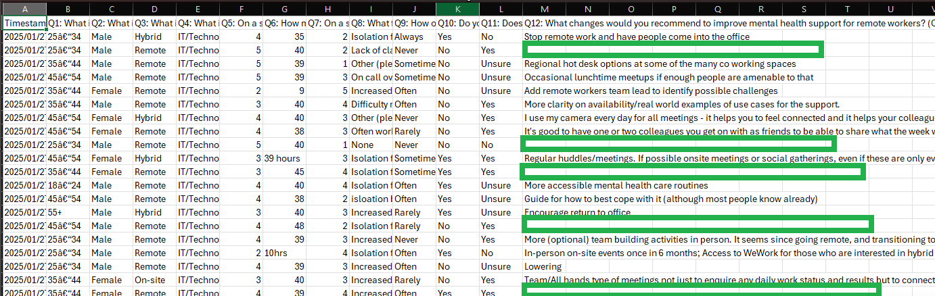
Data Preprocessing & Analysis for Primary Data
Snapshot of Primary Dataset (Survey) highlighting incomplete survey responses (missing data shown in green).

Slide 7
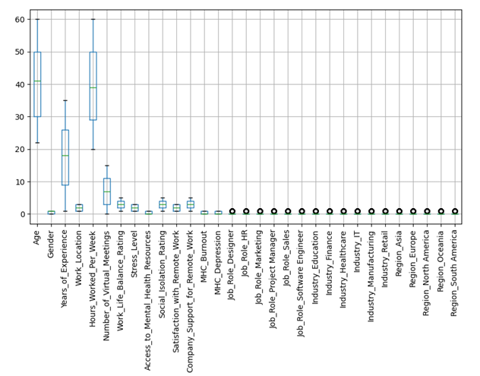
Data Preprocessing & Analysis for Secondary Data
Secondary dataset sourced from publicly available mental health records
Outlier detection applied across numeric variables
Notable outliers in:
Age
Years of experience
Virtual meetings per week
Hours worked per week
Preprocessed for ANOVA & regression modeling

Slide 8
Primary & Secondary Analysis & Findings
Key findings from primary data
Key findings from secondary data

Slide 9
Secondary Analysis & Findings
Key findings showed a moderate negative correlation between number of hours worked remotely and social connectedness.
Regression indicated that age and workload were significant predictors of mental health score.

Slide 10
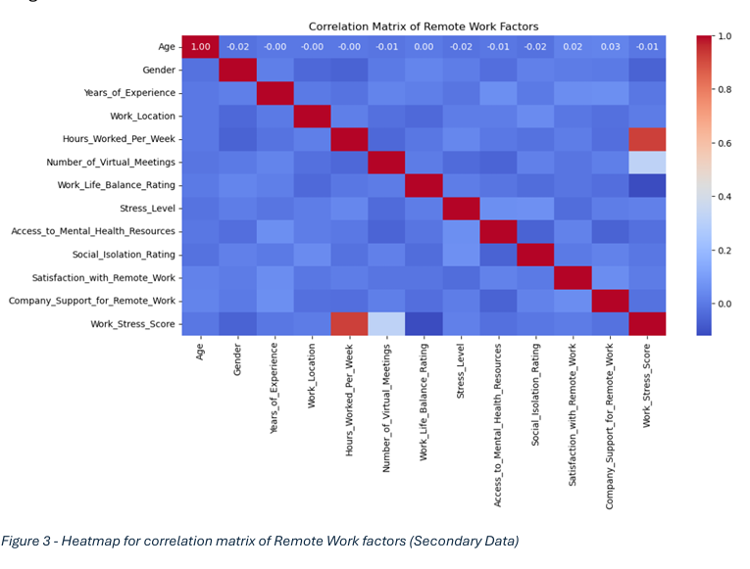
Key Findings - Secondary Data
Strong positive link between work stress and weekly hours (r ≈ 0.92)
➔ Long hours likely drive higher stress levels
Negative correlation between stress and mental health service access
➔Better access = lower stress
Weak/no clear correlation between stress and age, gender, or experience

Slide 11
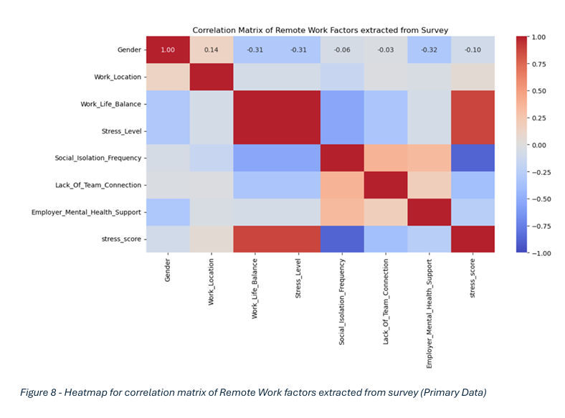
Key Findings – Primary Data
Work-Life Balance vs. Stress Level
➔ Moderate negative correlation (r = -0.55)→ Better balance = lower stress
Social Isolation also negatively linked to stress
➔ Frequent isolation = higher stress
Employer Support showed weak to moderate negative correlation with stress
➔ Support may help reduce stress
Stress Score strongly correlated with Stress Level (r = 0.88)
➔ Confirms stress score as a valid measure

Slide 12
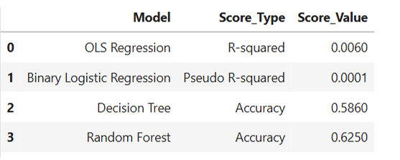
Model Comparisons for Secondary Dataset

Slide 13
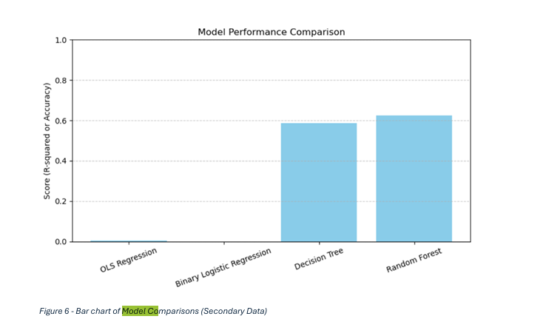
Model Comparisons for Secondary Dataset

Slide 14
Discussion
• Interpretation of results
• Comparison with existing literature
• Implications

Slide 15
Discussion -- Conclusion & Recommendations
Conclusion: Remote work presents both risks and benefits, flexibility vs. isolation.
Recommendations: Employers should foster community and encourage regular check-ins.

Slide 16
Self-Reflection & Challenges
Challenge: Planning and executing primary data collection required persistence and adaptability.
Data preprocessing for secondary data was time-intensive due to inconsistencies and noise.
Lessons learned: Importance of version control (used GitHub privately), and documenting all preprocessing steps clearly.
My Github: Robert-Solomon12

Slide 17
Future Work
• Recommendations for future research
• Improvements and extensions

Slide 18
Thank You!

Slide 19


Open to Questions?

Slide 20
Contact Information
Linkedin: https://www.linkedin.com/in/robertosolomon/
GITHUB: https://github.com/robert-solomon12

