Slide 1
BurgerAPI
1.0
By Róbert Weinber

Slide 2
Considerations
Security consideration
No user authentication is required to view information
Basic user authentication is required to create reviews
Admin level user authentication is required for CRUD operations on other items
Design principles
Accept and respond with JSON
Handle errors gracefully and return standard error codes
Include versioning
Documentation (Swagger)

Slide 3
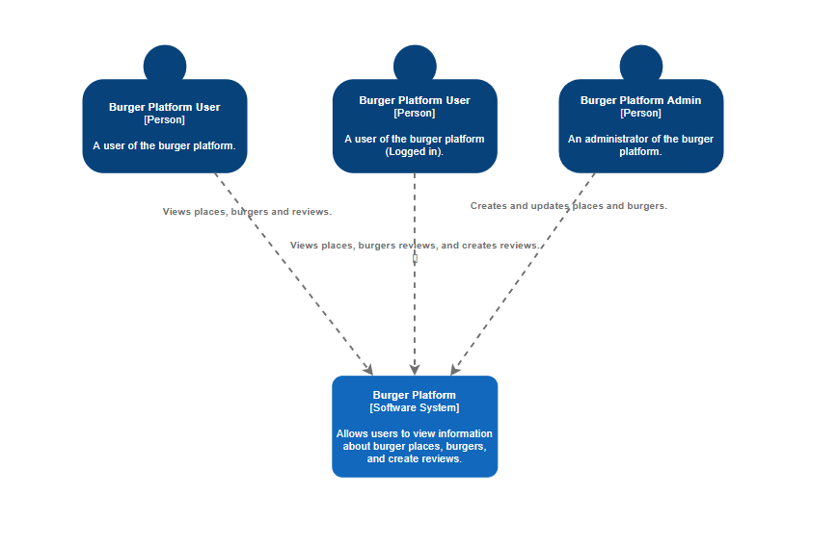
System Context Diagram

Slide 4
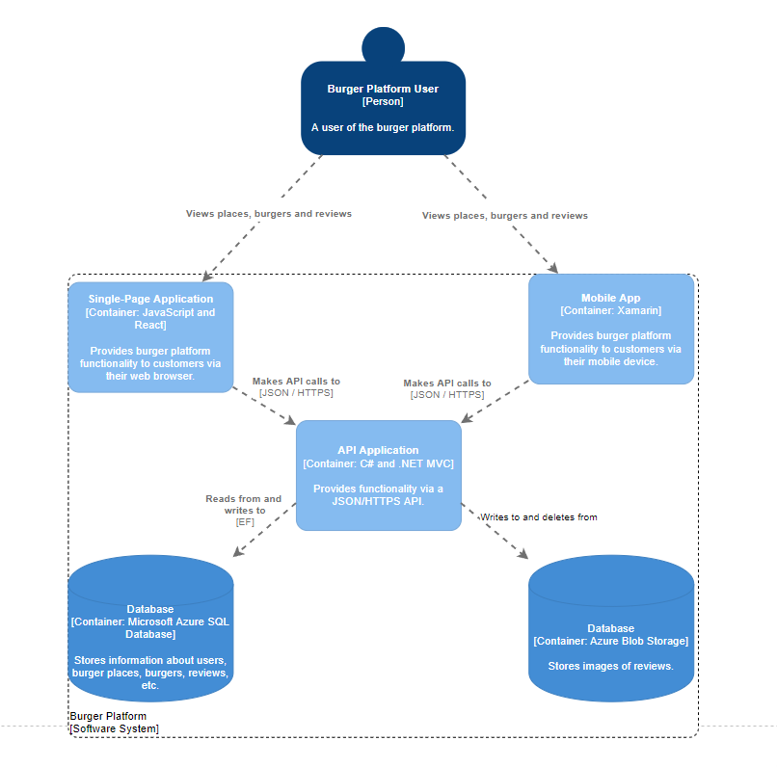
Container Diagram

Slide 5
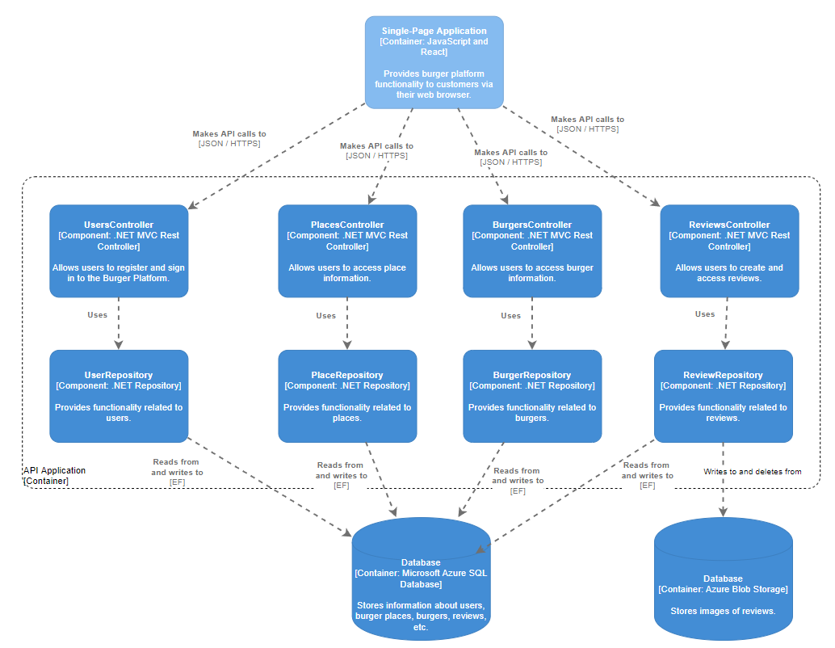
Component Diagram

Slide 6
Reflections
System scale and bottlenecks
Simple system(few models)
No complex/time consuming operations
Scales evenly with workload
Endpoints to access all, filtered or specific data
Frontend implementation can be tuned using feedback data
Possible improvements
User profiles
Find nearby restaurants using GPS

Slide 7
Thank You!

