Slide 1

Lost & Found
SSW695 – Spring 2024
Final Presentation

Slide 2

Agenda
Project Overview
Architecture & Design
Technology
Infrastructure
Security
Software Quality
Requirements
Project Management & Communication
Lessons Learned
Demo
Source Code-
Questions

Slide 3

Team members
Backend developers
Aayushi Desai
Robert Hernandez
Frontend developers/testers
Meet Jain
Ishan Patel
Admin
Jashil Mehta
Group Lead
Robert Hernandez

Slide 4
Project Overview
what
Missing item tool
Who
Students - Faculties
How
Having a tool where one can report a missing item
Why
Alleviate and increase the speed of potentially finding the missing item

Slide 5

Project Overview
Our project aims to create a reliable, simple system that allows users to locate and recover their missing items faster.
In addition to serving as a tool for locating missing items, it will encourage others to play an essential role in helping their community find their missing items by simplifying the search process.
To us, success means knowing that we were able to help someone find their valuable item faster because of the use our tool.

Slide 6
Features
Report a missing item request
Update the item requested
Search for missing items
Ability to log in to the application
Security
Notification report
Ability to contact admin for further questions

Slide 7
Requirements
Agile
As we continued progressing throughout the project, the team updated some requirements and added others.
Removed the admin side
Removed redundant features

Slide 8
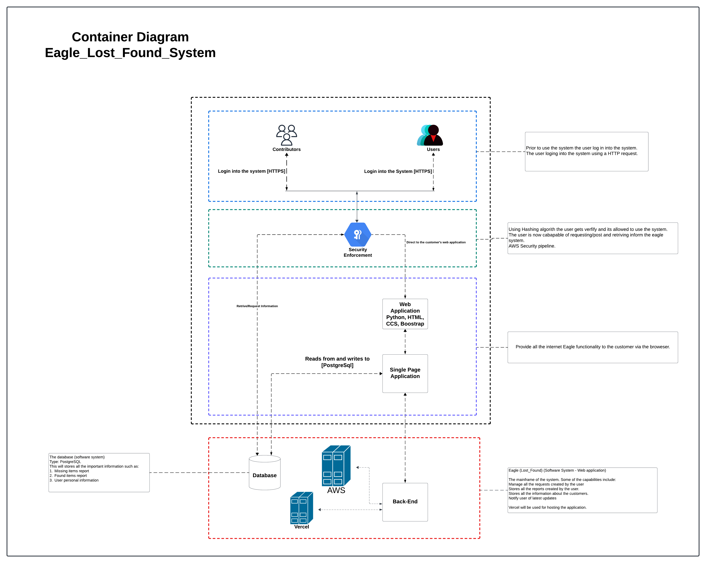
Architecture & Design

Slide 9

Architecture & Design cont.
There were multiple ideas…
Programming language
php
Database to use
MongoDB
Based on the project’s requirements and the team’s agreement, it was concluded that this was the best design due to its flexibility regarding scalability, security, and reliability.
In addition, we only had 13 weeks to work on it.

Slide 10

Technology
Tools:
GitHub, Visual Studio Code, pgAdmin4
Languages:
Python, JavaScript PostgreSQL, HTML, and CSS
Frameworks:
Bootstrap, Django
Infrastructure
AWS
Vercel

Slide 11
Infrastructure
Source code
GitHub
Data
AWS & PostgreSQL
Build and deployment
Vercel

Slide 12
Testing
Acceptance
Security
Unit
Regression

Slide 13
Security
PostgreSQL
Data encryption system
Data is encrypted on the client side before being sent to the server
Django
Authentication system
Prevent users from using the system’s features if it hasn’t been verified

Slide 14
Project Management
GitHub
Wiki
Project Status
Tasks
Communication
Text messages - WhatsApp
Zoom
For issues
Group discussion
Follow up

Slide 15

Lessons Learned
Lessons
Communication
Time management
Flexibility
– Prof. Kempinski
“Do something that feels uncomfortable doing it.”
Something different…
Prioritization
Work left
Admin side

Slide 16

Live Demo

Slide 17

Thank you! Question?

