Slide 1

Jet Blue Flight Deals
Robert Amezquita & Stefan Avey
November 8, 2015 | YHack
Outline

Slide 2
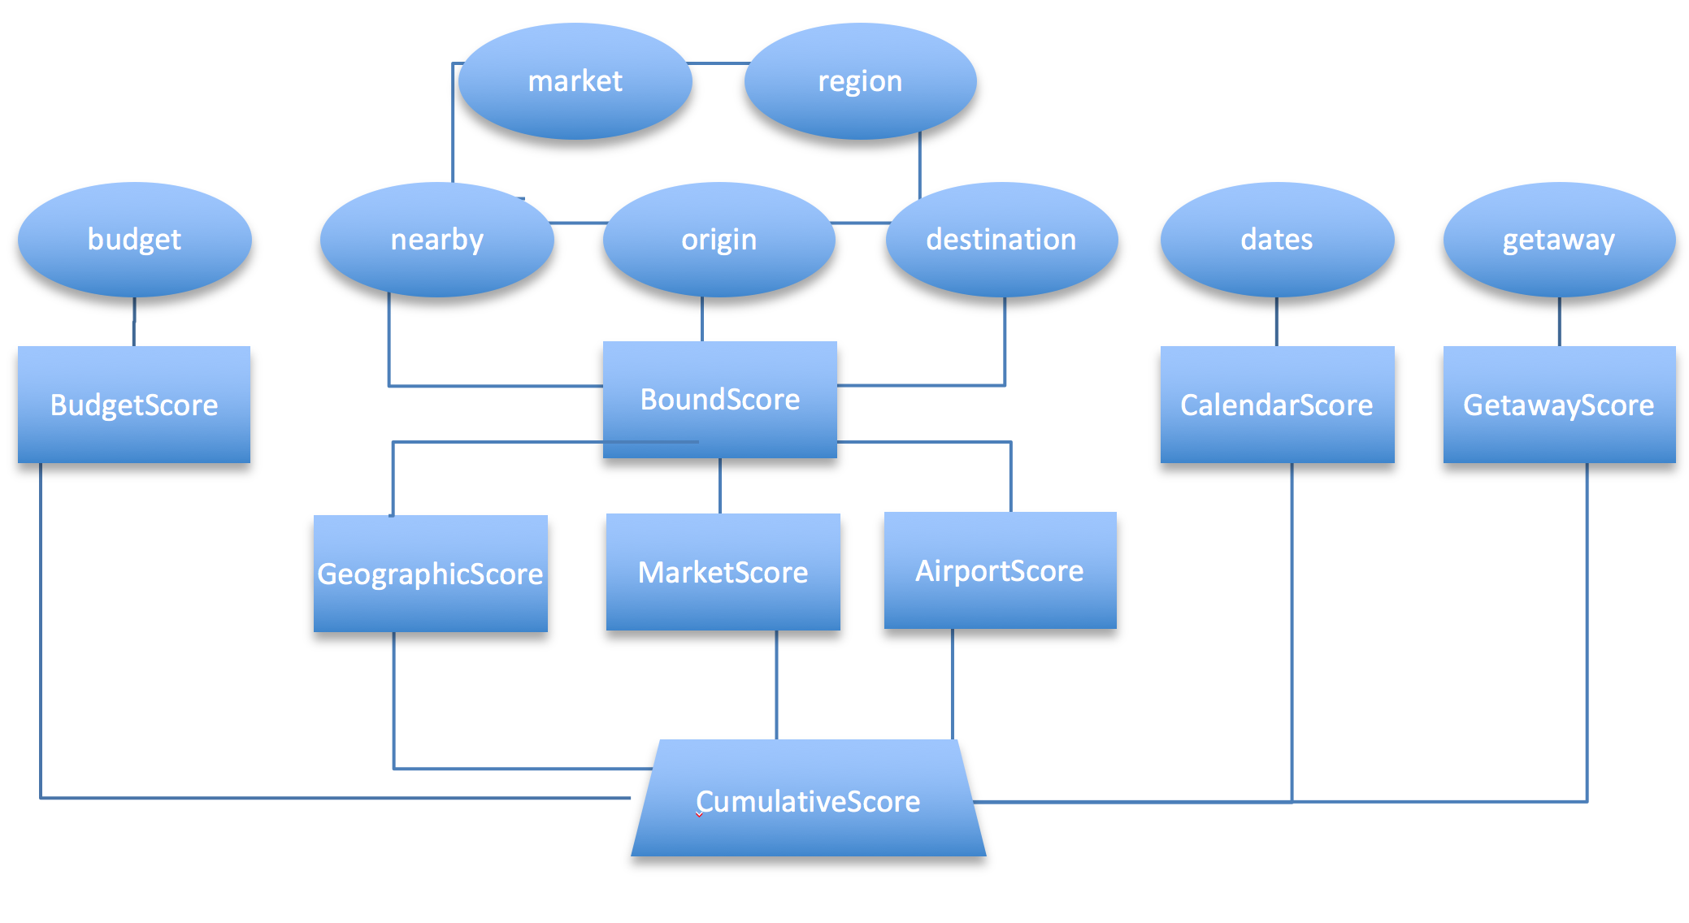
Outline
Algorithm
Inputs
Processing
Ranking
Notes:
INput

