Slide 1
Petrobras Oil Rig Platform Slideshow
Courtesy of the
Society of Reliability Engineers
Click the slideshow button for automated show.

Slide 2
This slideshow is a photo essay of the accidental sinking of an oil rig platform that was being installed off the coast of Brazil for Petrobras

Slide 3
The following is a Petrobras press release that preceded this multi-million dollar catastrophe

Slide 4
Press Release Excerpt
“Petrobras has established new global benchmarks for the generation of exceptional shareholder wealth through an aggressive and innovative programme of cost-cutting on its P36 production facility”

Slide 5
Press Release Excerpt (cont.)
“Conventional constraints have been successfully challenged and replaced with new paradigms appropriate to the globalised corporate marketplace”

Slide 6
Press Release Excerpt (cont.)
“Through an integrated network of facilitated workshops, the project successfully rejected the established constricting and negative influences of prescriptive engineering, onerous quality requirements, and outdated concepts of inspection and client control”

Slide 7
Press Release Excerpt (cont.)
“Elimination of these unnecessary straitjackets has empowered the project's suppliers and contractors to propose highly economical solutions, with the win-win bonus of enhanced profitability margins for themselves”

Slide 8
Press Release Excerpt (cont.)
“The P36 platform shows the shape of things to come in unregulated global market economy of the 21st Century”

Slide 9


Slide 10


Slide 11
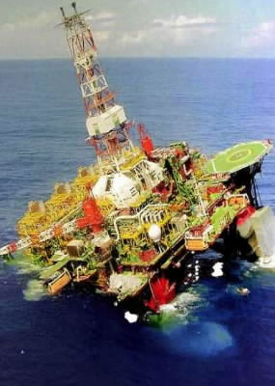

Slide 12
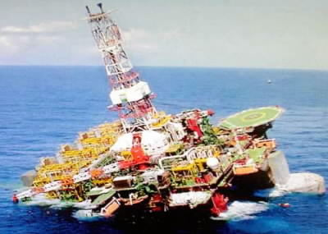

Slide 13
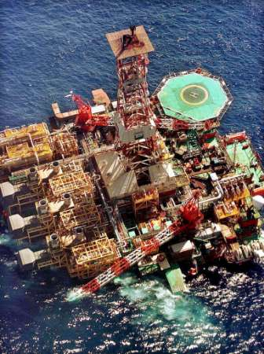

Slide 14
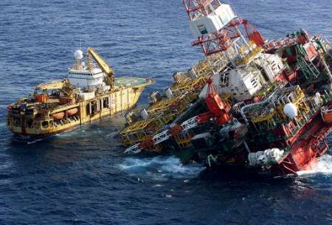

Slide 15
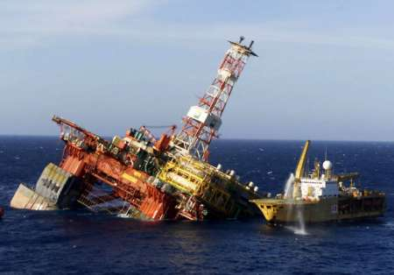

Slide 16
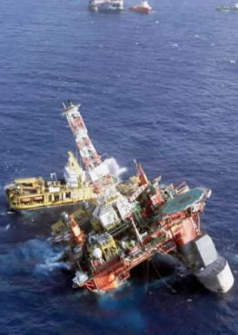

Slide 17


Slide 18
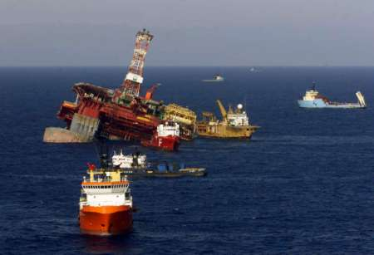

Slide 19
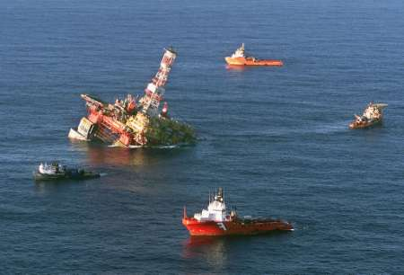

Slide 20
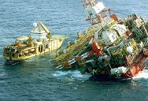

Slide 21
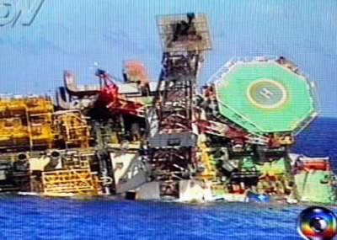

Slide 22
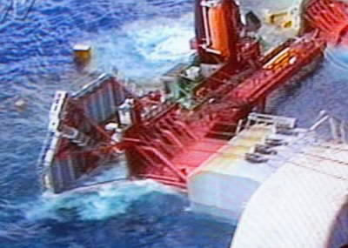

Slide 23
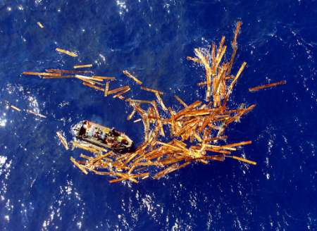

Slide 24


Slide 25
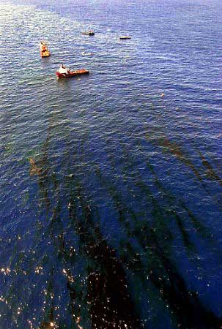

Slide 26


Slide 27
What are the intangible costs of unreliability?
The multi-million dollar lesson learned here is that there is a need for attention to the "systems" approach in program management that includes Reliability and Quality oversight, not just attention to the tangible costs that affect the bottom line

Slide 28
Makes you think about the risks of short-cutting reliability engineering, doesn’t it?

Slide 29
