Slide 1
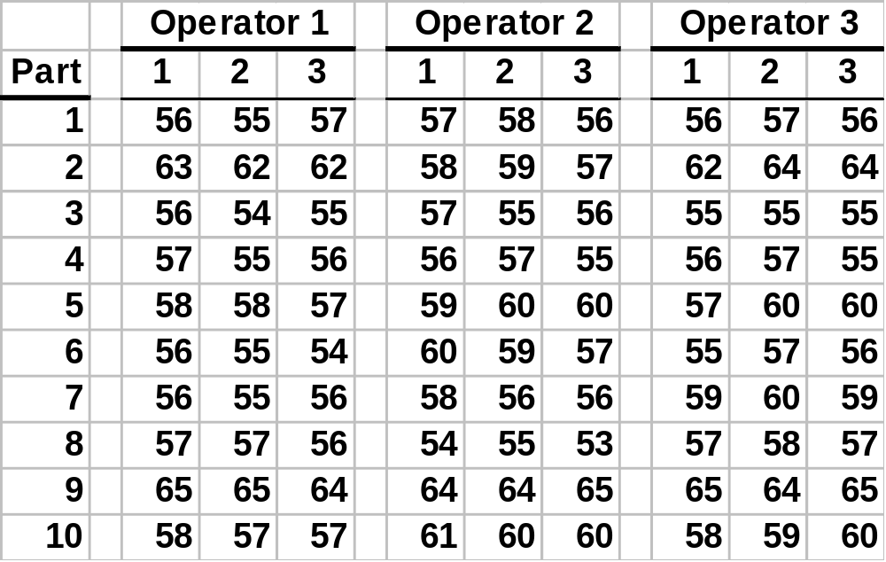
Classic Gauge R&R Study
Notes:
Types of Errors
Errors due to modeling assumptions
Errors due to using an approximate method of solution
Errors due to carrying out inexact arithmetic, i.e. rounding errors
Errors in the data
[Guide to Mathematical Modeling, Dilwyn Edwards & Mike Hamson, p. 118-119]
Plus there are errors in the measurement system.
Here’s a classic Gage R&R Study with 3 Operators, 10 Parts, 3 Trials per operator-part combination.

Slide 2
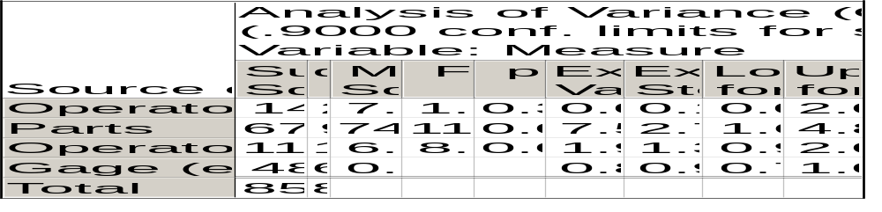
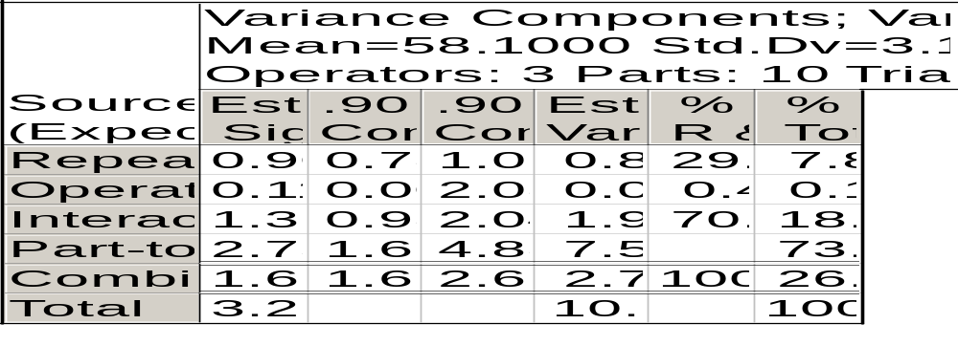
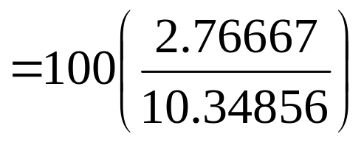
Classical Gauge R&R ANOVA
Notes:
We would report that the Combined R&R is 26.7% based on the ratio of Combined R&R variance (2.76667 = 0.81111 + 0.01317 + 1.94239) to total variance (10.34856).

