Slide 1
DSO 522 • APPLIED FORECASTING
Machine Learning &
Deep Learning for
Forecasting
Understand the idea → run Python → compare forecasts
Intuition-first lecture | Google Colab demonstration

Slide 2
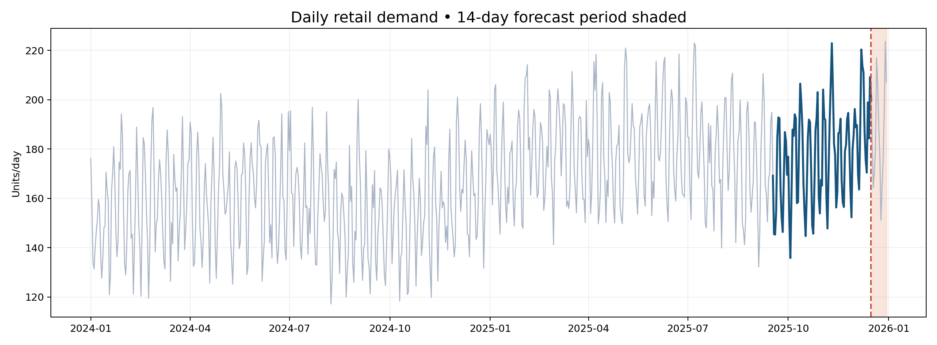
THE QUESTION
How should we forecast the next 14 days of store demand?
One shared business problem, several approaches
DSO 522 | APPLIED TIME SERIES FORECASTING
02

Slide 3
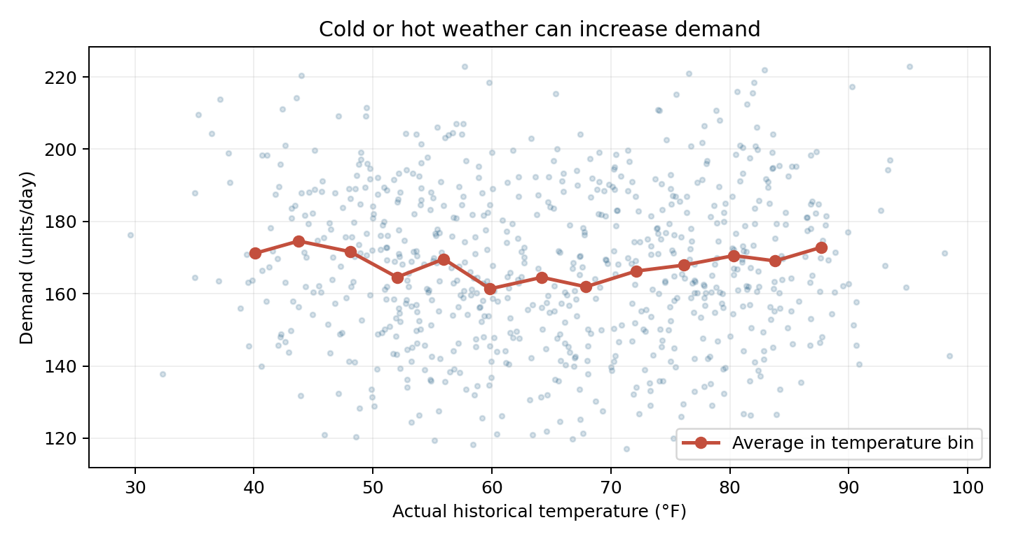
BUSINESS CASE
Weather, demand, and nonlinearity
Historical weather may reveal effects that a simple correlation misses.
The practical question
Would a weather outlook help predict sales that depend on both unusually cold and hot days?
Trees can learn nonlinear effects.
DSO 522 | APPLIED TIME SERIES FORECASTING
03

Slide 4
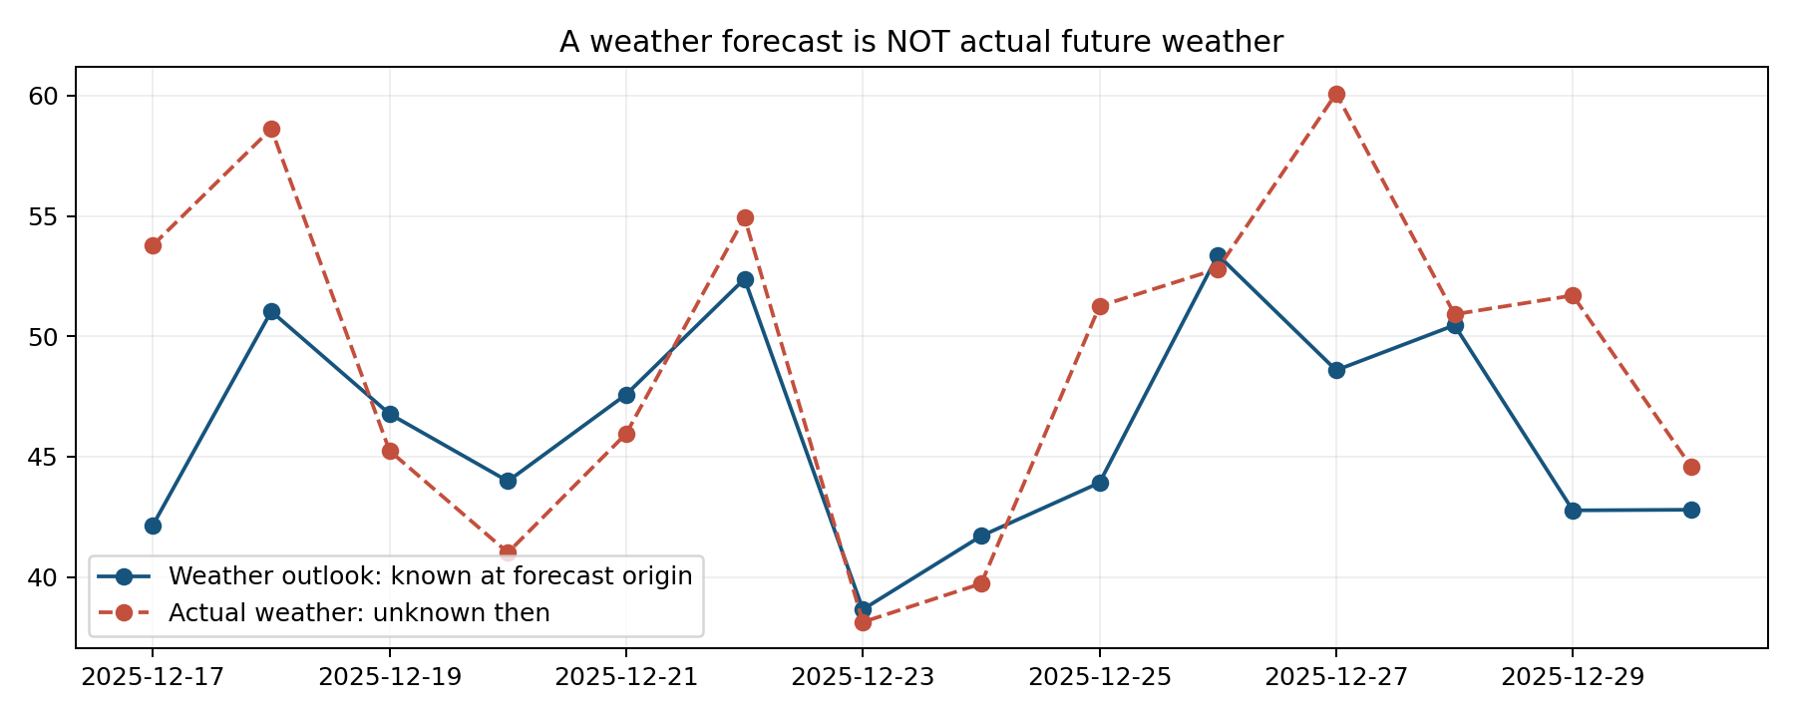
AVAILABILITY RULE
A forecast is not a future observation
Here is the central difference between predictive modeling and forecasting.
Allowed today
Past sales
Future weekday
Planned promotions
Weather outlook
NOT future actuals
Every future predictor needs a credible source at the forecast origin.
DSO 522 | APPLIED TIME SERIES FORECASTING
04

Slide 5
LEARNING OBJECTIVES
What will you be able to do?
Not derivations. Decisions, implementation, and interpretation.
Build the problem
Run the models
Choose wisely
Convert history into valid training examples; distinguish observed versus future-known features.
Implement XGBoost, LSTM, N-BEATS and NHITS using compact Python code.
Compare forecast accuracy and understand when added complexity helps—or does not.
DSO 522 | APPLIED TIME SERIES FORECASTING
05

Slide 6
START WITH DECISIONS
Not every model sees the same kind of information
Think about what is actually known at forecast time.
Observed history
Known in advance
Not yet known
Sales through today
Last week’s sales
Past temperature
Actual past prices
Day of week
Holiday calendar
Scheduled promotions
Planned future prices
Future actual sales
Unobserved future weather
Unplanned disruptions
Future forecast errors
Data leakage = letting a model use information that would not have existed when the forecast was made.
DSO 522 | APPLIED TIME SERIES FORECASTING
06

Slide 7
FEATURE ENGINEERING
What one machine-learning training row means
The target is the next day’s demand; predictors are known beforehand.
Date
Lag 1
Lag 7
Rolling mean 7
Weekday
Promo
Weather outlook
Target sales
Jan 29
161
154
152
Mon
No
58°F
168
Jan 30
168
164
156
Tue
Yes
62°F
183
Illustrative values. Lag 1 and the rolling average must be shifted so today’s outcome is not included.
DSO 522 | APPLIED TIME SERIES FORECASTING
07

Slide 8
LEAKAGE
Shift first, then summarize
A small code change can invalidate an otherwise impressive forecast.
Valid
Invalid
past = sales.shift(1)
rolling_7 = past.rolling(7).mean()
Uses yesterday and earlier observations.
rolling_7 = sales.rolling(7).mean()
The current-day target leaks into its own predictor.
Before running a model, ask: Could this feature exist at the moment we forecast?
DSO 522 | APPLIED TIME SERIES FORECASTING
08

Slide 9
FORECASTING WORKFLOW
A model can forecast multiple days in different ways
The strategy can matter as much as the algorithm.
Recursive
Direct
Multi-output
Predict tomorrow. Feed that prediction back to help forecast the next day.
Simple; errors may accumulate.
Train separate models for horizon 1, horizon 2, horizon 3…
More model management.
One model predicts the entire future window together.
Natural for N-BEATS / NHITS.
DSO 522 | APPLIED TIME SERIES FORECASTING
09

Slide 10
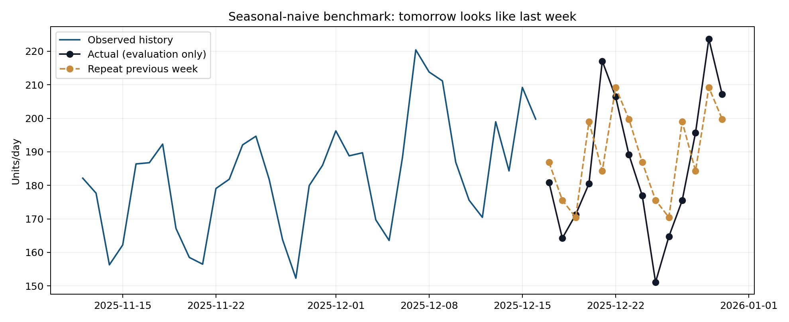
SANITY CHECK
First: beat a seasonal-naive benchmark
“Next Monday looks like last Monday.”
Why?
Fast
Transparent
Often strong
DSO 522 | APPLIED TIME SERIES FORECASTING
10

Slide 11
XGBOOST REFRESHER
Familiar algorithm. New forecasting features.
Boosting is not the lesson; knowing what features to build is.
Lag 1
Lag 7
Weekday
Promotion
XGBoost
Lag features use observed history only.
Tomorrow’s sales
Recursive predictions can feed future lags.
Future calendar and scheduled promotions may be known.
DSO 522 | APPLIED TIME SERIES FORECASTING
11

Slide 12
MODEL 1: XGBOOST
Practical parameters—not a forest of options
See the effect of changing a few settings in Colab.
n_estimators = 250
max_depth = 3
learning_rate = 0.05
How many small trees are added to the ensemble. More is not always better.
How detailed an individual tree can become. Larger may overfit.
How cautiously each new tree adjusts the overall predictions.
Demo: predict all 14 days; inspect feature importance; discuss what importance does NOT establish.
DSO 522 | APPLIED TIME SERIES FORECASTING
12

Slide 13
FAIR COMPARISONS
A better forecast can come from better information
Always separate algorithm quality from the advantage of extra predictors.
History-only XGBoost
XGBoost + business
Deep learning models
Past demand lags
Shifted rolling average
Comparable input information to sequence-only neural models.
Same demand history
PLUS planned promotion
PLUS weather outlook
Measures value of extra signals.
LSTM, N-BEATS, NHITS use the demand history in the core lab.
A fairer architecture test should use matched information.
DSO 522 | APPLIED TIME SERIES FORECASTING
13

Slide 14
NEURAL BRIDGE
What changes when a model reads a sequence?
Use a moving 28-day window, then predict tomorrow.
LSTM
Day t
t-7
t-6
t-5
t-4
t-3
t-2
t-1
The notebook uses 28 past days, not just the 7 schematic days shown here.
Scale data using training history only.
Different windows become training examples.
DSO 522 | APPLIED TIME SERIES FORECASTING
14

Slide 15
MODEL 2: LSTM
An intuitive “working memory” for sequential observations
It decides what information to carry through time.
What it does
What to be careful about
Reads one historical observation at a time, updates an internal state, and learns patterns from sequences.
Useful when temporal relationships are difficult to express manually.
Needs scaling and training choices.
No automatic advantage over XGBoost.
A simple LSTM does not magically know future promotions.
DSO 522 | APPLIED TIME SERIES FORECASTING
15

Slide 16
LSTM PARAMETERS
Only four knobs for today’s demo
Interpret the parameters as business / learning decisions.
lookback = 28
units = 24
How many days of history the network sees
How much internal representation capacity it has
epochs = 12
batch_size = 32
How many passes over training examples
How many windows per weight update
DSO 522 | APPLIED TIME SERIES FORECASTING
16

Slide 17
FORECAST-SPECIFIC NETWORKS
Why N-BEATS and NHITS are different
Unlike general-purpose LSTM, these were built for forecasting.
N-BEATS | refinement
NHITS | multiple scales
A window of historical values enters a stack of blocks. Blocks progressively contribute to the forecast.
Designed to learn useful patterns directly from series.
The network builds forecasts at several temporal resolutions.
Helpful intuition: broad level + recurring changes + finer variation.
Core difference to demonstrate: both predict a future window directly, without a 14-step recursive loop.
DSO 522 | APPLIED TIME SERIES FORECASTING
17

Slide 18
VISUAL COMPARISON
A window in → a whole horizon out
N-BEATS and NHITS directly produce 14 future points.
N-BEATS
or NHITS
Past 56 observed days
Next 14 days
h = 14
input_size = 56
How far into the future to predict
How much observed history each input window includes
DSO 522 | APPLIED TIME SERIES FORECASTING
18

Slide 19
MODEL SELECTION
When does more complexity make sense?
It depends on how many series, how much history, and the forecast horizon.
Seasonal naive
Strong baseline, limited data
XGBoost
Lag features + business predictors
LSTM
Learn from ordered sequences
N-BEATS
Predict from historical windows
NHITS
Multi-resolution and longer horizons
DSO 522 | APPLIED TIME SERIES FORECASTING
19

Slide 20
BEYOND THE CORE LAB
TFT: forecasts informed by business context
Attention is useful, but it is not a causal explanation.
Static
Historical
Future-known
Store region
Product category
Store size
Observed past sales
Past weather
Actual prior prices
Calendar dates
Planned prices
Scheduled promotions
TFT combines multiple input types and learned temporal relationships, at higher complexity and cost.
DSO 522 | APPLIED TIME SERIES FORECASTING
20

Slide 21
NEW FRONTIER
Pretrained forecasting foundation models
A useful forecast can be generated without fitting a custom model to this series.
Pretrained
model
Many pretraining series
Zero-shot forecast
Examples
Practical caution
Chronos (Amazon) • TimesFM (Google)
Check version, license, runtime, and real accuracy.
DSO 522 | APPLIED TIME SERIES FORECASTING
21

Slide 22
EVALUATION
What does a better forecast mean?
Same cutoff. Same holdout days. No future-information leakage.
MAE
RMSE
Business cost
Average absolute miss, expressed in sales units. Easy to communicate.
Penalizes unusually large errors more heavily than MAE.
Under-forecasting can cause shortages; over-forecasting can cause excess inventory.
A single 14-day holdout is a teaching demo; use rolling-origin evaluation for reliable model selection.
DSO 522 | APPLIED TIME SERIES FORECASTING
22

Slide 23
RELIABLE EVALUATION
One pretty forecast is not enough
A single holdout can reward luck; use several cutoffs.
Origin A
Past training data
Next 14 days
Origin B
Past training data
Next 14 days
Origin C
Past training data
Next 14 days
For each origin: rebuild features → refit model → forecast → score error.
DSO 522 | APPLIED TIME SERIES FORECASTING
23

Slide 24
BUSINESS IMPACT
Forecast error is not the same as business cost
Under-forecasting may create stockouts; over-forecasting may create waste.
Too little inventory
Too much inventory
Actual demand = 180 units
Forecast = 160 units
Shortage = 20 units
Lost margin and disappointed customers.
Actual demand = 160 units
Forecast = 180 units
Surplus = 20 units
Storage, markdowns, or waste.
A useful model is judged by accuracy AND the decision it supports.
DSO 522 | APPLIED TIME SERIES FORECASTING
24

Slide 25
COLAB WALKTHROUGH
One notebook, one storyline
Live demo sequence is deliberate: start simple, add complexity, compare.
01
Plot data
Spot weekly seasonality
02
Seasonal naive
Set a baseline
03
XGBoost
Apply known ML to lags
04
LSTM
Learn from sequences
05
N-BEATS / NHITS
Forecast entire windows
06
Compare
Accuracy and business relevance
DSO 522 | APPLIED TIME SERIES FORECASTING
25

Slide 26
DISCUSSION
What would you recommend to the store manager?
Choose based on tested performance and operating constraints.
Questions to ask
The right conclusion
Which method improves on seasonal naive?
Can the store supply the required future predictors?
How costly are under- and over-forecasts?
Do not select LSTM, XGBoost, or a Transformer just because it is sophisticated.
Pick the model that earns its complexity in out-of-sample forecasts.
DSO 522 | APPLIED TIME SERIES FORECASTING
26

Slide 27
The goal is not to memorize architectures.
The goal is to know what each model needs, how to run it,
and whether it improves business forecasts.
UNDERSTAND → APPLY → VISUALIZE → EVALUATE
DSO 522 | USC Marshall

