Slide 1
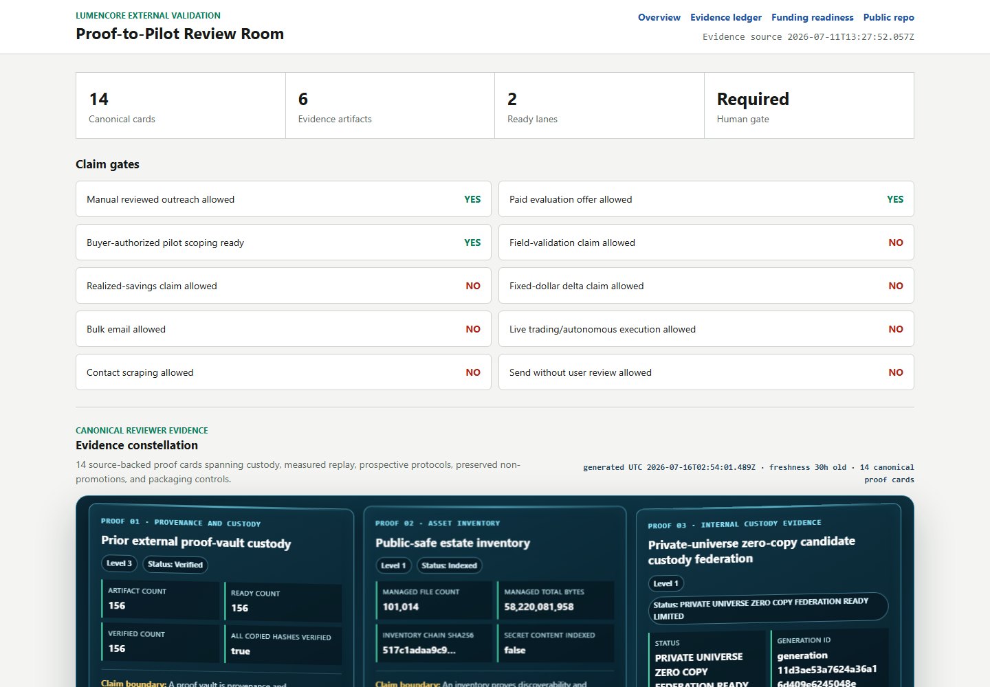
LUMENCORE
Evidence-to-pilot infrastructure
for decisions buyers can review
Turn candidate methods into reproducible decision packets before field, savings, or performance claims.
PITCH REVIEW COPY
$10K PRIZE PLAN GATED
Robert Ashworth | Founder
Launch Tennessee 3686 | 2026
Local proof room snapshot | 2026-07-29
LUMENCORE | 3686 PITCH REVIEW COPY | 2026-07-29
1/11
Notes:
[LaunchTN 3686 review controls]
- Local: grant_submissions/LAUNCHTN_3686_PITCH_2026/LAUNCHTN_3686_APPLICATION_MANIFEST_2026-07-29.json
- Prize and deadline facts are bound to the current application manifest.
- Legal entity, Tennessee eligibility, financing, upload, attestation, and submission remain founder-gated.

Slide 2
PROBLEM
02
Evidence fails before models do
In high-consequence operations, a buyer is not purchasing a score. The buyer is purchasing a defensible decision.
WHAT BREAKS TRUST
Data leakage
Future information contaminates the test.
A strong result can still fail review when the evidence trail cannot answer four basic questions.
Moving goalposts
Baselines or metrics change after results appear.
1
2
3
4
Hidden negatives
Only favorable runs survive into the deck.
Dataset identity
and allowed history
Baseline and
metric lock
Negative results
and uncertainty
Receipt, owner,
and next action
No custody trail
The artifact cannot be tied to code, data, or time.
LUMENCORE | 3686 PITCH REVIEW COPY | 2026-07-29
2/11
Notes:
[LaunchTN 3686 review controls]
- Local: grant_submissions/LAUNCHTN_3686_PITCH_2026/LAUNCHTN_3686_APPLICATION_MANIFEST_2026-07-29.json
- Prize and deadline facts are bound to the current application manifest.
- Legal entity, Tennessee eligibility, financing, upload, attestation, and submission remain founder-gated.

Slide 3
PRODUCT
03
One bounded workflow from claim to decision
LumenCore makes the evidence path explicit before any claim is promoted.
01
02
03
04
FREEZE
REPLAY
GATE
RECEIPT
Dataset, baseline, metric, window
Past-only execution with held-out windows
Uncertainty, abstention, and negative-result checks
Hash, custody record, owner, and pilot decision
HUMAN APPROVAL BEFORE EXTERNAL RELEASE
Output: a reviewer-readable packet that can be reproduced, challenged, and used to decide whether a scoped pilot is warranted.
LUMENCORE | 3686 PITCH REVIEW COPY | 2026-07-29
3/11
Notes:
[LaunchTN 3686 review controls]
- Local: grant_submissions/LAUNCHTN_3686_PITCH_2026/LAUNCHTN_3686_APPLICATION_MANIFEST_2026-07-29.json
- Prize and deadline facts are bound to the current application manifest.
- Legal entity, Tennessee eligibility, financing, upload, attestation, and submission remain founder-gated.

Slide 4
CUSTOMER
04
Start where one bad decision is expensive
Target hypothesis: organizations with costly reliability, planning, or forecasting errors and an incumbent baseline they already trust.
UTILITY / GRID
LAB / AGENCY
INDUSTRIAL RELIABILITY
BUYER
BUYER
BUYER
Analytics or operations lead
Program or technical lead
Reliability or asset lead
TRIGGER
TRIGGER
TRIGGER
A planning or forecasting model cannot clear internal review.
A research result needs a reproducible route to a field partner.
A failure-risk signal needs proof against the incumbent rule or model.
PILOT OUTCOME
PILOT OUTCOME
PILOT OUTCOME
Decision receipt + replay package
Reviewer packet + validation plan
Scoped pilot + accepted evidence gate
LUMENCORE | 3686 PITCH REVIEW COPY | 2026-07-29
4/11
Notes:
[LaunchTN 3686 review controls]
- Local: grant_submissions/LAUNCHTN_3686_PITCH_2026/LAUNCHTN_3686_APPLICATION_MANIFEST_2026-07-29.json
- Prize and deadline facts are bound to the current application manifest.
- Legal entity, Tennessee eligibility, financing, upload, attestation, and submission remain founder-gated.

Slide 5
EVIDENCE POSTURE
05
Current evidence is measurable, including the negative result
CURRENT SOURCE-NATIVE LEDGER
FROZEN PROSPECTIVE GATE
Retrospective benchmark state
Future-only validation
1
140 registered families; 35 implementations present
!
Eight source-native baselines
2
126 direct comparisons across 23 candidate-source cards
!
Sixteen one-sided Holm contrasts
3
0 global Holm-positive comparisons
!
520 future daily sessions or 60 monthly releases
4
0 promoted champions
!
Zero eligible future observations today
Supports bounded software, custody, and protocol review. No alpha, superiority, savings, or field claim.
Protocol LUMENCORE_TS_SOURCE_NATIVE_20260729_V1 is frozen and waiting for new source rows.
LUMENCORE | 3686 PITCH REVIEW COPY | 2026-07-29
5/11
Notes:
[LaunchTN 3686 review controls]
- Local: grant_submissions/LAUNCHTN_3686_PITCH_2026/LAUNCHTN_3686_APPLICATION_MANIFEST_2026-07-29.json
- Prize and deadline facts are bound to the current application manifest.
- Legal entity, Tennessee eligibility, financing, upload, attestation, and submission remain founder-gated.

Slide 6
BUSINESS MODEL
06
Commercial path begins with an accepted evidence contract
Three offers create a bounded entry, a controlled validation event, and a post-pilot expansion path.
1. EVIDENCE REVIEW
2. CONTROLLED PILOT
3. PROGRAM LICENSE
SCOPED
GATED
POST-PILOT
Price unquoted
Buyer-defined gate
After accepted receipt
Define the decision, lock the incumbent baseline, and produce a reviewer-ready evidence plan.
Replay buyer-controlled data against a written acceptance gate and issue an auditable receipt.
Automate repeatable reviews, evidence custody, governance, support, and approved workflows.
Buyer: Technical sponsor
Buyer: Design partner
Buyer: Program owner
No pricing, paid customer, savings, or contract is claimed. Scope and price require founder approval.
LUMENCORE | 3686 PITCH REVIEW COPY | 2026-07-29
6/11
Notes:
[LaunchTN 3686 review controls]
- Local: grant_submissions/LAUNCHTN_3686_PITCH_2026/LAUNCHTN_3686_APPLICATION_MANIFEST_2026-07-29.json
- Prize and deadline facts are bound to the current application manifest.
- Legal entity, Tennessee eligibility, financing, upload, attestation, and submission remain founder-gated.

Slide 7
COMPETITIVE LANDSCAPE
07
Positioned between model tooling and audit work
The wedge is not another model leaderboard. It is an evidence operating layer for decisions that must survive review.
REPEATABLE
LUMENCORE
TARGET POSITION
DISTINCTIVE CONTROLS
GENERIC
MLOPS
Past-only replay
Frozen baseline and metric
Visible negatives and abstention
Hashable custody receipt
Human release gate
CONSULTING /
AUDIT PROJECT
AD HOC
ANALYSIS
BESPOKE
LOW AUDITABILITY
HIGH AUDITABILITY
Positioning hypothesis; not a market-share or superiority claim.
LUMENCORE | 3686 PITCH REVIEW COPY | 2026-07-29
7/11
Notes:
[LaunchTN 3686 review controls]
- Local: grant_submissions/LAUNCHTN_3686_PITCH_2026/LAUNCHTN_3686_APPLICATION_MANIFEST_2026-07-29.json
- Prize and deadline facts are bound to the current application manifest.
- Legal entity, Tennessee eligibility, financing, upload, attestation, and submission remain founder-gated.

Slide 8
GO-TO-MARKET
08
Qualify one hard problem, prove it, then expand
The near-term objective is one serious design partner with controlled data and an accepted incumbent baseline.
01
02
03
QUALIFY
PROVE
EXPAND
Confirm the owner, decision, data rights, baseline, cost of error, and approval path.
Run a preregistered replay on buyer-controlled data and preserve every favorable and unfavorable result.
Convert the accepted pilot into repeatable workflows, annual support, and adjacent decisions.
Gate: written problem + baseline
Gate: accepted evidence receipt
Gate: paid renewal or license
QUALIFICATION GATE
Named owner | accepted baseline | controlled dataset | written acceptance test
LUMENCORE | 3686 PITCH REVIEW COPY | 2026-07-29
8/11
Notes:
[LaunchTN 3686 review controls]
- Local: grant_submissions/LAUNCHTN_3686_PITCH_2026/LAUNCHTN_3686_APPLICATION_MANIFEST_2026-07-29.json
- Prize and deadline facts are bound to the current application manifest.
- Legal entity, Tennessee eligibility, financing, upload, attestation, and submission remain founder-gated.

Slide 9
PILOT CONTRACT
09
A paid pilot is defined by acceptance, not a sales claim
BUYER SUPPLIES
LUMENCORE RETURNS
Controlled problem
Auditable receipt
1
Named decision owner and operating question
1
Frozen configuration and custody receipt
2
Lawfully controlled data with allowed-use terms
2
Past-only replay against the accepted baseline
3
Accepted incumbent baseline and metric
3
Favorable, neutral, negative, and invalid outcomes
4
Written cost-of-error and acceptance gate
4
Human-owned next decision with no automatic release
Inputs define the decision contract before any pilot price, schedule, or outcome is represented.
No savings, ROI, or field-performance claim before a buyer-controlled result.
LUMENCORE | 3686 PITCH REVIEW COPY | 2026-07-29
9/11
Notes:
[LaunchTN 3686 review controls]
- Local: grant_submissions/LAUNCHTN_3686_PITCH_2026/LAUNCHTN_3686_APPLICATION_MANIFEST_2026-07-29.json
- Prize and deadline facts are bound to the current application manifest.
- Legal entity, Tennessee eligibility, financing, upload, attestation, and submission remain founder-gated.

Slide 10
TEAM + PRIZE USE
10
A $10,000 prize would buy buyer-ready proof
FOUNDER + COMPANY
PROPOSED $10K PRIZE USE
What is established
What the prize would fund
1
Robert Ashworth | founder and systems architect
1
Outcome-independent protocol reproduction
2
Working software, custody, and frozen protocols
2
Buyer-controlled dataset integration
3
Company and Tennessee eligibility require founder confirmation
3
Security and compliance preparation
4
No customer, contract, revenue, or financing claim
4
Pilot acceptance-test and receipt package
Upload remains blocked until legal entity, Tennessee eligibility, team, and company-stage facts are founder-confirmed.
Competition ask: $10,000 prize. No equity raise, valuation, financing term, or spend is authorized by this deck.
LUMENCORE | 3686 PITCH REVIEW COPY | 2026-07-29
10/11
Notes:
[LaunchTN 3686 review controls]
- Local: grant_submissions/LAUNCHTN_3686_PITCH_2026/LAUNCHTN_3686_APPLICATION_MANIFEST_2026-07-29.json
- Prize and deadline facts are bound to the current application manifest.
- Legal entity, Tennessee eligibility, financing, upload, attestation, and submission remain founder-gated.

Slide 11
THE 3686 ASK
Help LumenCore earn its first
independent proof receipt.
WHAT WE ASK FROM 3686
01
A fair hearing for the $10,000 pitch prize
02
Buyer and design-partner introductions
The next milestone is not a louder claim. It is one named buyer, one accepted baseline, one controlled dataset, and one result a third party can reproduce.
03
An outcome-independent evaluator
04
Pilot-scope discipline after written gates
Robert Ashworth | Founder, LumenCore
Current software and protocol evidence. No external performance claim.
LUMENCORE | 3686 PITCH REVIEW COPY | 2026-07-29
11/11
Notes:
[LaunchTN 3686 review controls]
- Local: grant_submissions/LAUNCHTN_3686_PITCH_2026/LAUNCHTN_3686_APPLICATION_MANIFEST_2026-07-29.json
- Prize and deadline facts are bound to the current application manifest.
- Legal entity, Tennessee eligibility, financing, upload, attestation, and submission remain founder-gated.

