Slide 1
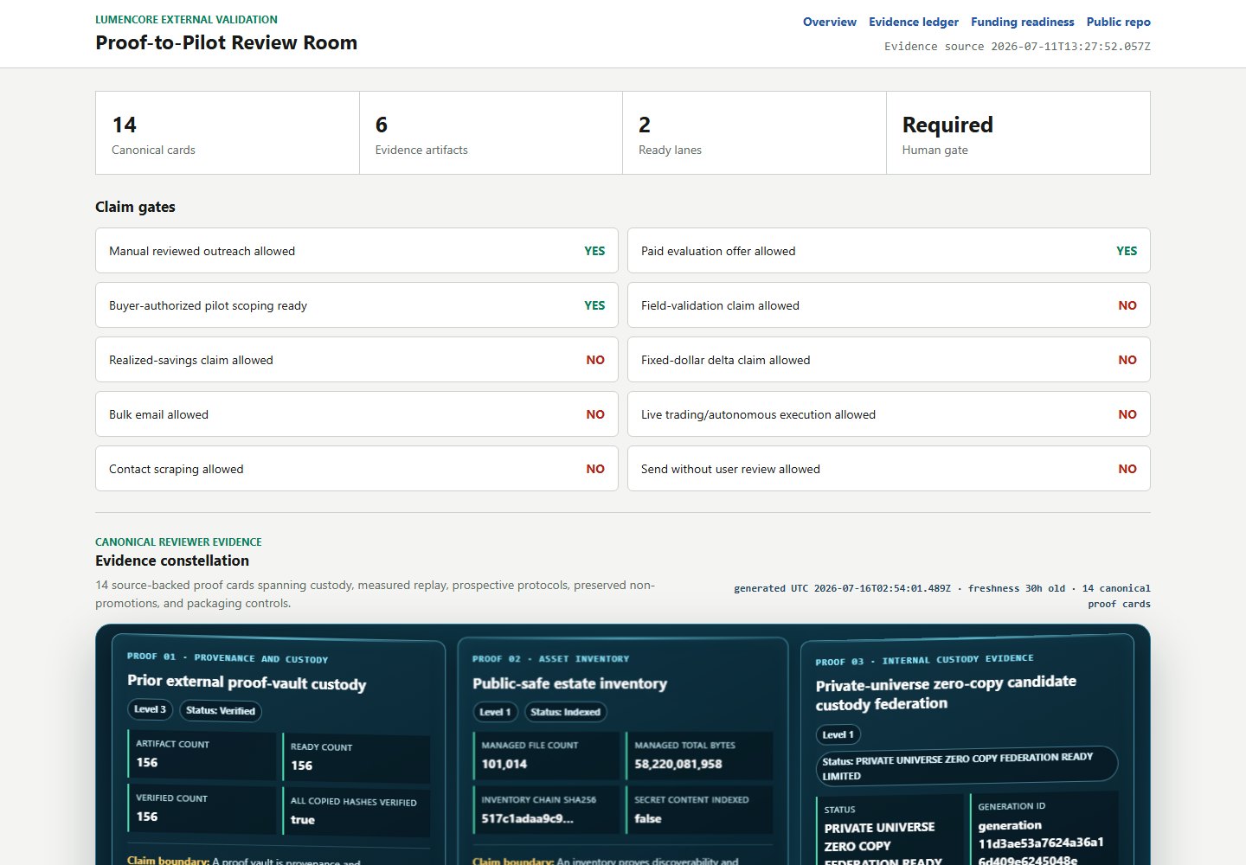
LUMENCORE
Evidence-to-pilot infrastructure
for reviewable AI decisions
Turn a candidate method into a reproducible decision packet before any field or performance claim.
CURRENT REVIEW BUILD
INDEPENDENT VALIDATION NEXT
Robert Ashworth | Founder
LumenCore | 2026
Local proof room snapshot | 2026-07-29
LUMENCORE | EVIDENCE-TO-PILOT BRIEF | 2026-08-02
1/11
Notes:
[Sources]
- Local: docs/LUMENCORE_SOURCE_NATIVE_BENCHMARK_WHITEPAPER_CURRENT.md
- Local: config/prooflock_opportunity_ops_pilot_v1.json
- Boundary: current software and protocol evidence; no external performance claim.
[Sources] - dashboard/proof_to_pilot.html - Internal product screenshot and workflow framing; no field-performance claim.

Slide 2
PROBLEM
02
Evidence fails before models do
In high-consequence operations, a buyer is not purchasing a score. The buyer is purchasing a defensible decision.
WHAT BREAKS TRUST
Data leakage
Future information contaminates the test.
A strong result can still fail review when the evidence trail cannot answer four basic questions.
Moving goalposts
Baselines or metrics change after results appear.
1
2
3
4
Hidden negatives
Only favorable runs survive into the deck.
Dataset identity
and allowed history
Baseline and
metric lock
Negative results
and uncertainty
Receipt, owner,
and next action
No custody trail
The artifact cannot be tied to code, data, or time.
LUMENCORE | EVIDENCE-TO-PILOT BRIEF | 2026-08-02
2/11
Notes:
[Sources]
- Local: config/federal_reviewer_objection_register_v1.json
- Local: config/prooflock_opportunity_ops_pilot_v1.json
- The trust-break framing is an internal operating hypothesis, not a market statistic.
[Sources] - config/federal_reviewer_objection_register_v1.json - Internal evidence-gating problem definition.

Slide 3
PRODUCT
03
One bounded workflow from claim to decision
LumenCore makes the evidence path explicit before any claim is promoted.
01
02
03
04
FREEZE
REPLAY
GATE
RECEIPT
Dataset, baseline, metric, window
Past-only execution with held-out windows
Uncertainty, abstention, and negative-result checks
Hash, custody record, owner, and pilot decision
HUMAN APPROVAL BEFORE EXTERNAL RELEASE
Output: a reviewer-readable packet that can be reproduced, challenged, and used to decide whether a scoped pilot is warranted.
LUMENCORE | EVIDENCE-TO-PILOT BRIEF | 2026-08-02
3/11
Notes:
[Sources]
- Local: config/prooflock_opportunity_ops_pilot_v1.json
- Local: out/ops/prooflock_opportunity_ops_pilot/latest/prooflock_opportunity_ops_pilot_definition.json
[Sources] - config/noahs_proof_chain_v1.json - Internal freeze, replay, gate, and receipt workflow.

Slide 4
CUSTOMER
04
Start where one bad decision is expensive
Target hypothesis: organizations with costly reliability, planning, or forecasting errors and an incumbent baseline they already trust.
UTILITY / GRID
LAB / AGENCY
INDUSTRIAL RELIABILITY
BUYER
BUYER
BUYER
Analytics or operations lead
Program or technical lead
Reliability or asset lead
TRIGGER
TRIGGER
TRIGGER
A planning or forecasting model cannot clear internal review.
A research result needs a reproducible route to a field partner.
A failure-risk signal needs proof against the incumbent rule or model.
PILOT OUTCOME
PILOT OUTCOME
PILOT OUTCOME
Decision receipt + replay package
Reviewer packet + validation plan
Scoped pilot + accepted evidence gate
LUMENCORE | EVIDENCE-TO-PILOT BRIEF | 2026-08-02
4/11
Notes:
[Sources]
- Local: config/prooflock_opportunity_ops_pilot_v1.json
- Target sectors and buyer roles are positioning hypotheses; no customer adoption is claimed.
[Sources] - code/ops/BUILD_FIRST_BUYER_TARGET_BOARD.py - Internal customer hypothesis; not market validation.

Slide 5
EVIDENCE POSTURE
05
Current evidence is measurable, including the negative result
CURRENT SOURCE-NATIVE LEDGER
FROZEN PROSPECTIVE GATE
Retrospective benchmark state
Future-only validation
1
140 registered families; 35 implementations present
!
Eight source-native baselines
2
126 direct comparisons across 23 candidate-source cards
!
Sixteen one-sided Holm contrasts
3
0 global Holm-positive comparisons
!
520 future daily sessions or 60 monthly releases
4
0 promoted champions
!
Zero eligible future observations today
Supports bounded software, custody, and protocol review. No alpha, superiority, savings, or field claim.
V3 protocol LUMENCORE_TS_SOURCE_NATIVE_20260802_V3 is sealed and awaiting future observations.
LUMENCORE | EVIDENCE-TO-PILOT BRIEF | 2026-08-02
5/11
Notes:
[Sources]
- Local: out/ops/source_native_family_baseline_ledger_latest.json
- Local: out/ops/market_signal_source_native_benchmark_latest.json
- Local: config/time_series_source_native_prospective_protocol_v3.json
- Local: docs/TIME_SERIES_SOURCE_NATIVE_PROSPECTIVE_CUSTODY_V3_2026-08-02.md
- Local: out/ops/time_series_source_native_prospective_protocol_status.json
[Sources]
- out/ops/source_native_family_baseline_ledger_latest.json
- out/ops/time_series_source_native_prospective_protocol_status.json

Slide 6
BUSINESS MODEL
06
Commercial path begins with an accepted evidence contract
Three offers create a bounded entry, a controlled validation event, and a post-pilot expansion path.
1. EVIDENCE REVIEW
2. CONTROLLED PILOT
3. PROGRAM LICENSE
SCOPED
GATED
POST-PILOT
Price unquoted
Buyer-defined gate
After accepted receipt
Define the decision, lock the incumbent baseline, and produce a reviewer-ready evidence plan.
Replay buyer-controlled data against a written acceptance gate and issue an auditable receipt.
Automate repeatable reviews, evidence custody, governance, support, and approved workflows.
Buyer: Technical sponsor
Buyer: Design partner
Buyer: Program owner
No pricing, paid customer, savings, or contract is claimed. Scope and price require founder approval.
LUMENCORE | EVIDENCE-TO-PILOT BRIEF | 2026-08-02
6/11
Notes:
[Sources]
- Local: config/prooflock_opportunity_ops_pilot_v1.json
- Pricing is intentionally unquoted and requires buyer-specific founder approval.
[Sources] - code/ops/BUILD_PROOF_TO_REVENUE_ENGINE.py - Proposed commercial path; not realized revenue.

Slide 7
COMPETITIVE LANDSCAPE
07
Positioned between model tooling and audit work
The wedge is not another model leaderboard. It is an evidence operating layer for decisions that must survive review.
REPEATABLE
LUMENCORE
TARGET POSITION
DISTINCTIVE CONTROLS
GENERIC
MLOPS
Past-only replay
Frozen baseline and metric
Visible negatives and abstention
Hashable custody receipt
Human release gate
CONSULTING /
AUDIT PROJECT
AD HOC
ANALYSIS
BESPOKE
LOW AUDITABILITY
HIGH AUDITABILITY
Positioning hypothesis; not a market-share or superiority claim.
LUMENCORE | EVIDENCE-TO-PILOT BRIEF | 2026-08-02
7/11
Notes:
[Sources]
- Local: config/prooflock_opportunity_ops_pilot_v1.json
- Competitive placement is a positioning hypothesis; no market share or superiority claim.
[Sources] - code/ops/BUILD_INVESTOR_READY_BUSINESS_PLAN_20260703.py - Internal positioning hypothesis.

Slide 8
GO-TO-MARKET
08
Qualify one hard problem, prove it, then expand
The near-term objective is one serious design partner with controlled data and an accepted incumbent baseline.
01
02
03
QUALIFY
PROVE
EXPAND
Confirm the owner, decision, data rights, baseline, cost of error, and approval path.
Run a preregistered replay on buyer-controlled data and preserve every favorable and unfavorable result.
Convert the accepted pilot into repeatable workflows, annual support, and adjacent decisions.
Gate: written problem + baseline
Gate: accepted evidence receipt
Gate: paid renewal or license
QUALIFICATION GATE
Named owner | accepted baseline | controlled dataset | written acceptance test
LUMENCORE | EVIDENCE-TO-PILOT BRIEF | 2026-08-02
8/11
Notes:
[Sources]
- Local: config/prooflock_opportunity_ops_pilot_v1.json
- Qualification gates are operating controls, not forecast conversion rates.
[Sources] - code/ops/BUILD_FIRST_BUYER_TARGET_BOARD.py - Internal go-to-market sequence.

Slide 9
PILOT CONTRACT
09
A paid pilot is defined by acceptance, not a sales claim
BUYER SUPPLIES
LUMENCORE RETURNS
Controlled problem
Auditable receipt
1
Named decision owner and operating question
1
Frozen configuration and custody receipt
2
Lawfully controlled data with allowed-use terms
2
Past-only replay against the accepted baseline
3
Accepted incumbent baseline and metric
3
Favorable, neutral, negative, and invalid outcomes
4
Written cost-of-error and acceptance gate
4
Human-owned next decision with no automatic release
Inputs define the decision contract before any pilot price, schedule, or outcome is represented.
No savings, ROI, or field-performance claim before a buyer-controlled result.
LUMENCORE | EVIDENCE-TO-PILOT BRIEF | 2026-08-02
9/11
Notes:
[Sources]
- Local: config/prooflock_opportunity_ops_pilot_v1.json
- Local: out/ops/prooflock_opportunity_ops_pilot/latest/prooflock_opportunity_ops_pilot_definition.json
[Sources] - code/ops/BUILD_FIELD_VALIDATION_BUYER_PILOT_PACKET.py - Proposed paid-pilot evidence contract.

Slide 10
FUNDING DISCIPLINE
10
Near-term funding should buy independent evidence
MILESTONE-ELIGIBLE USES
EXCLUDED WITHOUT APPROVAL
What funding unlocks
What this deck does not authorize
1
Outcome-independent evaluator
1
Valuation, dilution, or financing terms
2
Controlled-data integration
2
Unrestricted scale or marketing spend
3
Security, insurance, and compliance work
3
Live trading or autonomous external action
4
Buyer design sessions with written gates
4
Patent, legal, or certification assertions
Milestone: an independently reproducible receipt and a written paid-expansion decision.
Amount, pricing, dilution, legal terms, and spend remain unapproved.
LUMENCORE | EVIDENCE-TO-PILOT BRIEF | 2026-08-02
10/11
Notes:
[Sources]
- Local: docs/LUMENCORE_SOURCE_NATIVE_BENCHMARK_WHITEPAPER_CURRENT.md
- Local: config/prooflock_opportunity_ops_pilot_v1.json
- No funding amount, valuation, dilution, or spend authorization is represented.
[Sources] - code/ops/BUILD_SOURCE_NATIVE_RESEARCH_WHITEPAPER.py - Funding use is a proposed validation plan.

Slide 11
THE ASK
Help us earn the first
independent proof receipt.
WHAT WE NEED FROM A DESIGN PARTNER
01
Buyer introduction in energy, infrastructure, or agency work
02
Outcome-independent evaluator with a frozen protocol
LumenCore is ready for one named buyer, one accepted baseline, one controlled dataset, and one result an independent party can reproduce.
03
Qualified prime or contracting route when relevant
04
Scoped paid pilot after written acceptance gates
Robert Ashworth | Founder, LumenCore
Current software and protocol evidence. External performance validation next.
LUMENCORE | EVIDENCE-TO-PILOT BRIEF | 2026-08-02
11/11
Notes:
[Sources]
- Local: docs/LUMENCORE_SOURCE_NATIVE_BENCHMARK_WHITEPAPER_CURRENT.md
- Local: config/prooflock_opportunity_ops_pilot_v1.json
- The ask is for a bounded validation relationship, not an external performance claim.
[Sources] - grant_submissions/funding_sprint_20260709/CURRENT_REVIEWER_FRONT_DOOR_2026-07-29.md - Bounded ask and human release controls.

