Slide 1
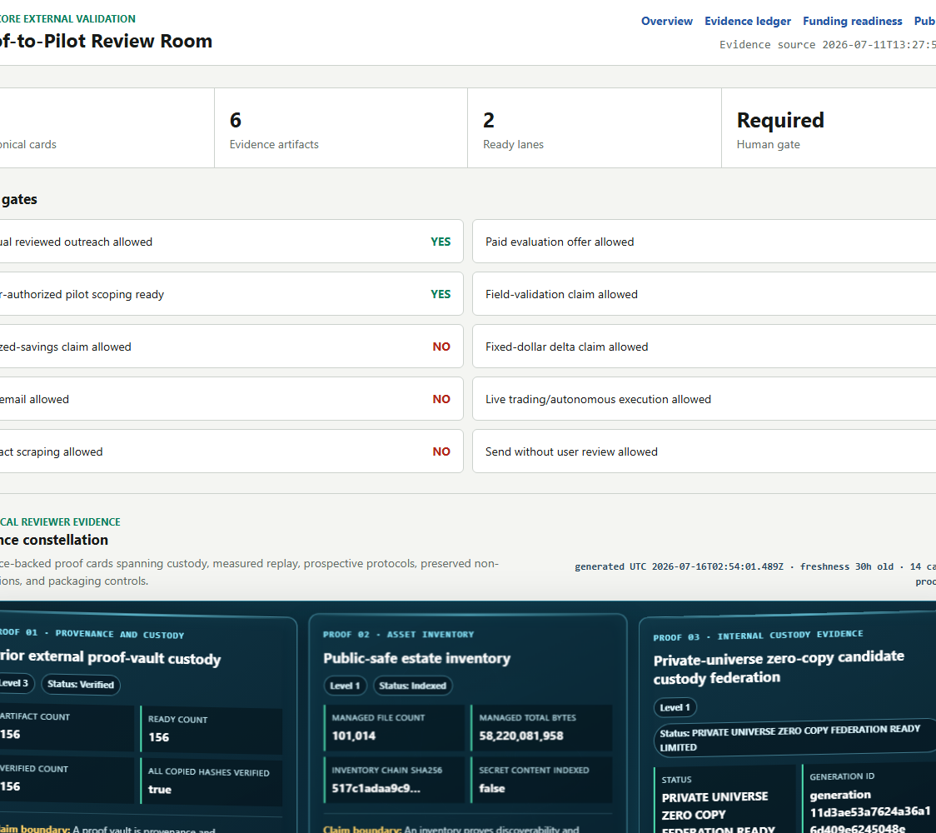
LUMENCORE
Proof-to-pilot AI validation
for energy and infrastructure
Turn a promising model into a decision a serious buyer can audit, reproduce, and price.
WORKING MVP
EXTERNAL VALIDATION NEXT
Robert Ashworth | Founder
Launch Tennessee 3686 | 2026
Product proof room | local reviewer view
LUMENCORE | 3686 PITCH APPLICATION | 2026-07-17
1/11

Slide 2
PROBLEM
02
AI scores arrive faster than buyer trust
In high-consequence operations, the buyer is not purchasing a score. The buyer is purchasing a defensible decision.
WHAT BREAKS TRUST
Data leakage
Future information contaminates the test.
A strong model can still fail procurement when the evidence trail cannot answer four basic questions.
Moving goalposts
Baselines or metrics change after results appear.
1
2
3
4
Hidden negatives
Only favorable runs survive into the deck.
Dataset identity
and allowed history
Baseline and
metric lock
Negative results
and uncertainty
Receipt, owner,
and next action
No custody trail
The artifact cannot be tied to code, data, or time.
LUMENCORE | 3686 PITCH APPLICATION | 2026-07-17
2/11

Slide 3
PRODUCT
03
One bounded workflow from claim to pilot
LumenCore makes the evidence path explicit before it makes the claim louder.
01
02
03
04
FREEZE
REPLAY
GATE
RECEIPT
Dataset, baseline, metric, window
Past-only execution with held-out windows
Uncertainty, abstention, and negative-result checks
Hash, custody record, owner, and pilot decision
HUMAN APPROVAL BEFORE EXTERNAL CLAIM
Output: a buyer-readable packet that can be reproduced, challenged, and converted into a scoped field pilot.
LUMENCORE | 3686 PITCH APPLICATION | 2026-07-17
3/11

Slide 4
CUSTOMER
04
Start where one bad decision is expensive
Initial wedge: organizations with costly reliability, planning, or forecasting errors and an existing baseline they already trust.
UTILITY / GRID
LAB / AGENCY
INDUSTRIAL RELIABILITY
BUYER
BUYER
BUYER
Analytics or operations lead
Program or technical lead
Reliability or asset lead
TRIGGER
TRIGGER
TRIGGER
A planning or forecasting model cannot clear internal review.
A research result needs a reproducible route to a field partner.
A failure-risk signal needs proof against the incumbent rule or model.
PILOT OUTCOME
PILOT OUTCOME
PILOT OUTCOME
Decision receipt + replay package
Reviewer packet + validation plan
Scoped pilot + economic acceptance gate
LUMENCORE | 3686 PITCH APPLICATION | 2026-07-17
4/11

Slide 5
EVIDENCE POSTURE
05
The MVP is real; the next value gate is external
PROVEN IN CURRENT ARTIFACTS
REQUIRES OUTSIDE EVIDENCE
Working review room
Field validation
Y
Canonical review cards and evidence artifacts present
!
Buyer-controlled data and accepted incumbent baseline
Y
Claim gates separate outreach from field validation
!
Independent reproduction by a named third party
Y
Hashable packets and custody records are supported
!
Measured operational or economic outcome
Y
Negative-result and abstention states remain visible
!
Reference customer, contract, or production deployment
What this supports today: a bounded buyer conversation and a reproducible pilot design.
No claim in this deck crosses this boundary. The application asks for the introductions and discipline needed to cross it.
LUMENCORE | 3686 PITCH APPLICATION | 2026-07-17
5/11

Slide 6
BUSINESS MODEL
06
Sell the proof path before the platform
Three offers create a low-friction entry, a paid validation event, and a repeatable expansion path.
1. EVIDENCE REVIEW
2. CONTROLLED PILOT
3. PLATFORM LICENSE
$5k-$10k
$20k-$50k
$60k-$150k / yr
Planning range
Planning range
Planning range
Scope the decision, lock the incumbent baseline, and produce a reviewer-ready evidence packet.
Replay on buyer-controlled data, measure against a preregistered acceptance gate, and issue a receipt.
Automate repeatable reviews, evidence custody, governance, support, and approved operating workflows.
Buyer: Technical sponsor
Buyer: Design partner
Buyer: Program owner
All pricing is a founder-review assumption. No paid pilot, customer commitment, or contract is claimed.
LUMENCORE | 3686 PITCH APPLICATION | 2026-07-17
6/11

Slide 7
COMPETITIVE LANDSCAPE
07
Positioned between model tooling and audit work
The wedge is not another model leaderboard. It is an evidence operating layer for decisions that must survive review.
REPEATABLE
LUMENCORE
TARGET POSITION
DISTINCTIVE CONTROLS
GENERIC
MLOPS
Past-only replay
Frozen baseline and metric
Visible negatives and abstention
Hashable custody receipt
Human release gate
CONSULTING /
AUDIT PROJECT
AD HOC
ANALYSIS
BESPOKE
LOW AUDITABILITY
HIGH AUDITABILITY
Positioning hypothesis; not a market-share or superiority claim.
LUMENCORE | 3686 PITCH APPLICATION | 2026-07-17
7/11

Slide 8
GO-TO-MARKET
08
Qualify one hard problem, prove it, then expand
The near-term objective is one serious design partner with controlled data and an accepted incumbent baseline.
01
02
03
QUALIFY
PROVE
EXPAND
Confirm the owner, decision, data rights, baseline, cost of error, and approval path.
Run a preregistered replay on buyer-controlled data and preserve every favorable and unfavorable result.
Convert the accepted pilot into repeatable workflows, annual support, and adjacent decisions.
Gate: written problem + baseline
Gate: accepted evidence receipt
Gate: paid renewal or license
90-DAY FOCUS
10 qualified conversations | 3 controlled-data design sessions | 1 paid or independently reproduced pilot
LUMENCORE | 3686 PITCH APPLICATION | 2026-07-17
8/11

Slide 9
EVIDENCE POSTURE
05
The MVP is real; the next value gate is external
PROVEN IN CURRENT ARTIFACTS
REQUIRES OUTSIDE EVIDENCE
Working review room
Field validation
Y
Canonical review cards and evidence artifacts present
!
Buyer-controlled data and accepted incumbent baseline
Y
Claim gates separate outreach from field validation
!
Independent reproduction by a named third party
Y
Hashable packets and custody records are supported
!
Measured operational or economic outcome
Y
Negative-result and abstention states remain visible
!
Reference customer, contract, or production deployment
What this supports today: a bounded buyer conversation and a reproducible pilot design.
No claim in this deck crosses this boundary. The application asks for the introductions and discipline needed to cross it.
LUMENCORE | 3686 PITCH APPLICATION | 2026-07-17
5/11

Slide 10
EVIDENCE POSTURE
05
The MVP is real; the next value gate is external
PROVEN IN CURRENT ARTIFACTS
REQUIRES OUTSIDE EVIDENCE
Working review room
Field validation
Y
Canonical review cards and evidence artifacts present
!
Buyer-controlled data and accepted incumbent baseline
Y
Claim gates separate outreach from field validation
!
Independent reproduction by a named third party
Y
Hashable packets and custody records are supported
!
Measured operational or economic outcome
Y
Negative-result and abstention states remain visible
!
Reference customer, contract, or production deployment
What this supports today: a bounded buyer conversation and a reproducible pilot design.
No claim in this deck crosses this boundary. The application asks for the introductions and discipline needed to cross it.
LUMENCORE | 3686 PITCH APPLICATION | 2026-07-17
5/11

Slide 11
THE ASK
Help us earn the first
independent proof receipt.
WHAT WE NEED FROM LAUNCHTN
01
Buyer introductions in energy and infrastructure
02
Pricing and pilot-scope discipline
LumenCore is ready for the next disciplined step: one buyer, one accepted baseline, one controlled dataset, and one result that another party can reproduce.
03
Pitch coaching grounded in evidence
04
3686 exposure to serious design partners
Robert Ashworth | Founder, LumenCore
Working MVP. Honest boundaries. External validation next.
LUMENCORE | 3686 PITCH APPLICATION | 2026-07-17
11/11

