Slide 1
4RA: Travelling-Platform
Barbu Robert Gabriel
Berbecaru-Iovan Andrei
Iftimi Ruxandra
Ionescu Radu-Constantin
Stefanoiu Rares-Andrei

Slide 2
This platform offers you a wide array of communication means with fellow tourists from the travelling community, offering you a unique environment well suited for discovering the best travel destination for your next trip.
This app supports group chats with text messages. These groups are based on specific individual destinations, ranging from local to international trips to bring people closer and create a sense of community and belonging.
Join us and let your once in a lifetime adventure start NOW!

Slide 3
Features list
reviews section
authentification system
roles administration system
modern design
description section for each location
navigation menu
calendar for available dates
search bar
booking services

Slide 4
Backlog creation
We used Trello for keeping track of the tasks https://trello.com/b/Y9VQDw32/travelling-platform

Slide 5
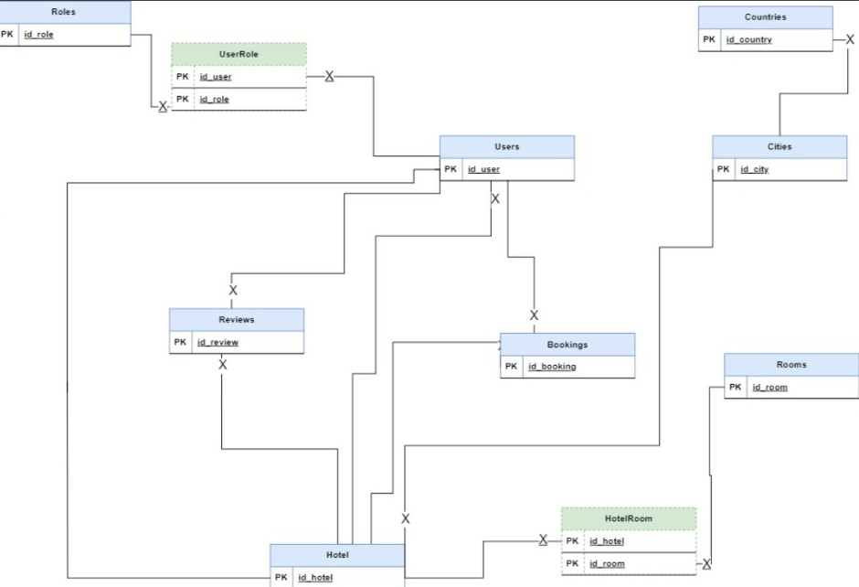
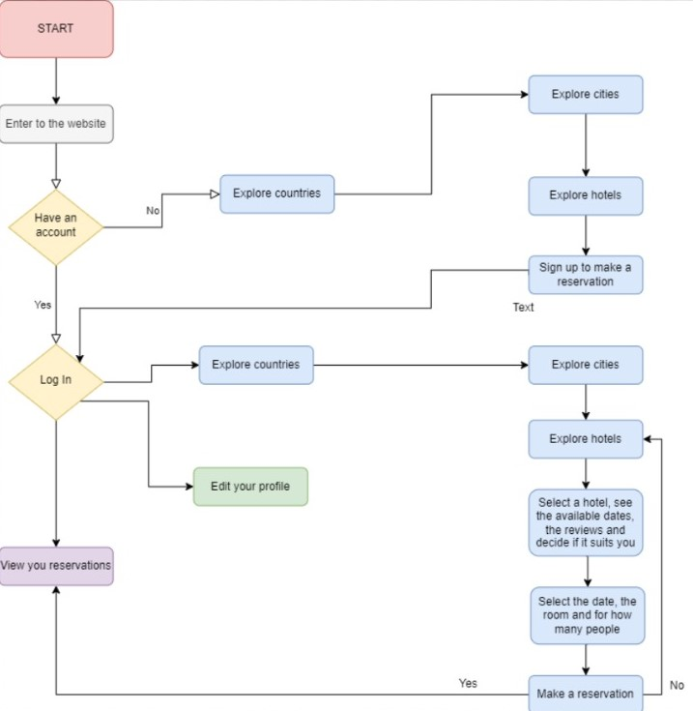
Diagrama UML si Workflow

Slide 6
User Stories
as a manager of a hotel I would like to edit the information for my hotel.
as a user I want to see informations about a possible holiday destination.
as a user I want to leave a review for hotels.
as an admin I want to create and administrate the places from the platform.
as a user I want to edit my informations if I completed them wrong.
as an admin I want to be able to delete reviews if they are inappropiate.
as a manager of a hotel I want to manage the rooms I have and add or remove them.
as a user I want an easy way to find a hotel in a country and city that I want.
as an admin I want to have different features for myself after I log in.
as a user I want to have photos and description for the countries, cities and hotels that I'm interested in.

Slide 7
AI usage
We used both chatGPT and GitHub Copilot for helping us with errors that we didn't resolve of for snippets of code for a quicker solution. We attached some screen shots of how we used AI in wiki.

Slide 8
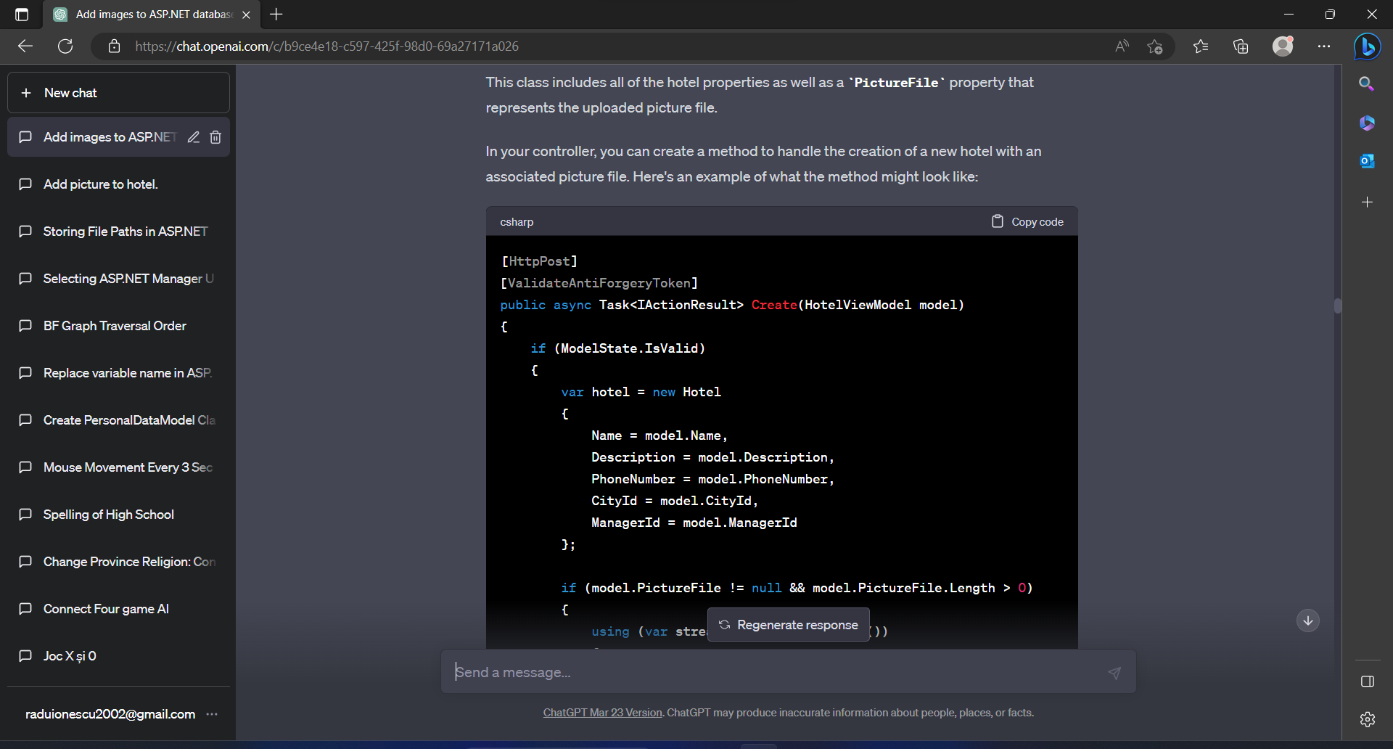
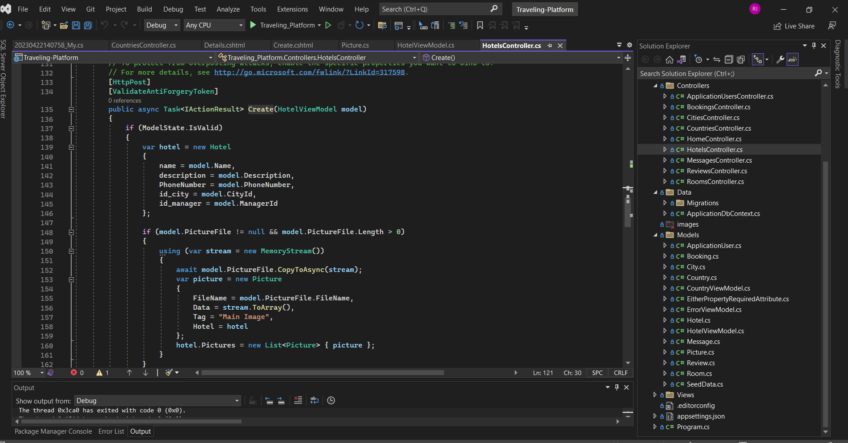

Slide 9
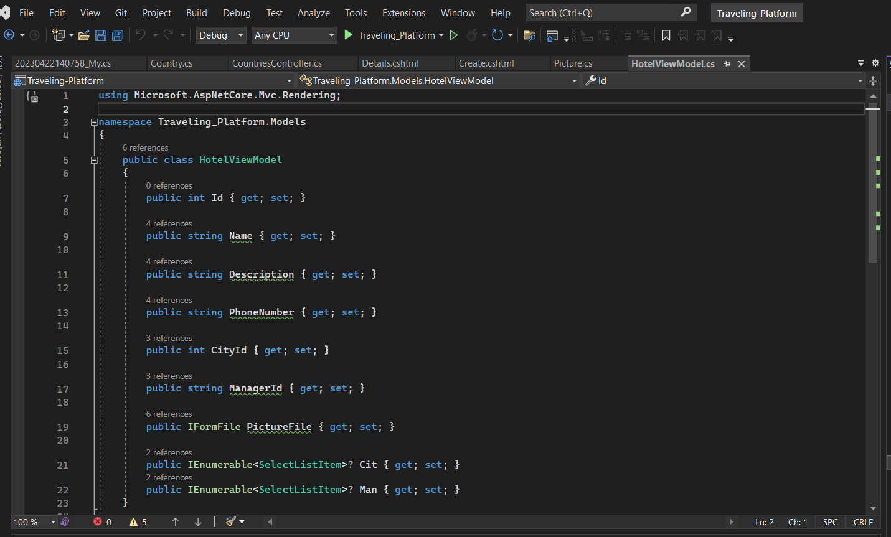
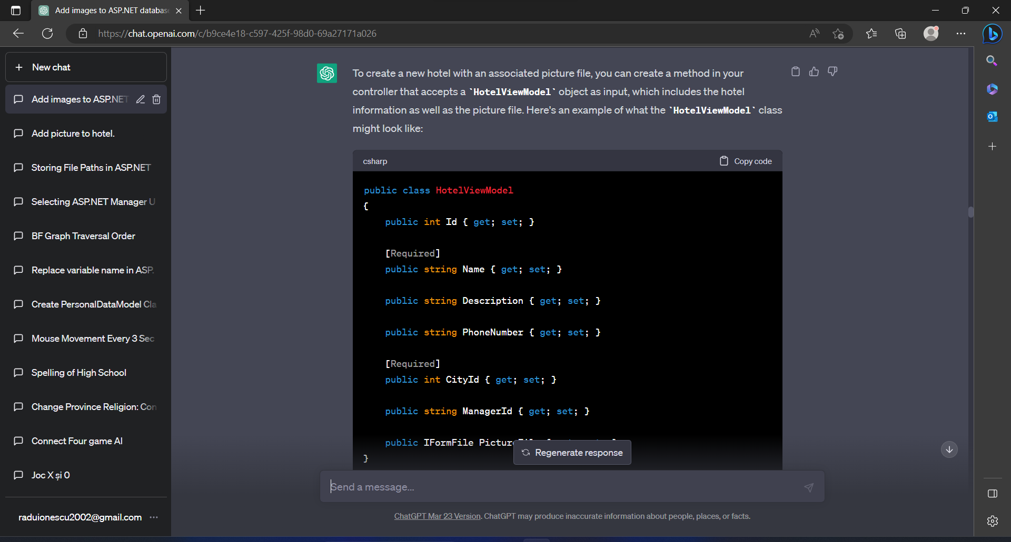

Slide 10
