Slide 1

ROBIN
Gamification Project
Robert Bastian · Paavan Buddhdev · Aiken Cairncross · James Dai · Alistair Gavin

Slide 2
What
Users who form part of a small group/team
Each user takes turns writing challenges for other users to solve
Multiple rounds, like an ongoing tournament
Each round of tournament has a question-master, who sets the challenge and timescale, and scores the solutions afterwards
Separate instance for each group – e.g. yourteamname.robin.com (like Slack)

Slide 3
Why
Our brief: teach programming, using elements of games to incentivise and encourage more learning.
System to create challenges for other users
Competition!
points & trophies
challenging users who you know

Slide 4
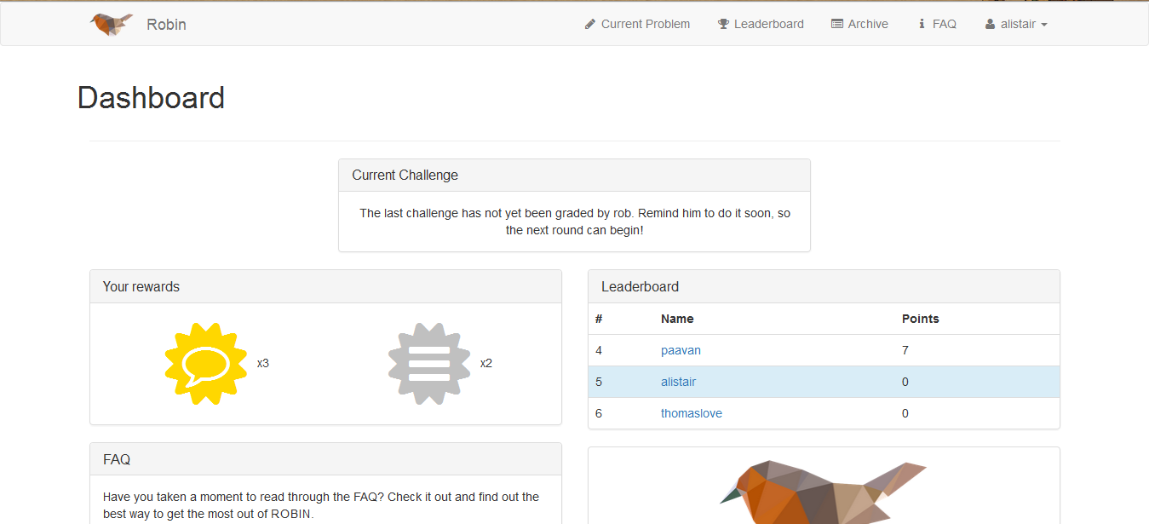
Problem lifecycle

Slide 5
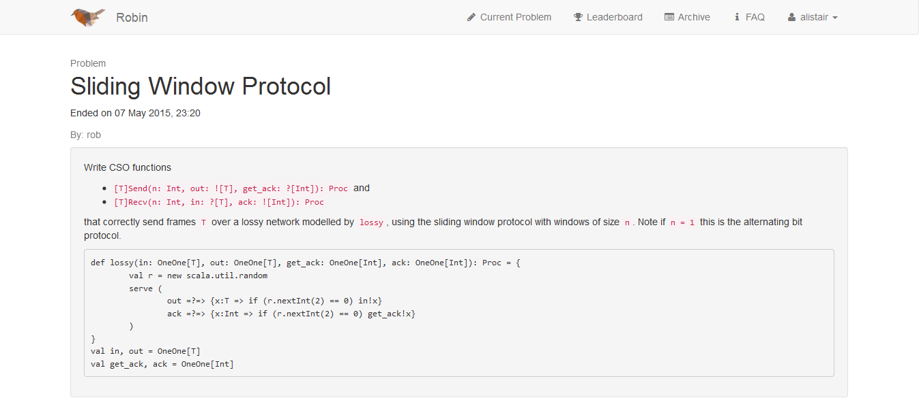
Problem lifecycle

Slide 6
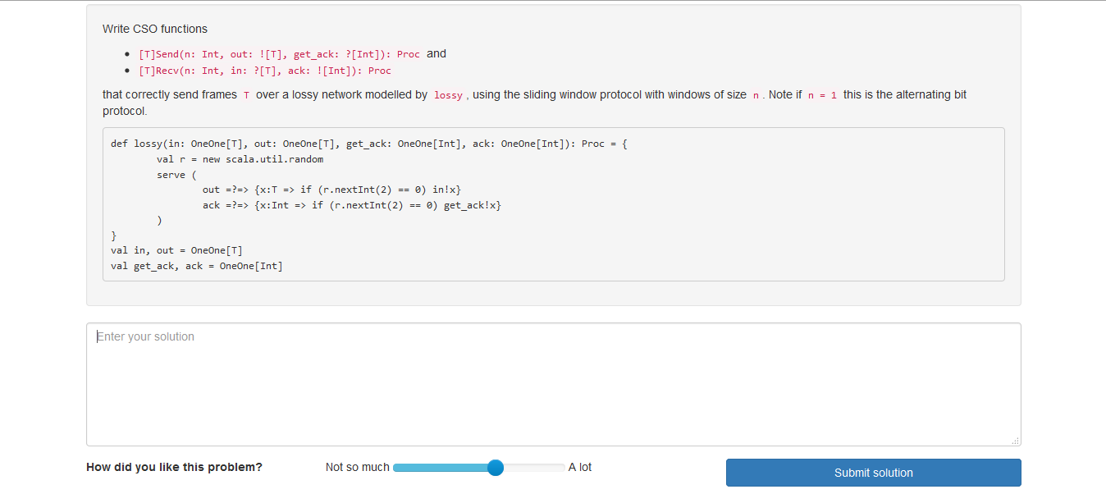
Problem lifecycle

Slide 7
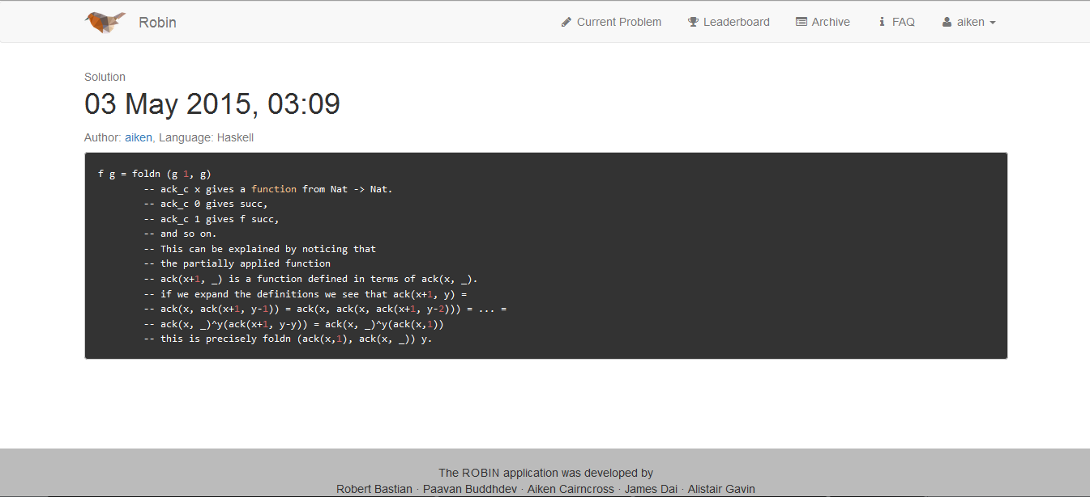
Problem lifecycle

Slide 8
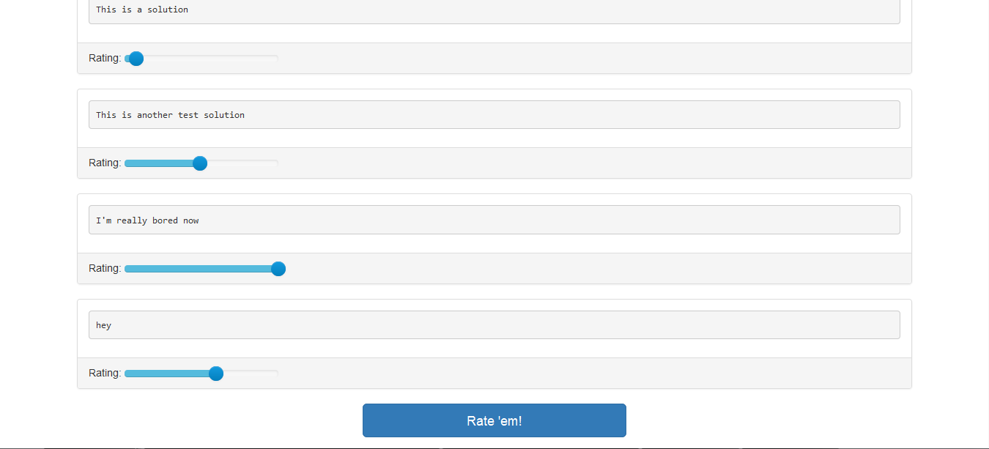
Problem lifecycle

Slide 9
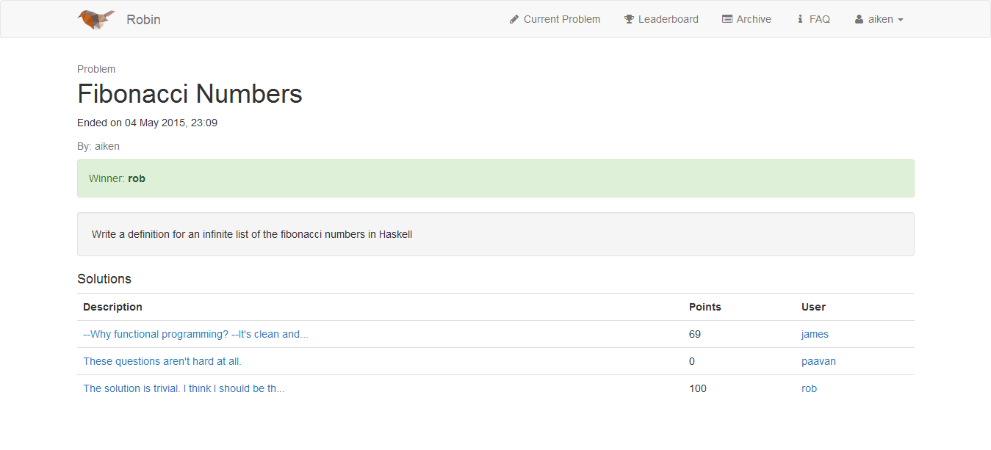
Problem lifecycle

Slide 10
States
Anyone is able to submit a challenge
When no previous problem
The QM can set a challenge
Previous challenge ended; that challenge’s winner is new QM
The solvers can submit solutions
QM has submitted challenge and it hasn’t expired
One solution for each solver
The QM can grade the solutions
All the registered users have submitted solutions OR expiry time reached

Slide 11
Structural base
Ruby-on-Rails (and SQLite)
Widely used ∴ widely documented
Fast and powerful
Ruby was new to us so good to try out
Bootstrap
Elements for alerts etc. built-in
Huge range of structural elements – e.g. our FAQ uses an accordion, alerts returned use warning/danger classes to stand out, etc.

Slide 12
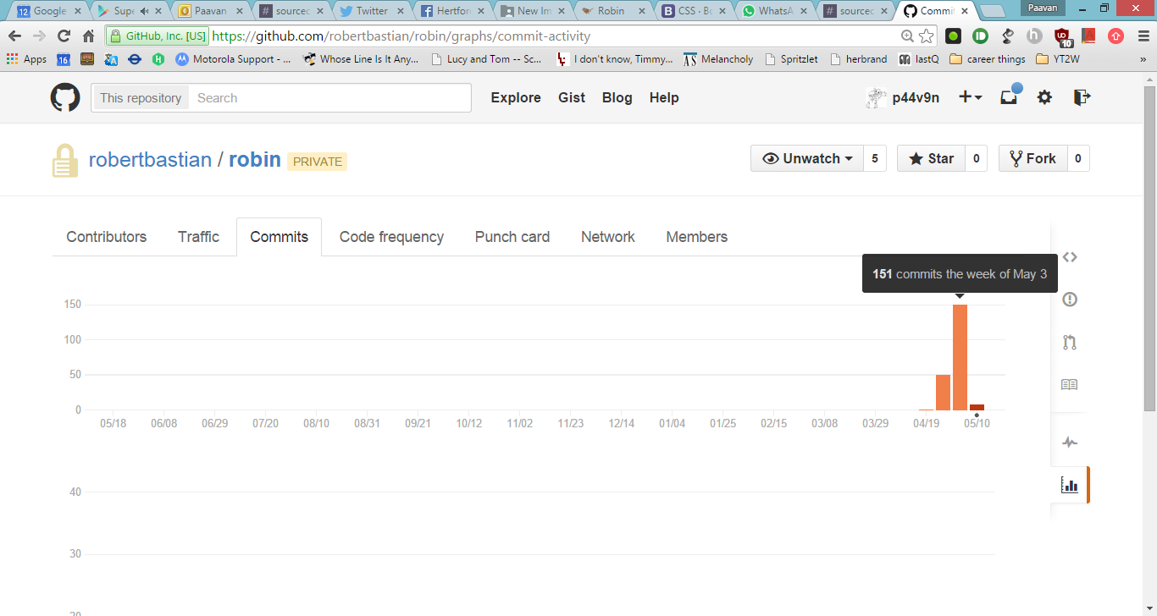
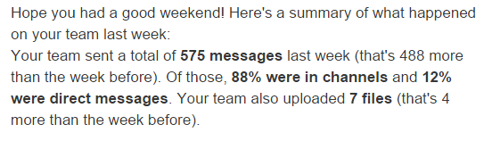
Group dynamics
Kept up using Slack and Git!
We had a late start (but hey, who didn’t…)
Each of us had individual roles with lots of room for overlap
Windows vs Unix

Slide 13


Huge thanks to Ivo (our supervisor),
and to Tom (our sponsor from Palantir),
and to all of you for listening!

