Slide 1
PSICS (parallel stochastic ion channel simulator)
Problem domain
History and development process
Algorithms
Model specification and usage
Comparison with other systems
Icing – user interface for channel distributions

Slide 2
Ion channels are discrete entities, either open or closed
What if you model them this way?
HH
x 3
General
Kinetic schemes
More realistic, less temperamental,
different properties?
...spontaneous activity, stochastic resonance, propagation failures, “symmetry breaking”,...

Slide 3
Matt Nolan + Textensor Ltd. - discussions and estimates
BBSRC Tools and Resource application
Awarded
Work starts
No delays hiring
people,
no relocation or
startup costs
Formal contract drawn up with Edinburgh University
Payments dependent on milestones being met
Calculations
Documentation
Even the boring bits get done because the contractor gets paid to do them.
Examples
Validation, etc
........
Completion
Months
0
4
8
12
16
20
24

Slide 4
Ways to write a simulator
Model specification
Generic ODE
solver
Flexibility
Extensibility
User defined
components
Ease of use
Writability
(development costs)
Model specification
Plugin
architecture
Scope
Validability
3rd party
implementations
3rd party
implementations
3rd party
implementations
Performance
Specification-specific
implementation
Model specification

Slide 5
Evaluate local channel densities
as continuous functions of
position on the cell
Allocate channels with
exact 3D positions
Discretize the morphology
and associate channels
with compartments
Java
Convert HH style channels
to Kinetic Schemes
Evaluate transition rates on a grid
of fixed potentials (with dynamically
compiled code if necessary)
Fortran
Export a standard specification
of the model with the cell
discretized and all rates tabulated
4% code,
99% runtime
Read standard format and
compute results
Generate figures and web
pages from the results

Slide 6
Choice of algorithms - Objectives
Model (channel numbers and positions, capacitance, distances etc) should be independent of spatial discretization and choice between stochastic and continuous calculation.
Accuracy/efficiency trade-off
  Channels on isopotential compartments are genuinely interchangeable
  Is the RNG the dominant cost (it should be)
  How few random numbers can you get away with?

Slide 7
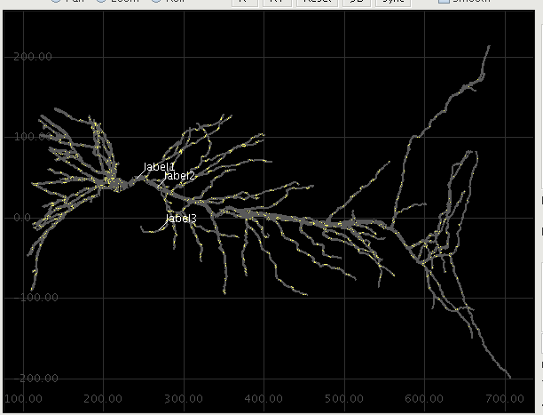
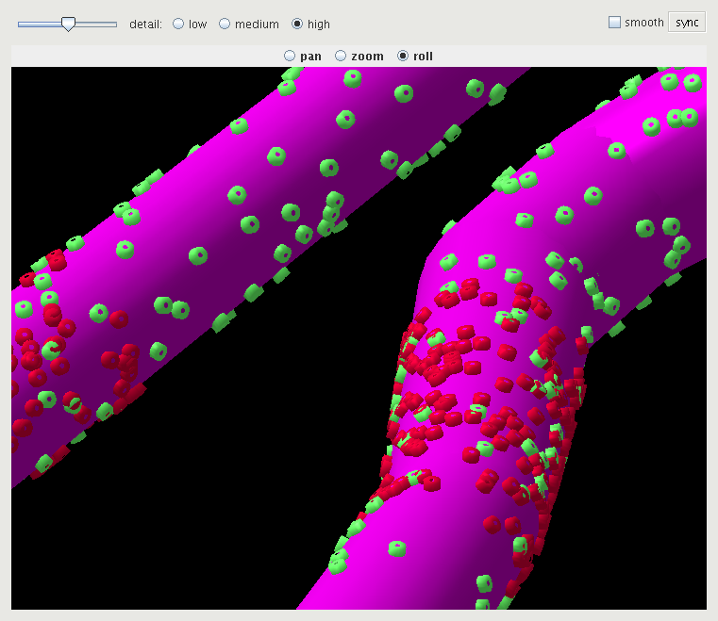
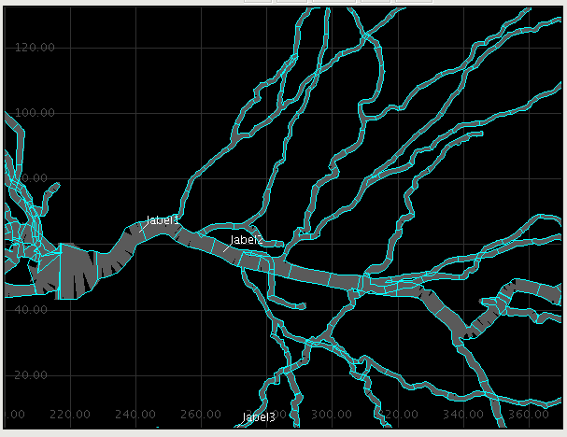

Slide 8
Channel updates
At a given potential, the probability of occupying a given state, pi evolves as
dp/dt = M p
so for a fixed interval δt,
pt+δt = e^{Mδt} p
Given n channels in state pi at time t, where are they at time t + δt ?
Slow method: generate n uniform rvs, rk, and sample row i of e^{Mδt} to generate n new
states. Subtract elements from rk until you reach zero – thats the selected state.
Better: sort row i of e^{Mδt} to put the largest element first (so most loops terminate at the
first comparison)
Better still: sort row i and then only sample m out of n channels (m << n) restricted to the
range (1 – m/n, 1). ie, only consider those channels that have a non-negligible chance of
changing state this step. Under normal conditions, almost all channels are in the same
state at the end of a step as they are at the beginning.

Slide 9
Assume the last section gets its exact share of points and only generate
these. Sometimes will underestimate the number falling in the colored area.
Pick bounds to keep this rare enough to ignore.

Slide 10
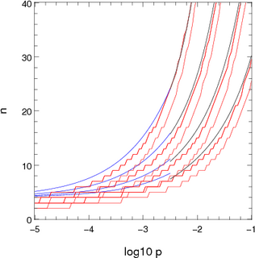
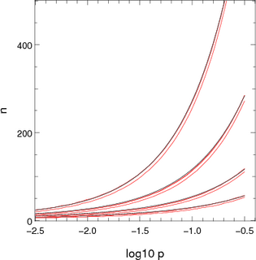
nc = 4 + 8 * sqrt(n p) for p < 0.003
nc = 6 + 5 * log n + n p0.5 + 0.12 * log n + 4 log p for 0.003 < p < 0.15
Approximations used for computing the number of channels to consider stochastically when there is one dominant destination. The x-axis shows log10 p where p is the probability of not ending up in the dominant location. The pairs or red lines show the points where the chance of n channels not ending up in the dominant destination are 10⁻⁵ and 10-⁷. The blue and black lines show the two approximations presented above. The different sets of lines correspond to different population sizes: 2000 (top set), 700, 250 and 100 (bottom set).

Slide 11
Design issues
Separate one-off preprocessing from core calculations
Get as much as possible in the former: run user-defined code there and tabulate the results
Core calculations work on standardized tables
Fortran offers lots of advantages here:
  Multi-dimensional arrays
  Modules and data structures rather than objects and methods
  Range of sizes for reals (useful to keep within the cache)
  Compiler directives (non addressable arrays, fixed allocation)
  Data-parallel statements (nice to write but slower on a single core)
  Format based IO

Slide 12
Model Specification
Collection of XML files – 100% declarative
  Channel kinetics
  Membrane properties (channel distribution)
  Environment
  Stimulation and recording
  Morphology
  Master file combining references to the others, control parameters, and output visualization

Slide 13
rallpack3/cell.xml
<CellMorphology id="cell">
<Point id="p0" x="0" y="0" z="0" r="0.5" />
<Point parent="p0" id="p1" x="1000" y="0" z="0" r="0.5" />
</CellMorphology>
rallpack3/environment.xml
<CellEnvironment id="environment">
<Ion id="LEAK" name="Non-specific leak" reversalPotential="-65mV" />
<Ion id="K" name="Potassium" reversalPotential="-77mV" />
<Ion id="Na" name="Sodium" reversalPotential="50mV" />
</CellEnvironment>
rallpack3/membrane.xml
<CellProperties id="membrane" cytoplasmResistivity="100ohm_cm" membraneCapacitance="1uF_per_cm2">
<ChannelPopulation channel="leak" density="25per_um2" />
<ChannelPopulation channel="HH_Na" density="60per_um2" />
<ChannelPopulation channel="HH_K" density="18per_um2" />
</CellProperties>
rallpack3/HH_K.xml
<KSChannel id="HH_K" permeantIon="K" gSingle="20pS">
<KSComplex id="n" instances="4">
<ClosedState id="c" />
<OpenState id="o" />
<ExpLinearTransition from="c" to="o" rate="0.1per_ms" midpoint="-55.mV" scale="10mV" />
<ExpTransition from="o" to="c" rate="0.125per_ms" midpoint="-65.mV" scale="-80mV" />
</KSComplex>
</KSChannel>
rallpack3/recording.xml
<Access id="recording">
<CurrentClamp at="p0" lineColor="red" hold="0.1nA">
</CurrentClamp>
<VoltageRecorder at="p1" lineColor="blue" />
</Access>

Slide 14
rallpack3/HH_Na.xml
<KSChannel id="HH_Na" permeantIon="Na" gSingle="20pS">
<KSComplex id="m" instances="3">
<ClosedState id="c" />
<OpenState id="o" />
<ExpLinearTransition from="c" to="o" rate="1.per_ms" midpoint="-40.mV" scale="10mV" />
<ExpTransition from="o" to="c" rate="4.per_ms" midpoint="-65.mV" scale="-18mV" />
</KSComplex>
<KSComplex id="h">
<ClosedState id="c" />
<OpenState id="o" />
<ExpTransition from="c" to="o" rate="0.07per_ms" midpoint="-65.mV" scale="-20.mV" />
<SigmoidTransition from="o" to="c" rate="1per_ms" midpoint="-35mV" scale="10mV" />
</KSComplex>
</KSChannel>
rallpack3/run.xml
<PSICSRun timeStep="0.1ms" runTime="250ms" startPotential="-65mV" morphology="cell" environment="environment"
properties="membrane" access="recording" stochThreshold="0">
<StructureDiscretization baseElementSize="1um" />
<info>Cable with HH sodium and potassium channels, different timesteps</info>
<RunSet vary="timeStep" values="[10, 20, 50, 100]us" filepattern="ts-$" />
<ViewConfig>
<LineGraph width="500" height="400">
<XAxis min="0" max="250" label="time / ms" />
<YAxis min="-80" max="60" label="potential / mV" />
<Line file="ref_axon_0_neuron.txt" color="white" width="1" rescale="[1000, 1000.]" />
<Line file="ref_axon_x_neuron.txt" color="white" width="1" rescale="[1000, 1000.]" />
<LineSet file="ts-10.txt" color="red" />
<LineSet file="ts-20.txt" color="blue" />
<LineSet file="ts-50.txt" color="cyan" />
<LineSet file="ts-100.txt" color="green" />
<View id="whole" xmin="-10." xmax="260." ymin="-100." ymax="80." />
<View id="start" xmin="0." xmax="30." ymin="-100." ymax="80." />
<View id="end" xmin="210." xmax="255." ymin="-100." ymax="80." />
</LineGraph>
</ViewConfig>
</PSICSRun>

Slide 15
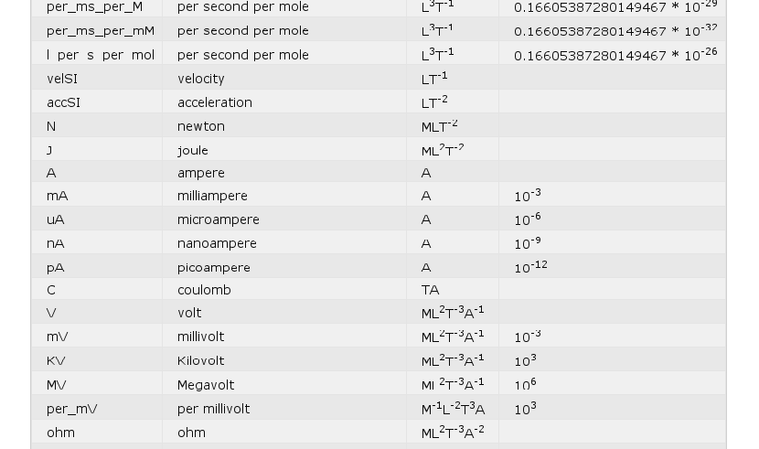
Units
Almost all dimensional quantities require units
Most commonly used unit choices are accepted

Slide 16
(Embarrassing) Parallelization
Most model specifications involve multiple runs
  multiple realizations with different seed
  Parameter sweeps
Each run is defined in a single file for the Fortran core calculations
In a parallel environment (GridEngine) these are automatically submitted as separate jobs
Otherwise, they are run sequentially
Final plots and documentation are submitted as a job that depends on completion of the others

Slide 17
Comparisons
PSICS
No interpreter – declarative only
Efficient for stochastic channels
Units supplied with quantities
Irregular shaped compartments
User extensions only at preprocessing stage – important?
Command line only
Partial input of NeuroML
No synapses, calcium dynamics or networks yet
Others
Interpreters – Hoc, Python etc
Neuron has Gillespie (exact but slow) method
Implicit unit sets or user's responsibility
Cell gets straightened
Coded user extensions
GUIs
Minimal if any?

Slide 18
ICING (interactive channel insertion gui)
Facilitate creation of membrane properties XML files
1-1 correspondence with model specification schema
Generates XML that is still hand-editable
Visualization of the effects of particular parameter choices

Slide 19
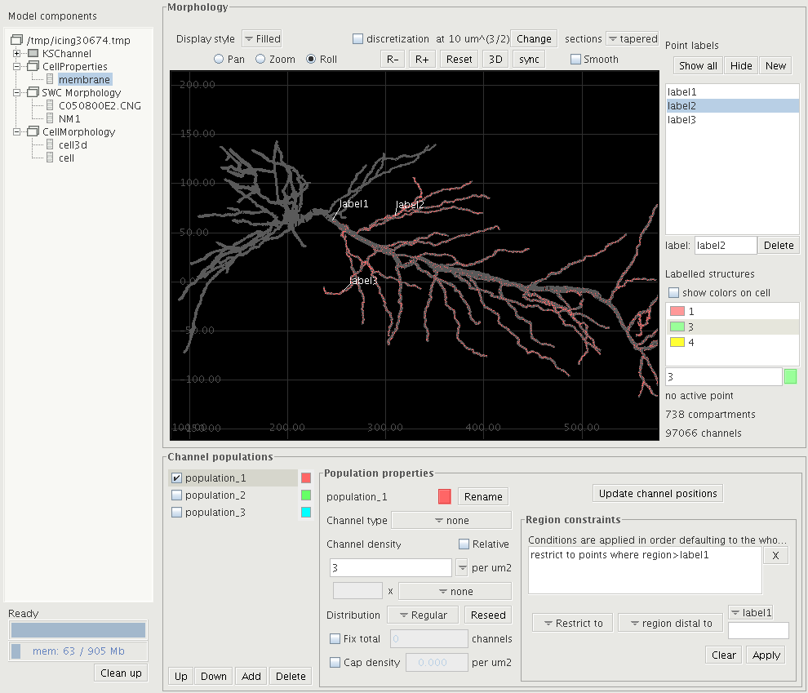

Slide 20
