Slide 1
Executing LEMS models via LEMS-Lite
Familiar old problem
  Published descriptions of models in neuroscience are almost always inadequate for reproducing results.
  You can't do much science if you can't analyze, extend, reuse or build upon other people's work.
Familiar old solution
  Declarative model descriptions using basic design principles form software engineering: separate logic (equations) from data (parameter values); avoid duplication; think about your design and refactor as needed.
  As implemented in LEMS-NeuroML, NineML, SpineML, SBML.

Slide 2
What next?
How do you execute models?
  Map NeuroML/LEMS models to existing tools, such as Neuron
  New simulators designed for the LEMS data model. jLEMS, pyLEMS
  Generate code for general purpose compilers
  Generate code for custom hardware

Slide 3
LEMS
Embeds knowledge of:
Physics – dimensionality
Geometry – containment,
adjacency, trees,
1-D skeleton of 3-D tree
Source code for
general purpose
hardware
?
Source code for
custom
hardware

Slide 4
LEMS
Embeds knowledge of:
Physics – dimensionality
Geometry – containment,
adjacency, trees,
1-D skeleton of 3-D tree
Single-step code generation embeds a lot of knowledge – physics, geometry, and numerics.
We've swapped a monolithic simulator for a monolithic code generator.
X
Source code for
general purpose
hardware

Slide 5
LEMS
Embeds knowledge of:
Physics – dimensionality
Geometry – containment,
adjacency, trees,
1-D skeleton of 3-D tree
Stage 1:
Remove physics and
Geometry. Keep ODEs
Flat LEMS model
Still expressed in LEMS
Comparble to NineML
Stage 2:
Combine with declarative representation of numerics
ODEs → update rules
Numerical Integration Schemes
Euler, RK4 etc
LEMS-Lite
Components, Arrays, Update rules
No geometry
No ODEs
No neuroscience terms
Source code for
general purpose
hardware
Code for custom
hardware

Slide 6
What next?
How do you execute models?
  Map NeuroML/LEMS models to existing tools, such as Neuron
  New simulators designed for the LEMS data model. jLEMS, pyLEMS
  Generate code for general purpose compilers
  Generate code for custom hardware

Slide 7
What next?
How do you execute models?
  Map NeuroML/LEMS models to existing tools, such as Neuron
  New simulators designed for the LEMS data model. jLEMS, pyLEMS
  Generate code for general purpose compilers
  Generate code for custom hardware

Slide 9
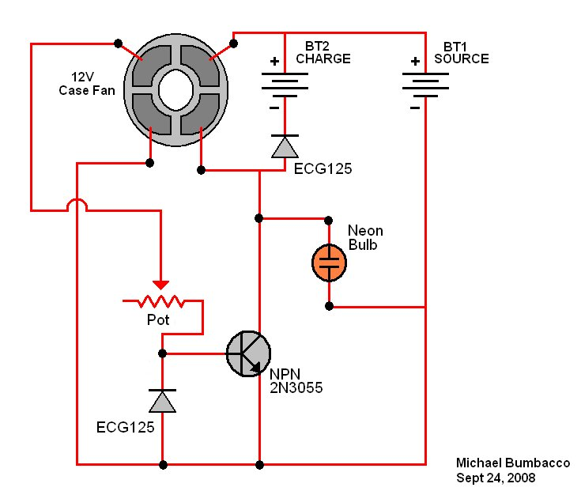
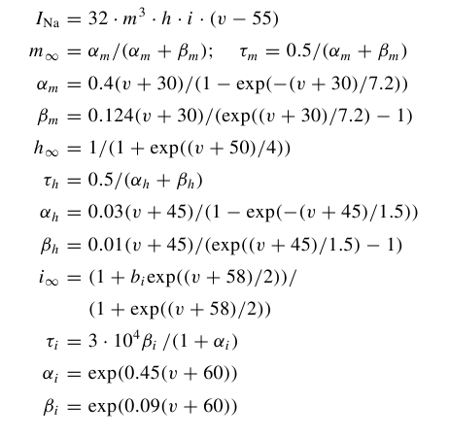
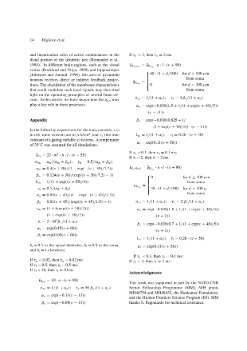
Electrical Circuit
Shared understanding
Not restated every time
Kirchoff's
Laws
etc, etc...
I₁ + i₂ + i₃ = 0
I₄ – i₃ + i₅ = 0
Etc
+
Abstracting Kirchoff's laws as shared knowledge allows a mode to be communicated at the diagram rather than equation level.
(eg) Hodgkin Huxley ion
channel model
?
?
+

Slide 10
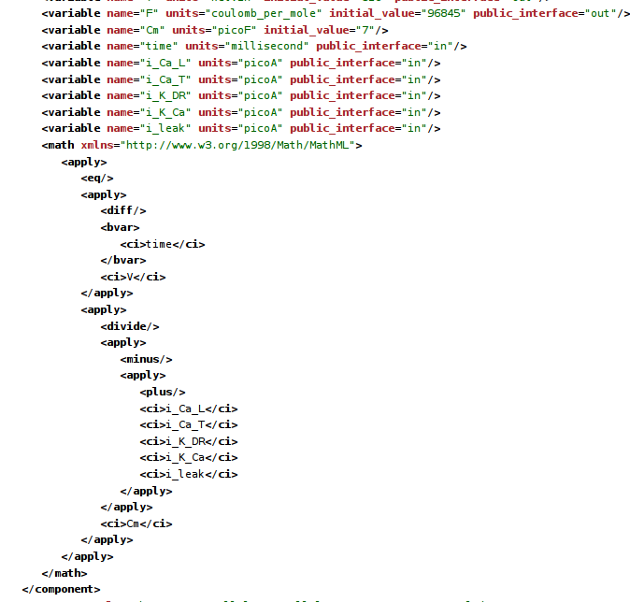
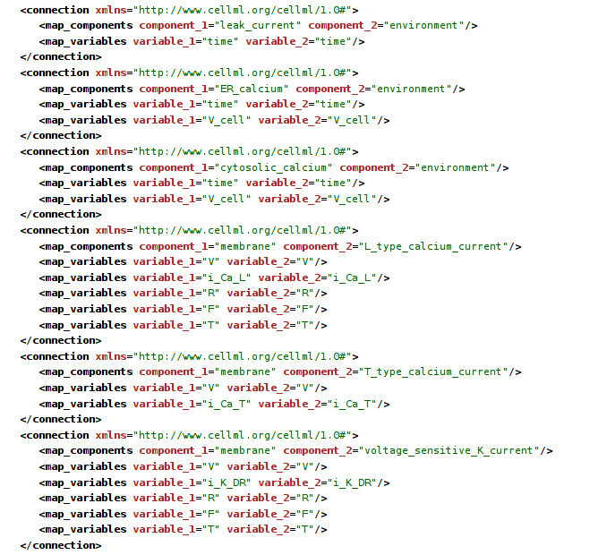
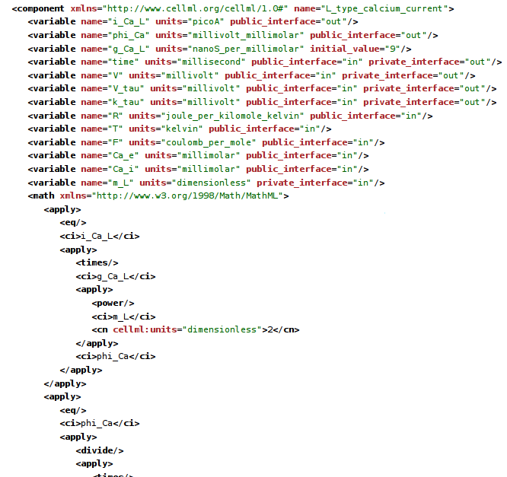
What not to do...
3 of about 30 pages that constitute
the CellML representation of a fairly
simple HH based cell model.
Says C dV/dt = ∑i,
… but without using ∑
All the currents are enumerated explicitly

Slide 11
What actually is the model?
Original HH model and almost all derivatives have:
Serial independent gates
Gate opening and closing governed by a rate expression with one of three forms:
    exp(V)
    exp(V) / (1+exp(v))
    V / (1 – exp(-V))
Each rate expression has three parameters – V scale, Rate scale, V offset
rate
V

Slide 12
NeuroML exploits this structure to allow concise expression of HH style models: (this is actually the PSICS form, but its pretty much equivalent)
<KSChannel id="HH_Na" permeantIon="Na" gSingle="20pS">
<KSComplex id="m" instances="3">
<ClosedState id="c"/>
<OpenState id="o"/>
<ExpLinearTransition from="c" to="o" rate="1.per_ms" midpoint ="-40.mV" scale="10mV"/>
<ExpTransition from="o" to = "c" rate="4.per_ms" midpoint="-65.mV" scale="-18mV"/>
</KSComplex>
<KSComplex id="h">
<ClosedState id="c"/>
<OpenState id="o"/>
<ExpTransition from="c" to="o" rate="0.07per_ms" midpoint="-65.mV" scale="-20.mV"/>
<SigmoidTransition from="o" to="c" rate="1per_ms" midpoint="-35mV" scale="10mV"/>
</KSComplex>
</KSChannel>
<KSChannel id="HH_K" permeantIon="K" gSingle="20pS">
<KSComplex id="n" instances="4">
<ClosedState id="c"/>
<OpenState id="o"/>
<ExpLinearTransition from="c" to="o" rate="0.1per_ms" midpoint ="-55.mV" scale="10mV"/>
<ExpTransition from="o" to = "c" rate="0.125per_ms" midpoint="-65.mV" scale="-80mV"/>
</KSComplex>
</KSChannel>
But this depends on external definitions for the element types.
What if we want to express the whole lot from scratch?

Slide 13
Need a way to express -
The structures shared by many models, once
For a particular model, just the parts unique to that model, with a reference to the shared structure
Without editing the schema/specification every time – neuroscience models are just too diverse.
Similar principle to:
Modelica (mechanical systems)
VHDL (electronic design)
NineML (networks and more)
...and others
Desired content of the
top layer of the model
specification
<Include file="hhchannel.xml" />
<Unit symbol="mV" dimension="voltage" powTen="-3" />
<Unit symbol="per_ms" dimension="per_time" powTen="3" />
<Unit symbol="pS" dimension="conductance" powTen="-12" />
<HHChannel id="na" conductance="20pS">
<HHGate id="m" power="3">
<Forward type="HHExpLinearRate" rate="1.per_ms" midpoint="-40mV" scale="10mV" />
<Reverse type="HHExpRate" rate="4per_ms" midpoint="-65mV" scale="-18mV" />
</HHGate>
<HHGate id="h" power="1">
<Forward type="HHExpRate" rate="0.07per_ms" midpoint="-65.mV" scale="-20.mV" />
<Reverse type="HHSigmoidRate" rate="1per_ms" midpoint="-35mV" scale="10mV" />
</HHGate>
</HHChannel>
<HHChannel id="k" conductance="20pS">
<HHGate id="n" power="4">
<Forward type="HHExpLinearRate" rate="0.1per_ms" midpoint="-55mV" scale="10mV" />
<Reverse type="HHExpRate" rate="0.125per_ms" midpoint="-65mV" scale="-80mV" />
</HHGate>
</HHChannel>
Syntactic fiddles:
“<XXX .../>”
is shorthand for
“<Component type='XXX'/>”
“a='value unit'”
is shorthand for
“<value parameter='a'
size='val'
unit='unit'/>'

Slide 14
<Dimension name="voltage" m="1" l="2" t="-3" i="-1" />
<Dimension name="time" t="1" />
<Dimension name="per_time" t="-1" />
<Dimension name="conductance" m="-1" l="-2" t="3" i="2" />
<Dimension name="capacitance" m="-1" l="-2" t="4" i="2" />
<Dimension name="current" i="1" />
<ComponentType name="HHRate">
<Parameter name="rate" dimension="per_time" />
<Parameter name="midpoint" dimension="voltage" />
<Parameter name="scale" dimension="voltage" />
<Behavior>
<IndependentVariable name="v" dimension="voltage" />
<DerivedVariable name="r" dimension="per_time" />
</Behavior>
</ComponentType>
<ComponentType name="HHExpRate" extends="HHRate">
<Behavior inherit="variables">
<DerivedVariable name="r" value="rate * exp((v - midpoint)/scale)" />
</Behavior>
</ComponentType>
<ComponentType name="HHSigmoidRate" extends="HHRate">
<Behavior inherit="variables">
<DerivedVariable name="r" value="rate / (1 + exp(0 - (v - midpoint)/scale))" />
</Behavior>
</ComponentType>
<ComponentType name="HHExpLinearRate" extends="HHRate">
<Behavior inherit="variables">
<DerivedVariable name="x" value="(v - midpoint) / scale" />
<DerivedVariable name="r" value="rate * x / (1 - exp(0 - x))" />
</Behavior>
</ComponentType>

Slide 15
<ComponentType name="HHGate">
<Parameter name="power" dimension="none" />
<Child name="Forward" type="HHRate" />
<Child name="Reverse" type="HHRate" />
<Behavior>
<IndependentVariable name="v" dimension="voltage" />
<StateVariable name="q" dimension="none" />
<ExternalVariable name="rf" dimension="per_time" select="Forward/r" />
<ExternalVariable name="rr" dimension="per_time" select="Reverse/r" />
<TimeDerivative variable="q" value="rf * (1 - q) - rr * q" />
<DerivedVariable name="fcond" dimension="none" value="q^power" />
</Behavior>
</ComponentType>
<ComponentType name="HHChannel">
<Parameter name="conductance" dimension="conductance" />
<Children name="gates" type="HHGate" min="0" max="4" />
<Behavior>
<IndependentVariable name="v" dimension="voltage" />
<ExternalVariable name="gatefeff" dimension="none"
select="product(gates[*]/fcond)" />
<DerivedVariable name="g" value="conductance * gatefeff" />
</Behavior>
</ComponentType>
With these definitions in place, most of the ion channel models in the modeling literature can
be expressed in 10 or 15 lines of XML.

Slide 16
Why “LEMS” - Low Entropy Model Specification?
c.f. Kolmogorov complexity, or algorithmic entropy:
abababababababababababababababababababababababab = 24(ab)
aeagarg89dafgertdfgbsdrgtqewrsae4lgi7hdf89bkfsdsg0efhe (nothing shorter than itself)
The first string has lower entropy and the simple coding scheme lets it be expressed in a
way that makes this clear.
LEMS is about doing the same thing for biological models.
Several benefits:
1) Easier for people to read and understand the concise form
2) Can be mapped onto other representations (easier to increase entropy than reduce it)
3) Allows a notion of “proximity” on models ( “24(ab)” is near “25(ab)” and 24(ac)”)
- crucial when each model is just a single point in an infinite parameter space
4) Less repetition helps with implementation and validation

Slide 17
Component type
definitions
Component
definitions
Hypothetical fully-
expanded model
Dimensions and Equations
Hand-written in XML
Possibly machine generated in some cases
Concise, and relatively few of them
Need referencing and selection mechanisms operating across types.
  eg to say the relative conductance of a channel is the product of the relative conductances of its gates
Units and Parameter values
Can be hand-written in XML by a modeler, possibly generated
Need references and selections across a model
  Eg to specify the channel model to use for a particular collection of channels
Also need references and selections across the (hypothetical) instantiated model
  Eg to select cells for a particular connectivity pattern (targets don't exist in the XML)
Simulator state as nesting structure and dimensional quantities
One entry for every cell in a network, every state variable in a simulation.
Could be used to simulate a model (but not a very efficient way of doing it)
In general, may never be generated
But can still write xpath or equivalent to operate over it

Slide 18
Paths and references – cases to be addressed
Component type definition refers to state variables in related type definitions
    Eg channel has gates; channel definition refers to properties of those gates. Note at this stage we have no particular channel in mind, so the gate components do not exist at the definition level.
Component has a path to another component
    Eg channel component refers to a “sodium” component for its permeant ion. Type definition needs to look up that ion in some environment object to get its reversal potential.
Run-time instance needs a path to another run-time instance
    Eg cells connected by gap junctions or synapses

Slide 19
Hierarchical type definitions provide a natural way to handle “build-time” connections
A channel type definition can refer to its child gates in a generic way without knowing what they are
Almost the same mechanism applies for children that are dynamically generated synapse objects
    Parent type definition specifies that instances of components of the corresponding type can have children of a particular type in a particular container
    Dynamics can specify what is done with them (summing currents etc) based on the container they are in – no need to explicitly wire ports together.
      Requires a notion of type inheritance
      “Containment” concept avoids the need to explicitly connect the membrane potential from parent to child synapse

