Slide 1
NeuroML 2.0 and LEMS
Motivation for LEMS
Defining Component Classes and Components
Structure of models
Similar goals to NineML
Will focus on two areas not yet addressed by NineML
    Hierarchical component types
    Connecting components together

Slide 2
Motivation
From the NeuroML meeting in Arizona, March 2010 report:
    “Discussion focused around two main topics: a possible structure for a more modular and flexible synapse specification; and the wide range of synaptic phenomena that might or might not be expressible in such a structure.”
    “... would need to express a wide range of possible behaviors and could include kinetic scheme elements as for the channel specification, state variables governed by differential equations or reaction networks expressed as SBML”
Essentially, how can you keep the clarity and simplicity of domain specific “top level elements”, but also allow it to be easily extended with new types of component?

Slide 3
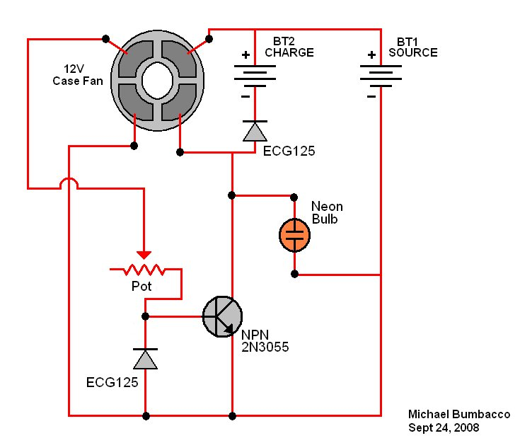
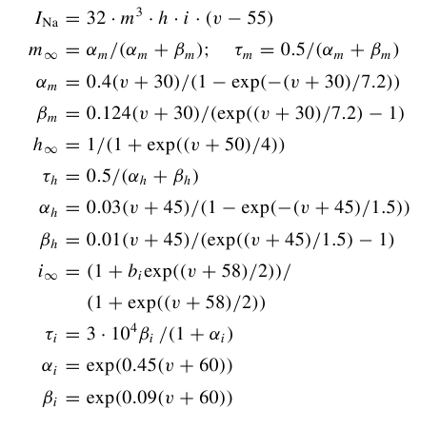
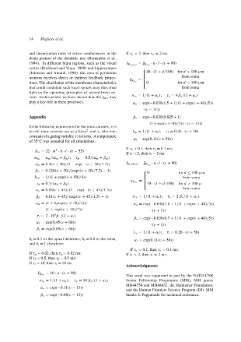
Electrical Circuit
Shared understanding
Not restated every time
Kirchoff's
Laws
etc, etc...
I₁ + i₂ + i₃ = 0
I₄ – i₃ + i₅ = 0
Etc
+
Abstracting Kirchoff's laws as shared knowledge allows a mode to be communicated at the diagram rather than equation level.
(eg) Hodgkin Huxley ion
channel model
?
?
+

Slide 4
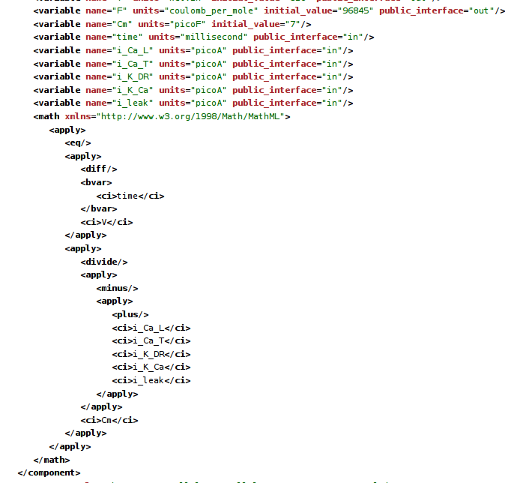
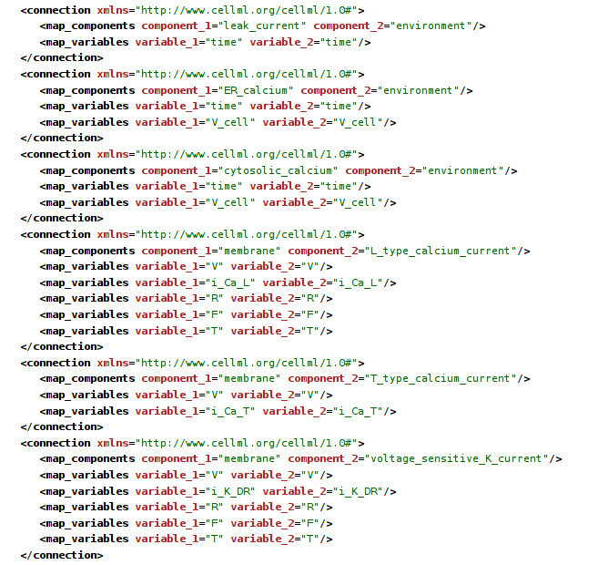
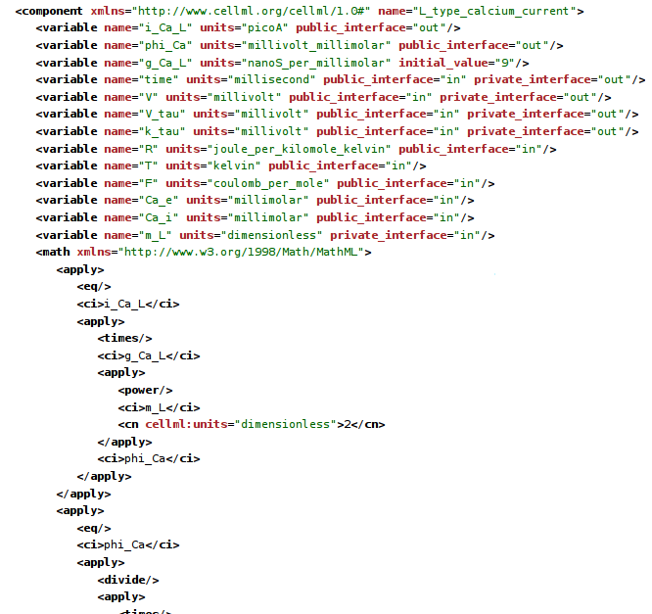
What not to do...
3 of about 30 pages that constitute
the CellML representation of a fairly
simple HH based cell model.
Says C dV/dt = ∑i,
… but without using ∑
All the currents are enumerated explicitly

Slide 5
What actually is the model?
Original HH model and almost all derivatives have:
Serial independent gates
Gate opening and closing governed by a rate expression with one of three forms:
    exp(V)
    exp(V) / (1+exp(v))
    V / (1 – exp(-V))
Each rate expression has three parameters – V scale, Rate scale, V offset
rate
V

Slide 6
NeuroML exploits this structure to allow concise expression of HH style models: (this is actually the PSICS form, but its pretty much equivalent)
<KSChannel id="HH_Na" permeantIon="Na" gSingle="20pS">
<KSComplex id="m" instances="3">
<ClosedState id="c"/>
<OpenState id="o"/>
<ExpLinearTransition from="c" to="o" rate="1.per_ms" midpoint ="-40.mV" scale="10mV"/>
<ExpTransition from="o" to = "c" rate="4.per_ms" midpoint="-65.mV" scale="-18mV"/>
</KSComplex>
<KSComplex id="h">
<ClosedState id="c"/>
<OpenState id="o"/>
<ExpTransition from="c" to="o" rate="0.07per_ms" midpoint="-65.mV" scale="-20.mV"/>
<SigmoidTransition from="o" to="c" rate="1per_ms" midpoint="-35mV" scale="10mV"/>
</KSComplex>
</KSChannel>
<KSChannel id="HH_K" permeantIon="K" gSingle="20pS">
<KSComplex id="n" instances="4">
<ClosedState id="c"/>
<OpenState id="o"/>
<ExpLinearTransition from="c" to="o" rate="0.1per_ms" midpoint ="-55.mV" scale="10mV"/>
<ExpTransition from="o" to = "c" rate="0.125per_ms" midpoint="-65.mV" scale="-80mV"/>
</KSComplex>
</KSChannel>
But this depends on external definitions for the element types.
What if we want to express the whole lot from scratch?

Slide 7
Need a way to express -
The structures shared by many models, once
For a particular model, just the parts unique to that model, with a reference to the shared structure
Without editing the schema/specification every time – neuroscience models are just too diverse.
Similar principle to:
Modelica (mechanical systems)
VHDL (electronic design)
NineML (networks and more)
...and others
Desired content of the
top layer of the model
specification
<Include file="hhchannel.xml" />
<Unit symbol="mV" dimension="voltage" powTen="-3" />
<Unit symbol="per_ms" dimension="per_time" powTen="3" />
<Unit symbol="pS" dimension="conductance" powTen="-12" />
<HHChannel id="na" conductance="20pS">
<HHGate id="m" power="3">
<Forward type="HHExpLinearRate" rate="1.per_ms" midpoint="-40mV" scale="10mV" />
<Reverse type="HHExpRate" rate="4per_ms" midpoint="-65mV" scale="-18mV" />
</HHGate>
<HHGate id="h" power="1">
<Forward type="HHExpRate" rate="0.07per_ms" midpoint="-65.mV" scale="-20.mV" />
<Reverse type="HHSigmoidRate" rate="1per_ms" midpoint="-35mV" scale="10mV" />
</HHGate>
</HHChannel>
<HHChannel id="k" conductance="20pS">
<HHGate id="n" power="4">
<Forward type="HHExpLinearRate" rate="0.1per_ms" midpoint="-55mV" scale="10mV" />
<Reverse type="HHExpRate" rate="0.125per_ms" midpoint="-65mV" scale="-80mV" />
</HHGate>
</HHChannel>
Syntactic fiddles:
“<XXX .../>”
is shorthand for
“<Component type='XXX'/>”
“a='value unit'”
is shorthand for
“<value parameter='a'
size='val'
unit='unit'/>'

Slide 8
<Dimension name="voltage" m="1" l="2" t="-3" i="-1" />
<Dimension name="time" t="1" />
<Dimension name="per_time" t="-1" />
<Dimension name="conductance" m="-1" l="-2" t="3" i="2" />
<Dimension name="capacitance" m="-1" l="-2" t="4" i="2" />
<Dimension name="current" i="1" />
<ComponentType name="HHRate">
<Parameter name="rate" dimension="per_time" />
<Parameter name="midpoint" dimension="voltage" />
<Parameter name="scale" dimension="voltage" />
<Behavior>
<IndependentVariable name="v" dimension="voltage" />
<DerivedVariable name="r" dimension="per_time" />
</Behavior>
</ComponentType>
<ComponentType name="HHExpRate" extends="HHRate">
<Behavior inherit="variables">
<DerivedVariable name="r" value="rate * exp((v - midpoint)/scale)" />
</Behavior>
</ComponentType>
<ComponentType name="HHSigmoidRate" extends="HHRate">
<Behavior inherit="variables">
<DerivedVariable name="r" value="rate / (1 + exp(0 - (v - midpoint)/scale))" />
</Behavior>
</ComponentType>
<ComponentType name="HHExpLinearRate" extends="HHRate">
<Behavior inherit="variables">
<DerivedVariable name="x" value="(v - midpoint) / scale" />
<DerivedVariable name="r" value="rate * x / (1 - exp(0 - x))" />
</Behavior>
</ComponentType>

Slide 9
<ComponentType name="HHGate">
<Parameter name="power" dimension="none" />
<Child name="Forward" type="HHRate" />
<Child name="Reverse" type="HHRate" />
<Behavior>
<IndependentVariable name="v" dimension="voltage" />
<StateVariable name="q" dimension="none" />
<ExternalVariable name="rf" dimension="per_time" select="Forward/r" />
<ExternalVariable name="rr" dimension="per_time" select="Reverse/r" />
<TimeDerivative variable="q" value="rf * (1 - q) - rr * q" />
<DerivedVariable name="fcond" dimension="none" value="q^power" />
</Behavior>
</ComponentType>
<ComponentType name="HHChannel">
<Parameter name="conductance" dimension="conductance" />
<Children name="gates" type="HHGate" min="0" max="4" />
<Behavior>
<IndependentVariable name="v" dimension="voltage" />
<ExternalVariable name="gatefeff" dimension="none"
select="product(gates[*]/fcond)" />
<DerivedVariable name="g" value="conductance * gatefeff" />
</Behavior>
</ComponentType>
With these definitions in place, most of the ion channel models in the modeling literature can
be expressed in 10 or 15 lines of XML.

Slide 10
Why “LEMS” - Low Entropy Model Specification?
c.f. Kolmogorov complexity, or algorithmic entropy:
abababababababababababababababababababababababab = 24(ab)
aeagarg89dafgertdfgbsdrgtqewrsae4lgi7hdf89bkfsdsg0efhe (nothing shorter than itself)
The first string has lower entropy and the simple coding scheme lets it be expressed in a
way that makes this clear.
LEMS is about doing the same thing for biological models.
Several benefits:
1) Easier for people to read and understand the concise form
2) Can be mapped onto other representations (easier to increase entropy than reduce it)
3) Allows a notion of “proximity” on models ( “24(ab)” is near “25(ab)” and 24(ac)”)
- crucial when each model is just a single point in an infinite parameter space
4) Less repetition helps with implementation and validation

Slide 11
Component type
definitions
Component
definitions
Hypothetical fully-
expanded model
Dimensions and Equations
Hand-written in XML
Possibly machine generated in some cases
Concise, and relatively few of them
Need referencing and selection mechanisms operating across types.
  eg to say the relative conductance of a channel is the product of the relative conductances of its gates
Units and Parameter values
Can be hand-written in XML by a modeler, possibly generated
Need references and selections across a model
  Eg to specify the channel model to use for a particular collection of channels
Also need references and selections across the (hypothetical) instantiated model
  Eg to select cells for a particular connectivity pattern (targets don't exist in the XML)
Simulator state as nesting structure and dimensional quantities
One entry for every cell in a network, every state variable in a simulation.
Could be used to simulate a model (but not a very efficient way of doing it)
In general, may never be generated
But can still write xpath or equivalent to operate over it

Slide 12
Paths and references – cases to be addressed
Component type definition refers to state variables in related type definitions
    Eg channel has gates; channel definition refers to properties of those gates. Note at this stage we have no particular channel in mind, so the gate components do not exist at the definition level.
Component has a path to another component
    Eg channel component refers to a “sodium” component for its permeant ion. Type definition needs to look up that ion in some environment object to get its reversal potential.
Run-time instance needs a path to another run-time instance
    Eg cells connected by gap junctions or synapses

Slide 13
Hierarchical type definitions provide a natural way to handle “build-time” connections
A channel type definition can refer to its child gates in a generic way without knowing what they are
Almost the same mechanism applies for children that are dynamically generated synapse objects
    Parent type definition specifies that instances of components of the corresponding type can have children of a particular type in a particular container
    Dynamics can specify what is done with them (summing currents etc) based on the container they are in – no need to explicitly wire ports together.
      Requires a notion of type inheritance
      “Containment” concept avoids the need to explicitly connect the membrane potential from parent to child synapse

