Slide 1

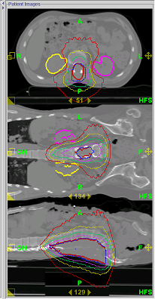
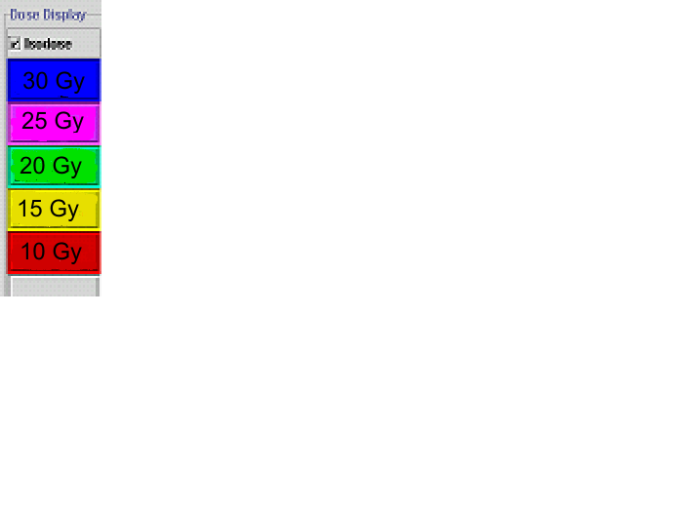
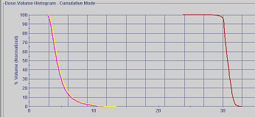
University of
Wisconsin
(clinical)
Spine
UAB
re-treats
Ptv
lt kidney
Rt kidney
Notes:
A spine Retreat. Avoiding both kidney’s. The next slide goes with this one, it shows the registration that was done on a daily basis for treatment.

Slide 2
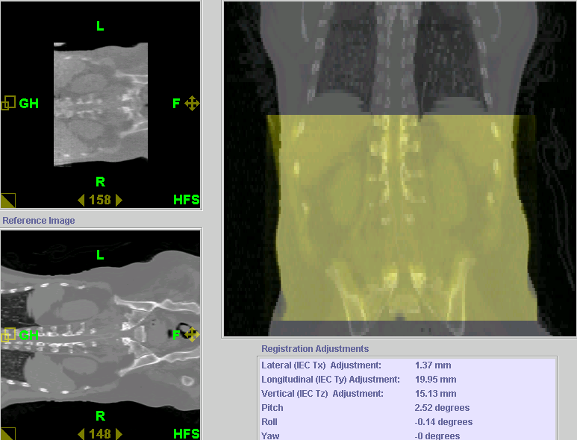
University of Wisconsin (Clinical)
Spine
UAB
re-treats
Notes:
This is the registration. able to match the spine exact every day and you can see that you are avoiding the kidney’s.

Slide 3
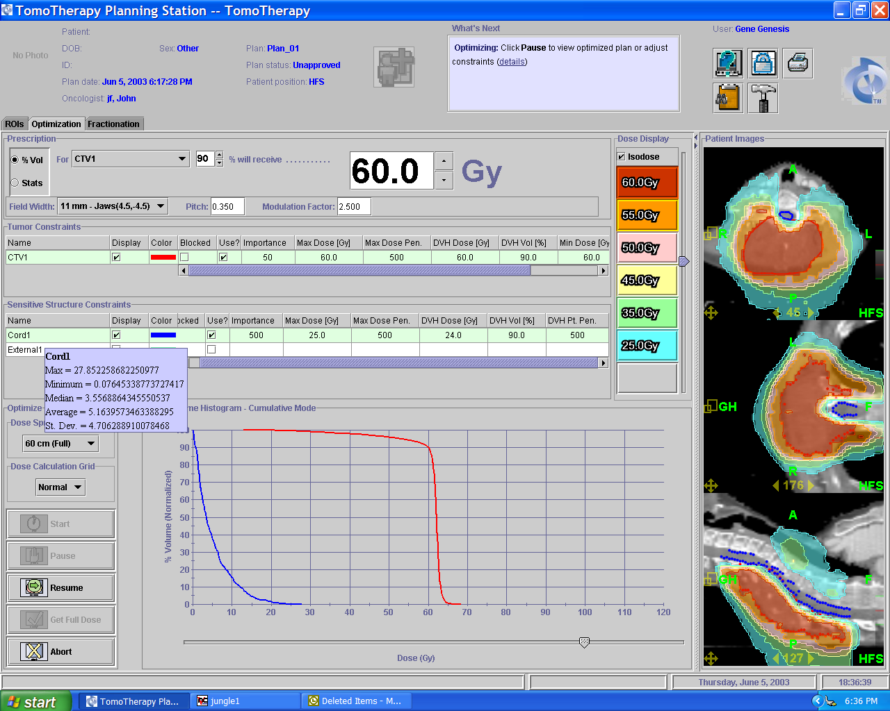
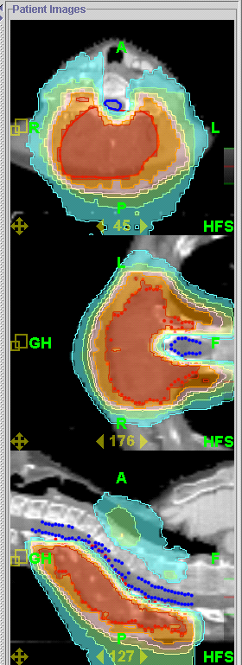
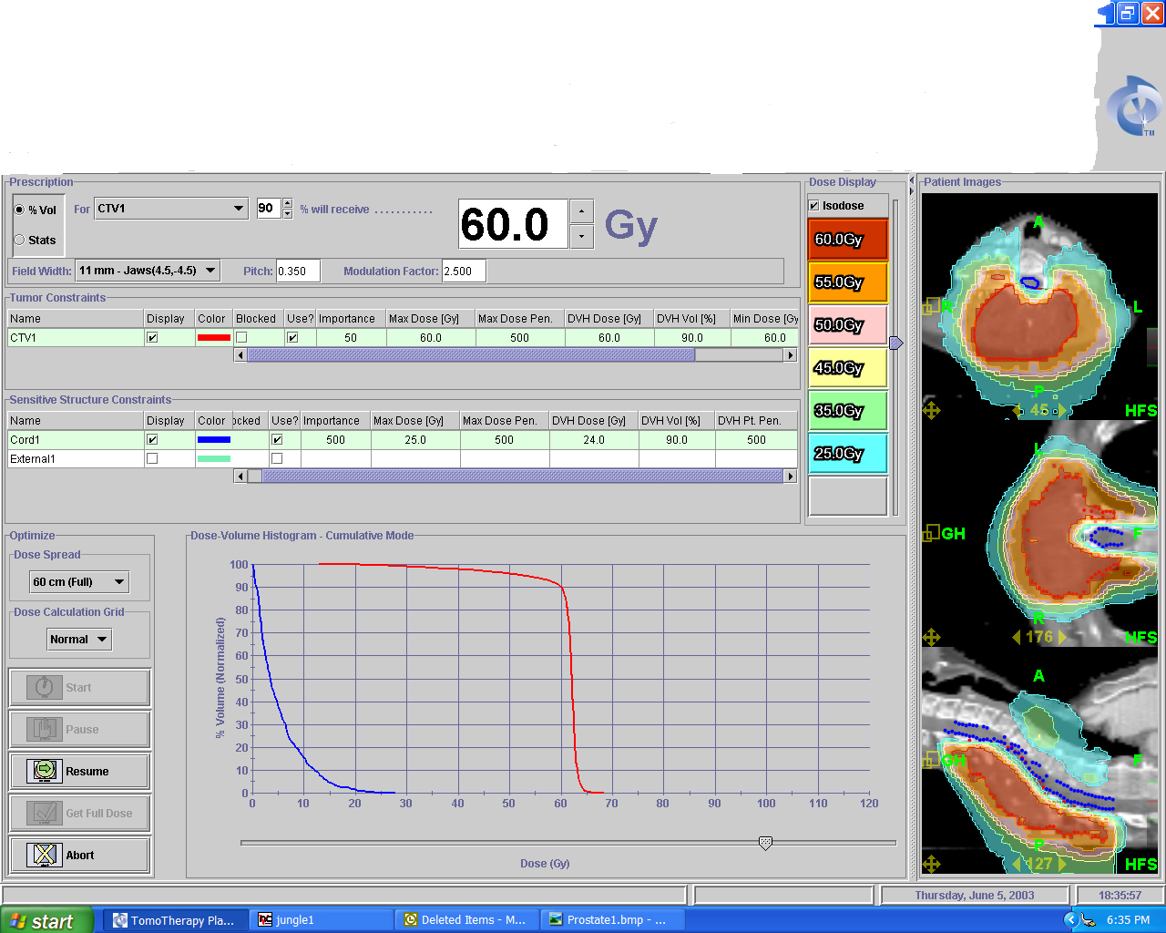
UAB re-treats
Spine
University
of
Wisconsin
(clinical)
Spinal Cord
Notes:
treating an area that is close to a part of the spine that was already treated. dose painting the spine out of the fields and still able to treat the are of interest.

Slide 4
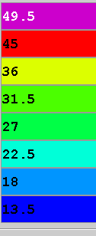
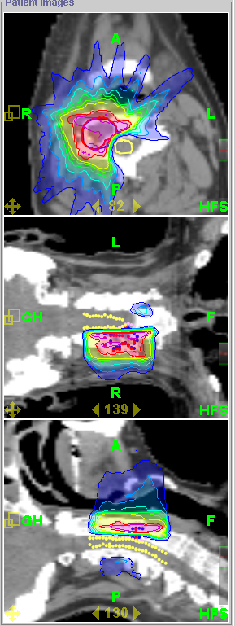
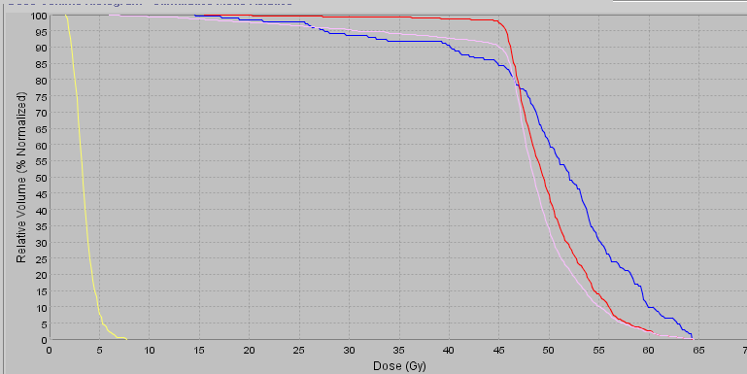
UAB re-treats
Spine
University
of
Wisconsin
(clinical)
Spinal Cord
Notes:
retreating the bone of the spinal column while avoiding the spinal cord.

Slide 5
Click Here to return to
Clinical Case Studies PowerPoint

