Slide 1
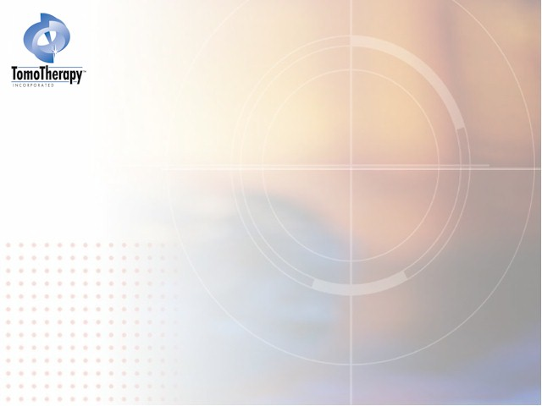
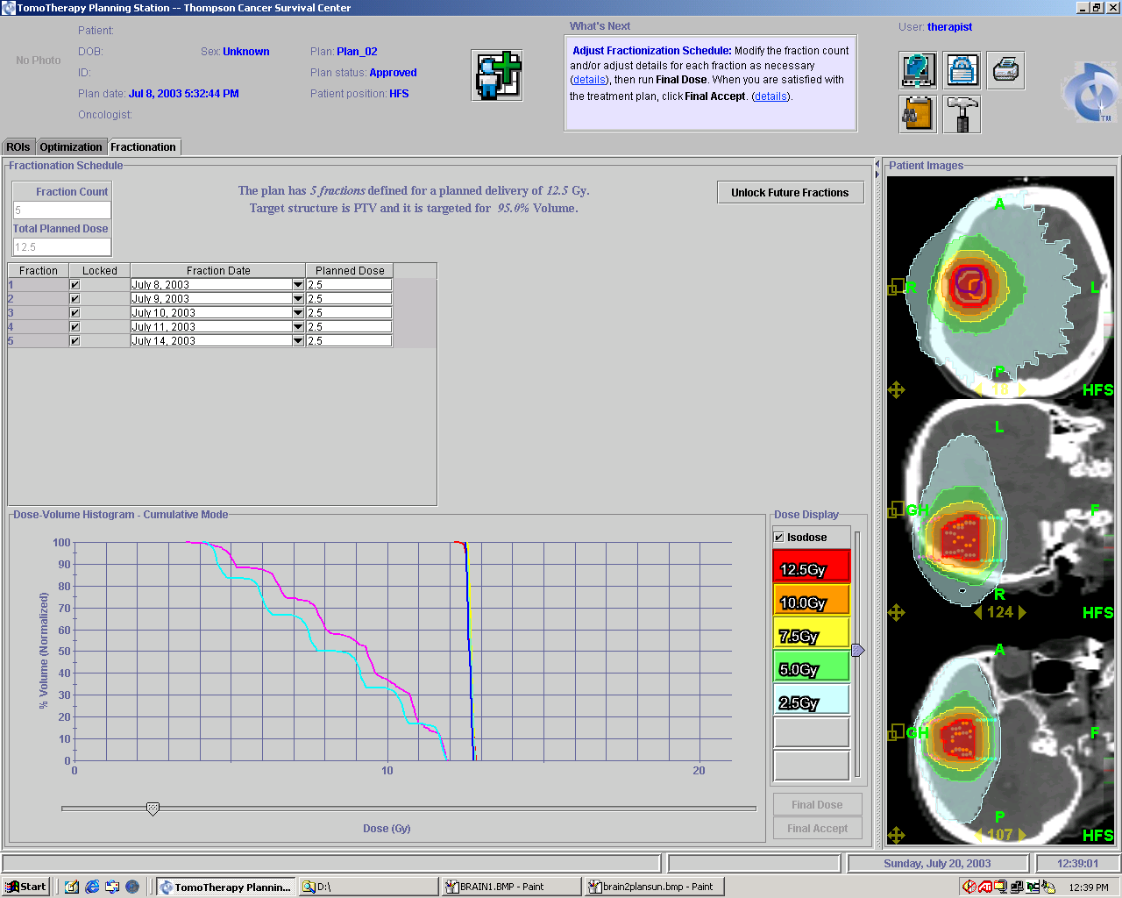
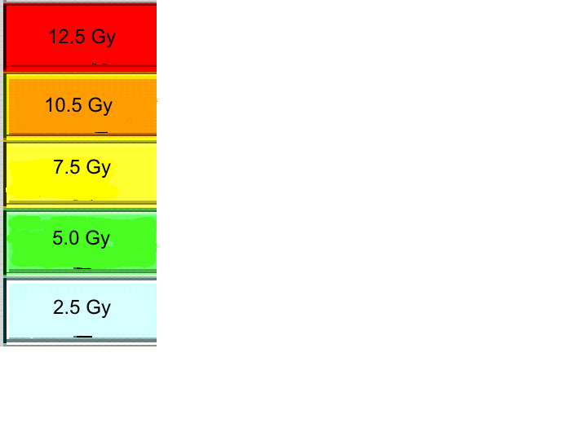
Thompson
(clinical)
Thompson
(clinical)
Baylor
H&N
Fairfax H&N
UVA
H&N
Notes:
solitary brain tumor. IMPORTANT: This demonstrates a vertex field using tomotherapy. NO dose to the eyes. Clinics think that since our table doesn’t rotate, we don’t have the ability to treat a vertex field (conventional you rotate the table to achieve this). Another plus is filming this “vertex” field is easy and readable. We take a TomoImage.

Slide 2
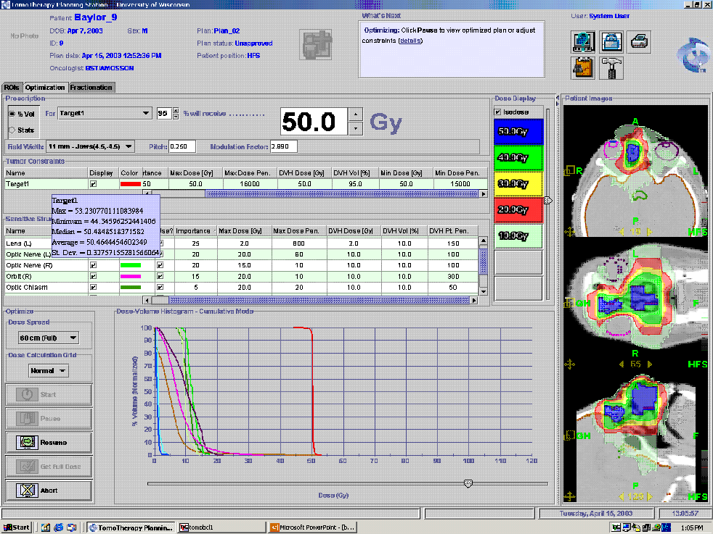
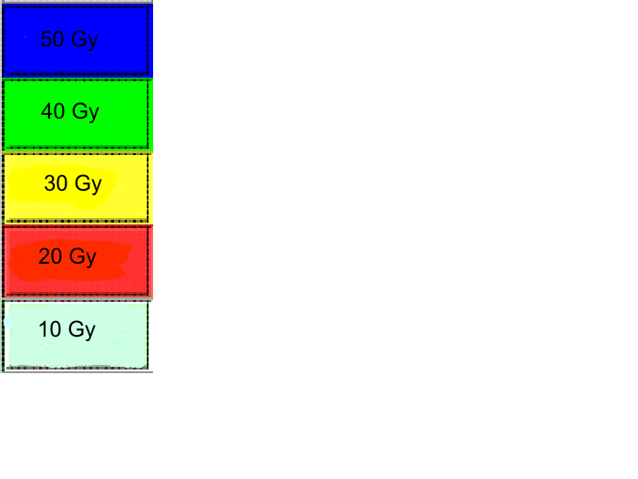
Baylor
H&N
Thompson
(clinical)
Fairfax H&N
UVA
H&N
Notes:
Avoiding dose around the orbits while treating in the nasopharynx region.

Slide 3
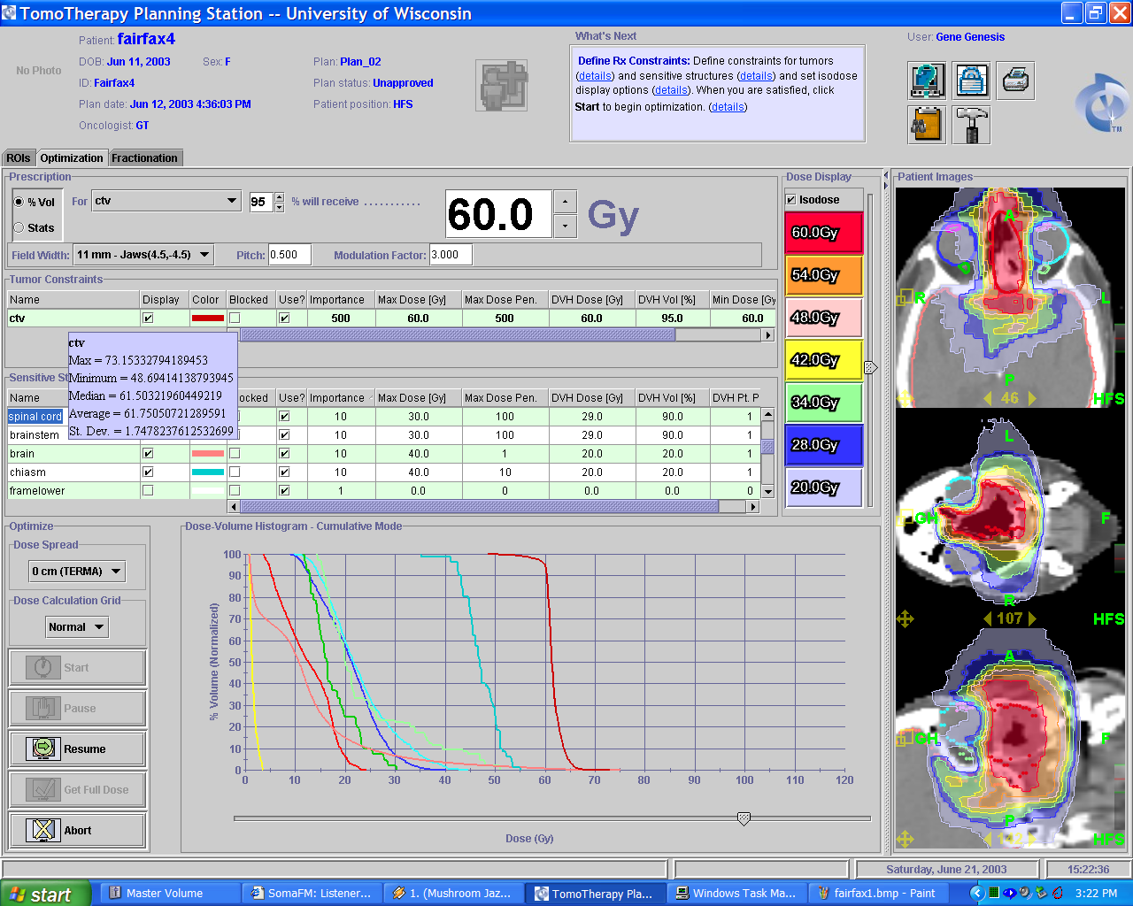
Fairfax
H&N
Baylor
H&N
Thompson
(clinical)
lt orbit
rt orbit
optic nerve
UVA
H&N
Notes:
dose painting around both orbits, optic nerves,

Slide 4
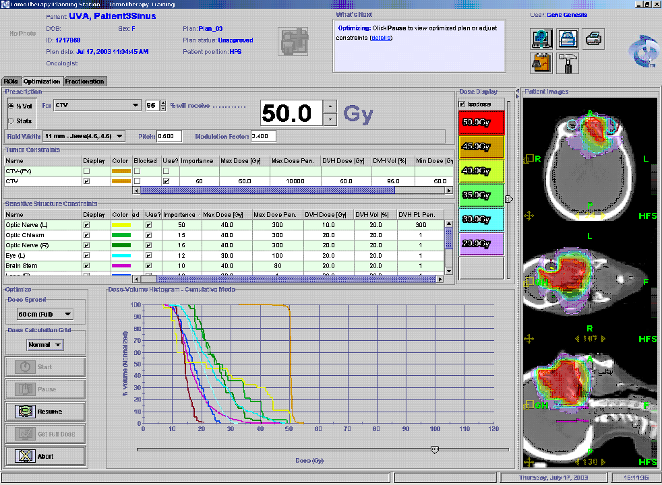
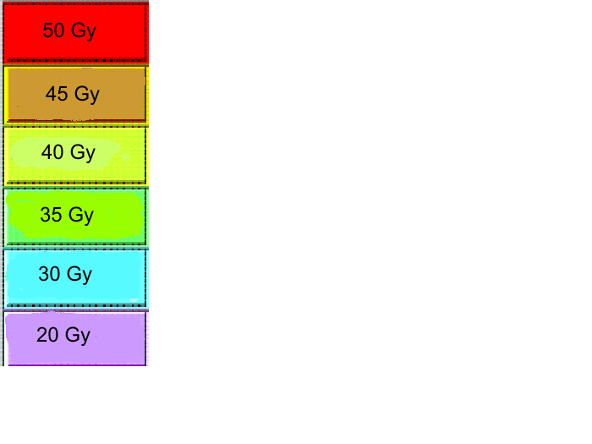
UVA
H&N
Fairfax H&N
Baylor
H&N
Optic Chiasm
Otic Nerve
CTV
Thompson
(clinical)
Lt. Eye
Rt. Eye
Brain Stem
Lt Optic Nerve
Notes:
avoiding eyes and brain stem( purple line on rt picture)

Slide 5
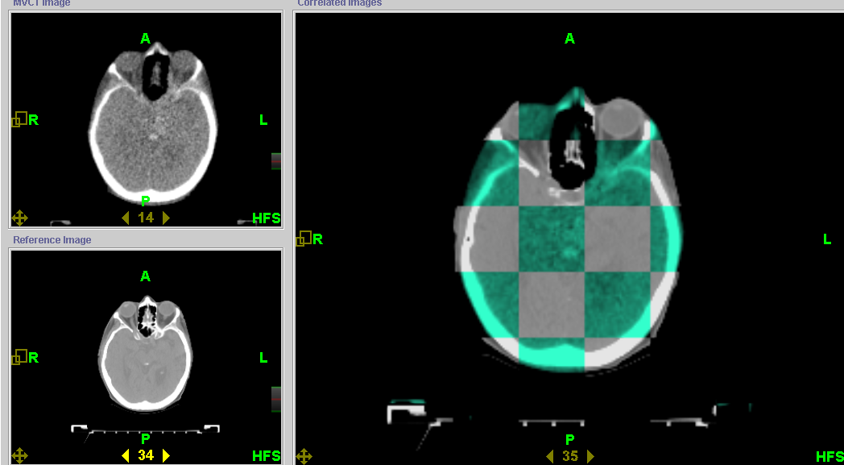
Thompson
(clinical)
Baylor
H&N
Fairfax H&N
UVA
H&N
Notes:
TomoImage top left, planning ct bottom lt. combination of the two on the right. gray is planning and green is TomoImage. Registration is completed and the match is perfect.

Slide 6
Click Here to return to
Clinical Case Studies PowerPoint

