Slide 1

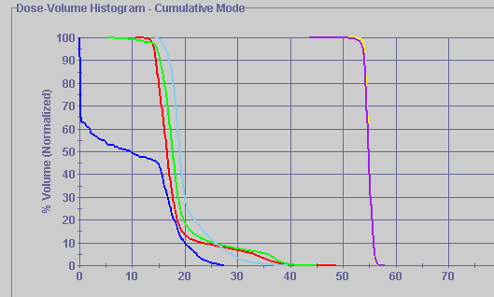
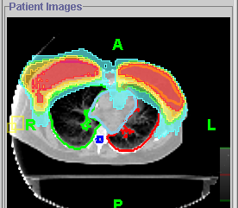
Supine Breast
Heart
PTV
Lt Lung
Rt Lung
Spinal Cord
Notes:
Bi-lateral breast treatment. We don’t have to worry about junction matches from both breasts. One set-up to treat both at the same time. Eliminates hot and cold spots ( missed and over treated areas between the breasts)

Slide 2
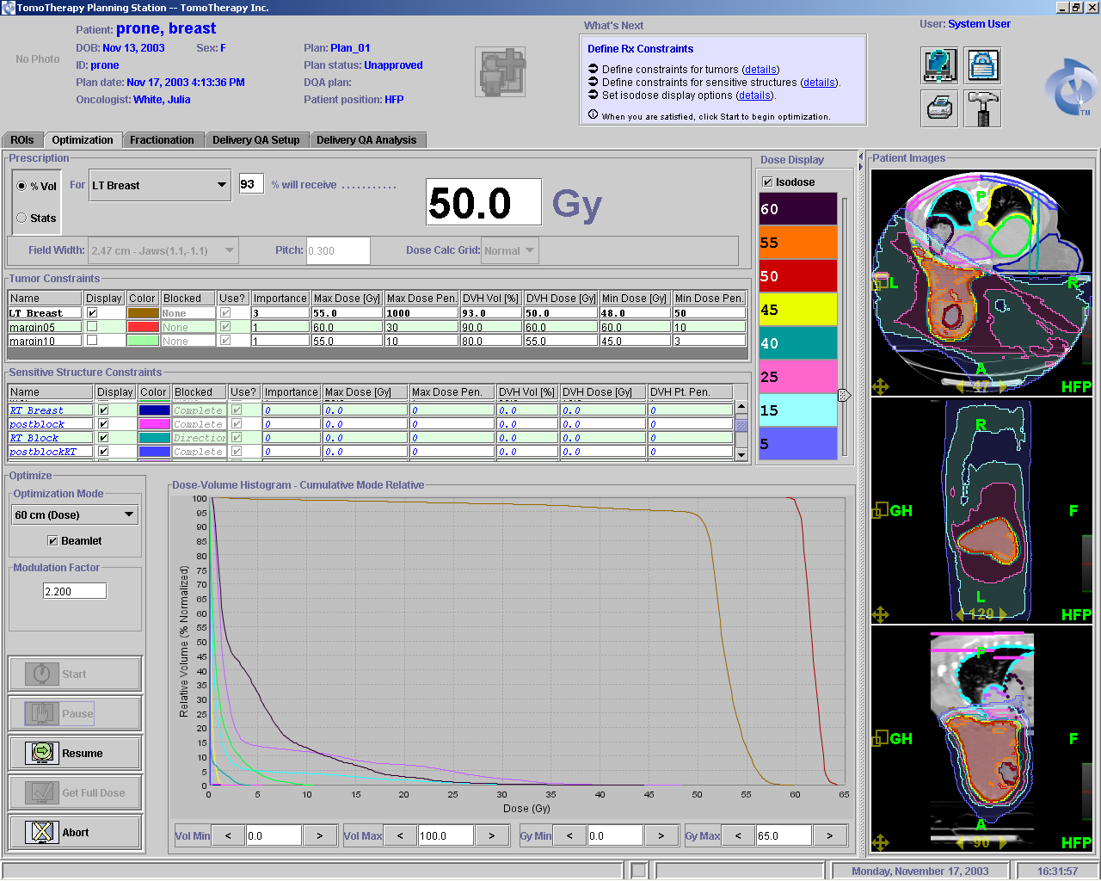
MCOW
Prone Breast
Lt Lung
Rt Lung
Spinal Cord
Notes:
Prone Breast eliminates treatment to opposing breast, breast falls away from critical structures such as the heart and lungs. The blue and pink structures are put in so you can block all radiation from the patients back and Rt side. The thought is to use the prone breast biopsy table, minus the coils, and place it on top of the tomo table for treatment.

Slide 3
Click Here to return to
Clinical Case Studies PowerPoint

