Slide 1
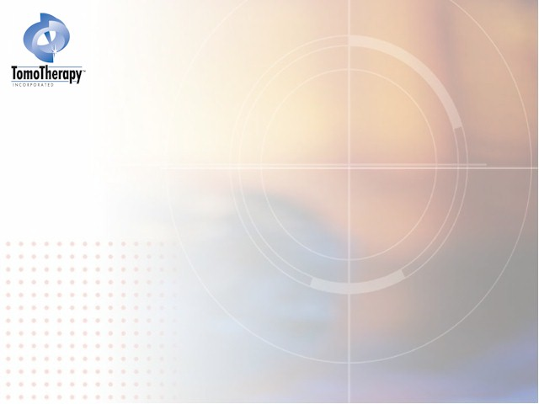
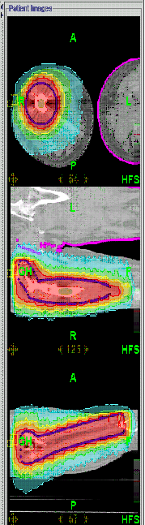
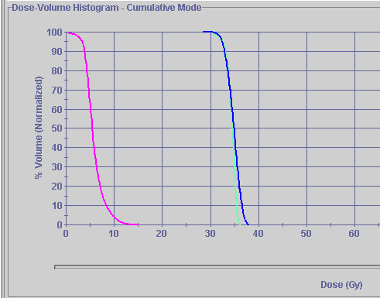
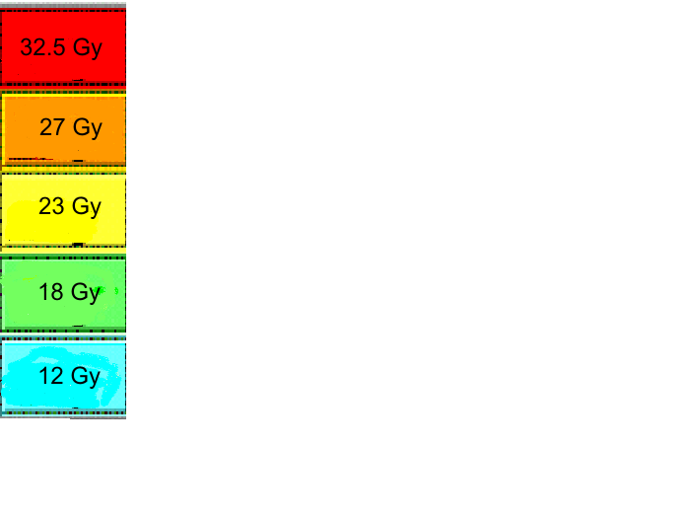
Thompson
(clinical)
Femur
MCOW
Ptv
Rt leg
Lt Leg
Notes:
able to avoid the unaffected leg without putting the patient in uncomfortable position. We are less concern about patient movement during treatment. Usual set-up: opposing leg somehow raised above the affected leg (blocks and tape).

Slide 2
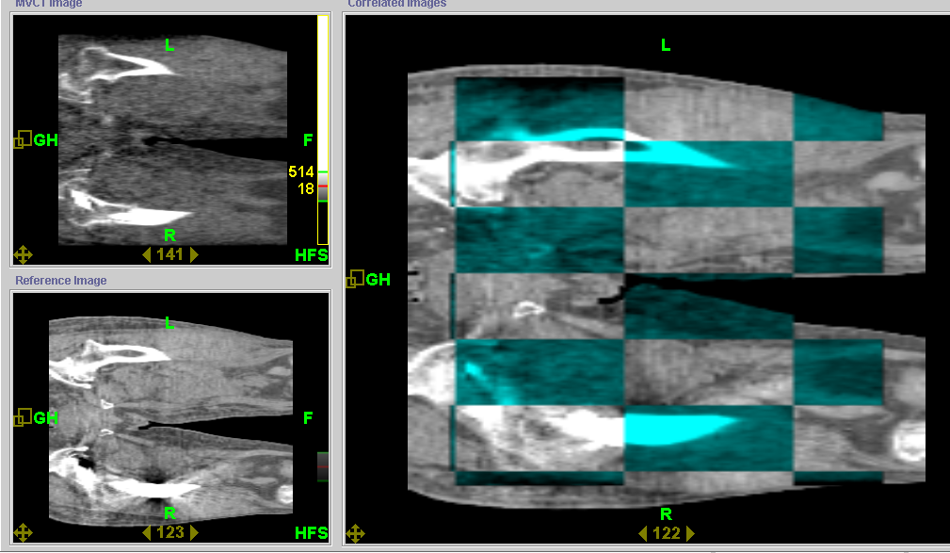
Thompson
(clinical)
Femur
MCOW
Notes:
top tomoimage, bottom planning ct. rt is the combine of both. Green is tomo, gray is planning. Registration shows how you can match bones in both legs. Also notice no artifact on the MVCT on the right side

Slide 3
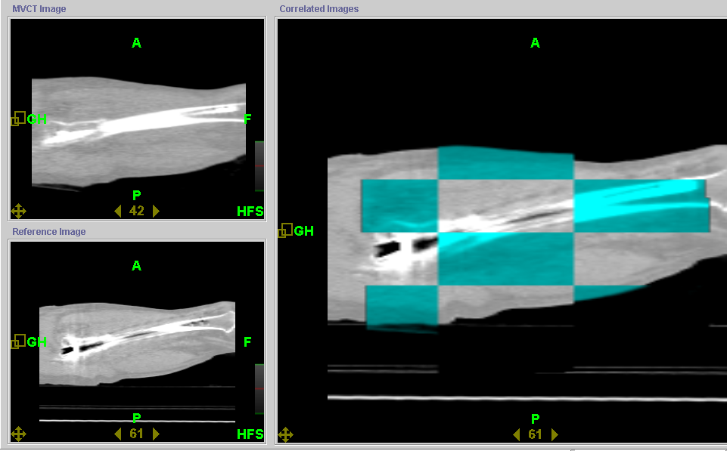
Thompson
(clinical)
Femur
MCOW
Notes:
besides the two images, shows less scatter from the tomoimage

Slide 4
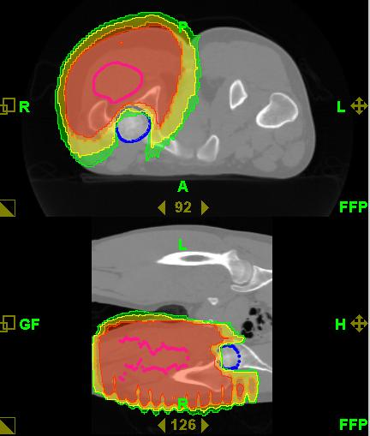
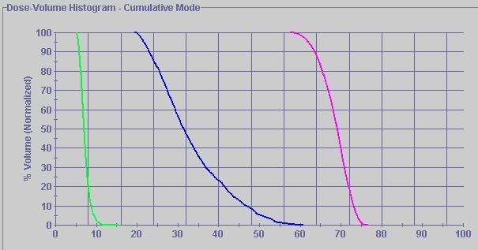
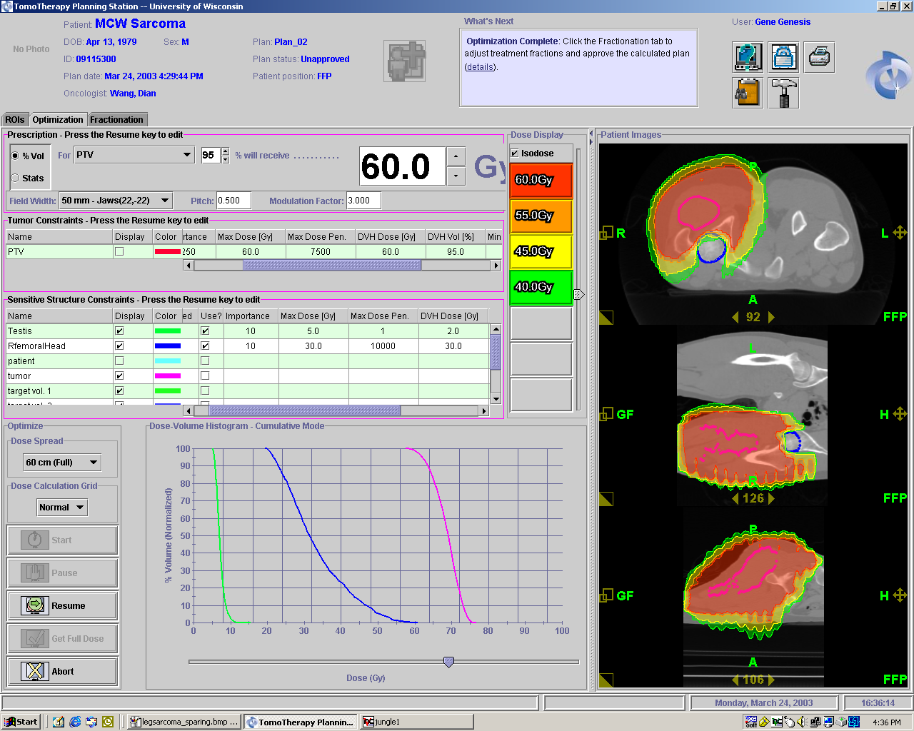
MCOW Sarcoma
Femur
Thompson
(clinical)
PTV
Femoral
Head
Notes:
able to shape the dose to the Ptv, leaving more healthy tissue out of the fields. Avoiding Lt leg.

Slide 5
Click Here to return to
Clinical Case Studies PowerPoint

