Slide 1

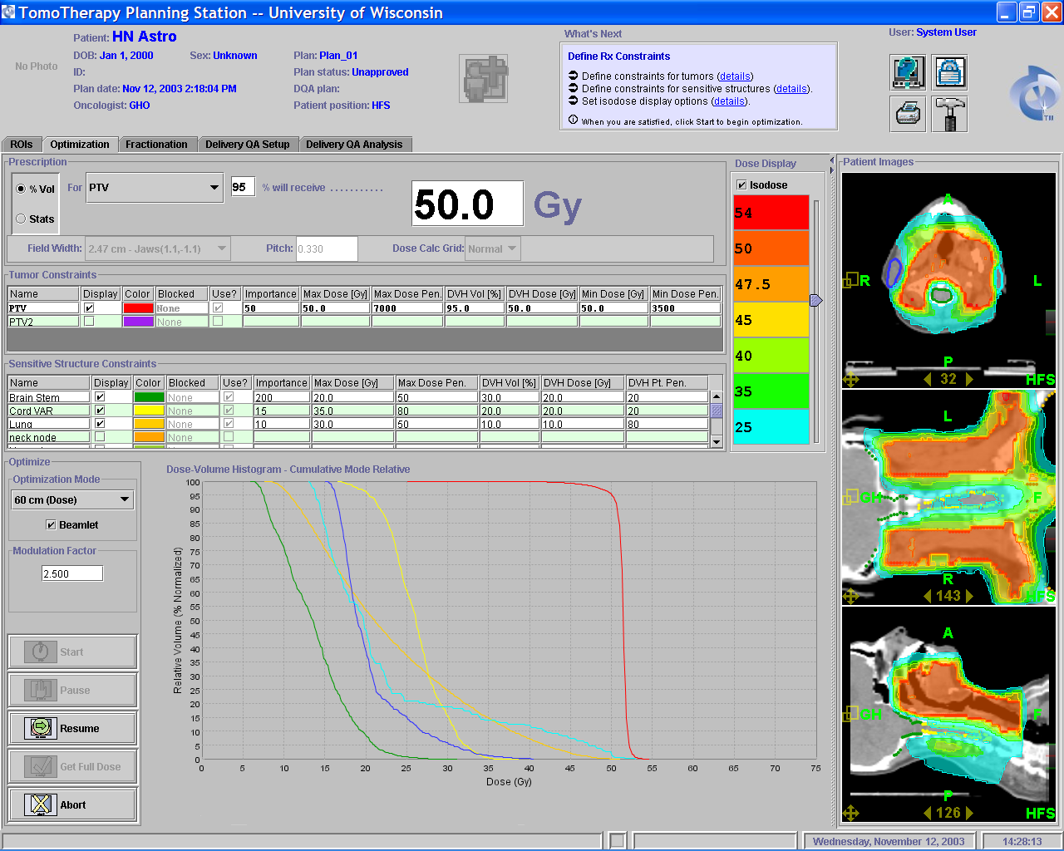
Thompson
( Clinical)
Head and Neck
Patient Images
UVA
MCOW
RTOG H0022
St. Luc
Brussels
Rt Parotid
PTV
St. Agnes
Brain Stem
Spinal Cord
Lutheran
Southeast Regional
Cancer Center
Lung
Lt Parotid
Notes:
Dose painting around the spinal cord and parotids. Both brain stem and spinal cord are below tolerance levels.

Slide 2
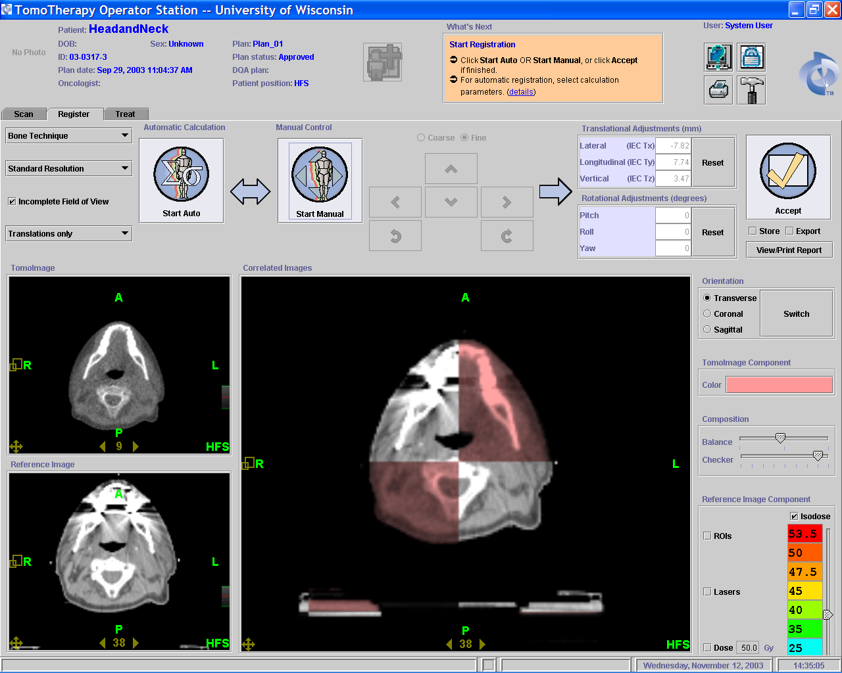
Thompson
( Clinical)
Head and Neck
UVA
MCOW
RTOG H0022
St. Luc
Brussels
St. Agnes
Lutheran
Southeast Regional
Cancer Center
Notes:
tomoimage on the top, planning ct on the bottom, large window is the combination of the two. Scatter difference between the scans. Tomoimages can be exported via DICOM to contouring work station. Send them back to Tomo for planning for accurate heterogeneity calculations.

Slide 3
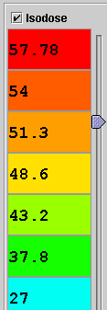
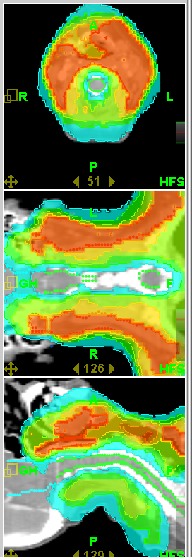
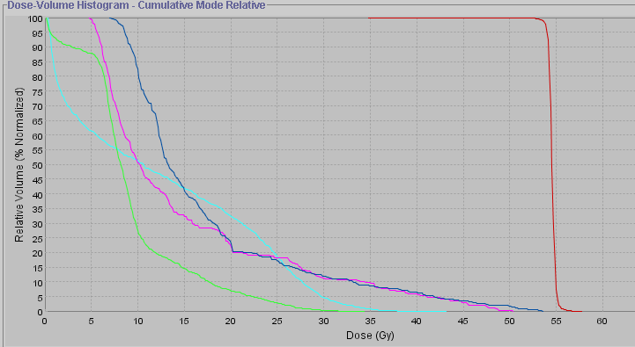
UVA
Head and Neck
Patient Images
Thompson
( Clinical)
MCOW
RTOG H0022
St. Luc
Brussels
PTV
Rt Parotid
St. Agnes
Lutheran
Lt Parotid
Southeast Regional
Cancer Center
Brain Stem
Spinal Cord
Notes:
Dose painting around the cord. No hot spots on the back of the neck.

Slide 4
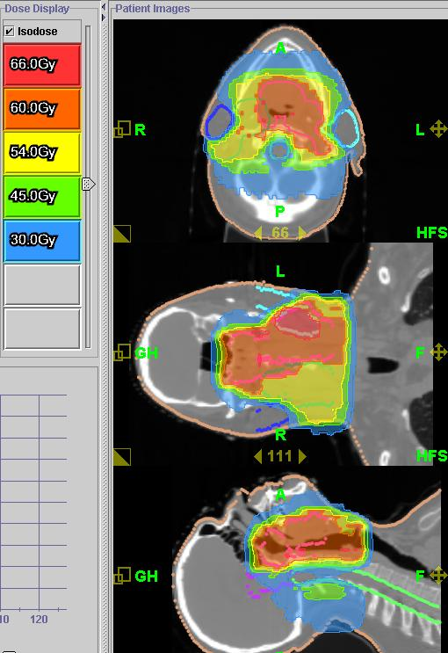
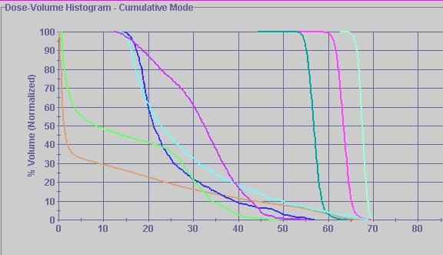
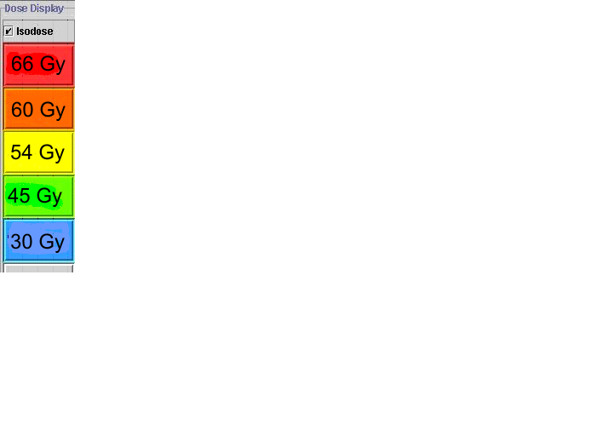
MCOW
RTOG H0022
Head and Neck
Thompson
( Clinical)
UVA
St. Luc
Brussels
Lt Parotid
PTV2
PTV1
St. Agnes
Rt Parotid
Lutheran
Spinal Cord
Southeast Regional
Cancer Center
PTV3
Brain Stem
Patient
Contour
Notes:
dose painting of the parotids. saving both so fewer side affects.

Slide 5
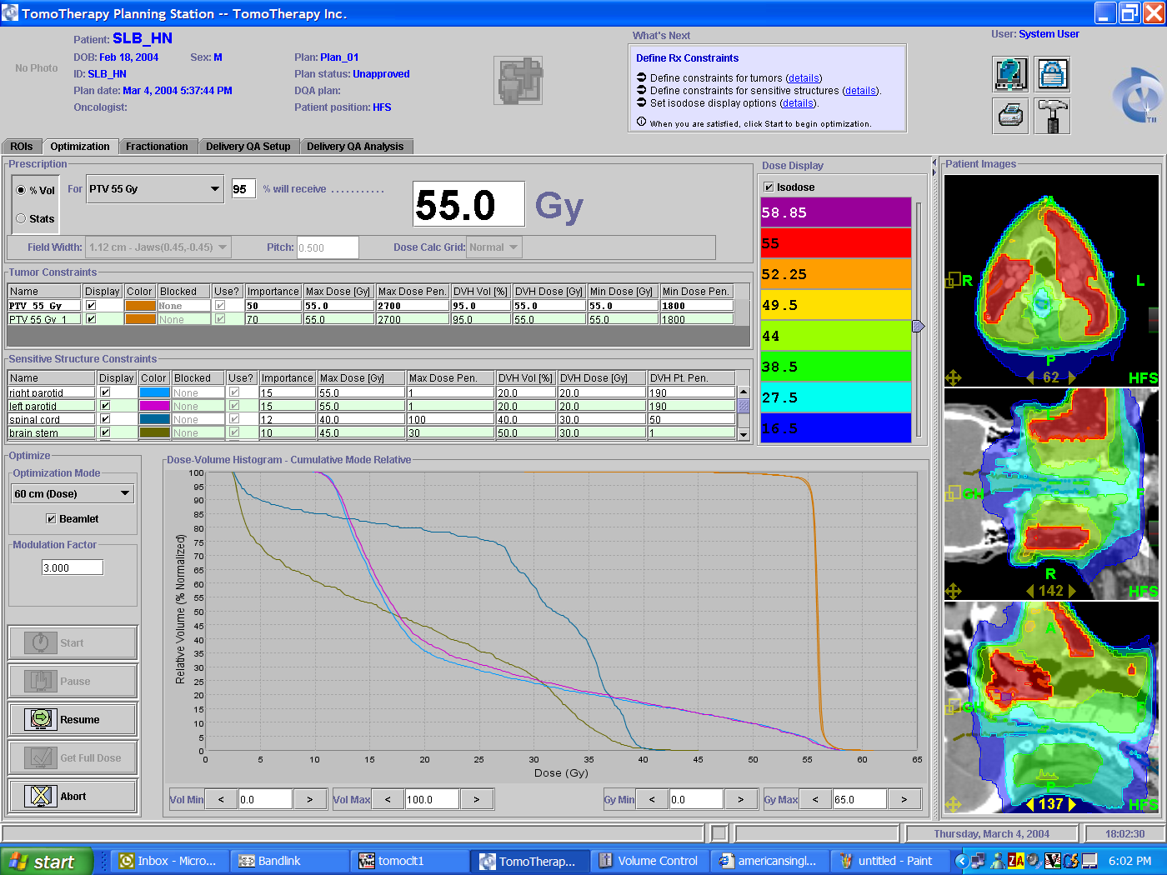
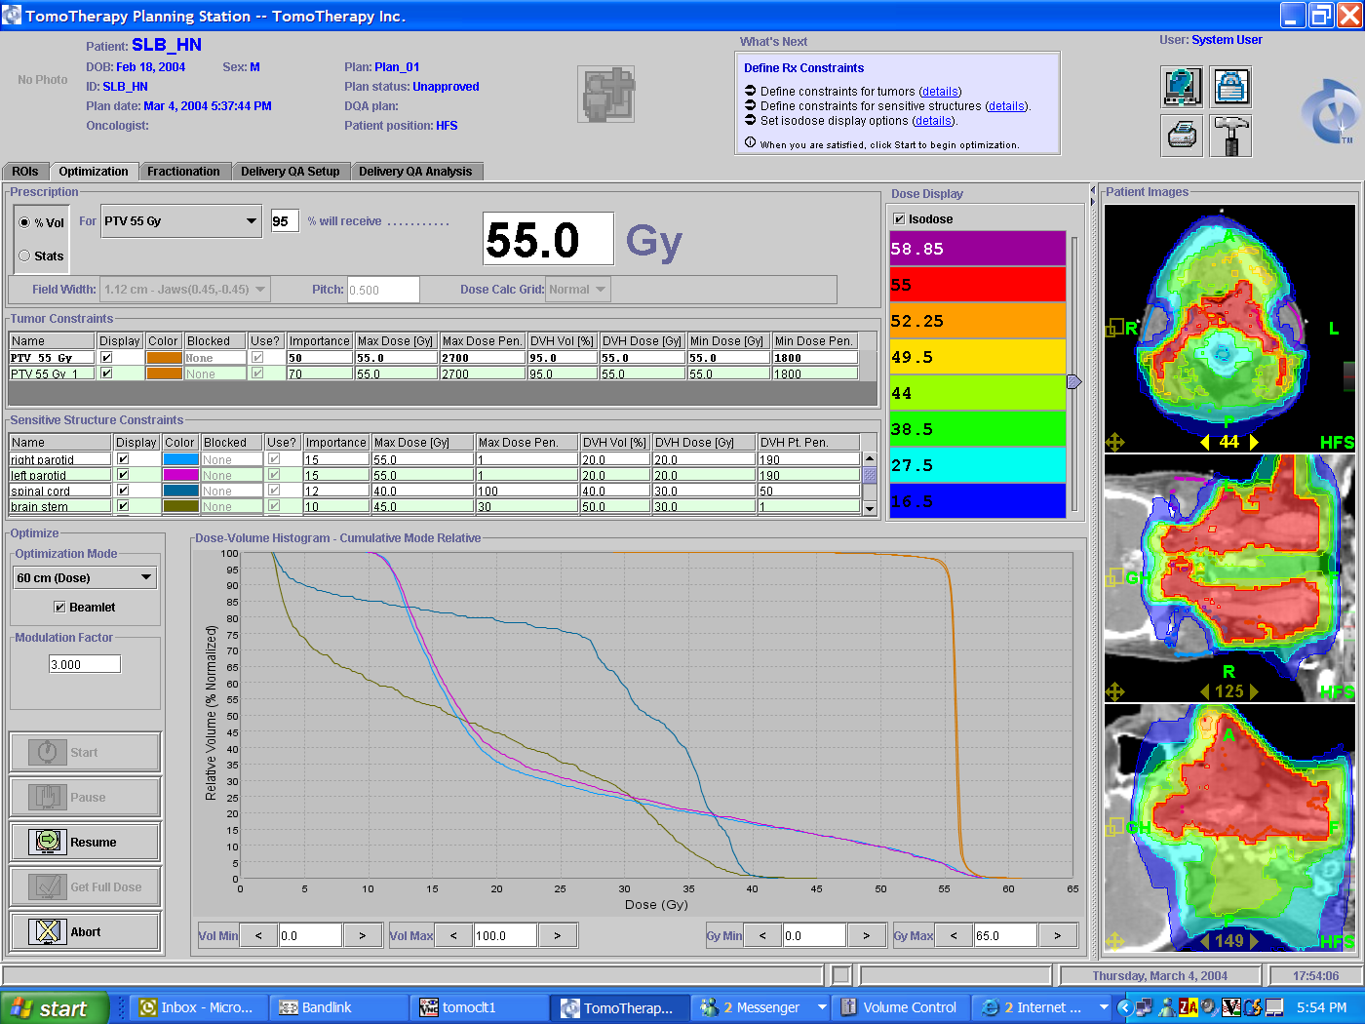
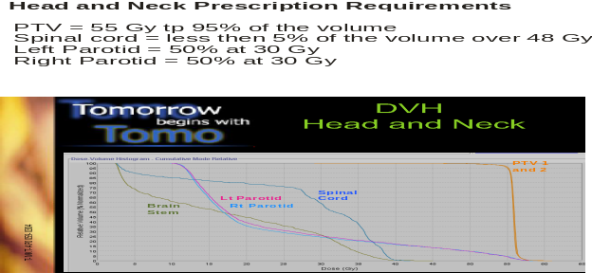
St. Luc
Brussels
Head and Neck
Thompson
( Clinical)
UVA
MCOW
RTOG H0022
PTV 1
and 2
St. Agnes
Lutheran
Brain
Stem
Spinal
Cord
Southeast Regional
Cancer Center
Lt Parotid
Rt Parotid
Notes:
head and neck treated in one long continuous field. No matching fields, or multiple set-ups.

Slide 6
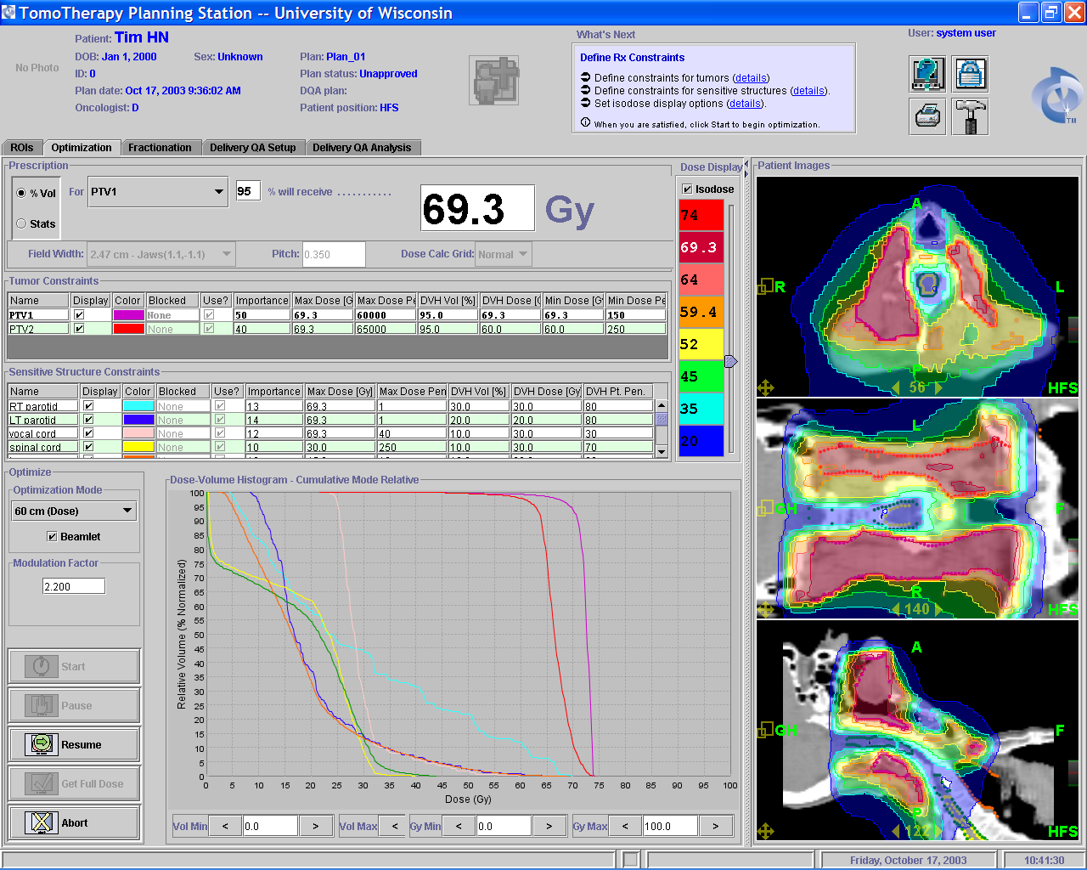
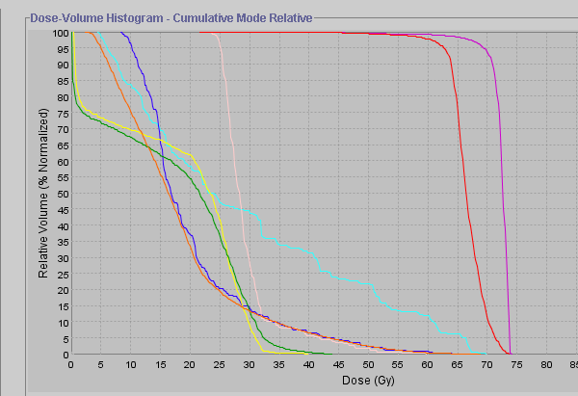
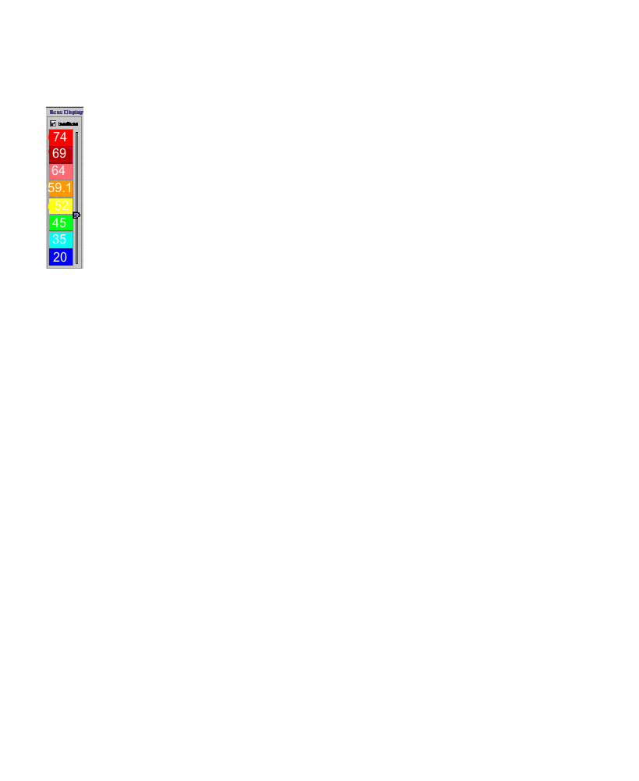
St. Agnes
Head and Neck
Thompson
( Clinical)
UVA
MCOW
RTOG H0022
Vocal Cords
PTV1
St. Luc
Brussels
PTV2
Lutheran
Lungs
RT Parotid
Southeast Regional
Cancer Center
Cord
Avoidance
LT Parotid
Spinal cord
Notes:
additional views on next page.

Slide 7
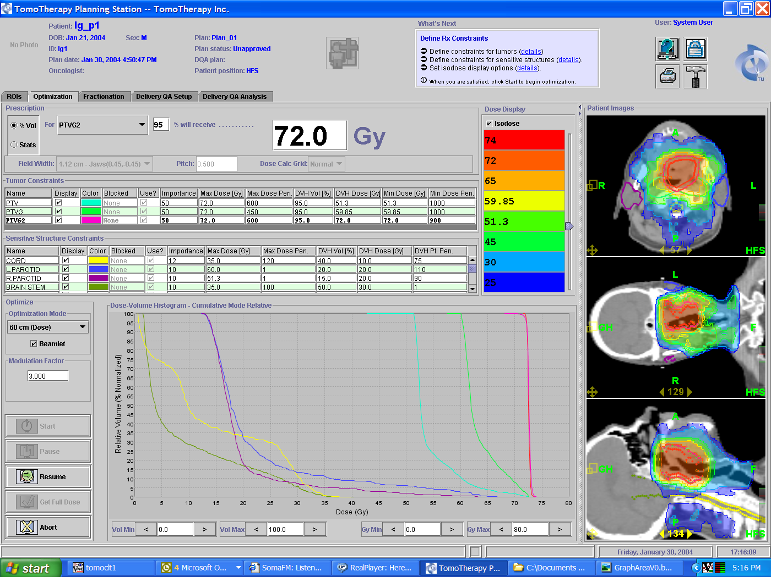
Lutheran
Head and Neck
Thompson
( Clinical)
70 Gy to 100% of GTV
UVA
MCOW
RTOG H0022
PTV
PTVON
St. Luc
Brussels
PTVGLN
St. Agnes
Lt Parotid
GTV
Rt Parotid
Southeast Regional
Cancer Center
Spinal Cord
Brain Stem
Notes:
another example of dose painting of the parotids and spinal cord.

Slide 8
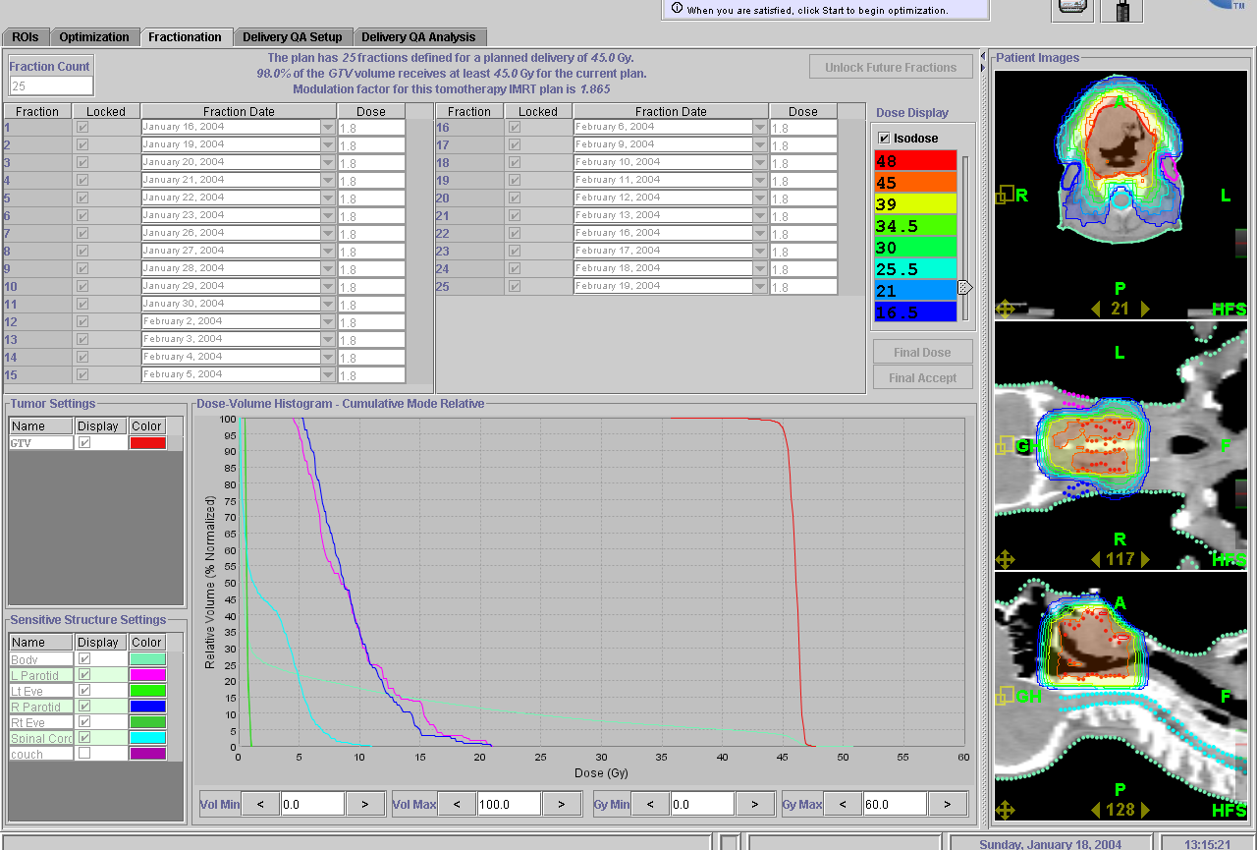
Clinical - Base of Tongue
Case courtesy of Dr. D. Cho
Thompson
( Clinical)
UVA
4 Minutes 47 Seconds
MCOW
RTOG H0022
St. Luc
Brussels
PTV
Rt Parotid
St. Agnes
Lt Parotid
Lutheran
Southeast Regional
Cancer Center
Spinal Cord
Pt. Contour
Notes:
large gross tumor, dose painting parotid’s, no dose to the back of the neck.

Slide 9
Click Here to return to
Clinical Case Studies PowerPoint

