Slide 1


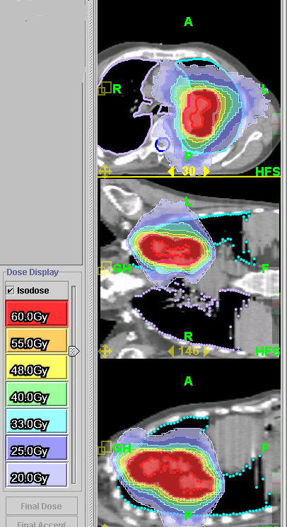
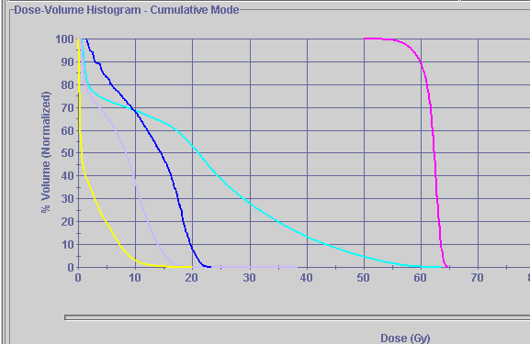
Thompson
(Clinical)
Lung
60 Gy
55 Gy
48 Gy
40 Gy
30 Gy
25 Gy
20 Gy
Southeast Regional
Cancer Center
(Clinical)
PTV
Rt. Lung
Spinal Cord
Lt. Lung
Notes:
Many start with an AP/PA field for lungs, this plan shows an AP/PA field. No need for a boost, we are already avoiding the spine. The boost would consist of re-siming (CTSim) the patient, re-planning, and another New Start slot on the machine.

Slide 2
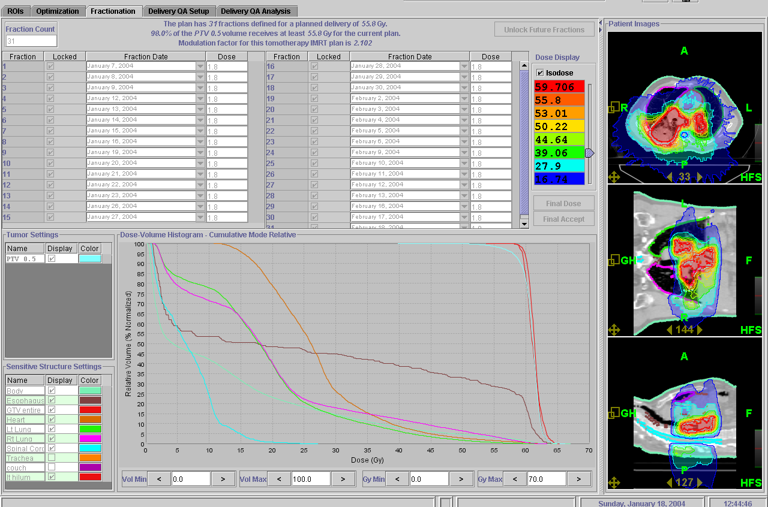
Lung Patient
Case courtesy of Dr. D. Cho
Thompson
(Clinical)
7 Minutes 39 Seconds
Southeast Regional
Cancer Center
(Clinical)
Lt Lung
PTV
1 and 2
Rt Lung
Heart
Esophagus
Pt. Outline
Spinal Cord
Notes:
Large lung mass. Avoiding the spine. Again, this shows that you can treat the entire prescription with one plan, not multiple reductions/plans.

Slide 3
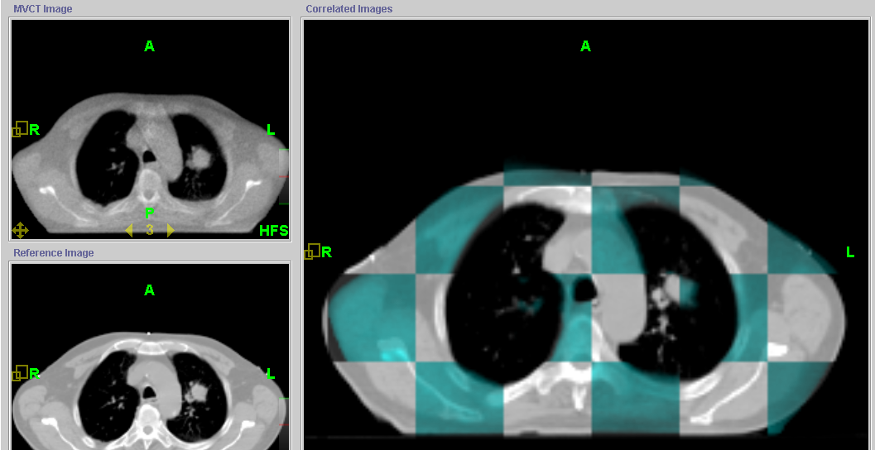
Thompson (Clinical)
Lung
Southeast Regional
Cancer Center
(Clinical)
Notes:
top Lt is tomoimage, bottom lt is planning ct, on the Rt is the two combined. Blue is the tomoimage, gray is tomoimage. Registration is complete. Point out matching points: spine, esophagus, lung lesions, sternum, and fat pads on the side.

Slide 4
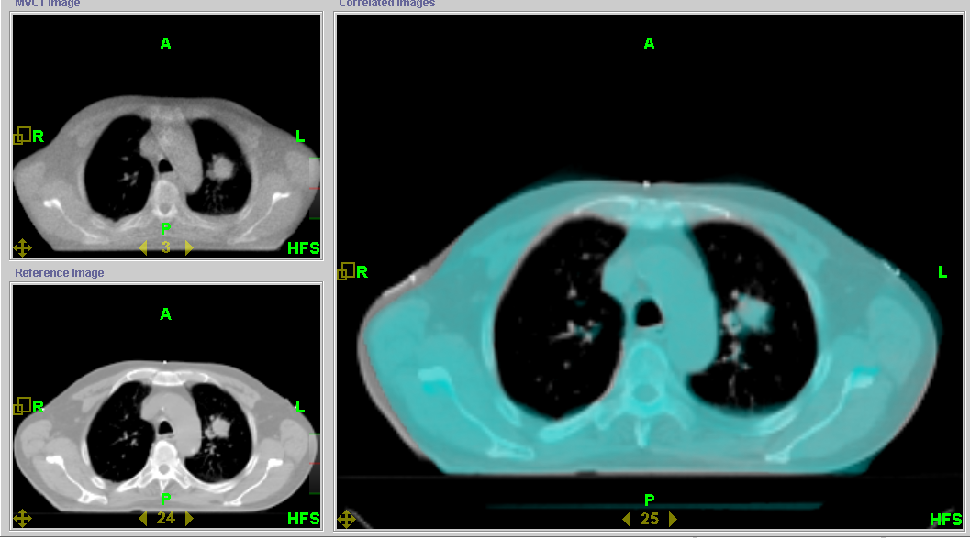
Thompson
(Clinical)
Lung
Southeast Regional
Cancer Center
(Clinical)

Slide 5
Click Here to return to
Clinical Case Studies PowerPoint

