Slide 1

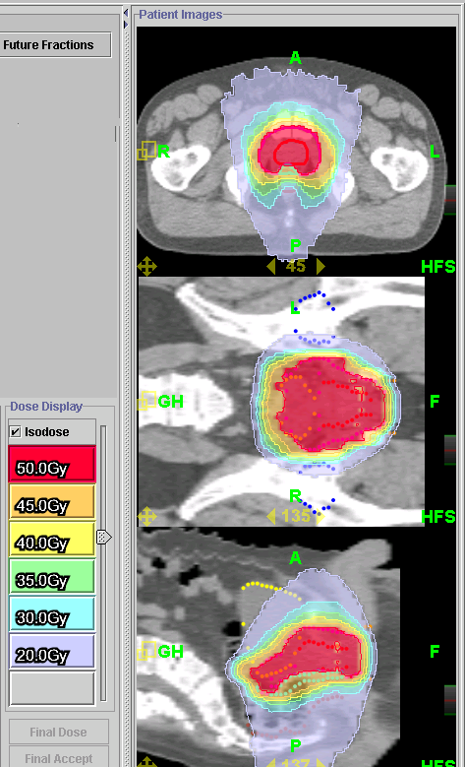
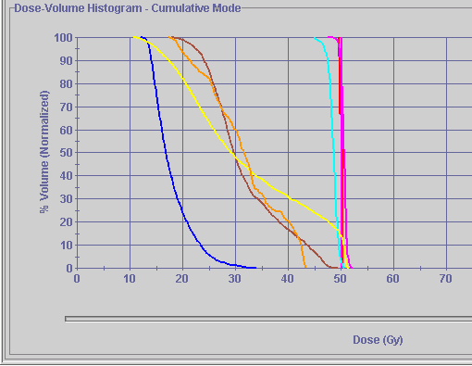

Thompson (Clinical)
Prostate
M.D. Anderson
Rectum
Hoag Hospital
Prostate
PTV
San Raffaele
Milan, Italy
Lt/Rt Femoral
heads
Bladder
Notes:
avoiding Lt/Rt femoral heads. Minimizing dose to the rectal area, dose painting.

Slide 2
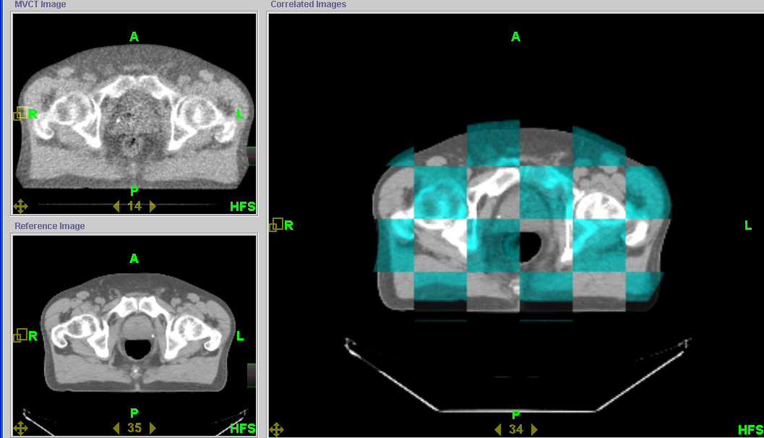
Thompson (Clinical)
Prostate
M.D. Anderson
Hoag Hospital
San Raffaele
Milan, Italy
Notes:
top lt tomoimage, bottom lt is planning ct, to the Rt is the two combined. Blue is tomoimage, gray is planning ct.
The pictures shows you that the bones are not lined up, BUT the rectal and prostate wall are perfectly in line. Cause: difference in the rectum from the day he had his planning CT to today. You can adjust daily to the movement of the prostate. Movie shows the concept of fusion on the operating station

Slide 3
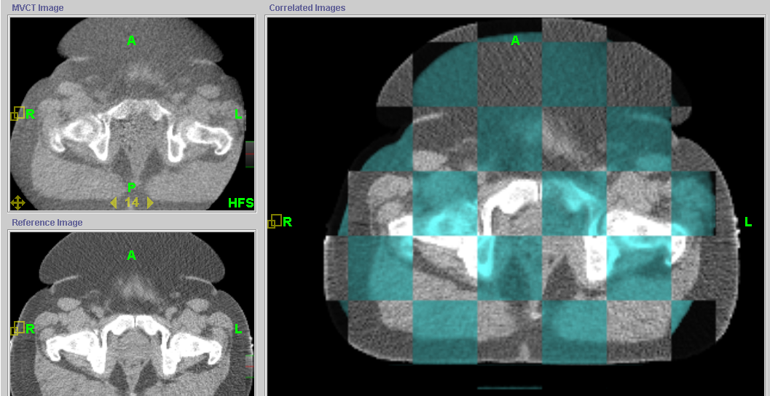
Thompson (Clinical)
Prostate
M.D. Anderson
Hoag Hospital
San Raffaele
Milan, Italy
Notes:
We are matching the prostate and rectal wall again in this one. Notice that neither the bones or belly match in the combined images. In Traditional therapy, you use skin marks to line the patient up, with this patient it is difficult because the belly is movable. Also if they use the BAT or SONIRAY for positioning, it is very difficult to do ultrasound through this tissue.

Slide 4
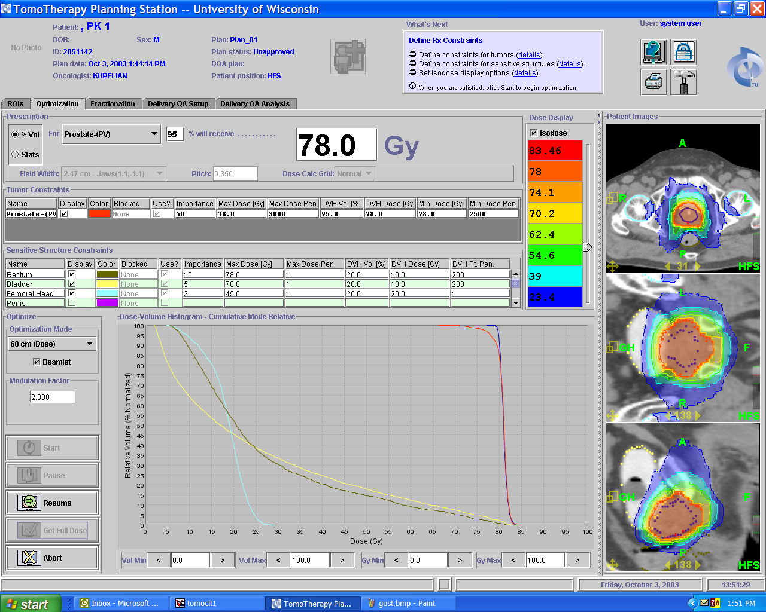

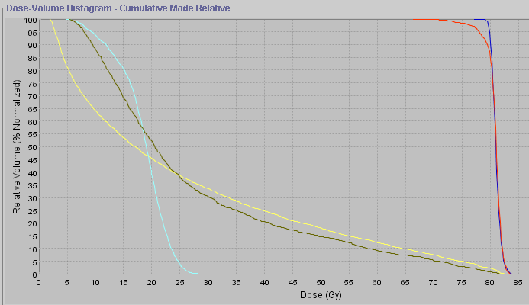
M.D. Anderson
Prostate
Thompson
( Clinical)
Prostate
Hoag Hospital
Lt/Rt Femoral
heads
San Raffaele
Milan, Italy
PTV
Rectum
Bladder
Notes:
great picture of the dose painting of the rectum on the top picture (right above the P/ black dot).

Slide 5
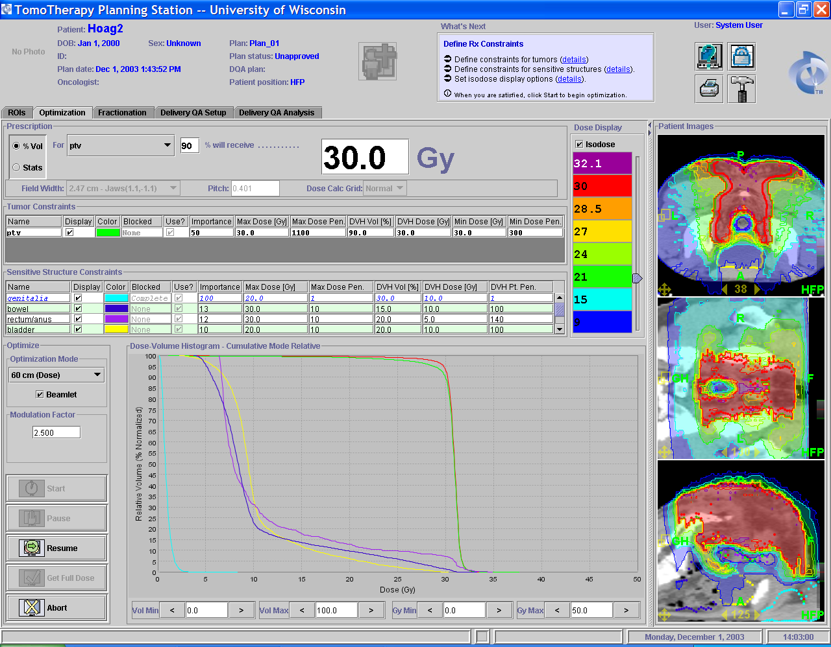
Hoag Hospital
Prostate
M.D. Anderson
30 Gy to 90 % of the PTV
Target
PTV
San Raffaele
Milan, Italy
Bladder
Bowel
Thompson
( Clinical)
Rectum/anus
Genitalia
Notes:
large field extending to the posterior side of the patient. We are still able to dose paint the rectum out of the field (Top picture blue circle). It also demonstrates that you can get a high dose close to the skin surface. Eliminating boost fields.

Slide 6
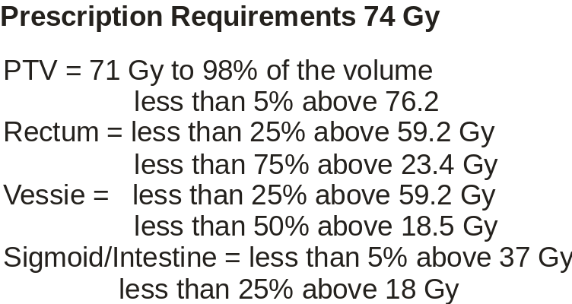
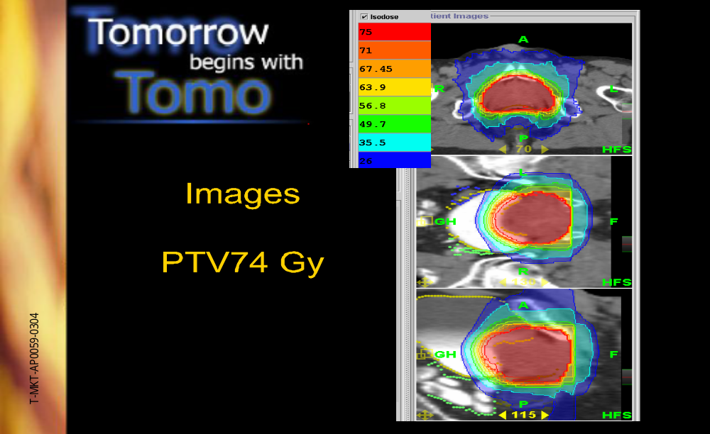
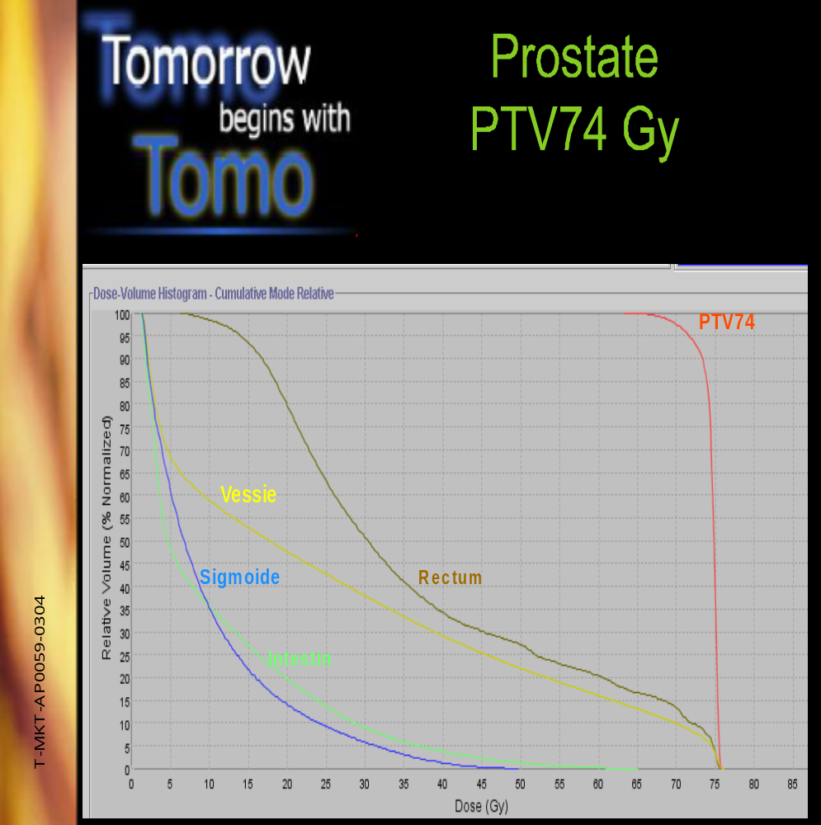
Hoag Hospital
San Raffaele
Milan, Italy
Thompson
( Clinical)
M.D. Anderson

Slide 7
Click Here to return to
Clinical Case Studies PowerPoint

