Slide 1

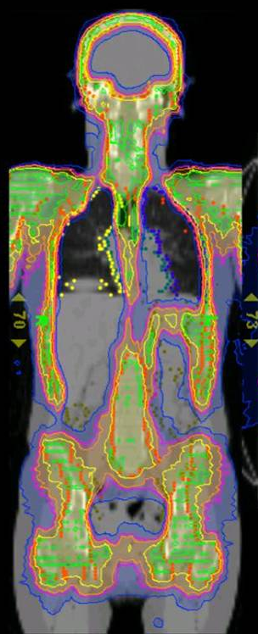
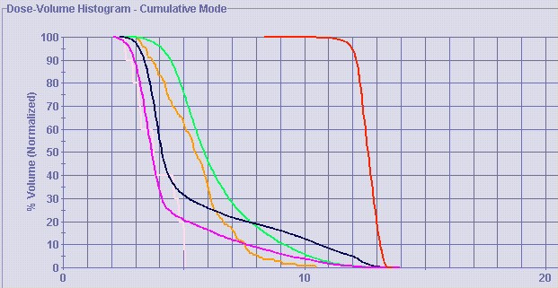
City of Hope
TBI
Notes:
Total Body Irradiation. In our case, we can avoid the critical organs and only treat the bones. Easier for the patient, less side effects. Patient is also more comfortable, supine on our treatment table.

Slide 2
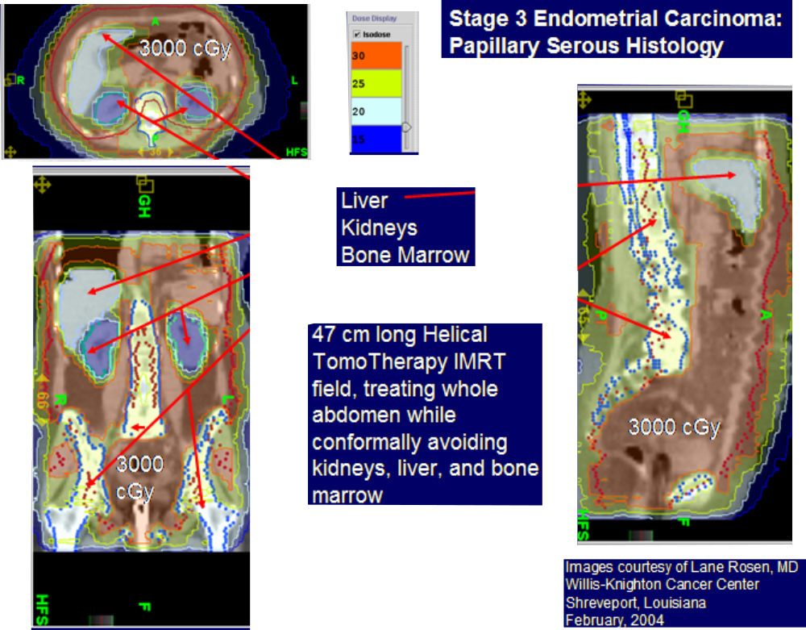

Slide 3
Click Here to return to
Clinical Case Studies PowerPoint

