Slide 1


Slide 2
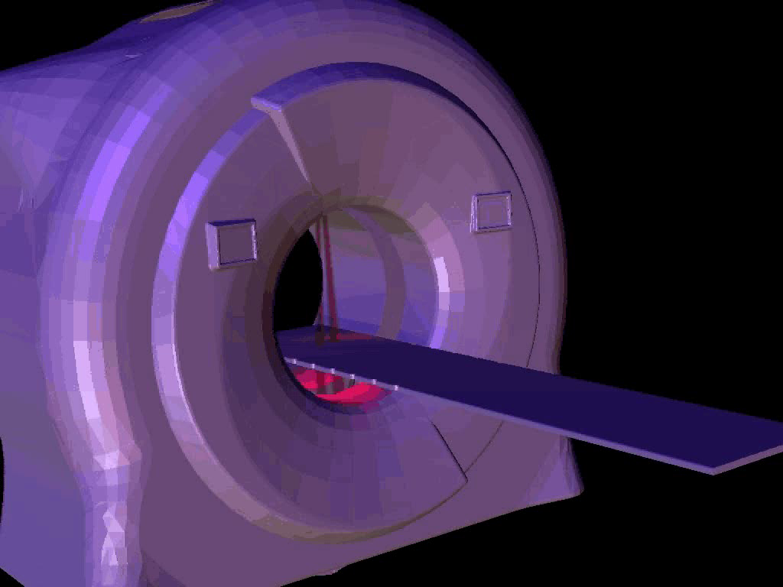
TomoTherapy HI⋅ART System

Slide 3
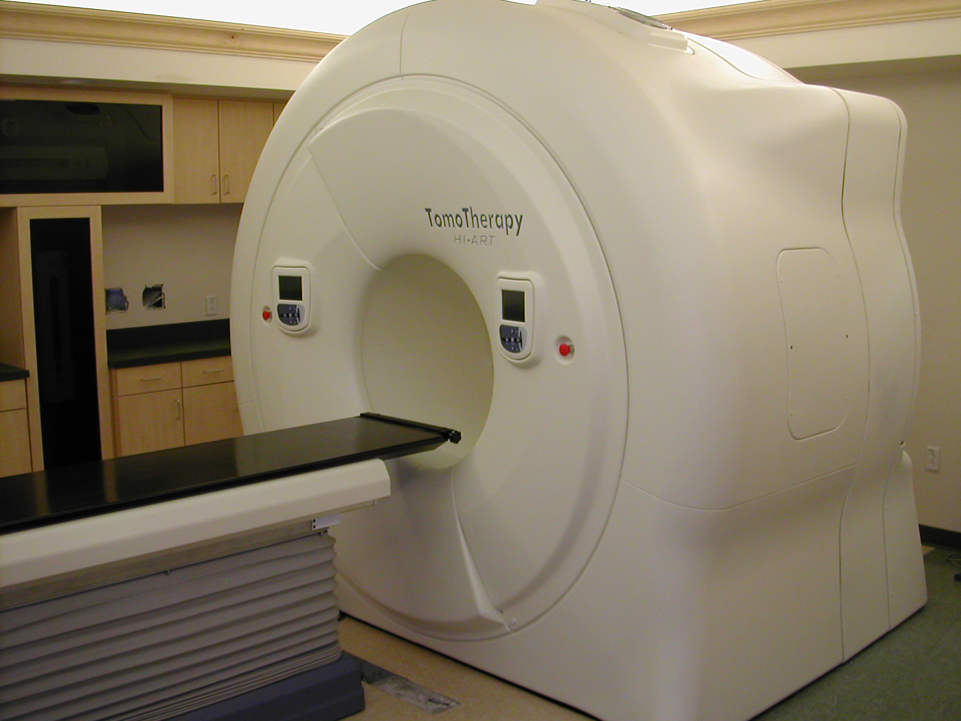
TomoTherapy HI⋅ART System
Highly
Intergrated
Adaptive
Radiotherapy
T-MKT-AP0068

Slide 4
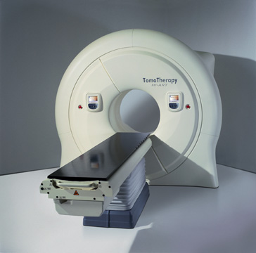


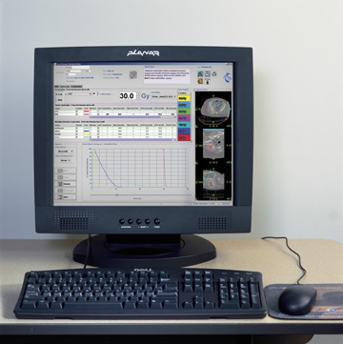
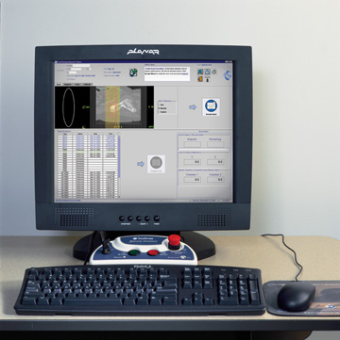
HI·ART Integrated System Components
Click on each icon
Gantry
System
Why
TomoTherapy?
Revenue
Tomo
Database
Planning
Console
Delivery
Console
T-MKT-AP0068

Slide 5
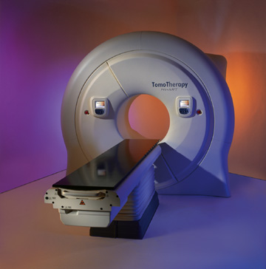
Who said Radiotherapy had to be complicated?
No electrons
No electron cones
No wedges
No gantry angles
No collimator angles
No table angles
No hand pendants
No MLC shapes
No field size
No field light
No 3rd party R&V
TomoTherapy – Tomorrow’s Therapy

Slide 6
Now that you have taken all your notes…

Slide 7
Why not contact your local Sales Manager for an appointment?
If you would like to know who is your local representative, go to:
www.tomotherapy.com/company/comp_sales.html

