Slide 1

The planning process
is an easy four step
Planning Station.
DQA
Final Dose
Plan
progression
Stuctures
F5-7, Rev B Copyright ® 2004 TomoTherapy Incorporated. All right reserved.

Slide 2
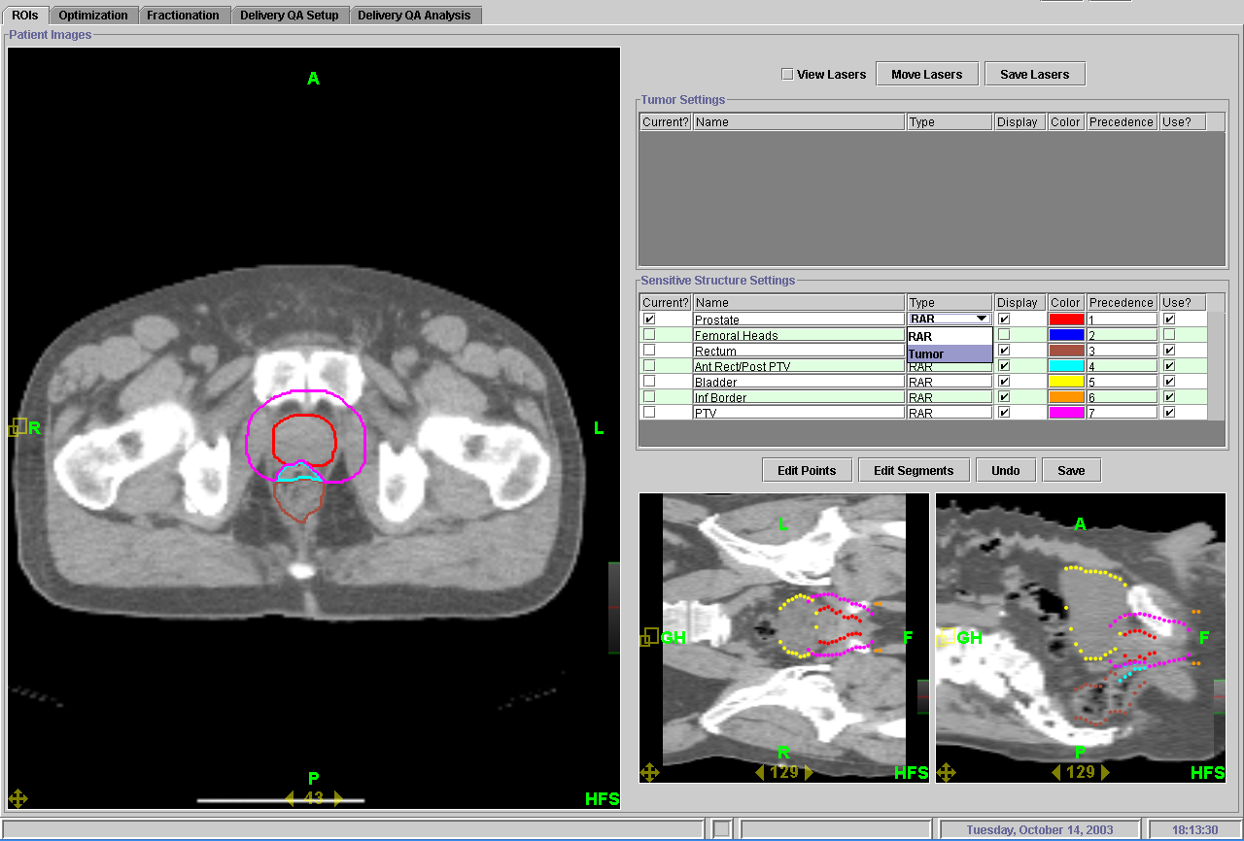
1. Determine what is tumor and what are sensitive structures
Planning Station.
T-MKT-AP0068

Slide 3
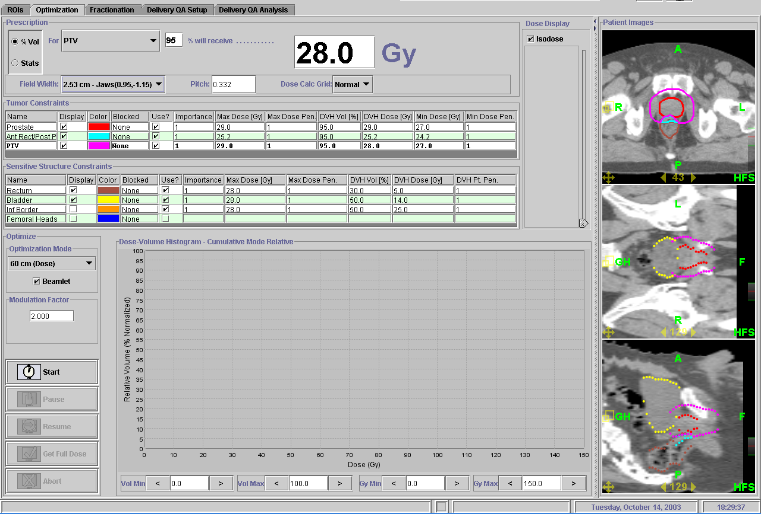
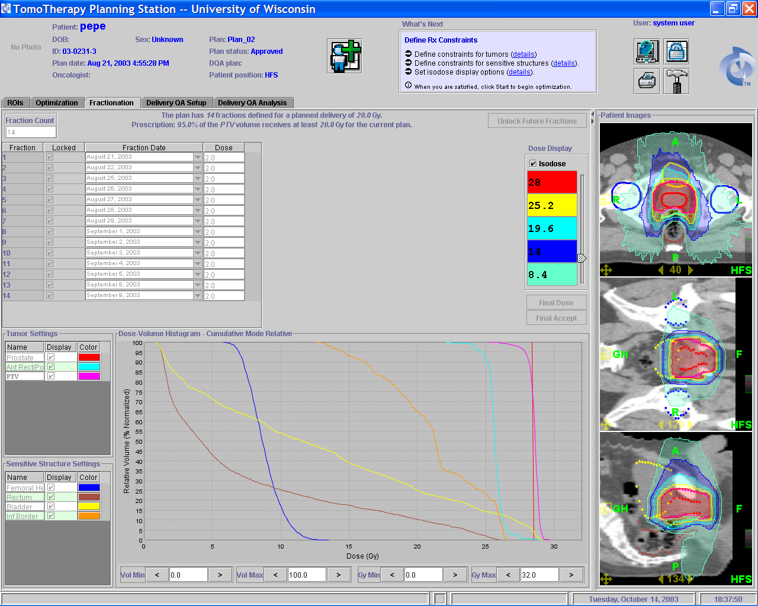
2. Optimize the data for the best plan
Planning Station.
T-MKT-AP0068

Slide 4
3. Set fractions
Planning Station.
T-MKT-AP0068

Slide 5
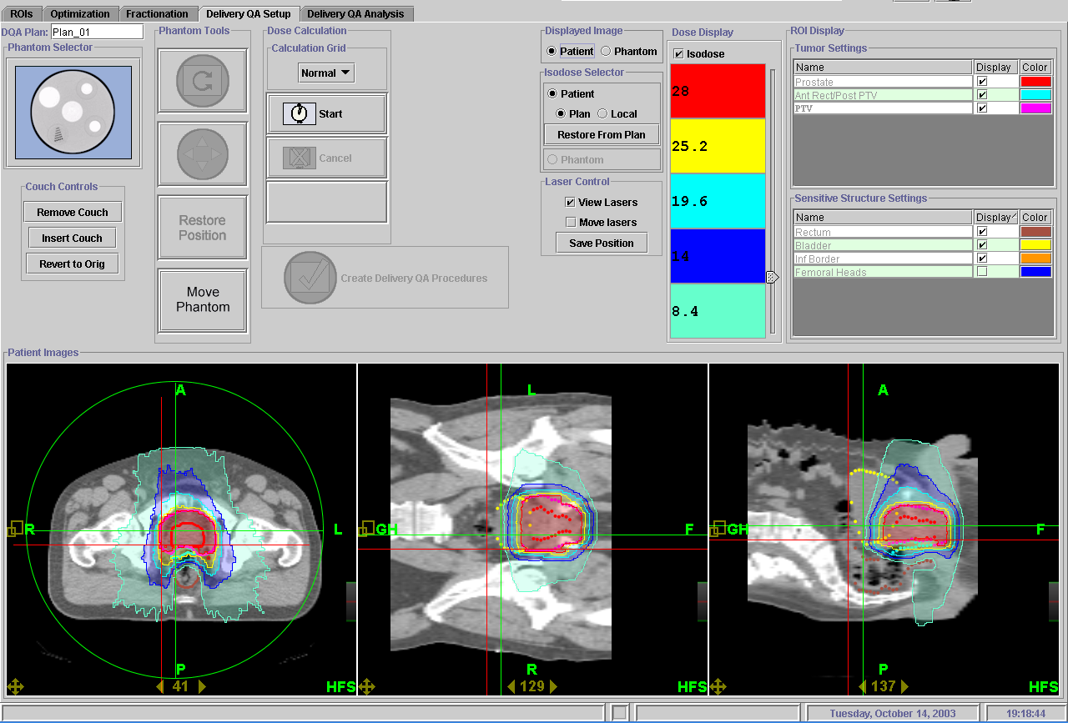
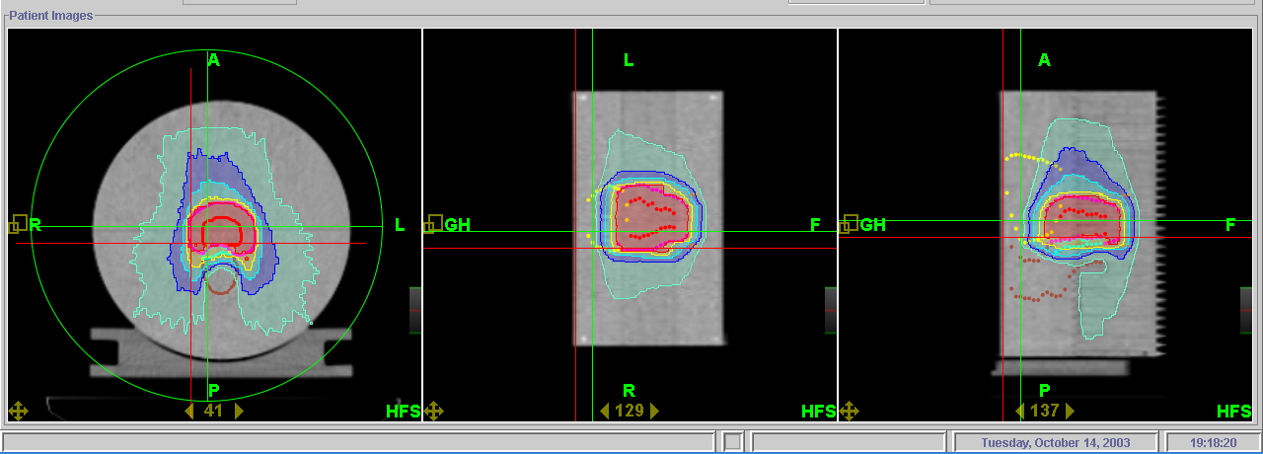
4. Quality assurance
Verify treatment using the TomoPhantom
Planning Station.
T-MKT-AP0068

Slide 6
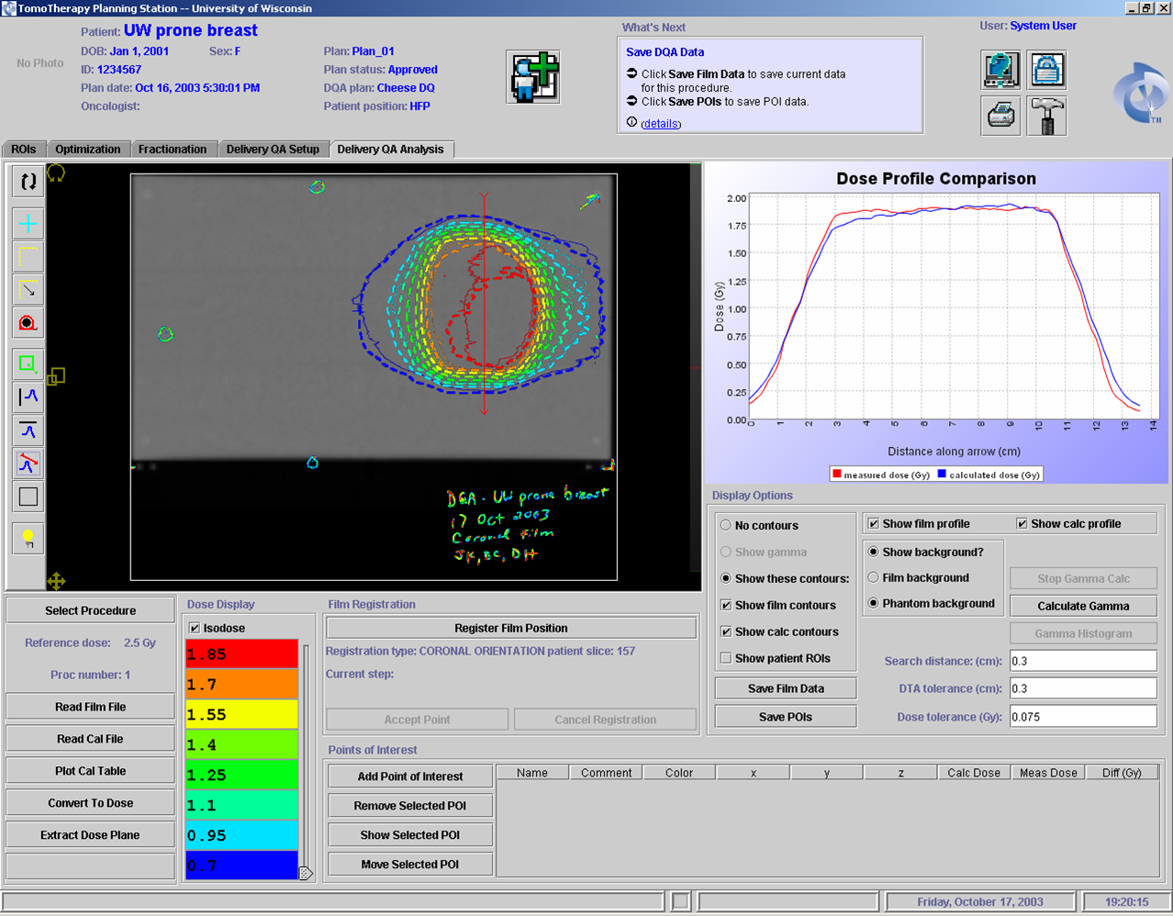
4. Quality assurance
Compare measured dose to calculated dose
Planning Station.
T-MKT-AP0068

Slide 7
Click Here to return
to Overview PowerPoint

